Slide 1
Figure 1 Profiles of nucleotide involvement in secondary structures, free energy of secondary structure formation and ...
Notes:
Figure 1 Profiles of nucleotide involvement in secondary structures, free energy of secondary structure formation and sequence conservation around the start codon (A) and the stop codon (B) in human mRNAs. Positions from −30 to −1 correspond to 5′-UTRs and positions from 1 to 60 correspond to CDSs (A). Positions from −60 to −1 correspond to CDSs and positions from 1 to 30 correspond to 3′-UTRs (B). Blue, sequence conservation in 6919 orthologous human and mouse mRNAs. Red, base paired nucleotides in 19 317 human mRNAs. Green, free Gibbs energy of base pairing in 19 317 human mRNAs.
Unless provided in the caption above, the following copyright applies to the content of this slide: © The Author 2006. Published by Oxford University Press. All rights reserved The online version of this article has been published under an open access model. Users are entitled to use, reproduce, disseminate, or display the open access version of this article for non-commercial purposes provided that: the original authorship is properly and fully attributed; the Journal and Oxford University Press are attributed as the original place of publication with the correct citation details given; if an article is subsequently reproduced or disseminated not in its entirety but only in part or as a derivative work this must be clearly indicated. For commercial re-use, please contact journals.permissions@oxfordjournals.org

Slide 2
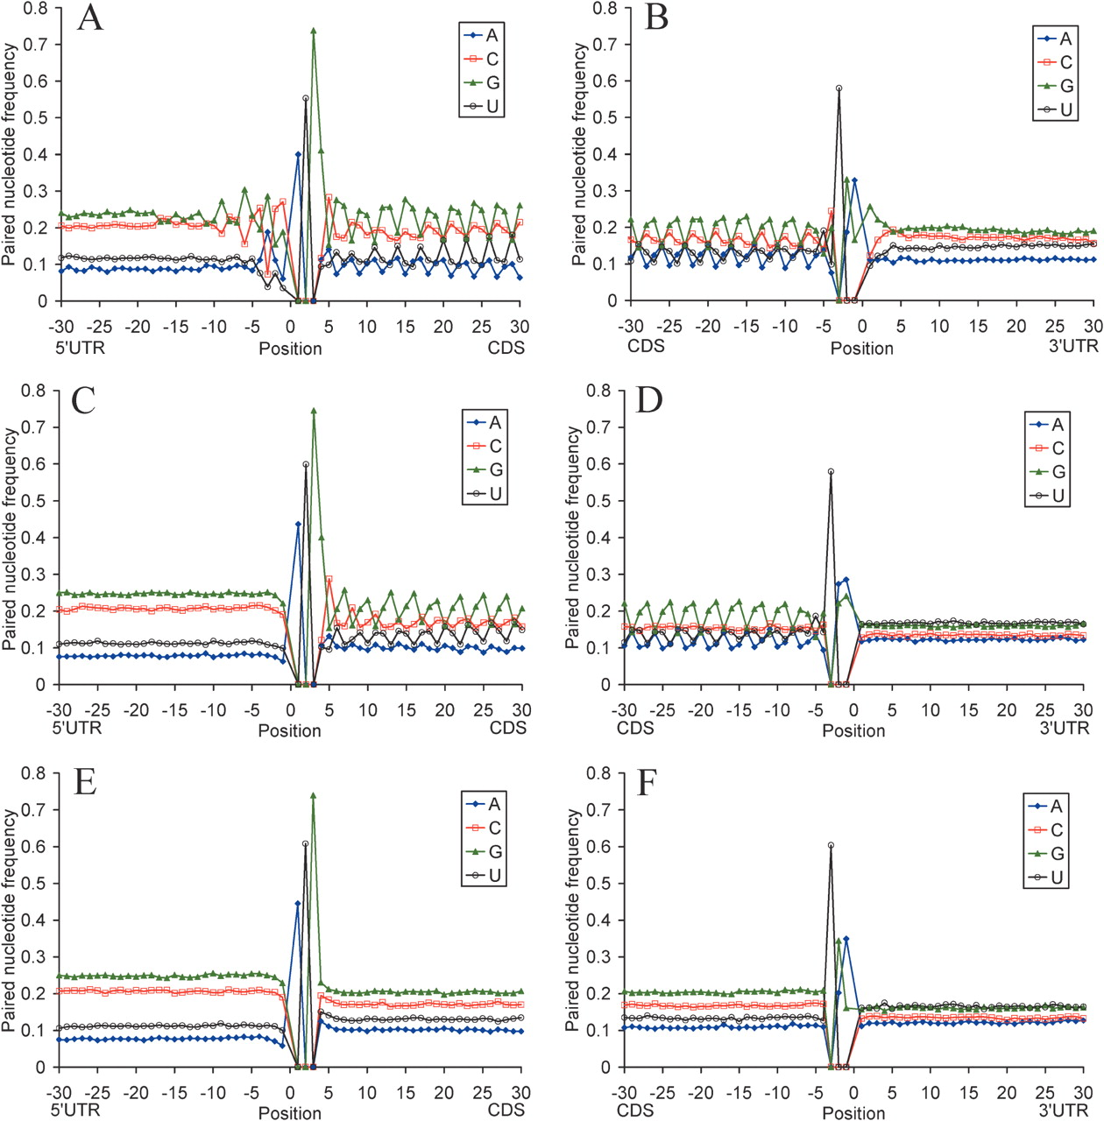
Figure 2 Profiles of nucleotide base pairing around the start codon (A, C and E) and the stop codon (B, D and F) for ...
Notes:
Figure 2 Profiles of nucleotide base pairing around the start codon (A, C and E) and the stop codon (B, D and F) for 19 317 human mRNAs (A and B), for sequences with randomly chosen synonymous codons (C and D), and sequences with randomly shuffled nucleotides and the same nucleotide composition as native mRNAs (E and F). Blue, guanine; red, cytosine; green, adenosine; orange, uridine.
Unless provided in the caption above, the following copyright applies to the content of this slide: © The Author 2006. Published by Oxford University Press. All rights reserved The online version of this article has been published under an open access model. Users are entitled to use, reproduce, disseminate, or display the open access version of this article for non-commercial purposes provided that: the original authorship is properly and fully attributed; the Journal and Oxford University Press are attributed as the original place of publication with the correct citation details given; if an article is subsequently reproduced or disseminated not in its entirety but only in part or as a derivative work this must be clearly indicated. For commercial re-use, please contact journals.permissions@oxfordjournals.org

Slide 3
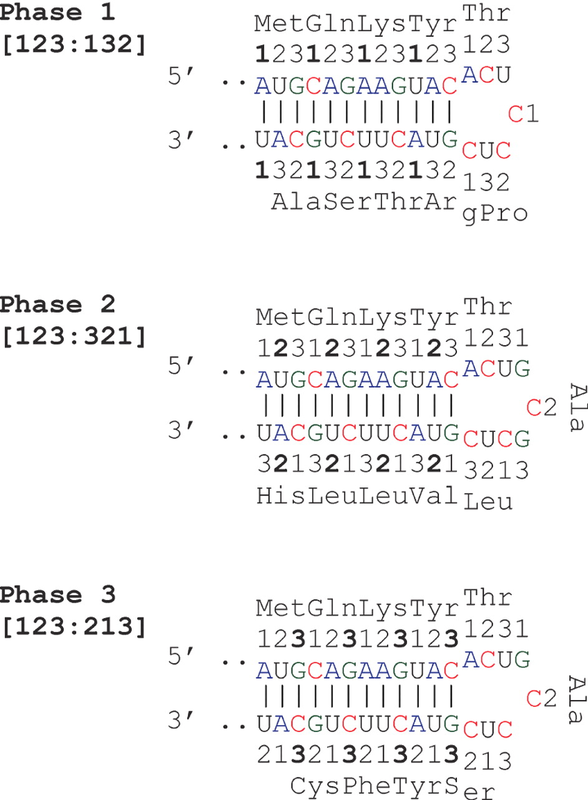
Figure 3 The three phases of nucleotide base pairing in the mRNA CDS. The numbers denote codon sites.
Notes:
Figure 3 The three phases of nucleotide base pairing in the mRNA CDS. The numbers denote codon sites.
Unless provided in the caption above, the following copyright applies to the content of this slide: © The Author 2006. Published by Oxford University Press. All rights reserved The online version of this article has been published under an open access model. Users are entitled to use, reproduce, disseminate, or display the open access version of this article for non-commercial purposes provided that: the original authorship is properly and fully attributed; the Journal and Oxford University Press are attributed as the original place of publication with the correct citation details given; if an article is subsequently reproduced or disseminated not in its entirety but only in part or as a derivative work this must be clearly indicated. For commercial re-use, please contact journals.permissions@oxfordjournals.org

Slide 4
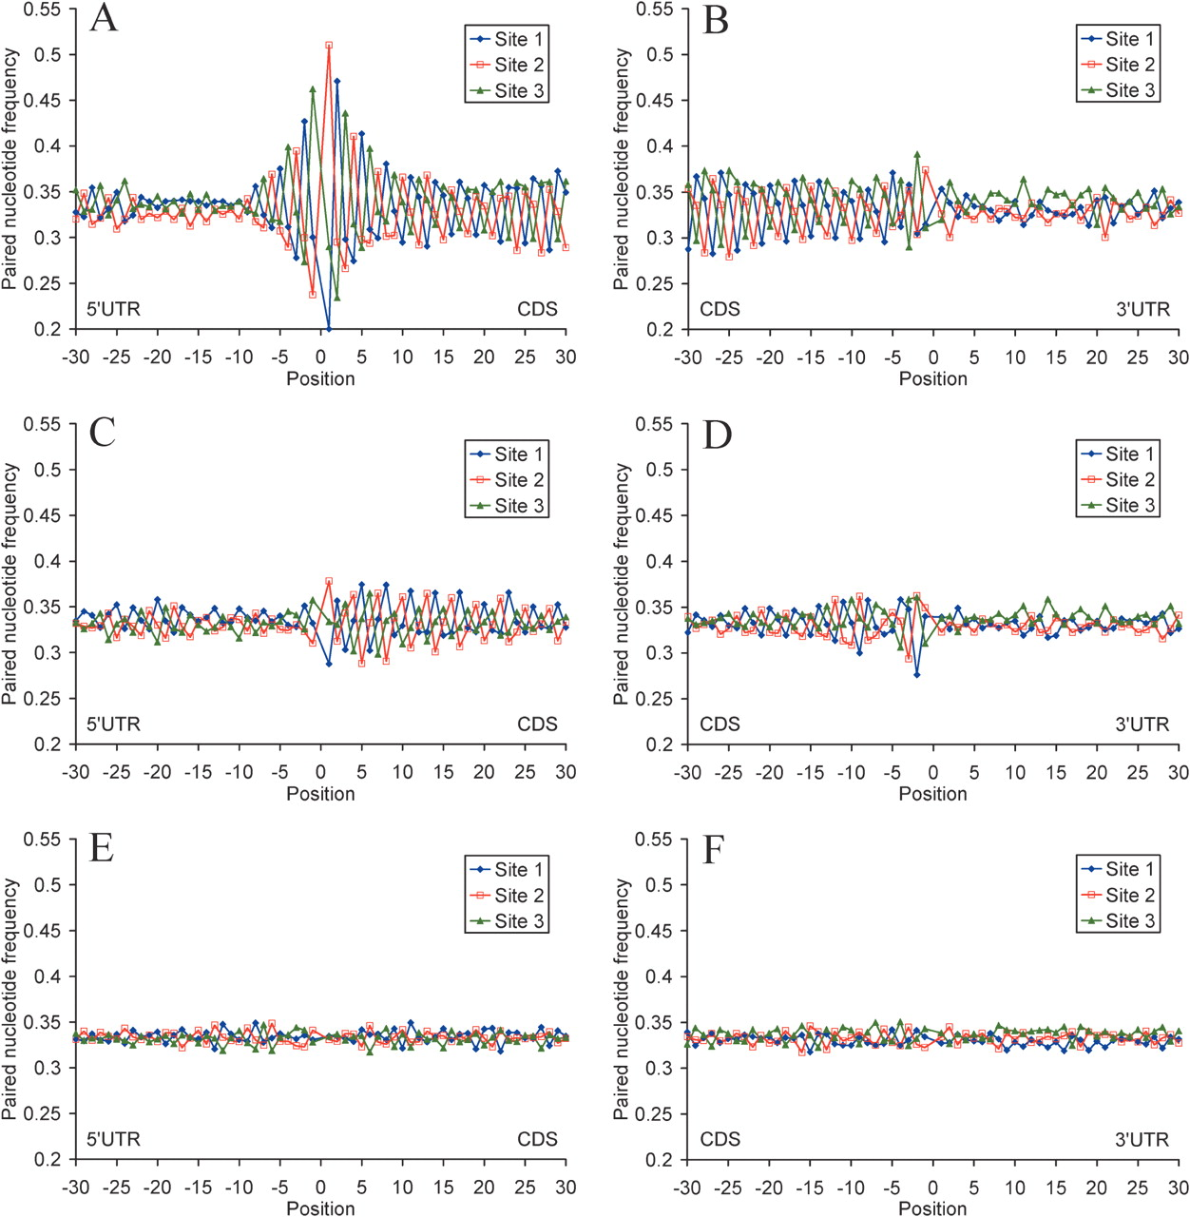
Figure 4 Profiles of base pairing for nucleotides around the start codon (A, C and E) and the stop codon (B, D and F) ...
Notes:
Figure 4 Profiles of base pairing for nucleotides around the start codon (A, C and E) and the stop codon (B, D and F) with different codon sites for 19 317 human mRNAs (A and B), for sequences with randomly chosen synonymous codons (C and D), and sequences with randomly shuffled nucleotides and the same nucleotide composition as native mRNAs (E and F). Nucleotides paired with codon sites 1, 2 and 3 are shown in blue, red and green, respectively.
Unless provided in the caption above, the following copyright applies to the content of this slide: © The Author 2006. Published by Oxford University Press. All rights reserved The online version of this article has been published under an open access model. Users are entitled to use, reproduce, disseminate, or display the open access version of this article for non-commercial purposes provided that: the original authorship is properly and fully attributed; the Journal and Oxford University Press are attributed as the original place of publication with the correct citation details given; if an article is subsequently reproduced or disseminated not in its entirety but only in part or as a derivative work this must be clearly indicated. For commercial re-use, please contact journals.permissions@oxfordjournals.org

Slide 5
Figure 5 Profiles of base pairing for nucleotides around the start codon (A) and the stop codon (B) with different ...
Notes:
Figure 5 Profiles of base pairing for nucleotides around the start codon (A) and the stop codon (B) with different mRNA structural domains. Blue, nucleotides paired with the 5′-UTRs; red, nucleotides paired with the CDSs; green, nucleotides paired with the 3′-UTRs. Data for 19 317 human mRNAs.
Unless provided in the caption above, the following copyright applies to the content of this slide: © The Author 2006. Published by Oxford University Press. All rights reserved The online version of this article has been published under an open access model. Users are entitled to use, reproduce, disseminate, or display the open access version of this article for non-commercial purposes provided that: the original authorship is properly and fully attributed; the Journal and Oxford University Press are attributed as the original place of publication with the correct citation details given; if an article is subsequently reproduced or disseminated not in its entirety but only in part or as a derivative work this must be clearly indicated. For commercial re-use, please contact journals.permissions@oxfordjournals.org

