Slide 1
Figure 1. The location of predicted TSS and TATA boxes as well as some of the conserved regulatory motifs in ...
Notes:
Figure 1. The location of predicted TSS and TATA boxes as well as some of the conserved regulatory motifs in aligned sequences of h-PGAM-M and r-PGAM2 orthologous gene pairs of human (top line) and rat. TSS and TATA boxes are given in bold italic. Conservative regulatory motifs from the Transfac database (23) are denoted by encircled numbers: 1, HS$TPI_04; 2, PA$PY_21; 3, MOUSE$M2EB; 4, SP1$CONS. For additional information, see Table S1 in the Supplementary Material.
Unless provided in the caption above, the following copyright applies to the content of this slide:

Slide 2
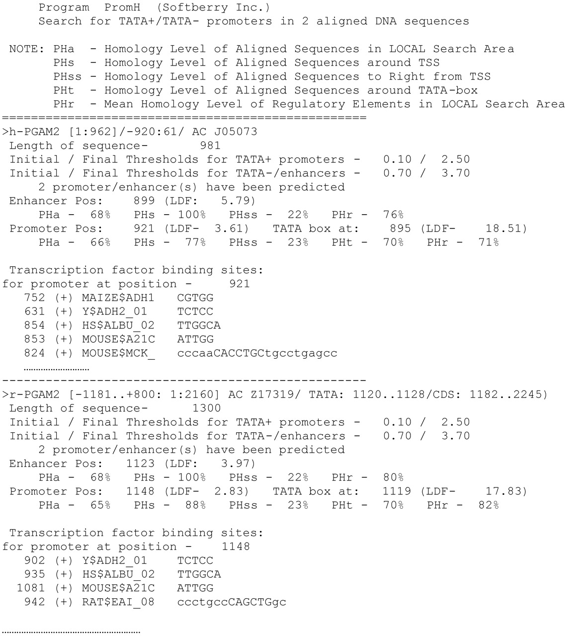
Figure 2. Results of the promoter search in human h-PGAM-M and rat r-PGAM2 orthologous genes by PromH ...
Notes:
Figure 2. Results of the promoter search in human h-PGAM-M and rat r-PGAM2 orthologous genes by PromH (example of finding only TATA promoters). Only the first few regulatory motifs are presented.
Unless provided in the caption above, the following copyright applies to the content of this slide:

Slide 3
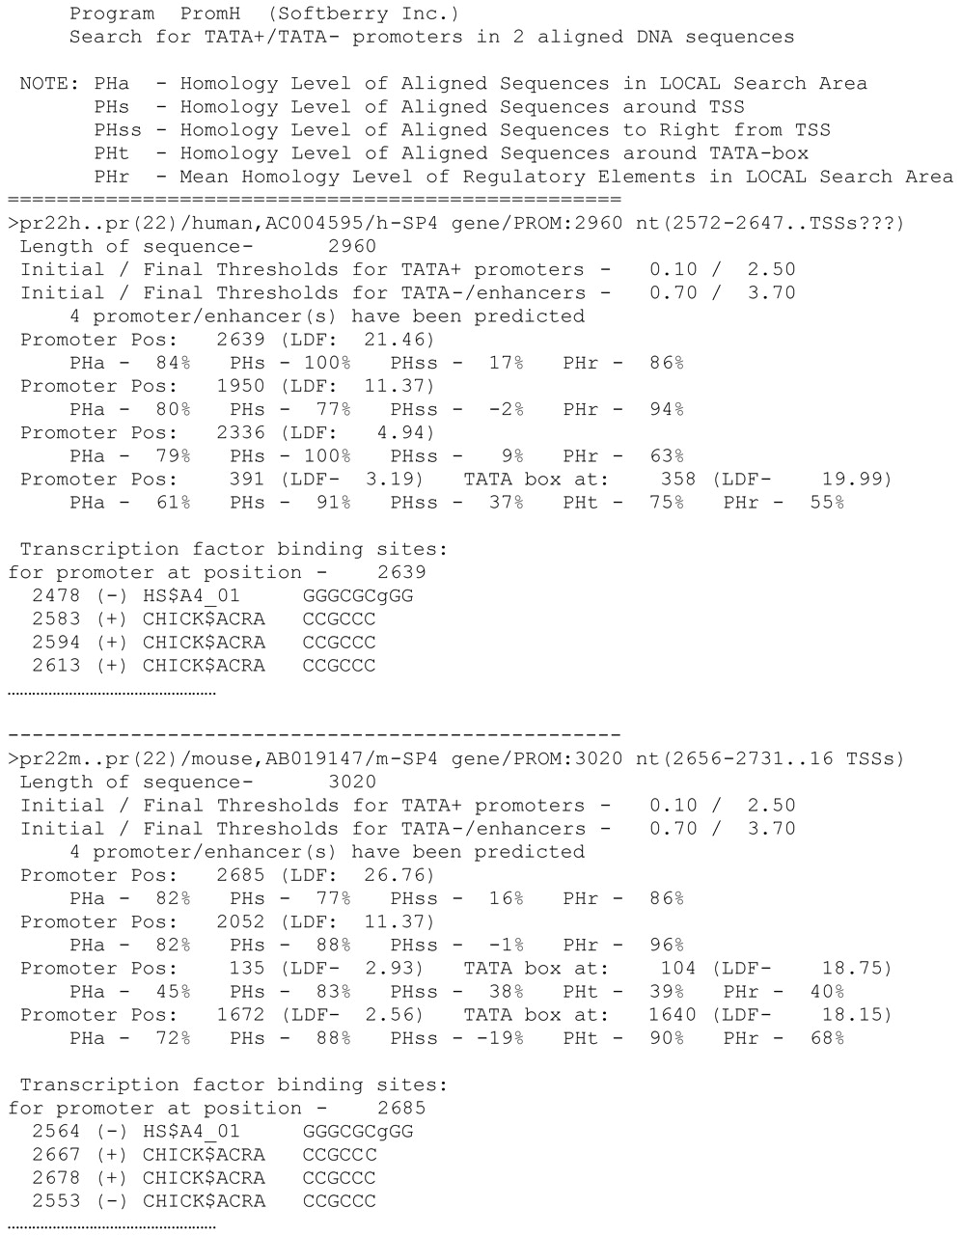
Figure 3. Results of the promoter search in human h-SP4 and mouse m-SP4 orthologous genes by PromH (example ...
Notes:
Figure 3. Results of the promoter search in human h-SP4 and mouse m-SP4 orthologous genes by PromH (example of finding both TATA and TATA-less promoters). Only the first several regulatory motifs are presented.
Unless provided in the caption above, the following copyright applies to the content of this slide:

