Slide 1
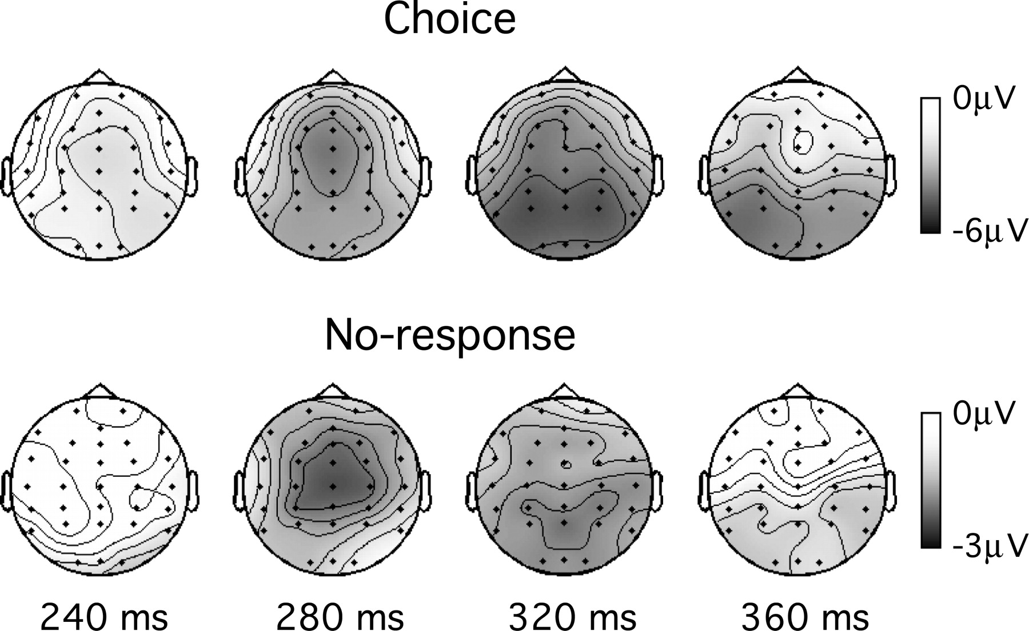
Figure 4. Scalp topography of the voltage differences between negative and positive outcomes in the Choice and ...
Notes:
Figure 4. Scalp topography of the voltage differences between negative and positive outcomes in the Choice and No-response tasks of experiment 2.
Unless provided in the caption above, the following copyright applies to the content of this slide: Cerebral Cortex V 15 N 5 © Oxford University Press 2004; all rights reserved

Slide 2
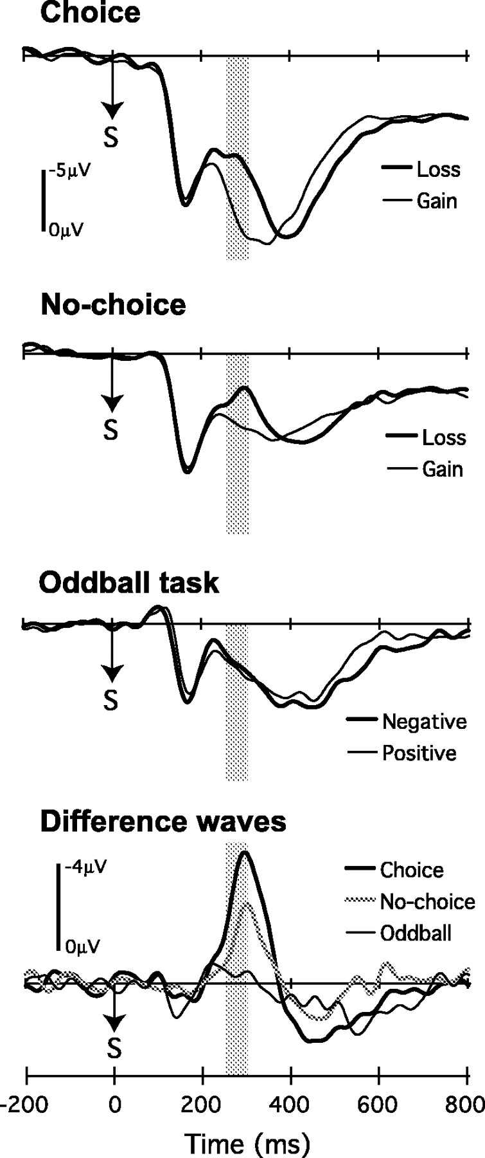
Figure 1. Grand-average ERP waveforms at Cz in experiment 1, separately for gain and loss trials in the Choice task ...
Notes:
Figure 1. Grand-average ERP waveforms at Cz in experiment 1, separately for gain and loss trials in the Choice task (top panel) and No-choice task (upper middle panel), and for happy (positive) and sad (negative) face target stimuli in the oddball counting task (lower middle panel). The lower panel plots the difference between grand-average ERP waveforms for negative and positive stimuli in each condition. ‘S’ indicates the time of feedback stimulus onset. The gray shaded areas indicate the 248–296 ms analysis window in which the feedback negativity was quantified.
Unless provided in the caption above, the following copyright applies to the content of this slide: Cerebral Cortex V 15 N 5 © Oxford University Press 2004; all rights reserved

Slide 3
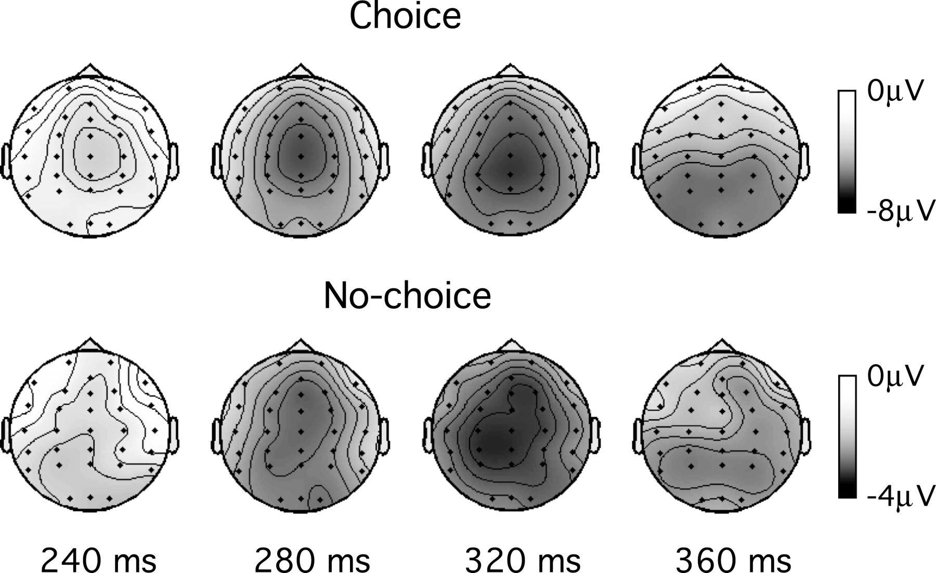
Figure 2. Scalp topography of the voltage differences between negative and positive outcomes in the Choice and ...
Notes:
Figure 2. Scalp topography of the voltage differences between negative and positive outcomes in the Choice and No-choice tasks of experiment 1. Timings are given relative to the onset of the outcome stimulus.
Unless provided in the caption above, the following copyright applies to the content of this slide: Cerebral Cortex V 15 N 5 © Oxford University Press 2004; all rights reserved

Slide 4
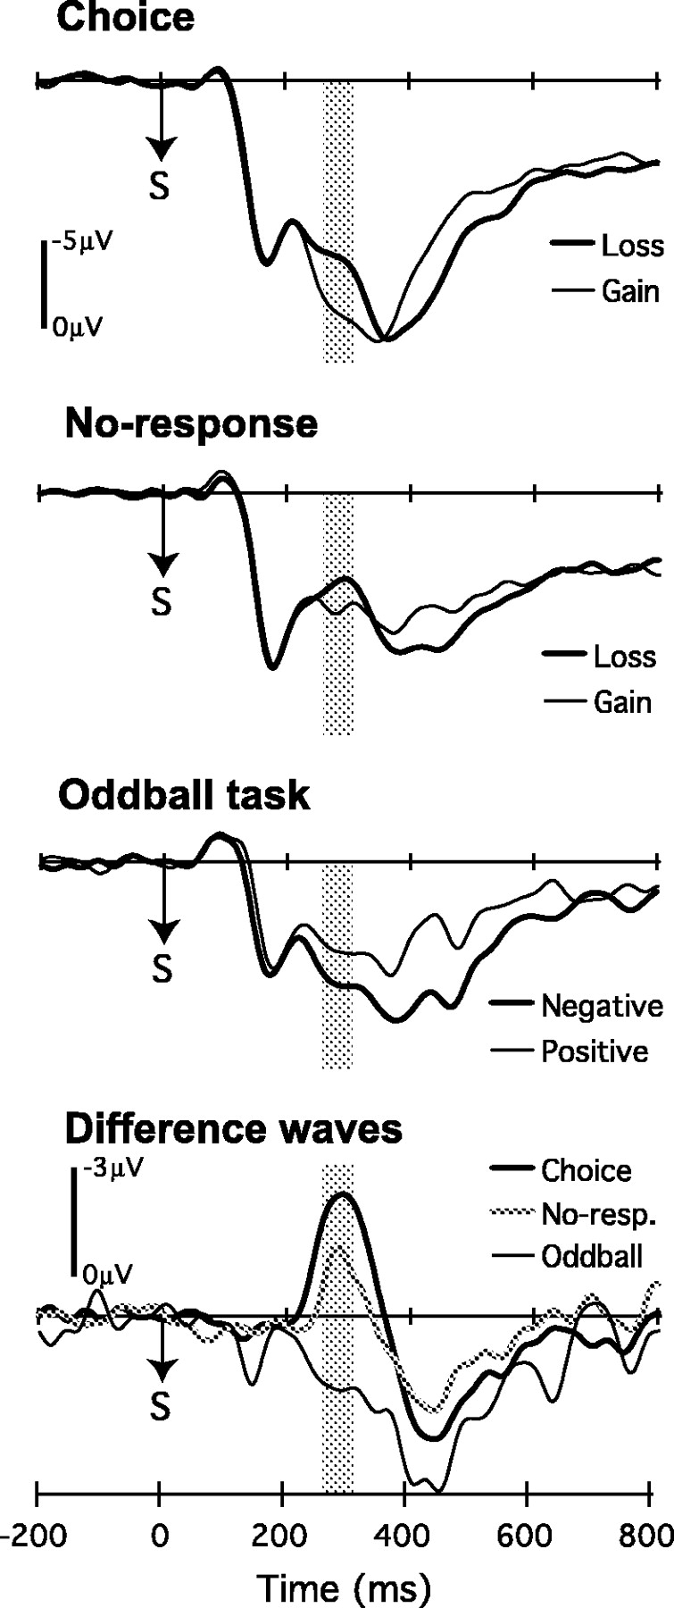
Figure 3. Grand-average ERP waveforms at Cz in experiment 2, separately for gain and loss trials in the Choice task ...
Notes:
Figure 3. Grand-average ERP waveforms at Cz in experiment 2, separately for gain and loss trials in the Choice task (top panel) and No-response task (upper middle panel), and for happy (positive) and sad (negative) face target stimuli in the oddball counting task (lower middle panel). The lower panel plots the difference between grand-average ERP waveforms for negative and positive stimuli in each condition. ‘S’ indicates the time of feedback stimulus onset. The gray shaded areas indicate the 248–296 ms analysis window in which the feedback negativity was quantified.
Unless provided in the caption above, the following copyright applies to the content of this slide: Cerebral Cortex V 15 N 5 © Oxford University Press 2004; all rights reserved

Slide 5
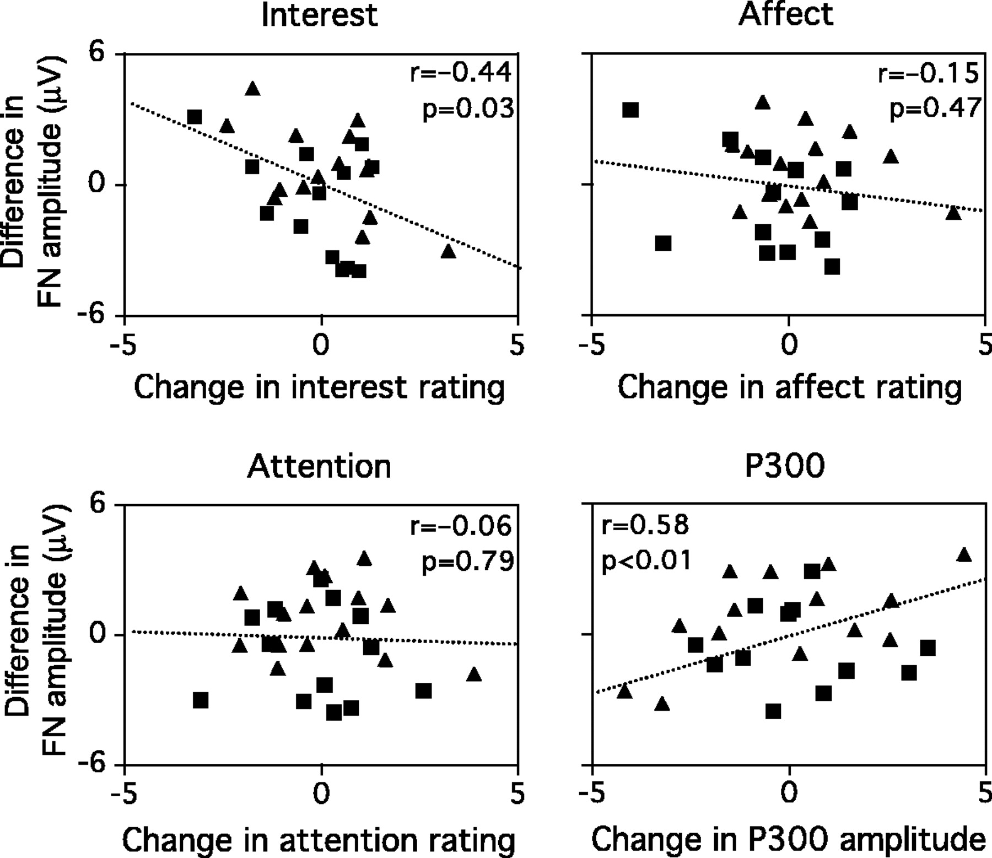
Figure 5. Partial regression plots from a multiple linear regression analysis designed to investigate whether ...
Notes:
Figure 5. Partial regression plots from a multiple linear regression analysis designed to investigate whether between-task differences in the amplitude of the feedback negativity (FN) correlate with between-task changes in subjective ratings of Interest, Affect, and Attention, and P300 amplitude. The data from experiments 1 and 2 were pooled together in the regression analysis to ensure a sufficient sample size, but are indicated separately in each panel as squares and triangles respectively. Along the ordinate of each panel, more negative values indicate increases in the amplitude of the feedback negativity in the Choice task relative to the No-choice/No-response tasks. Along the abscissa of the panels, more positive values indicate increases in P300 amplitude and in subjective ratings of Interest, Affect, Attention in the Choice task relative to the No-choice/No-response tasks.
Unless provided in the caption above, the following copyright applies to the content of this slide: Cerebral Cortex V 15 N 5 © Oxford University Press 2004; all rights reserved

