Slide 1
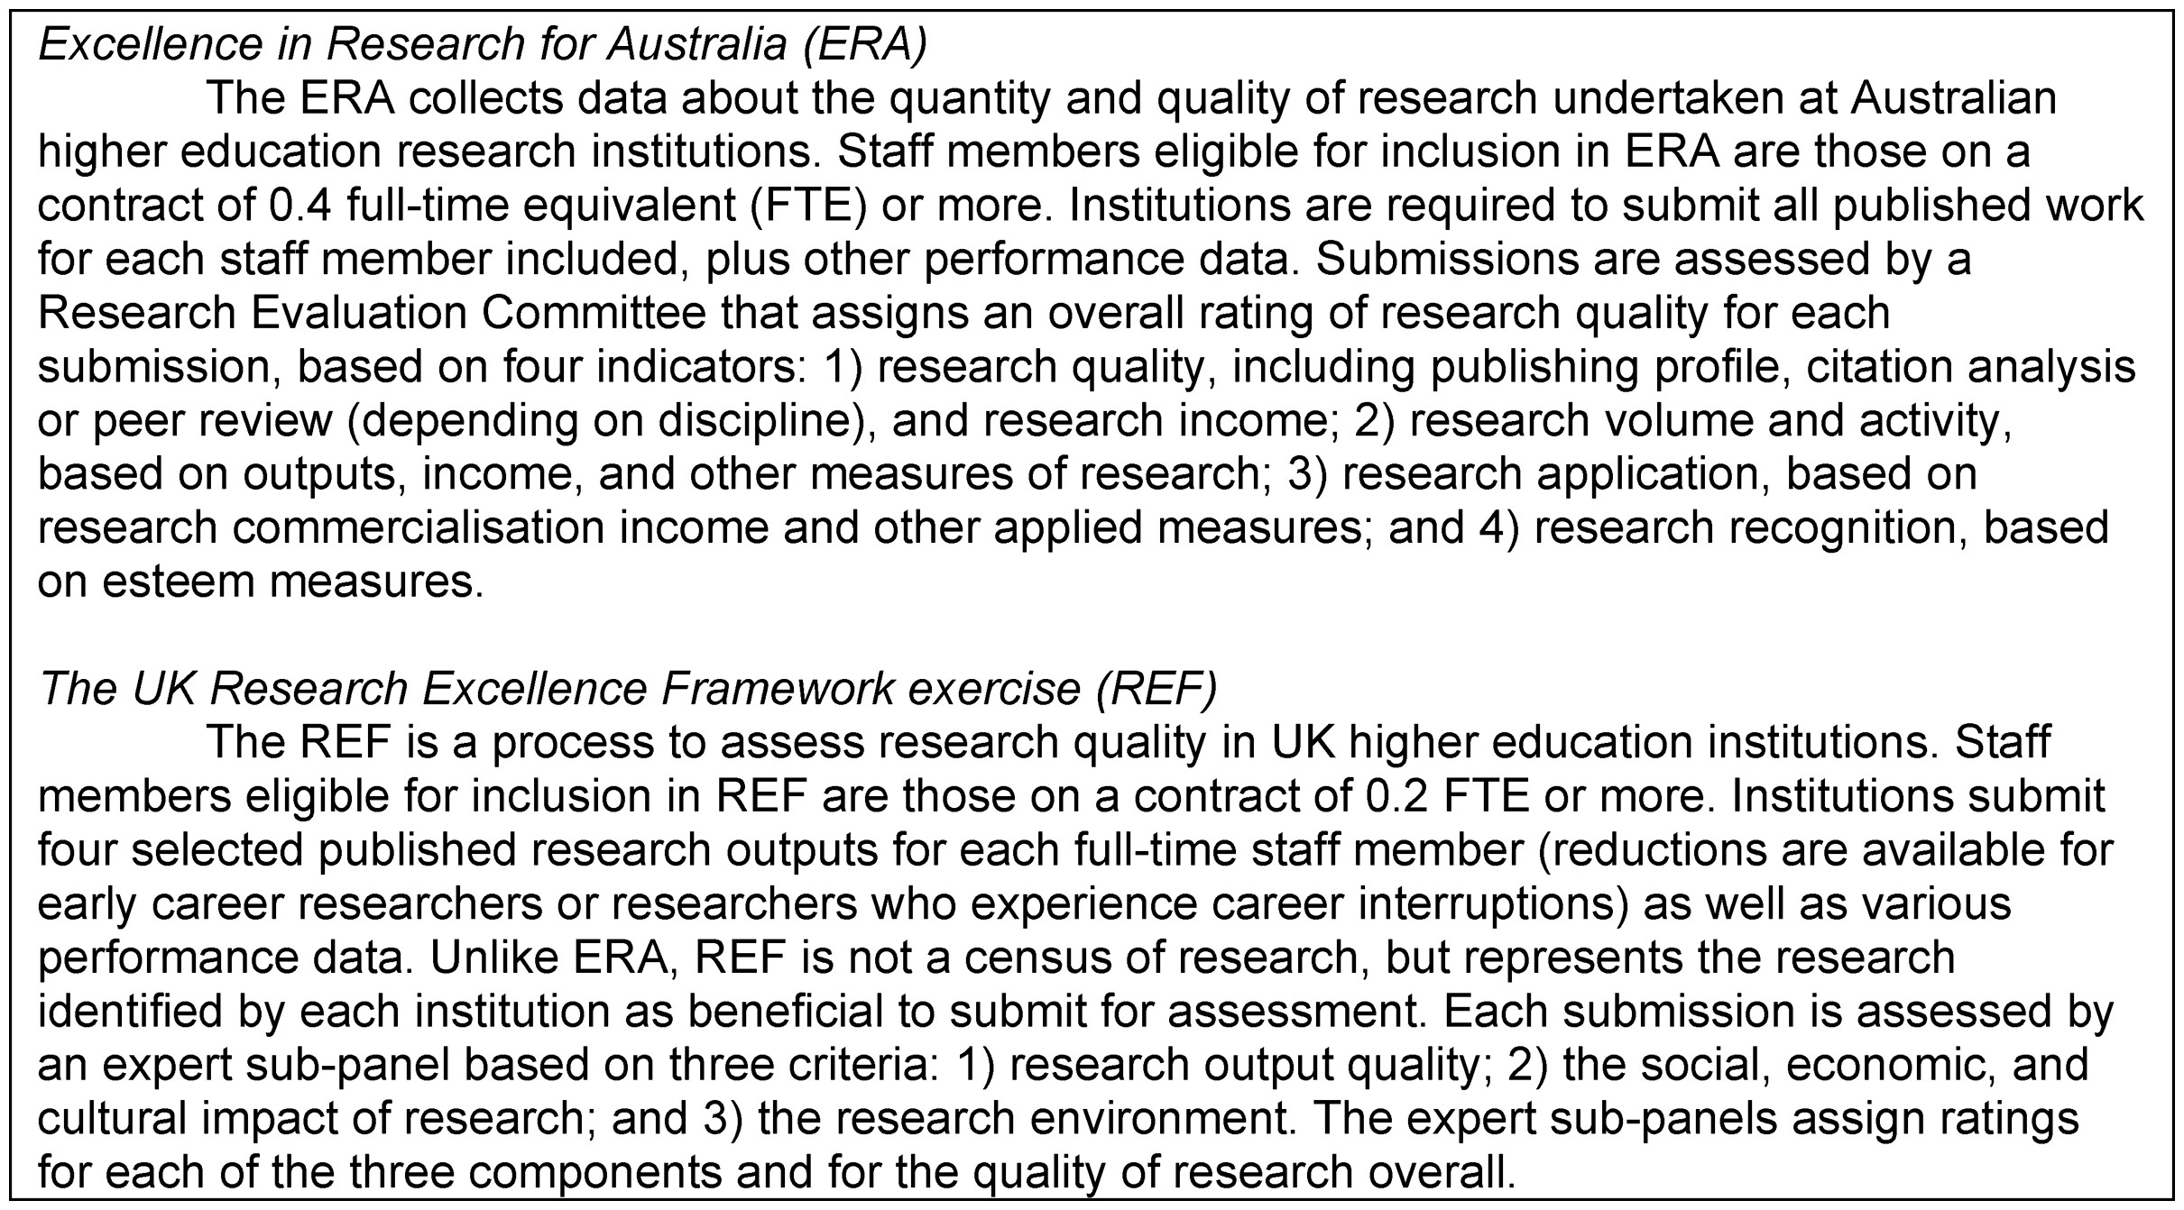
Figure 1. ERA and REF.
Notes:
Figure 1. ERA and REF.
Unless provided in the caption above, the following copyright applies to the content of this slide: © The Author 2017. Published by Oxford University Press on behalf of The British Association of Social Workers. All rights reserved.

Slide 2
Figure 2. Total number of research outputs for criminology, policy and administration, and social work, 2005–2013, ...
Notes:
Figure 2. Total number of research outputs for criminology, policy and administration, and social work, 2005–2013, based on ERA 2012 and ERA 2015. Note the overlapping reference period of 2008–2010. ERA 2015 notes that data collected for ERA 2012 is re-used in ERA 2015, with differences being due to factors such as staff entering and leaving the system and changes in eligible research outputs.
Unless provided in the caption above, the following copyright applies to the content of this slide: © The Author 2017. Published by Oxford University Press on behalf of The British Association of Social Workers. All rights reserved.

Slide 3
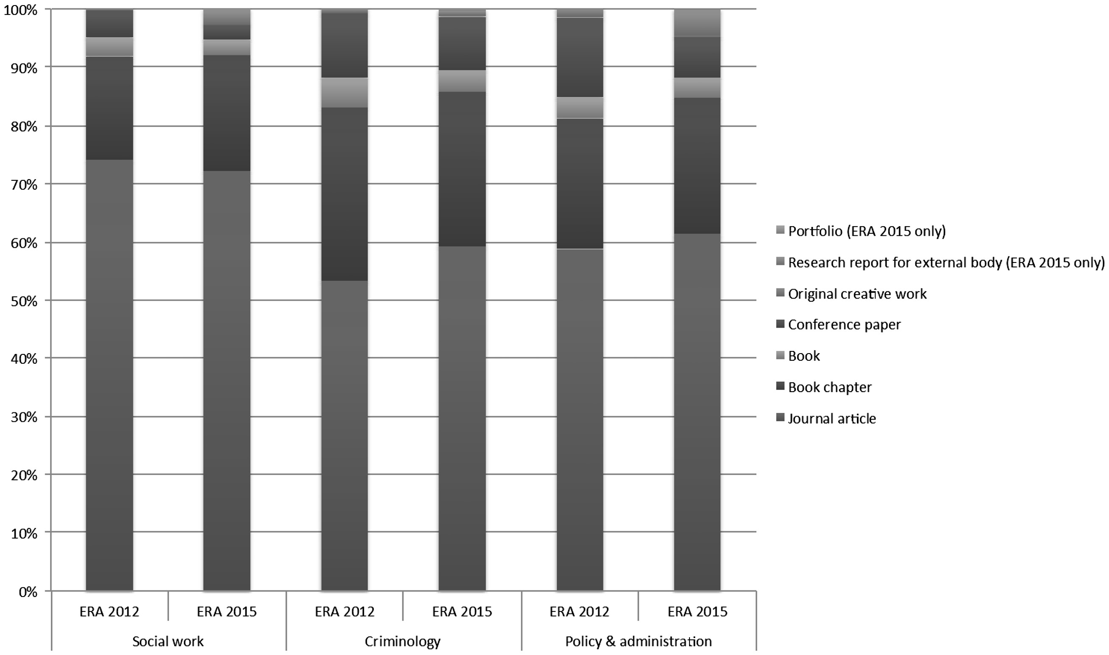
Figure 3. Comparison of types of research outputs produced by social work, criminology, and policy and administration ...
Notes:
Figure 3. Comparison of types of research outputs produced by social work, criminology, and policy and administration researchers in Australia, 2005–2013, based on ERA 2012 and ERA 2015. Note that ERA 2015 includes two additional types of research output: research report for external body; and portfolio.
Unless provided in the caption above, the following copyright applies to the content of this slide: © The Author 2017. Published by Oxford University Press on behalf of The British Association of Social Workers. All rights reserved.

Slide 4
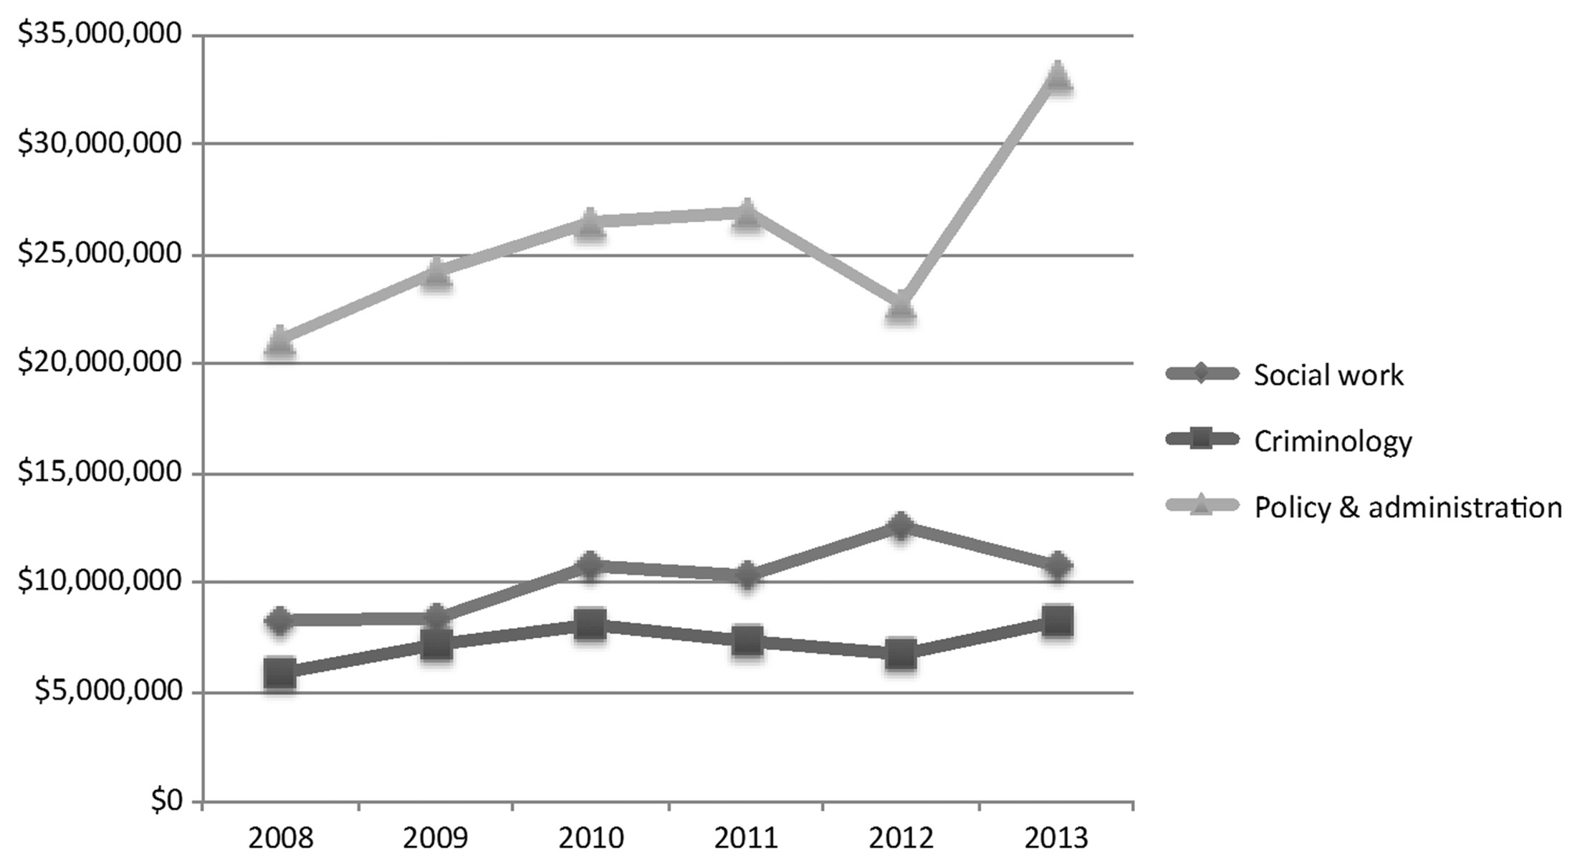
Figure 4. Total research income generated by social work, criminology, and policy and administration researchers, ...
Notes:
Figure 4. Total research income generated by social work, criminology, and policy and administration researchers, 2008–2013.
Unless provided in the caption above, the following copyright applies to the content of this slide: © The Author 2017. Published by Oxford University Press on behalf of The British Association of Social Workers. All rights reserved.

Slide 5
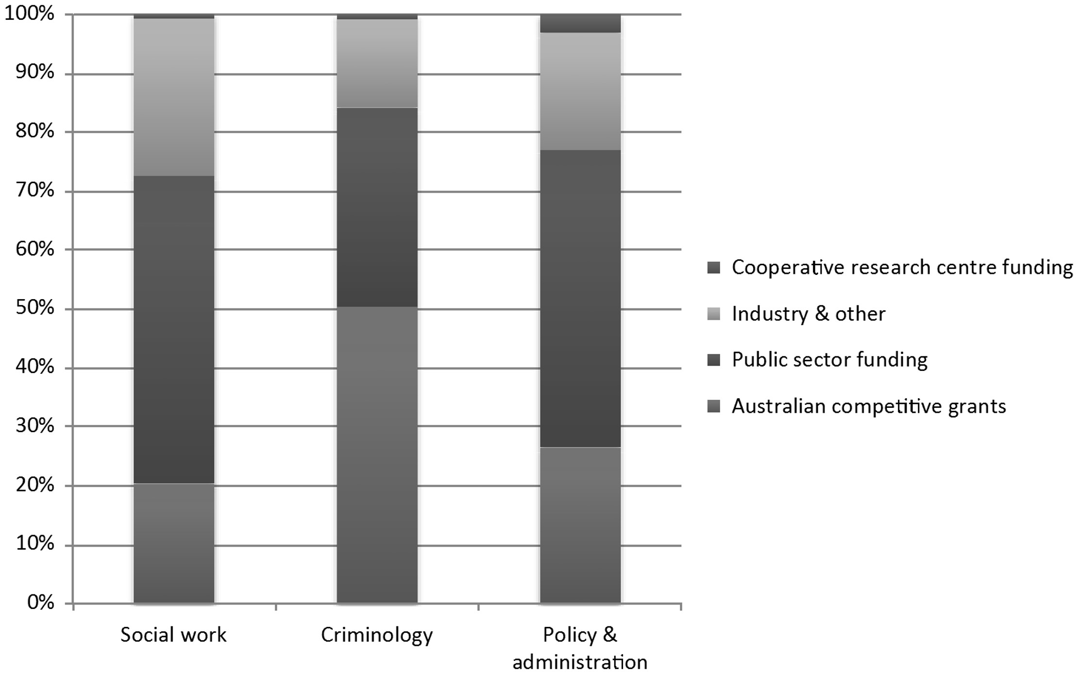
Figure 5. Source of funding for social work, criminology, and policy and administration research in Australia, ...
Notes:
Figure 5. Source of funding for social work, criminology, and policy and administration research in Australia, 2008-2013.
Unless provided in the caption above, the following copyright applies to the content of this slide: © The Author 2017. Published by Oxford University Press on behalf of The British Association of Social Workers. All rights reserved.

Slide 6
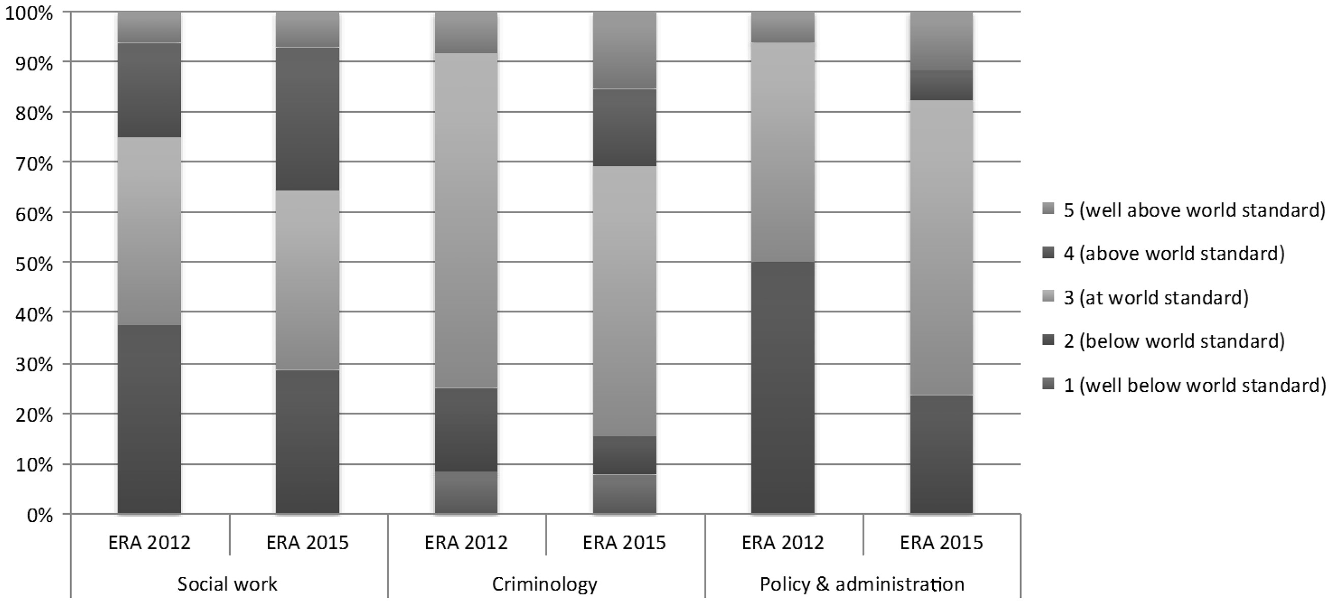
Figure 6. Comparison of ratings of the three disciplines of social work, criminology, and policy and administration in ...
Notes:
Figure 6. Comparison of ratings of the three disciplines of social work, criminology, and policy and administration in Australia, ERA 2012 and ERA 2015.
Unless provided in the caption above, the following copyright applies to the content of this slide: © The Author 2017. Published by Oxford University Press on behalf of The British Association of Social Workers. All rights reserved.

Slide 7
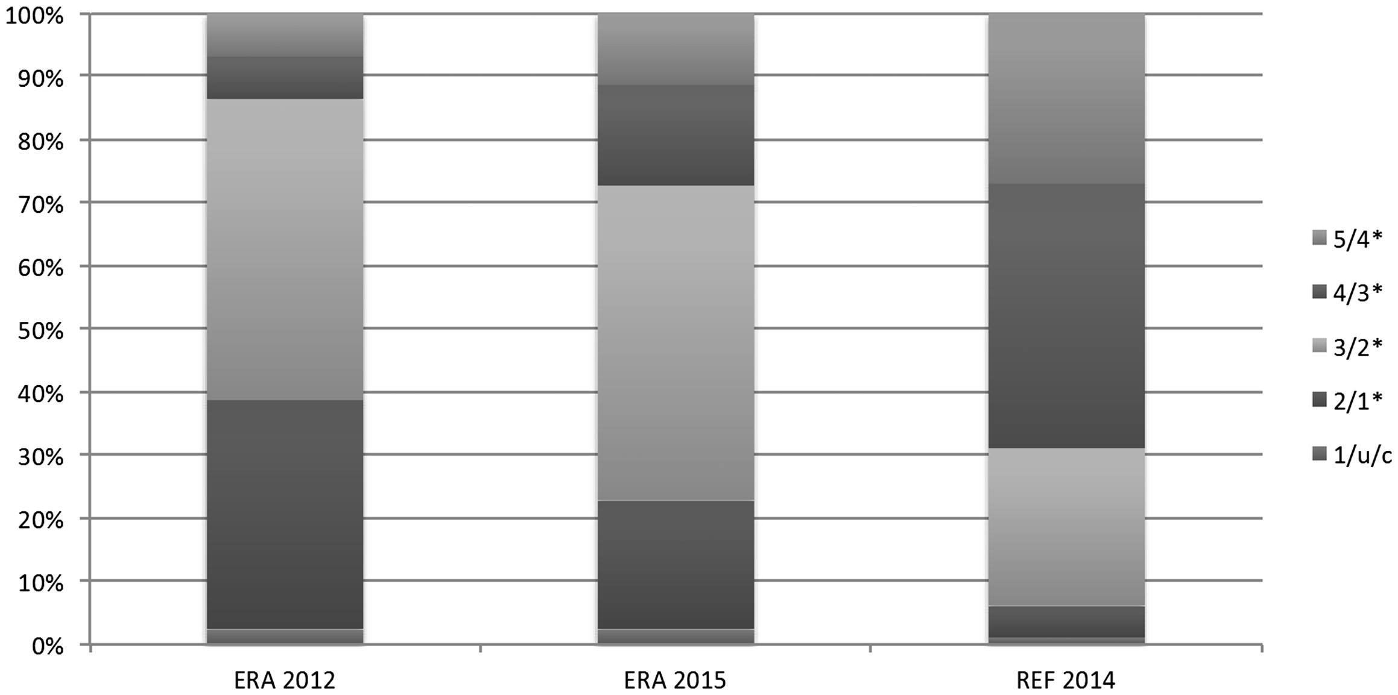
Figure 7. Comparison of overall ratings of social work and social policy research in Australia and the United Kingdom; ...
Notes:
Figure 7. Comparison of overall ratings of social work and social policy research in Australia and the United Kingdom; ERA 2012, ERA 2015, and REF 2014. Note that higher ratings equate to ratings of higher quality where the * system relates to REF ratings (see Table 1 for a comparison of the two rating systems).
Unless provided in the caption above, the following copyright applies to the content of this slide: © The Author 2017. Published by Oxford University Press on behalf of The British Association of Social Workers. All rights reserved.

