Slide 1
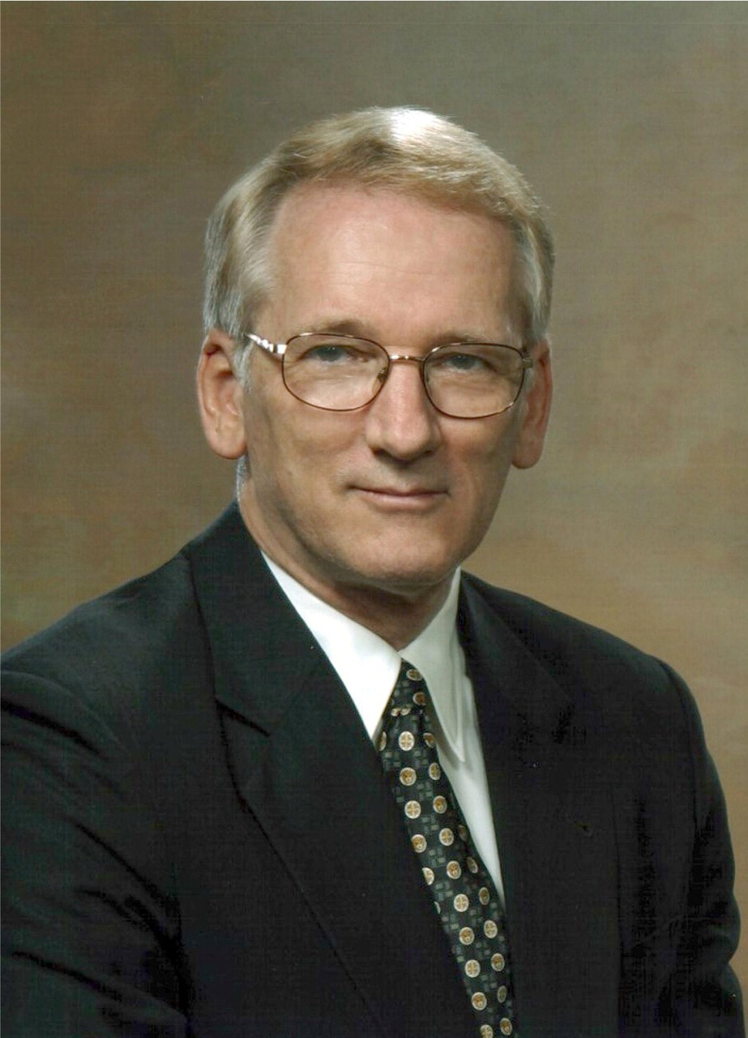
Figure 1 Edward H. Shortliffe, M.D., Ph.D.
Notes:
Figure 1 Edward H. Shortliffe, M.D., Ph.D.
Unless provided in the caption above, the following copyright applies to the content of this slide: American Medical Informatics Association

Slide 2
Figure 2 Ted Shortliffe, circa 1948.
Notes:
Figure 2 Ted Shortliffe, circa 1948.
Unless provided in the caption above, the following copyright applies to the content of this slide: American Medical Informatics Association

Slide 3
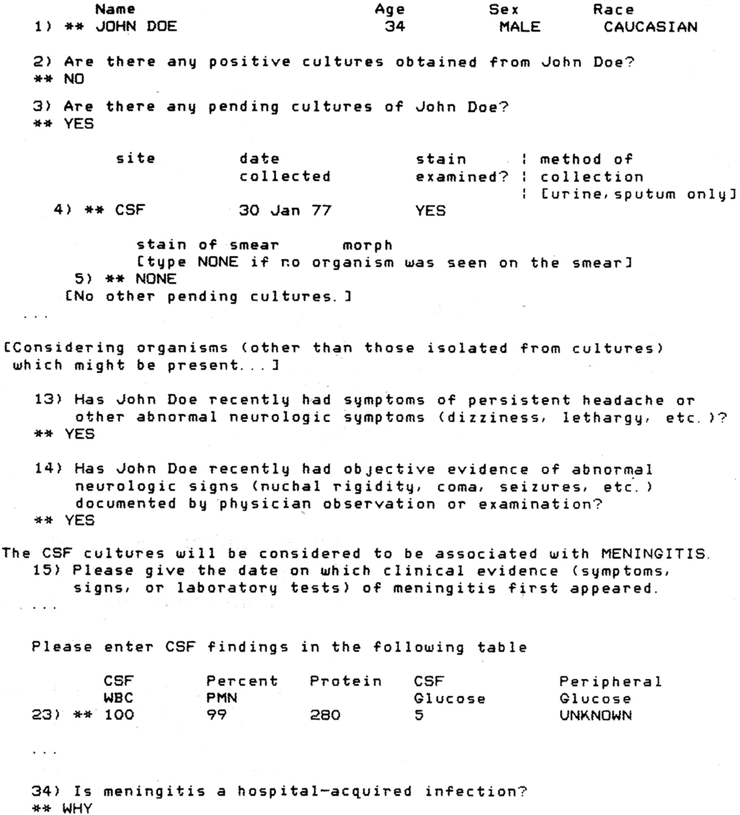
Figure 3 Sample MYCIN consultation session.
Notes:
Figure 3 Sample MYCIN consultation session.
Unless provided in the caption above, the following copyright applies to the content of this slide: American Medical Informatics Association

Slide 4
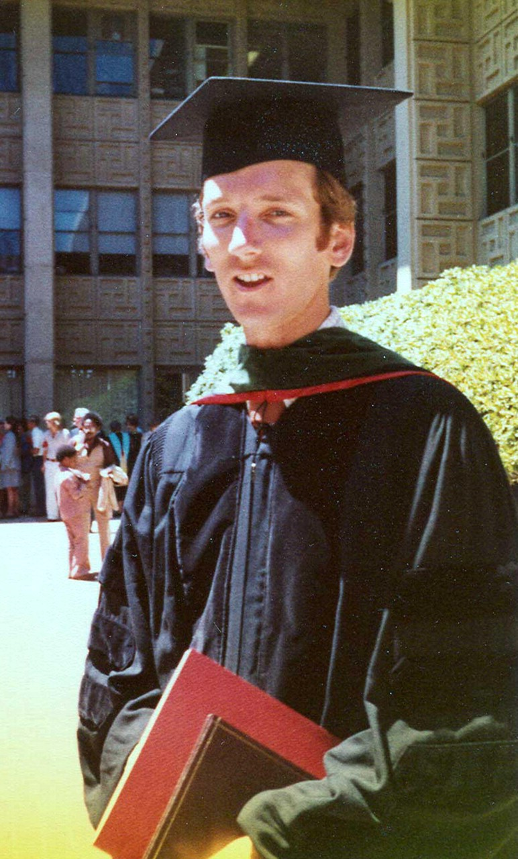
Figure 4 Edward H. Shortliffe, MD, PhD, at Stanford graduation, 1976.
Notes:
Figure 4 Edward H. Shortliffe, MD, PhD, at Stanford graduation, 1976.
Unless provided in the caption above, the following copyright applies to the content of this slide: American Medical Informatics Association

Slide 5
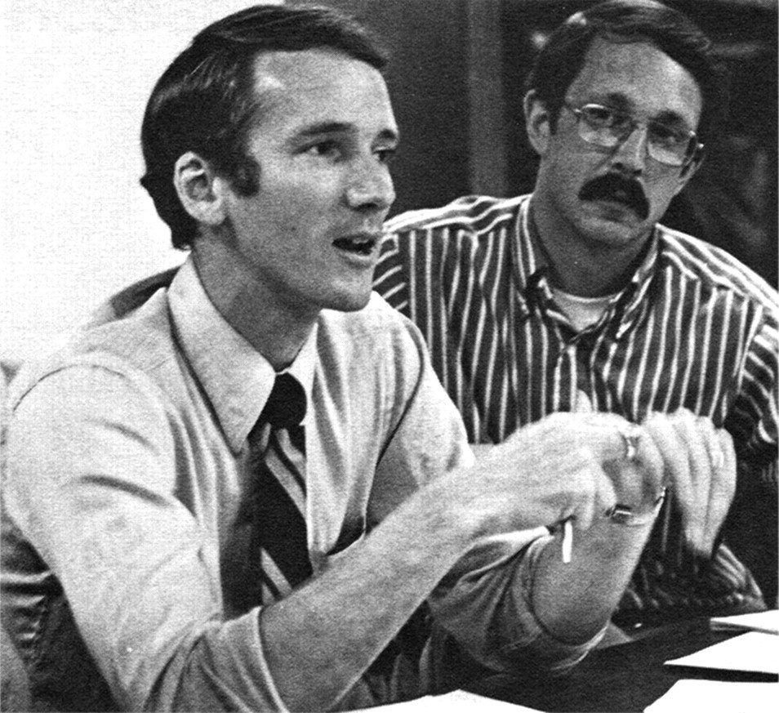
Figure 5 Ted Shortliffe and Bruce Buchanan as young Stanford faculty members, circa 1979.
Notes:
Figure 5 Ted Shortliffe and Bruce Buchanan as young Stanford faculty members, circa 1979.
Unless provided in the caption above, the following copyright applies to the content of this slide: American Medical Informatics Association

Slide 6
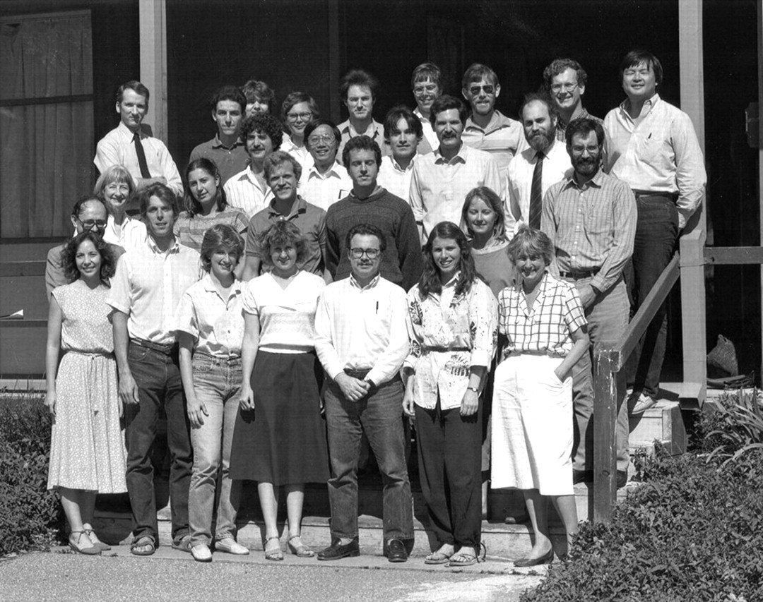
Figure 6 Ted Shortliffe, Section of Medical Informatics faculty, staff, and students, 1985. First row: Leslie ...
Notes:
Figure 6 Ted Shortliffe, Section of Medical Informatics faculty, staff, and students, 1985. First row: Leslie Perreault, Glenn Rennels, Joan Differding, Janice Rohn, Mark Frisse, Holly Jimison, Darlene Vian (administrator). Second row: Gio Weiderhold, Allison Grant (secretary), Isabelle deZegher-Geets, Steve Downs, Curt Langlotz, Janet McLaughlin, Michael Kahn. Third row: Ted Shortliffe, Thierry Barsalou, David Heckerman (back), Hank Rappaport, Greg Cooper, Samson Tu, Eric Horvitz, Christopher Lane, Cliff Wulfman, Mark Musen, David Combs, Larry Fagan, Don Rucker, Homer Chin.
Unless provided in the caption above, the following copyright applies to the content of this slide: American Medical Informatics Association

Slide 7
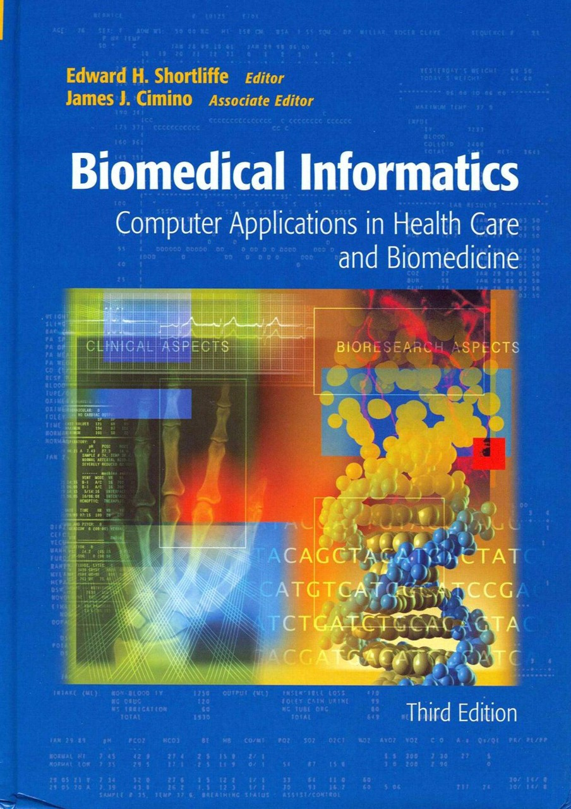
Figure 7 The “Standard” textbook in Biomedical Informatics. Shortliffe, E.H. (ed) and Cimino, J.J. (assoc ed). ...
Notes:
Figure 7 The “Standard” textbook in Biomedical Informatics. Shortliffe, E.H. (ed) and Cimino, J.J. (assoc ed). Biomedical Informatics: Computer Applications in Health Care and Biomedicine. New York: Springer-Verlag, 2006.
Unless provided in the caption above, the following copyright applies to the content of this slide: American Medical Informatics Association

Slide 8
Figure 8 Ted with family 2006: wife, Vimla Patel, and their respective children
Notes:
Figure 8 Ted with family 2006: wife, Vimla Patel, and their respective children
Unless provided in the caption above, the following copyright applies to the content of this slide: American Medical Informatics Association

