Slide 1
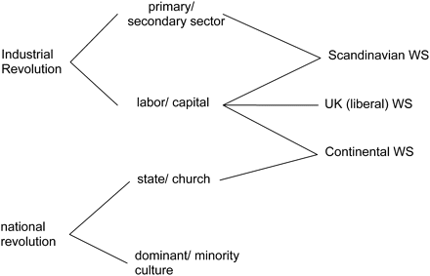
Figure 1 Cleavage structures and welfare states.
Notes:
Figure 1 Cleavage structures and welfare states.
Unless provided in the caption above, the following copyright applies to the content of this slide: © The Author 2008. Published by Oxford University Press and the Society for the Advancement of Socio-Economics. All rights reserved. For Permissions, please email: journals.permissions@oxfordjournals.org

