Slide 1
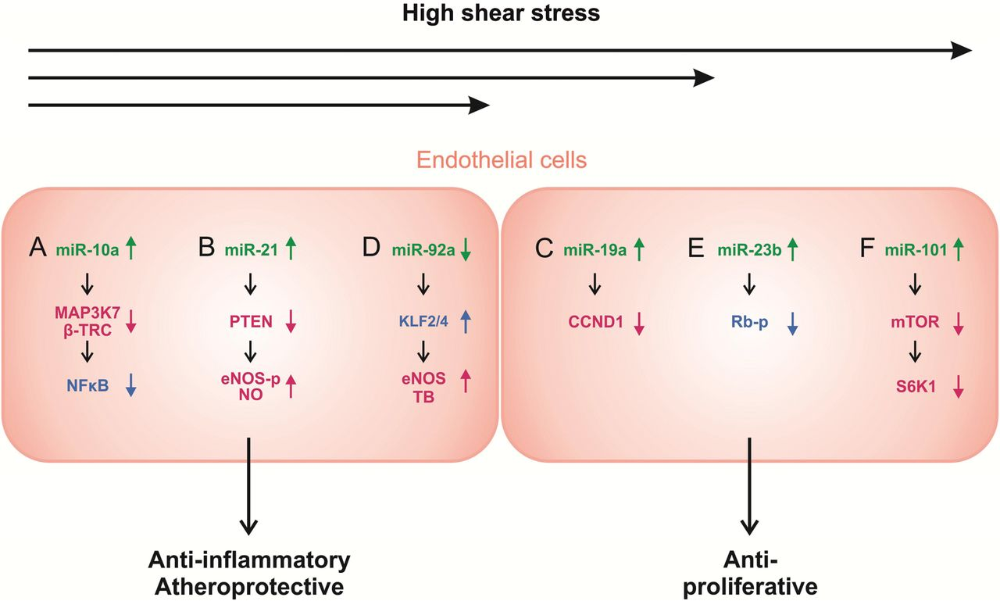
Figure 1 Shear stress-regulated miRs that support a physiological phenotype of ECs. While high shear stress (HSS) ...
Notes:
Figure 1 Shear stress-regulated miRs that support a physiological phenotype of ECs. While high shear stress (HSS) induces the up-regulation of miR-10a (A) and miR-21 (B), miR-92a (D) is repressed under these conditions leading to an anti-inflammatory and/or atheroprotective EC phenotype (left). Moreover, high shear stress comes along with an induction of miR-19a (C), miR-23b (E), and miR-101 (F) resulting in an anti-proliferative status of ECs. Colours: miRs, green; transcription factors or proteins that regulate transcription factor functions, blue; (general) mediators, red. β-TRC, β-transducin repeat-containing gene; CCND1, Cyclin D1; eNOS-p, phosphorylated endothelial nitric oxide synthase; HSS, high shear stress; KLF2/4, Krüppel-like factor 2 and 4; LSS; laminar shear stress; mTOR, mammalian target of rapamycin; MAP3K7, mitogen-activated kinase kinase kinase 7; NF-κB, nuclear factor κB; NO, nitric oxide; PTEN, phosphatase and tensin homolog; Rb-p, phosphorylated retinoblastoma; S6K1, ribosomal S6 kinase 1; TB, thrombomodulin.
Unless provided in the caption above, the following copyright applies to the content of this slide: Published on behalf of the European Society of Cardiology. All rights reserved. © The Author 2013. For permissions please email: journals.permissions@oup.com.

Slide 2
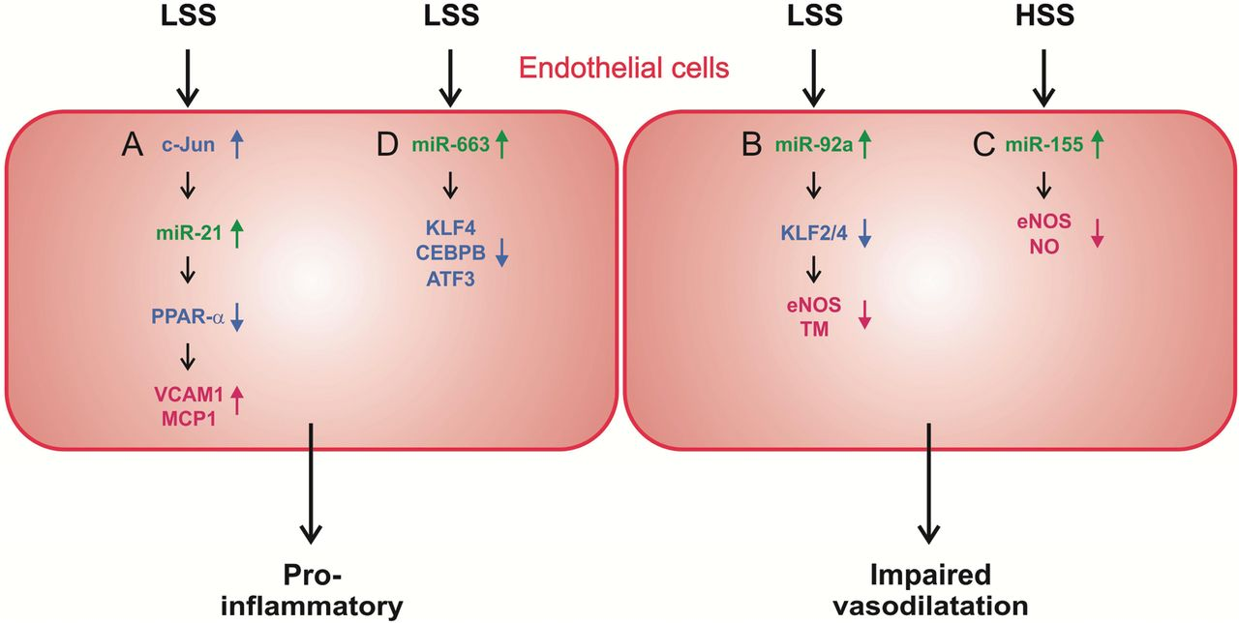
Figure 2 Shear stress-regulated miRs that mediate a pathophysiological phenotype of ECs. The induction of miR-21 via ...
Notes:
Figure 2 Shear stress-regulated miRs that mediate a pathophysiological phenotype of ECs. The induction of miR-21 via c-Jun (A) and miR-663 by low or disturbed shear stress (LSS) results in a pro-inflammatory EC phenotype (left). Enhanced expression of both miR-92a and miR-155 is associated with an impaired vasodilatation (right). Colours: miRs, green; transcription factors or proteins that regulate transcription factor functions, blue; (general) mediators, red. ATF3, activatin transcription factor 3; CEBPB, CCAAT/Enhancer-binding protein beta; c-Jun, jun avian sarcoma virus 17 oncogene homolog; eNOS, endothelial nitric oxide synthase; HSS, high shear stress; KLF2/4, Krüppel-like factor 2 and 4; KLF4, Krüppel-like factor 4; LSS, low shear stress; MCP1, monocyte chemotactic protein 1; NO, nitric oxide; PPARα, peroxisome proliferator-activated receptor α; TM, thrombomodulin; VCAM-1, vascular cell adhesion molecule-1.
Unless provided in the caption above, the following copyright applies to the content of this slide: Published on behalf of the European Society of Cardiology. All rights reserved. © The Author 2013. For permissions please email: journals.permissions@oup.com.

Slide 3
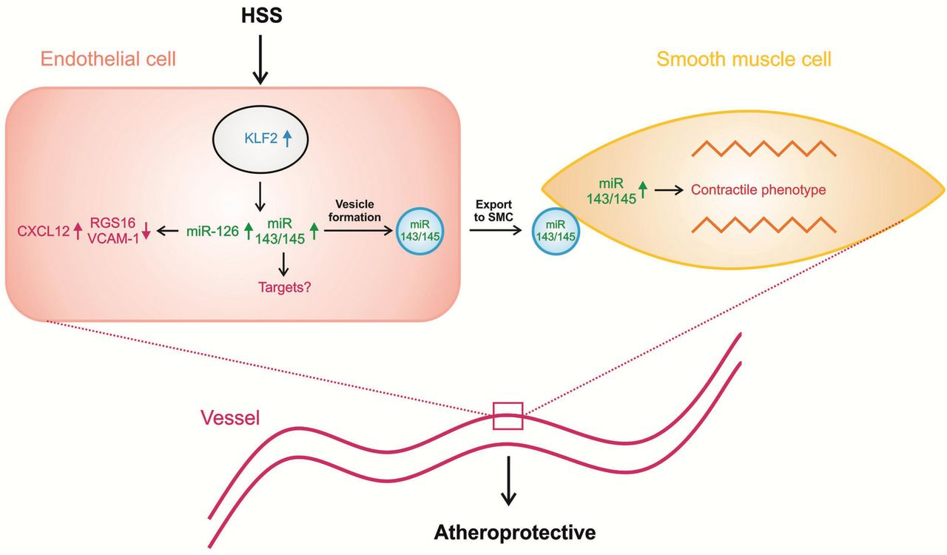
Figure 3 High shear stress induces the expression of KLF2. Mir-126 is up-regulated by KLF2, thereby repressing RGS16 ...
Notes:
Figure 3 High shear stress induces the expression of KLF2. Mir-126 is up-regulated by KLF2, thereby repressing RGS16 and VCAM-1. This results in an induction of CXCL12 which mediates an atheroprotective function (left). However, the regulation of miR-126 by shear stress/KLF2 has only been demonstrated in zebrafish. MiR-143/145 are direct targets of KLF2 in ECs and are up-regulated by laminar shear stress. The downstream targets of miR-143/145 in ECs have not identified up to now. However, laminar shear stress triggers the release of EC-derived microvesicles that are highly enriched in miR-143/145, both via KLF2 (left). These EC microvesicles transfer miR-143/145 to SMCs. By repressing proliferation and enhancing differentiation of SMCs, miR-143/145 communicate atheroprotective functions (right). Colours: miRs, green; transcription factors or proteins that regulate transcription factor functions, blue; (general) mediators, red. CXCL12, Chemokine CXC motif ligand 12; KLF2, Krüppel-like factor 2; RGS16, regulator of G-protein signalling 16; VCAM-1, vascular cell adhesion molecule-1.
Unless provided in the caption above, the following copyright applies to the content of this slide: Published on behalf of the European Society of Cardiology. All rights reserved. © The Author 2013. For permissions please email: journals.permissions@oup.com.

