Slide 1
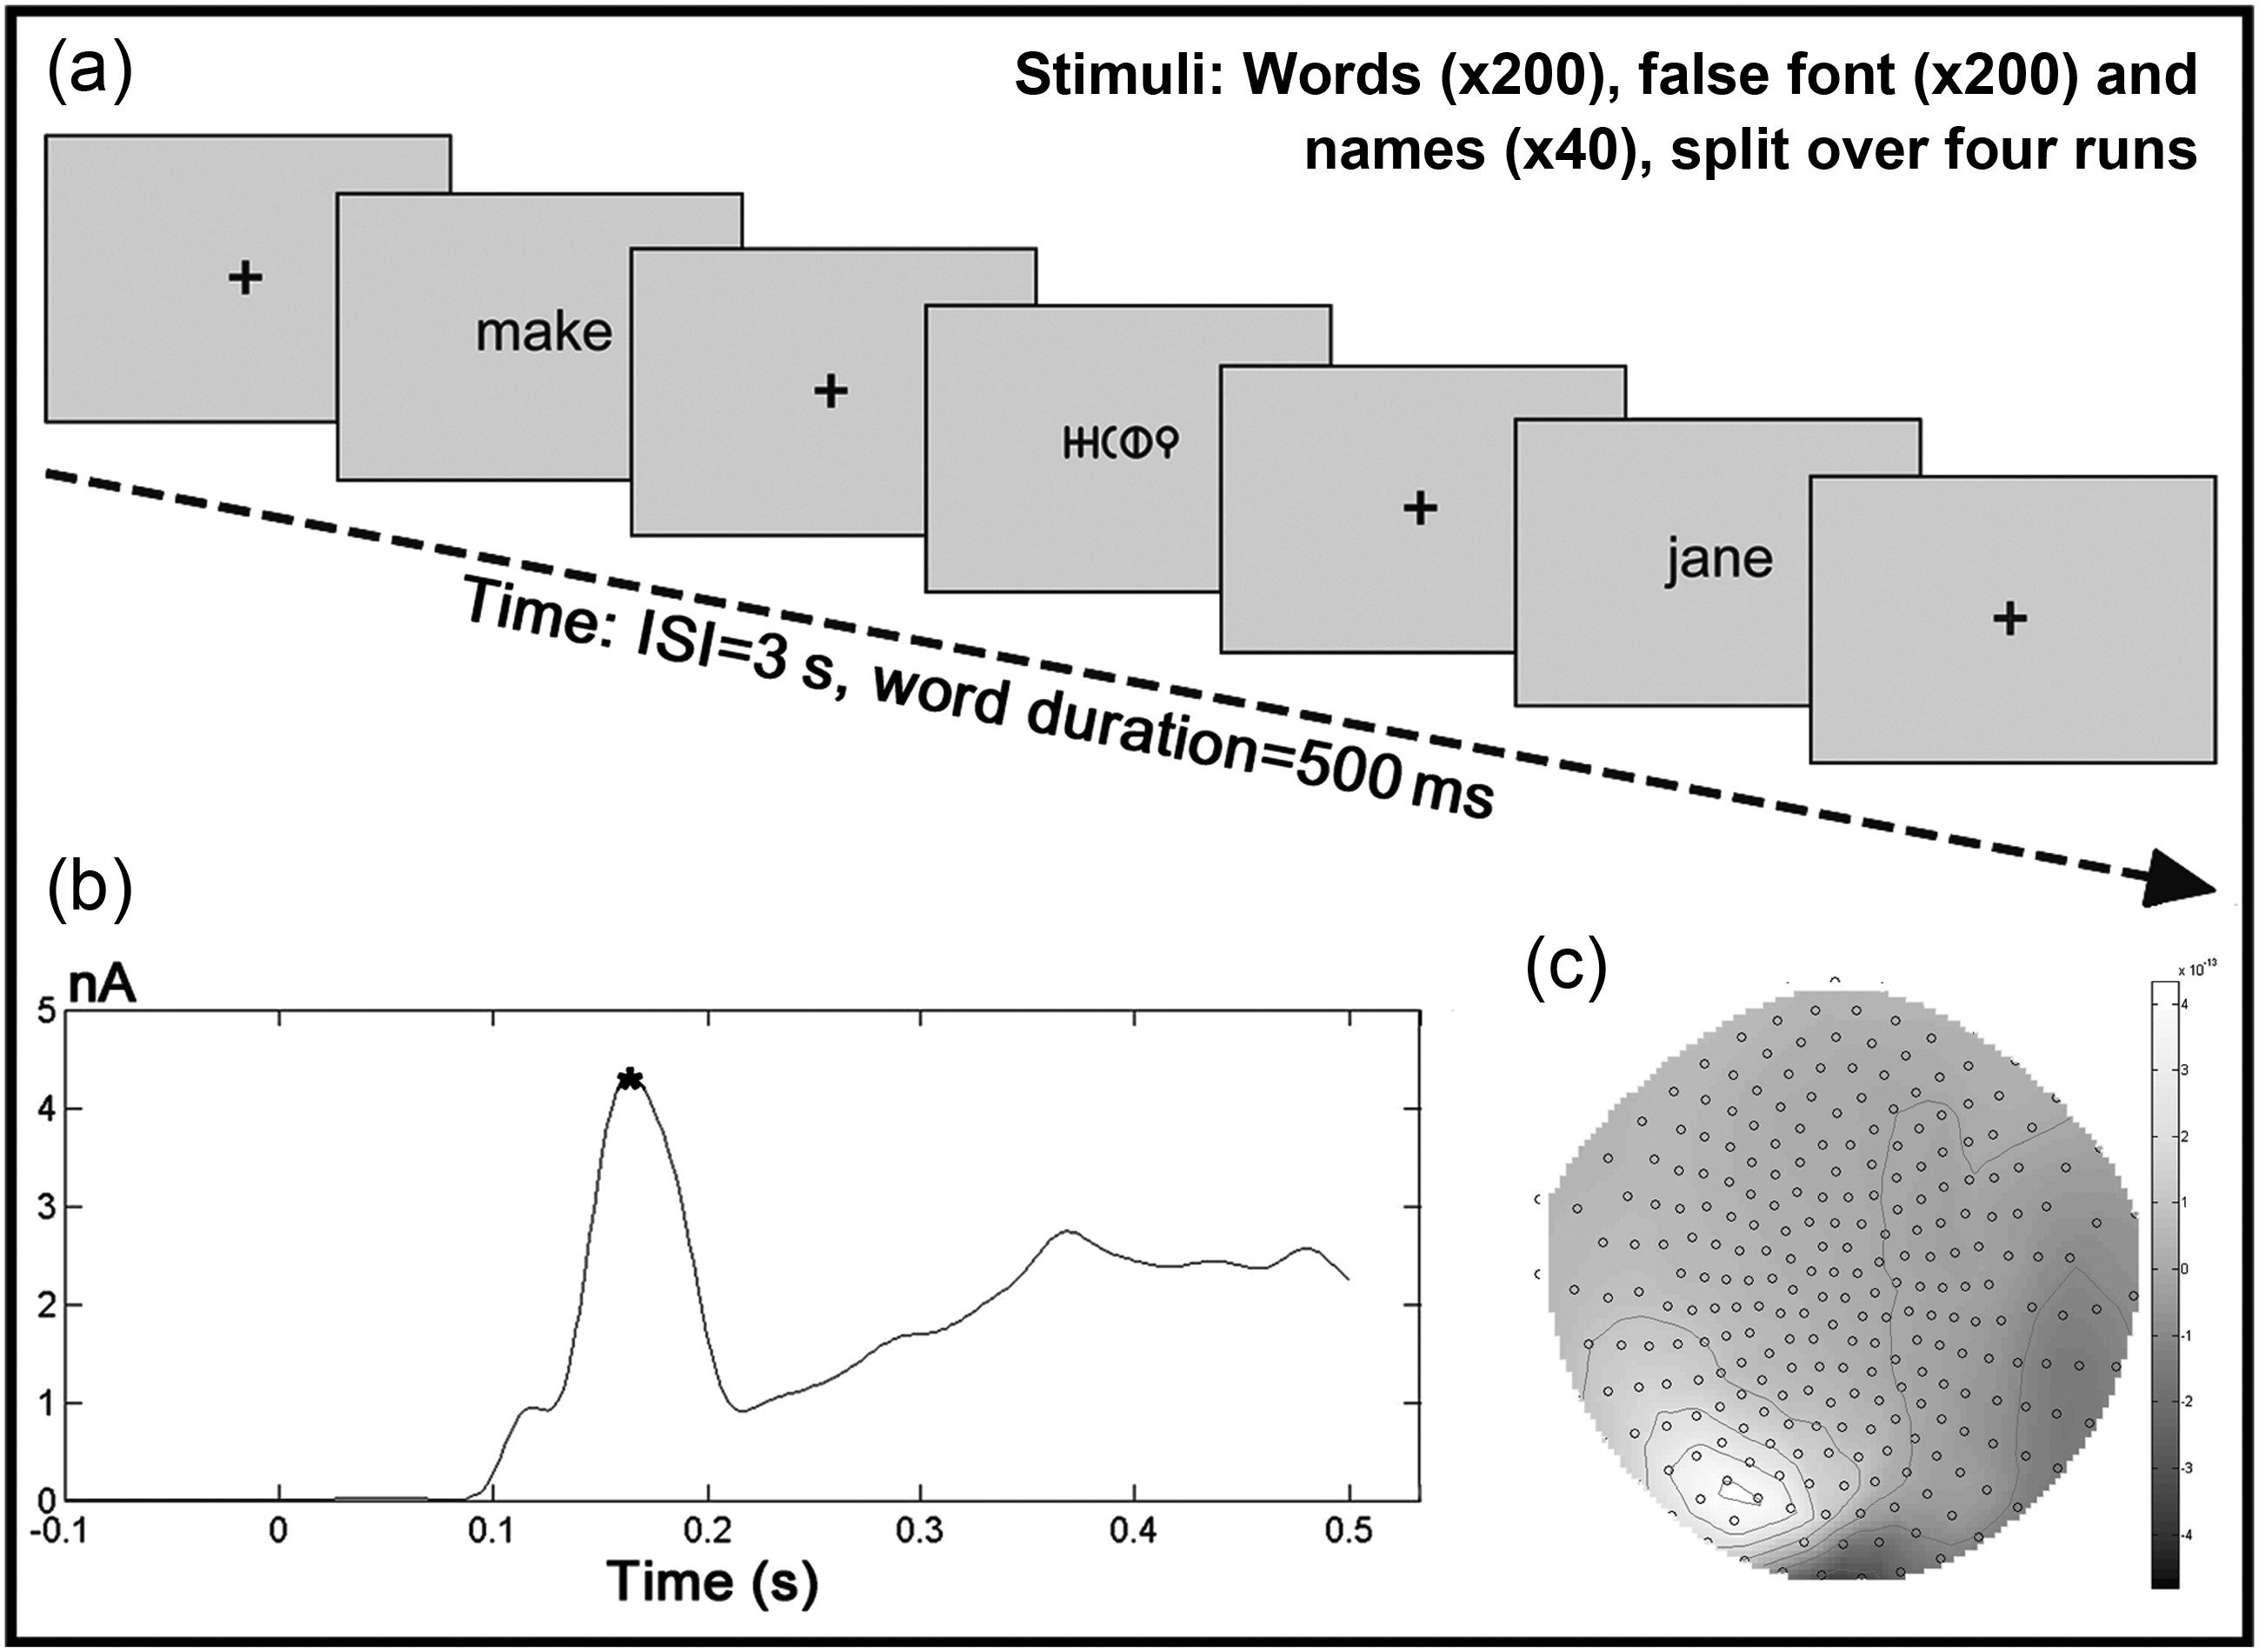
Figure 1. Experimental procedure and analysis. (a) Schematic diagram of the experimental procedure, comprising word, ...
Notes:
Figure 1. Experimental procedure and analysis. (a) Schematic diagram of the experimental procedure, comprising word, false font, and name trials. (b) Example root mean squared plot across all sensors for the average of all word and false font trials for a sample participant. The asterisk indicates the M170 peak, which was identified in a semisupervised manner in each participant and used as the time-point for the VB-ECD source localization. (c) An example of the distribution of the sensor space data at the time of the M170 peak for the same participant.
Unless provided in the caption above, the following copyright applies to the content of this slide: © The Author 2012. Published by Oxford University Press.This is an Open Access article distributed under the terms of the Creative Commons Attribution License (http://creativecommons.org/licenses/by-nc/3.0/), which permits non-commercial reuse, distribution, and reproduction in any medium, provided the original work is properly cited. For commercial re-use, please contact journals.permissions@oup.com.

Slide 2
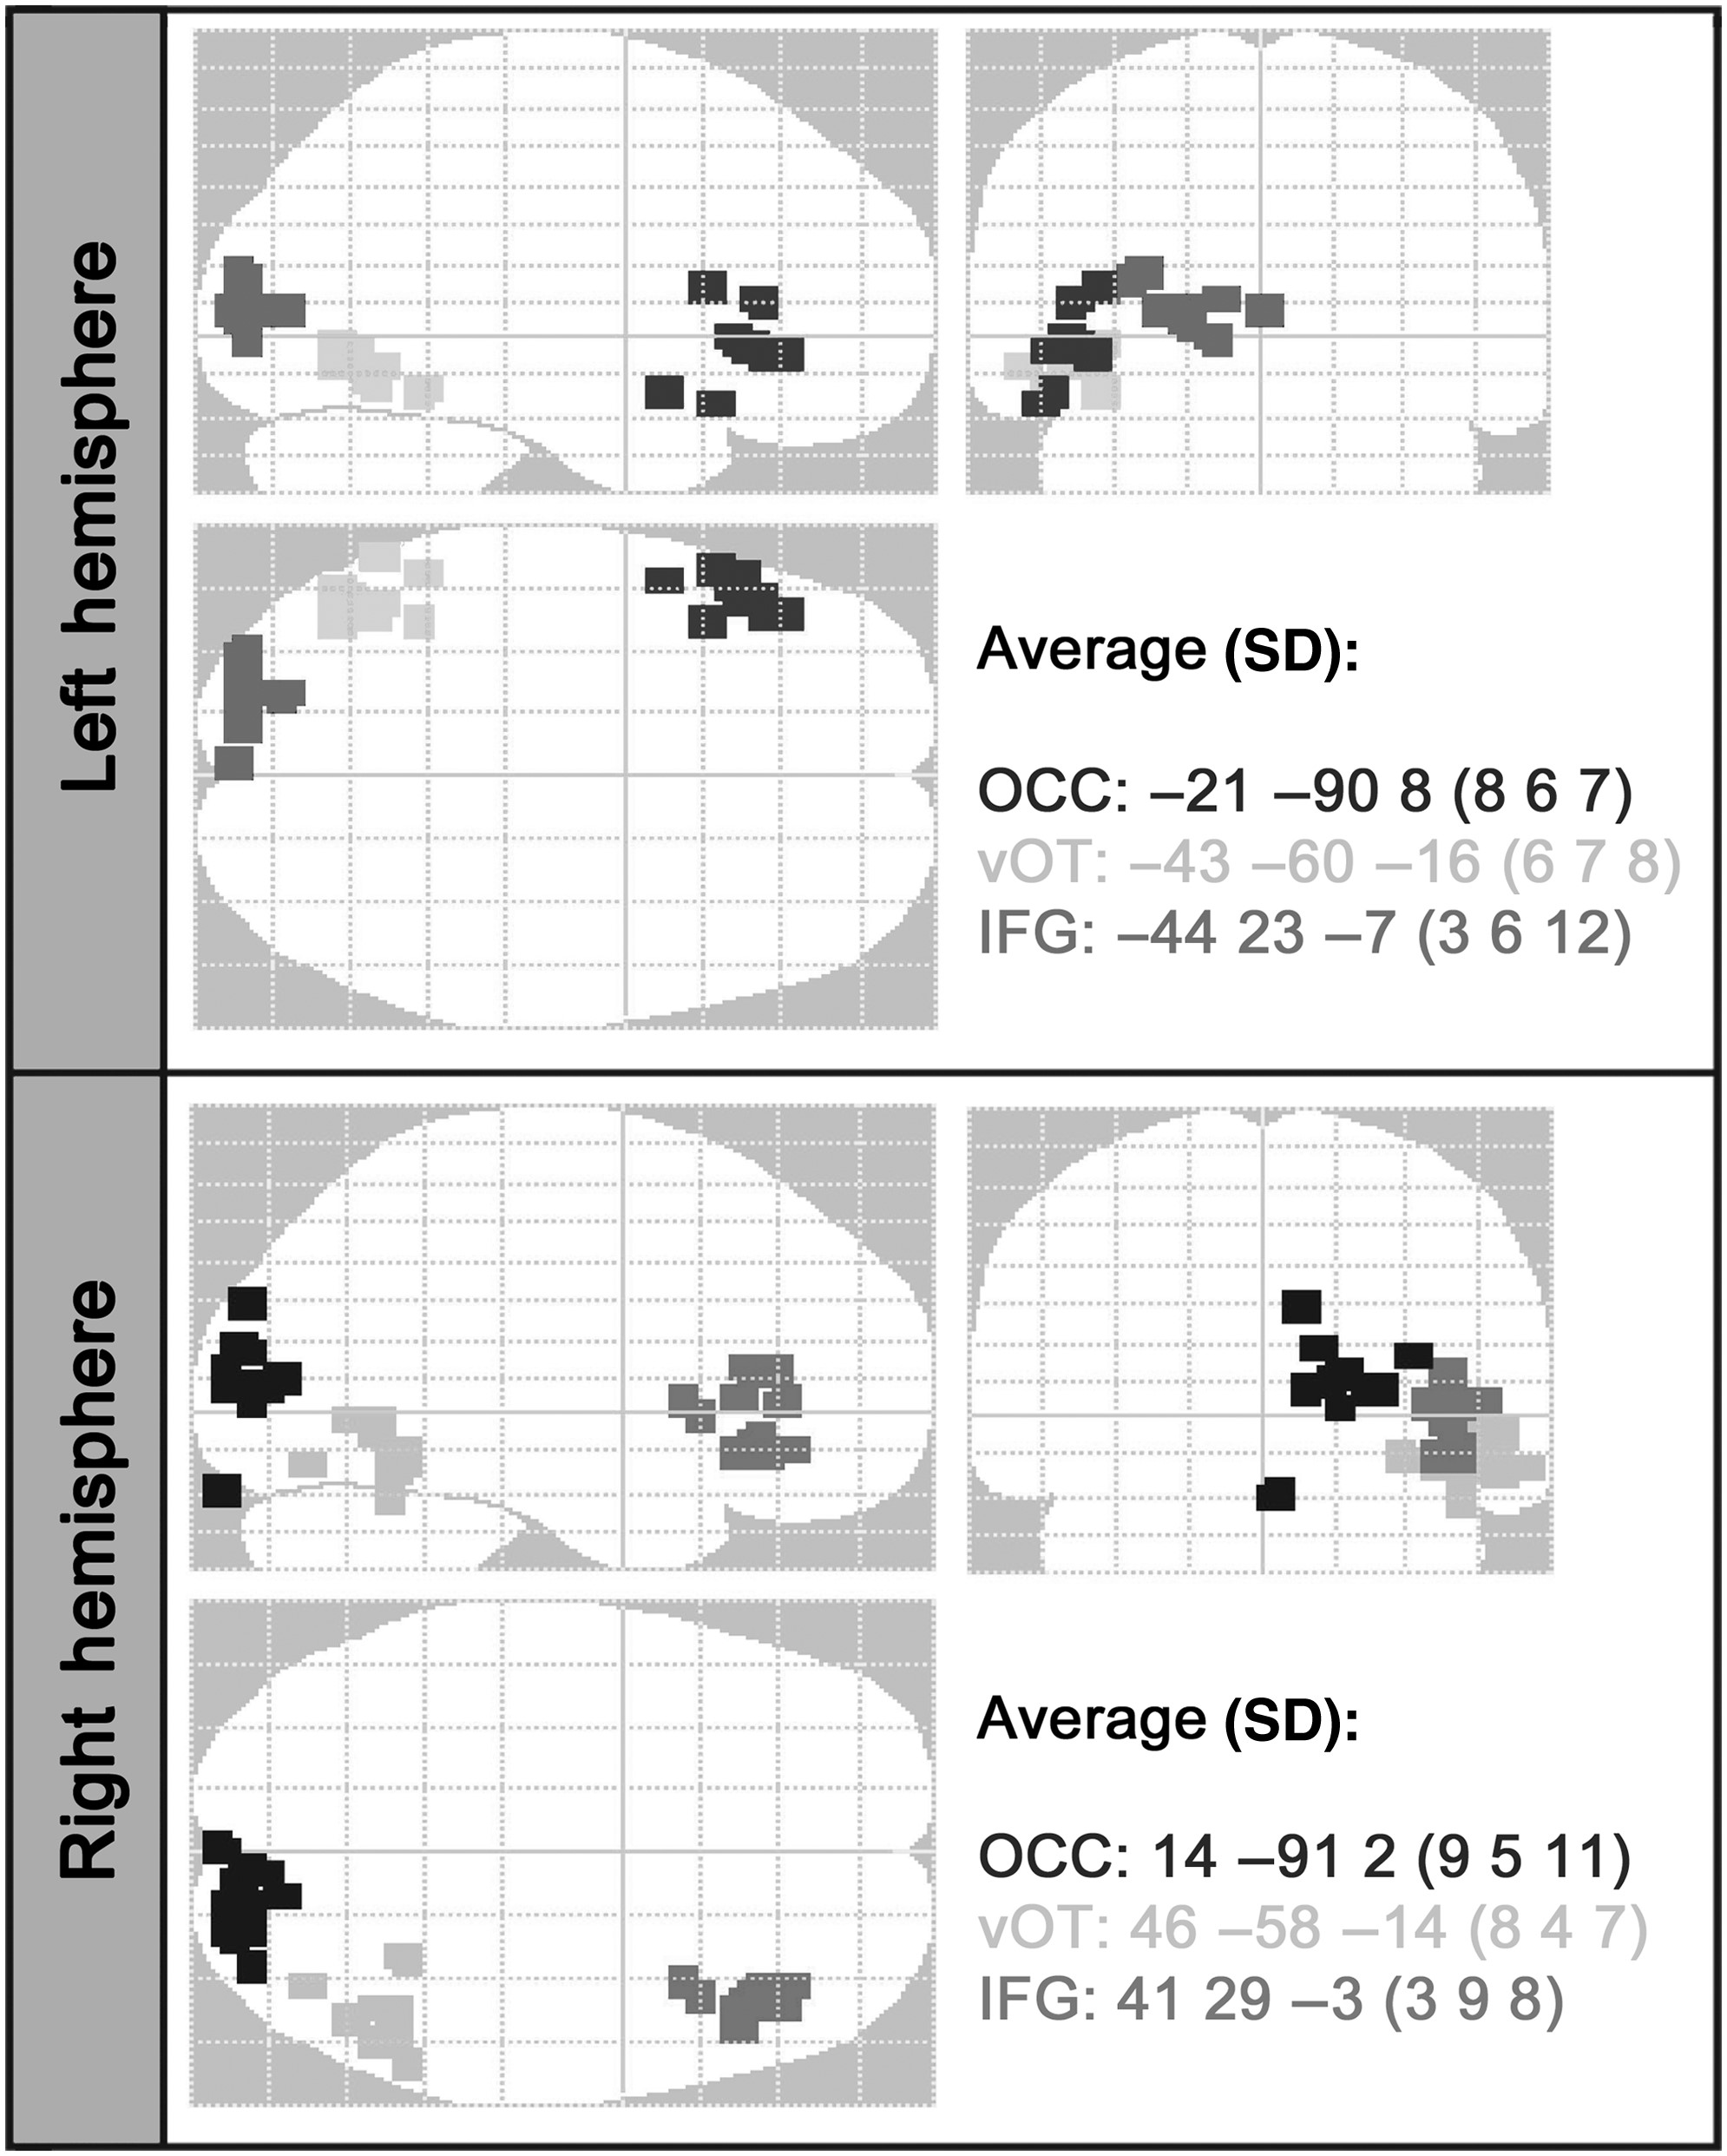
Figure 2. The locations of the winning coordinates across the group. Optimal source locations from the winning 6-source ...
Notes:
Figure 2. The locations of the winning coordinates across the group. Optimal source locations from the winning 6-source model for each participant plotted on a glass brain in MNI space. The start point-source locations were: OCC = ±15 –95 2; vOT = ±44 –58 –15 14; IFG = ±48 28 0. The average locations of the group's winning source locations are shown, with standard deviations. OCC: occipital pole; vOT: ventral occipitotemporal cortex; IFG: inferior frontal gyrus.
Unless provided in the caption above, the following copyright applies to the content of this slide: © The Author 2012. Published by Oxford University Press.This is an Open Access article distributed under the terms of the Creative Commons Attribution License (http://creativecommons.org/licenses/by-nc/3.0/), which permits non-commercial reuse, distribution, and reproduction in any medium, provided the original work is properly cited. For commercial re-use, please contact journals.permissions@oup.com.

Slide 3
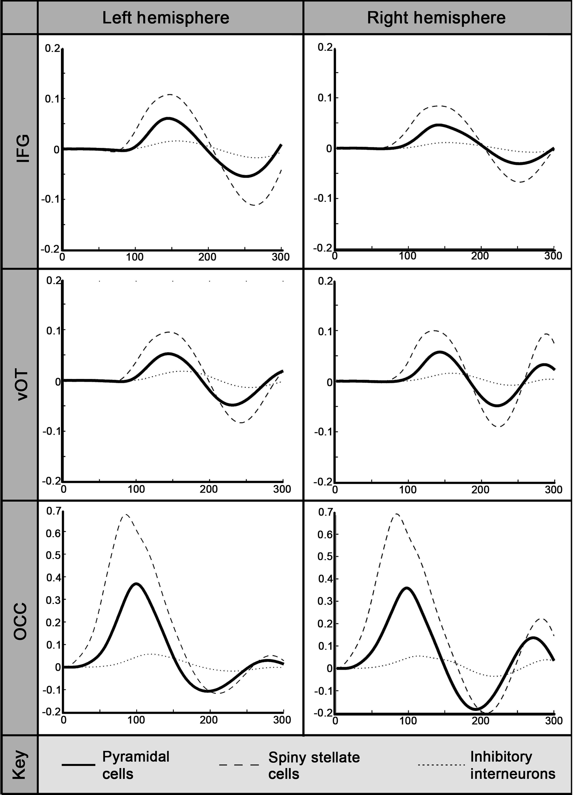
Figure 3. Fitted DCM source responses over time. Group average of the fitted DCM source responses over time for each ...
Notes:
Figure 3. Fitted DCM source responses over time. Group average of the fitted DCM source responses over time for each neuronal subpopulation (pyramidal cells, spiny stellate cells, and inhibitory interneurons). The data were taken from the model shown by the BMS analysis to best explain the word and false font data over the 1–300-ms time-window, which included sources in the left and right occipital cortex (OCC), ventral occipitotemporal cortex (vOT), and inferior frontal gyri (IFG).
Unless provided in the caption above, the following copyright applies to the content of this slide: © The Author 2012. Published by Oxford University Press.This is an Open Access article distributed under the terms of the Creative Commons Attribution License (http://creativecommons.org/licenses/by-nc/3.0/), which permits non-commercial reuse, distribution, and reproduction in any medium, provided the original work is properly cited. For commercial re-use, please contact journals.permissions@oup.com.

Slide 4
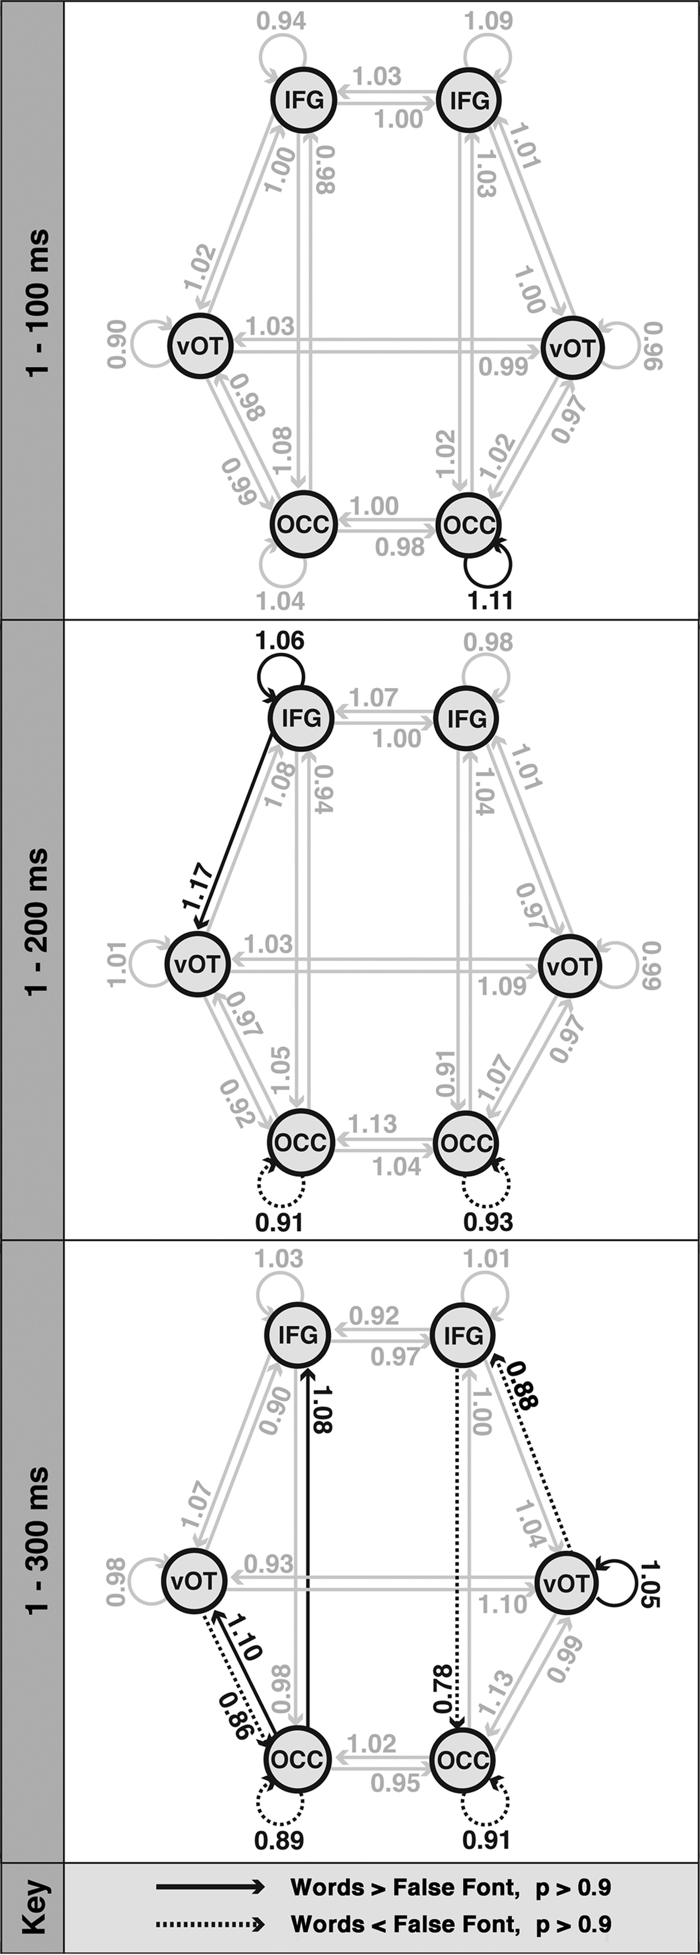
Figure 4. The effects of stimulus type on connection strength. Results of the DCM analyses in 3 time-windows: 1–100, ...
Notes:
Figure 4. The effects of stimulus type on connection strength. Results of the DCM analyses in 3 time-windows: 1–100, 1–200, and 1–300 ms. Arrows represent the modulatory effect of stimulus type on connection strengths. Values larger than one represent stronger connections for words relative to the false font baseline and were thresholded at P > 0.9 (highlighted with solid black lines). Values significantly smaller than one represent weaker connections for words versus baseline, again with a threshold of P > 0.9 (dotted black lines; N = 10).
Unless provided in the caption above, the following copyright applies to the content of this slide: © The Author 2012. Published by Oxford University Press.This is an Open Access article distributed under the terms of the Creative Commons Attribution License (http://creativecommons.org/licenses/by-nc/3.0/), which permits non-commercial reuse, distribution, and reproduction in any medium, provided the original work is properly cited. For commercial re-use, please contact journals.permissions@oup.com.

