Slide 1
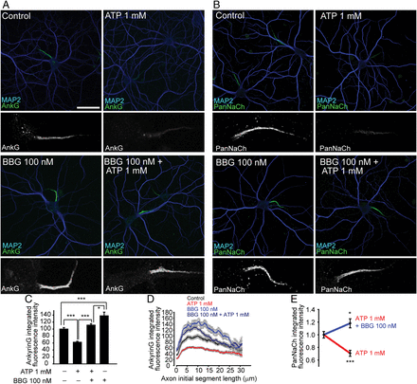
Figure 1. P2X7 receptor activation reduced the density of ankyrin G and voltage-gated sodium channels at the AIS (A,B) ...
Notes:
Figure 1. P2X7 receptor activation reduced the density of ankyrin G and voltage-gated sodium channels at the AIS (A,B) Hippocampal neurons were cultured for 20 DIV and then treated for 24 h with 1 mM ATP, 100 nM BBG or the combination of both. Neurons were fixed and stained with anti-MAP2 antibody (blue) and antiankyrin G (A) or PanNaCh (B) antibodies (green). The ×4 magnifications of AIS staining are shown under each image. Scale bar = 50 μm. Images of each experimental condition from 3 independent experiments obtained under the same conditions. Ankyrin G and PanNaCh fluorescence intensity were measured using Matlab software. (C) Quantification of total integrated ankyrin G fluorescence intensity. (D) Quantification of ankyrin G fluorescence intensity along the AIS. (E) Quantification of total integrated PanNaCh fluorescence intensity. All quantifications were done in at least 50 neurons in each experimental condition and experiment. Data are represented as the mean ± SEM of at least 3 independent experiments. Individual data were normalized to the control mean. (*P < 0.05; ***P < 0.001, Mann–Whitney test).
Unless provided in the caption above, the following copyright applies to the content of this slide: © The Author 2014. Published by Oxford University Press. All rights reserved. For Permissions, please e-mail: journals.permissions@oup.com

Slide 2
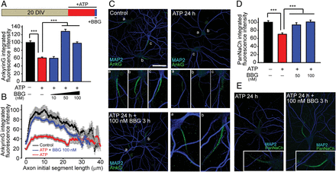
Figure 2. The P2X7 receptor antagonist BBG rescued ankyrin G and sodium channel density at the AIS after ATP treatment. ...
Notes:
Figure 2. The P2X7 receptor antagonist BBG rescued ankyrin G and sodium channel density at the AIS after ATP treatment. Hippocampal neurons were cultured for 20 DIV before treatment with ATP for 24 h. BBG was added for the last 3 h of treatment at increasing concentrations from 10 to 100 nM. Neurons were fixed and stained with antibodies against ankyrin G (green) or sodium channels (PanNaCh, green) and MAP2 (blue). (A) Quantification of total integrated ankyrin G fluorescence intensity. Data are represented as the mean ± SEM of 3 independent experiments (B) Mean ± SEM ankyrin G fluorescence intensity along the AIS of 3 experiments. (C) Representative images and ×4 magnifications of control and treated neurons stained with antiankyrin G antibody (green) and MAP2 (blue). Axons initial segments in each figure are identified by letters and the corresponding magnification is shown at the bottom of each image. Scale bar = 50 μm. (D) Quantification of integrated sodium channel fluorescence intensity at the AIS. Data are represented as the mean ± SEM of 3 independent experiments. (E) Representative images and ×4 magnifications of control and treated neurons stained with antiPanNaCh antibody (green) and MAP2 (blue). All quantifications were done in at least 50 neurons in each experimental and experiment. Individual data were normalized to the control mean. (***P < 0.001, Mann–Whitney test).
Unless provided in the caption above, the following copyright applies to the content of this slide: © The Author 2014. Published by Oxford University Press. All rights reserved. For Permissions, please e-mail: journals.permissions@oup.com

Slide 3
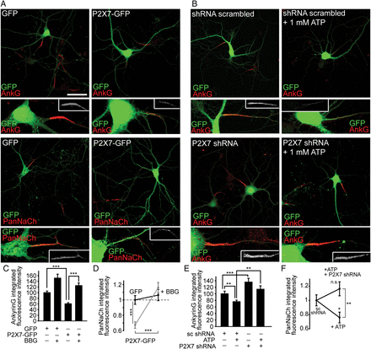
Figure 3. Effects of expression of P2X7 receptor-GFP or P2X7 receptor interference RNA on AIS protein density. ...
Notes:
Figure 3. Effects of expression of P2X7 receptor-GFP or P2X7 receptor interference RNA on AIS protein density. Hippocampal neurons were nucleofected with plasmids expressing GFP or P2X7-GFP (A) and scrambled interference RNA or P2X7 interference RNA (B) and maintained in culture for 20 DIV before treatment with BBG or ATP for 24 h. Neurons were fixed and stained with antibodies against ankyrin G or PanNaCh (red). Nucleofected neurons were identified by GFP expression (green). The ×4 magnifications of AISs from nucleofected neurons are shown under each image. Scale bar = 50 μm. (C,E) Quantification of integrated ankyrin G fluorescence intensity at the AIS. (D,F) Quantification of integrated PanNaCh fluorescence intensity. All quantifications were done in at least 50 neurons in each experimental and experiment. Data are represented as the mean ± SEM of at least 3 independent experiments. Individual data were normalized to the control mean. (n.s.: nonsignificant; *P < 0.05; **P < 0.01; ***P < 0.001, Mann–Whitney test).
Unless provided in the caption above, the following copyright applies to the content of this slide: © The Author 2014. Published by Oxford University Press. All rights reserved. For Permissions, please e-mail: journals.permissions@oup.com

Slide 4
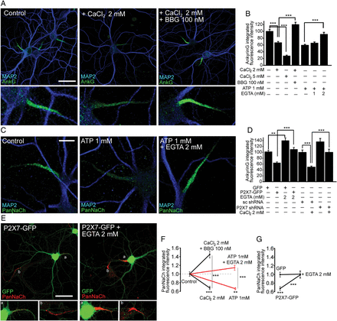
Figure 4. P2X7 receptor-dependent calcium influx mediates the reduction in AIS protein density. (A) Hippocampal neurons ...
Notes:
Figure 4. P2X7 receptor-dependent calcium influx mediates the reduction in AIS protein density. (A) Hippocampal neurons were cultured for 20 days and then calcium concentration was increased by adding CaCl2 (+2 mM) for 24 h in the presence or absence of 100 nM BBG. Neurons were fixed, stained with antiankyrin G antibody (green) and MAP2 (blue). Scale bar = 50 μm. (B) Quantification of integrated ankyrin G fluorescence intensity in neurons cultured in the presence of CaCl2 (+2 or +5 mM), ATP (+1 mM), 100 nM BBG or EGTA (1–2 mM) and their corresponding combined treatments. (C) Sodium channel expression at the AIS of hippocampal neurons treated with 1 mM ATP and 2 mM EGTA. Neurons were stained with anti-PanNaCh antibody (green) and MAP2 (blue). Scale bar = 20 μm. (D) Quantification of integrated ankyrin G fluorescence intensity in neurons nucleofected with GFP, P2X7-GFP, scrambled shRNA, or P2X7 shRNA and treated with 2 mM EGTA or 2 mM CaCl2. (E) Hippocampal neurons nucleofected with P2X7-GFP, cultured for 20 DIV and treated with 2 mM EGTA for 24 h. Neurons were fixed and stained with anti-PanNaCh antibody. The ×4 magnification of non-nucleofected and P2X7-GFP nucleofected neurons identified by letters are shown in the corresponding bottom panels. Scale bar = 50 μm. (F) Quantification of integrated sodium channel fluorescence intensity in neurons treated with 1 mM ATP or 2 mM CaCl2 alone or in combination with 2 mM EGTA or 100 nM BBG, respectively. (G) Quantification of integrated sodium channel fluorescence intensity in control or 2 mM EGTA treated neurons nucleofected with GFP or P2X7-GFP. (**P < 0.01; ***P < 0.001, Mann–Whitney test).
Unless provided in the caption above, the following copyright applies to the content of this slide: © The Author 2014. Published by Oxford University Press. All rights reserved. For Permissions, please e-mail: journals.permissions@oup.com

Slide 5
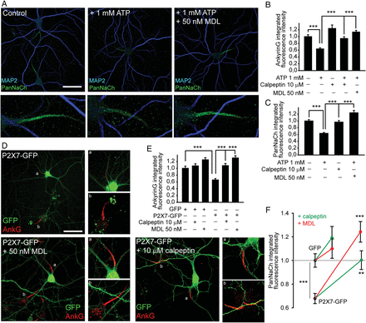
Figure 5. Calpain inhibition impairs the reduction of AIS protein density mediated by P2X7 receptors. (A) 20 DIV ...
Notes:
Figure 5. Calpain inhibition impairs the reduction of AIS protein density mediated by P2X7 receptors. (A) 20 DIV hippocampal neurons treated for the last 24 h with 1 mM ATP alone or in combination with the calpain inhibitor MDL-28170 (50 nM). Neurons were fixed and stained with anti-PanNaCh (green) and anti-MAP2 (blue) antibodies. Bottom panels show a ×4 magnification of AISs. (B,C) Quantification of integrated ankyrin G and sodium channels fluorescence intensity in neurons treated with 1 mM ATP alone or in combination with 10 μM calpeptin or 50 nM MDL. (D) 20 DIV hippocampal neurons nucleofected with P2X7-GFP plasmid and treated with the calpain inhibitors MDL (50 nM) or calpeptin (10 μM). Neurons were stained with antiankyrin G antibody (red). The ×4 magnifications show AISs from control nonnucleofected and P2X7-GFP nucleofected neurons. (E,F) Quantification of integrated ankyrin G and sodium channel fluorescence intensity in neurons nucleofected with GFP or P2X7-GFP plasmids and treated for 24 h with calpain inhibitors, MDL, or calpeptin. (**P < 0.01; ***P < 0.001, Mann–Whitney test).
Unless provided in the caption above, the following copyright applies to the content of this slide: © The Author 2014. Published by Oxford University Press. All rights reserved. For Permissions, please e-mail: journals.permissions@oup.com

Slide 6
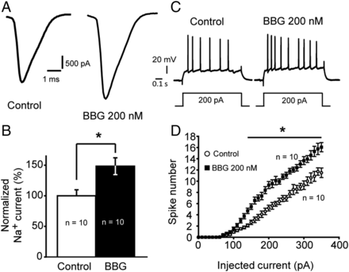
Figure 6. Inhibition of P2X7 receptors by BBG increases sodium current amplitude and intrinsic neuronal excitability. ...
Notes:
Figure 6. Inhibition of P2X7 receptors by BBG increases sodium current amplitude and intrinsic neuronal excitability. (A) Plot of the sodium current in CA3 hippocampal neurons from control or 200 nM BBG treated slices (350 μm). Sodium currents measured in CA3 hippocampal neurons were evoked by a depolarizing step from −70 to 0 mV. (B) Mean ± SEM normalized sodium current amplitude in 200 nM BBG treated neurons compared with control neurons. (*P < 0.02; paired t-test). Note the significant increase in the sodium current amplitude in BBG treated neurons. (C) Representative firing profiles of CA3 hippocampal neurons from control and 200 nM BBG treated slices. (D) Input–output curves for control (○) and BBG (•) treated neurons. Note the significant increase in excitability for BBG treated neurons (t-test, *P < 0.02).
Unless provided in the caption above, the following copyright applies to the content of this slide: © The Author 2014. Published by Oxford University Press. All rights reserved. For Permissions, please e-mail: journals.permissions@oup.com

Slide 7
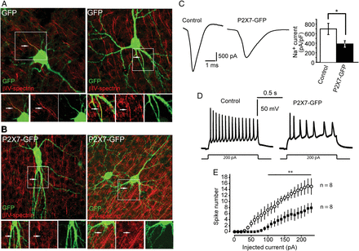
Figure 7. Expression of P2X7-GFP receptors in cortical neurons diminishes sodium current amplitude, intrinsic ...
Notes:
Figure 7. Expression of P2X7-GFP receptors in cortical neurons diminishes sodium current amplitude, intrinsic excitability, and βIV-spectrin density at the AIS. (A,B) GFP (A) or P2X7-GFP (B) expression plasmids were transfected in 450 μm brain slices including hippocampus and entorhinal cortex using the biolistic technique GeneGun. Brain slices were fixed and stained using an antibody against the AIS marker βIV-spectrin (red). Images show layer V cortical neurons. Note that the AIS of neurons expressing GFP show clear βIV-spectrin staining similar to that of surrounding GFP negative neurons, while βIV-spectrin staining is absent from the AIS of P2X7-GFP positive neurons. (C) Plot of the sodium current in L5 cortical neurons from control (GFP) or P2X7-GFP positive neurons. Sodium currents were evoked by a depolarizing step from −70 to 0 mV. The graph represents the mean ± SEM of the sodium current amplitude measured in control or P2X7-GFP neurons (n = 8; *P < 0.05; t-test). Note the significant reduction in the sodium current amplitude in P2X7-GFP positive neurons. (D) Representative firing profiles of L5 cortical neurons from control and P2X7-GFP neurons. (E) Input–output curves for control (○) and P2X7-GFP positive neurons (•). Note the significant neuronal excitability decrease in P2X7-GFP neurons (t-test, *P < 0.01).
Unless provided in the caption above, the following copyright applies to the content of this slide: © The Author 2014. Published by Oxford University Press. All rights reserved. For Permissions, please e-mail: journals.permissions@oup.com

Slide 8
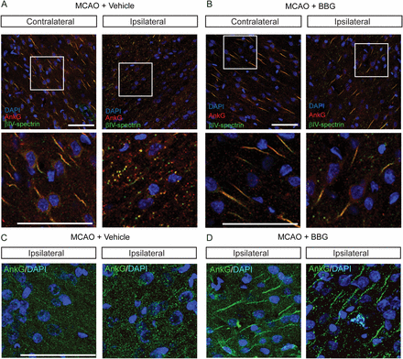
Figure 8. A P2X7 receptor antagonist prevents AIS injury in ischemia. (A,B) Rats were operated to induce brain ischemia ...
Notes:
Figure 8. A P2X7 receptor antagonist prevents AIS injury in ischemia. (A,B) Rats were operated to induce brain ischemia by middle cerebral artery occlusion (MCAO). Rats were injected intraperitoneally with PBS or the P2X7 receptor antagonist BBG (50 mg/kg) as described in Materials and Methods section. Brains were collected 72 h later. Coronal sections (30 μm) were stained with antiankyrin G (red) and antiβIV-spectrin (green) antibodies. Nuclei were stained using 4′,6-diamidino-2-phenylindole (blue). Images show representative pictures from the parietal cortex region of the contralateral side (undamaged region) or ipsilateral side (ischemic zone) from rat brains treated with vehicle (PBS) or BBG. White square zones were magnified 3 times and shown in the corresponding bottom panels. (C,D) Images from regions of ischemia damage from rat brains of a second independent experiment showing the absence of ankyrin G staining (green) in vehicle treated rats (C) and its protection in BBG treated rats (D). Scale bar = 50 μm.
Unless provided in the caption above, the following copyright applies to the content of this slide: © The Author 2014. Published by Oxford University Press. All rights reserved. For Permissions, please e-mail: journals.permissions@oup.com

