Slide 1
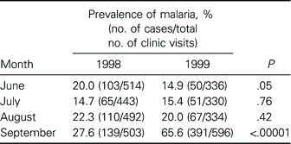
Table 1. Suspected cases of malaria as a proportion of reported clinic visits in the Kidal district, Mali, during ...
Notes:
Table 1. Suspected cases of malaria as a proportion of reported clinic visits in the Kidal district, Mali, during malaria transmission seasons in 1998 and 1999.
Unless provided in the caption above, the following copyright applies to the content of this slide: © 2004 by the Infectious Diseases Society of America

Slide 2
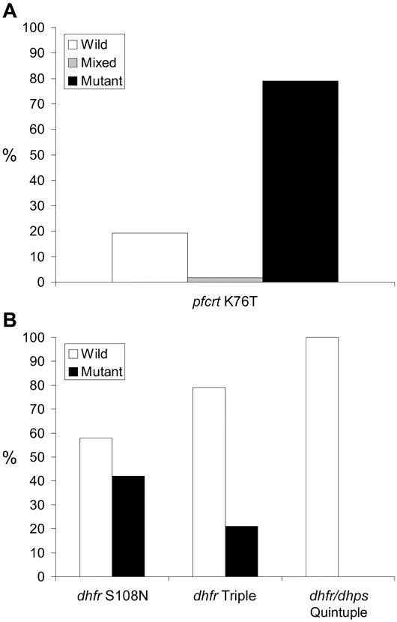
Figure 1. Prevalence of molecular markers for chloroquine-resistant Plasmodium falciparum during an epidemic of P. ...
Notes:
Figure 1. Prevalence of molecular markers for chloroquine-resistant Plasmodium falciparum during an epidemic of P. falciparum malaria in the Kidal district, Mali. A, Cases with wild-type K76 and mutant 76T forms of pfcrt and with both forms (“Mixed”). B, Cases with wild-type and mutant forms of dhfr and dhps. “dhfr Triple” indicates markers S108N, N51I, and C59R; “dhfr/dhps Quintuple” indicates the 3 dhfr markers plus dhps markers A437G and K540E.
Unless provided in the caption above, the following copyright applies to the content of this slide: © 2004 by the Infectious Diseases Society of America

