Slide 1
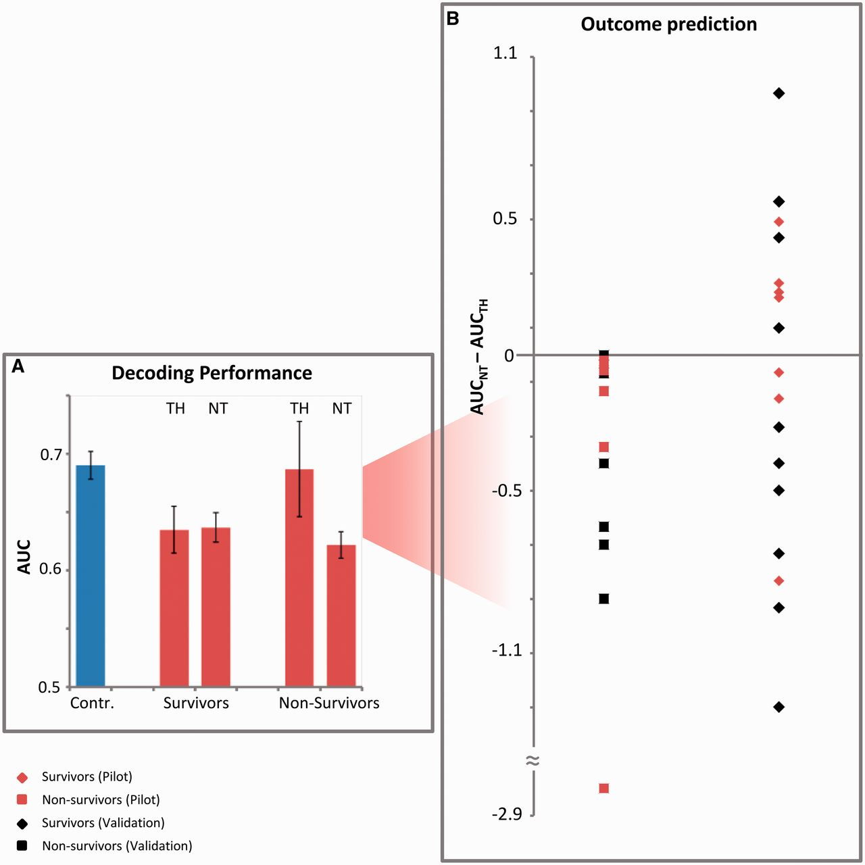
Figure 1 Decoding results and outcome prediction. (A) Average decoding performance (SEM indicated) for the five ...
Notes:
Figure 1 Decoding results and outcome prediction. (A) Average decoding performance (SEM indicated) for the five controls (blue) and the pilot group of 12 patients (red). Decoding was measured as the area under the curve (AUC) obtained when discriminating responses to standard versus one type of deviant sounds (in terms of duration, location or pitch). The decoding performance was averaged across the three types of deviants and across patients under therapeutic hypothermia (TH) and under normothermic (NT) conditions. The decoding performance was at similar levels for patients and controls, especially for non-survivors and during therapeutic hypothermia. This decoding performance typically decreases from therapeutic hypothermia to normothermic conditions in non-survivors. (B) The difference in decoding performance from therapeutic hypothermia to normothermic conditions, evaluated independently for each patient, was used for predicting the patients’ outcome. In the pilot group (red rhombi and squares), an improvement on the average decoding performance from therapeutic hypothermia to normothermic conditions was only observed in survivors (rhombi), resulting in a positive predictive value of 100%. All non-awakening patients showed a drop in their performance (squares). These results were replicated on a validation group of 18 patients (black rhombi and squares), whose data analysis was done blindly to their outcome.
Unless provided in the caption above, the following copyright applies to the content of this slide: © The Author (2012). Published by Oxford University Press on behalf of the Guarantors of Brain. All rights reserved. For Permissions, please email: journals.permissions@oup.com

Slide 2
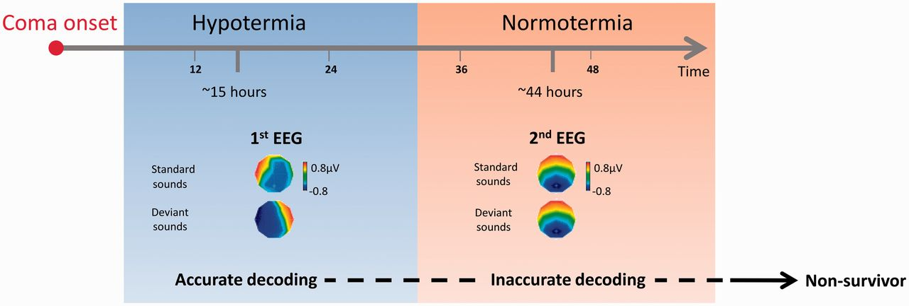
Figure 2 Schematic representation of the procedure and exemplar voltage topographies for a patient who did not awake. ...
Notes:
Figure 2 Schematic representation of the procedure and exemplar voltage topographies for a patient who did not awake. The first EEG recording was typically performed at ∼15 h after cardiac arrest, during therapeutic hypothermia and the second at ∼44 h, after rewarming, under normothermic conditions (Table 1). A worsening in decoding performance was observed in all the patients who did not awake from coma. Typically, based on the first EEG recording during therapeutic hypothermia, we obtained an accurate decoding performance, which resulted from topographic differences in response to standard and deviant sounds (voltage topographies estimated by the single-trial model along 100–300 ms post-stimulus onset; left panel). However, during normothermic conditions, the estimated voltage topographies over the same time window did not differ for the two types of sounds (right panel) and decoding was not above chance. Such a drop in decoding performance was observed in all patients who do not awake from coma. We conclude that the neural mechanisms responsible for sound discrimination are corrupted after 24 h from coma onset and after the end of therapeutic hypothermia.
Unless provided in the caption above, the following copyright applies to the content of this slide: © The Author (2012). Published by Oxford University Press on behalf of the Guarantors of Brain. All rights reserved. For Permissions, please email: journals.permissions@oup.com

Slide 3
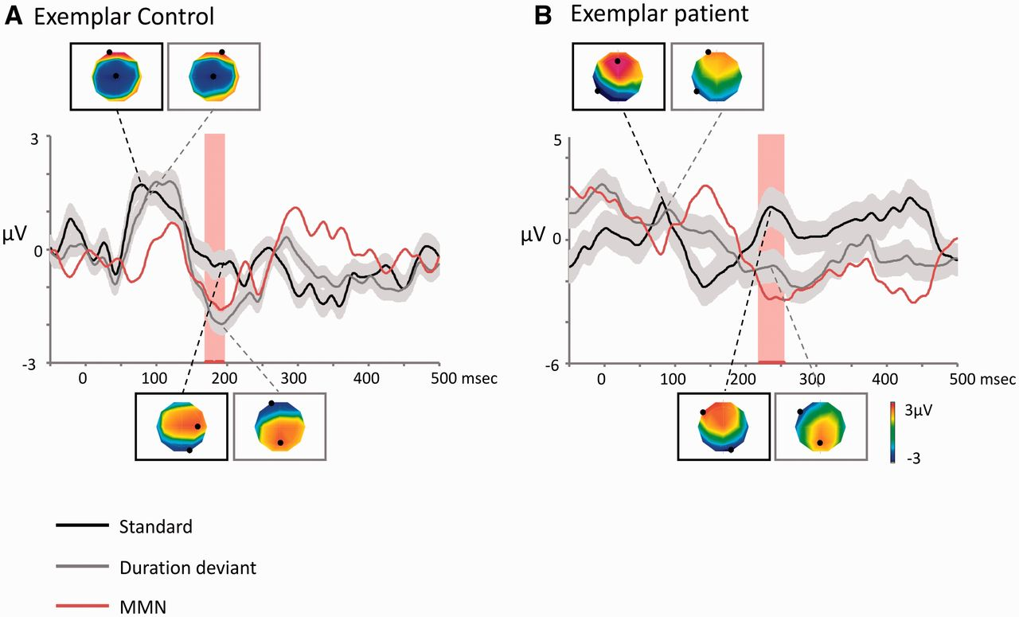
Figure 3 Average auditory evoked potential waveforms (standard error indicated) and scalp voltage topographies for an ...
Notes:
Figure 3 Average auditory evoked potential waveforms (standard error indicated) and scalp voltage topographies for an exemplar healthy control (A) and an exemplar patient (B). Average auditory evoked potential responses at a group of frontal electrodes (FP1, FP2 and Fz) to standard (black line), duration deviant sounds (grey line) and the difference of the two (red line—mismatch negativity) are plotted as a function of time. The average scalp topographies observed in response to standard and deviant sounds are plotted at the latencies of amplitude peaks (at 78 and 192 ms post-stimulus onset for the control and 81 and 234 ms post-stimulus onset for the patient). The post-stimulus time periods of significant difference (t-test; P < 0.05) between the two types of responses are indicated by red stripes. These periods were 172–180 ms and 186–195 ms post-stimulus onset for the healthy control (A) and 221–263 ms post-stimulus onset for the exemplar patient (B). Data in (B) were recorded from a patient during normothermic conditions who later died. MMN = mismatch negativity.
Unless provided in the caption above, the following copyright applies to the content of this slide: © The Author (2012). Published by Oxford University Press on behalf of the Guarantors of Brain. All rights reserved. For Permissions, please email: journals.permissions@oup.com

