Slide 1
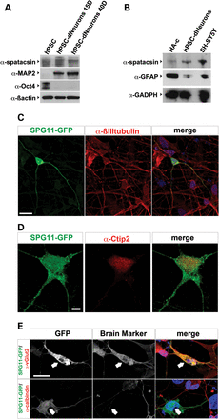
Figure 1. Characterization of spatacsin expression in human-derived neurons. (A) Blots of HUES6 (hPSC), HUES6-dNeurons ...
Notes:
Figure 1. Characterization of spatacsin expression in human-derived neurons. (A) Blots of HUES6 (hPSC), HUES6-dNeurons cultured in neuronal differentiation media for 15 (hPSC-dNeurons 15D) or 40 days (hPSC-dNeurons 40D). Blots were probed with α-spatacsin. Oct4 and MAP2 were employed as stem cell and neuronal markers, respectively. β-Actin served as loading control. (B) Blots of homogenates from human astrocytes (HA-c), HUES6-dNeurons (hPSC-dNeurons) and SH-SY5Y cells were probed with α-spatacsin, α-GFAP and α-GADPH as loading control. (C) HUES6-dNeurons cultures transfected with SPG11::GFP (SPG11-GFP, green) were labeled with α-βIII-tubulin (red) and DAPI (blue). Scale bar = 20 µm. (D) HUES6-dNeurons cultures transfected with SPG11::GFP (green) were stained with α-Citp2 (red). Scale bar = 5 µm. (E) HUES6-dNeurons transfected with SPG11::GFP (SPG11-GFP; green) colabeled with antibodies against α-vGlut2 or α-calbindin (red; arrows). Scale bar = 20 µm.
Unless provided in the caption above, the following copyright applies to the content of this slide: © The Author 2014. Published by Oxford University Press.This is an Open Access article distributed under the terms of the Creative Commons Attribution License (http://creativecommons.org/licenses/by/4.0/), which permits unrestricted reuse, distribution, and reproduction in any medium, provided the original work is properly cited.

Slide 2
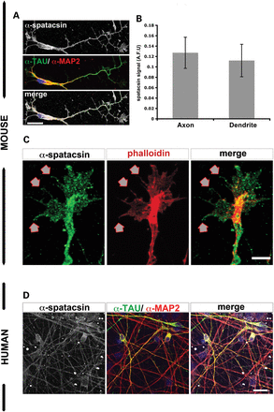
Figure 2. Spatacsin was present in the most distal tips of neurites of human pluripotent stem cell-derived neurons and ...
Notes:
Figure 2. Spatacsin was present in the most distal tips of neurites of human pluripotent stem cell-derived neurons and mouse cortical neurons. (A) Mouse cortical neurons showed spatacsin expression (gray) together with the axonal marker α-TAU (green) and the dendritic marker α-MAP2 (red). Scale bar = 20 µm. (B) Graph for spatacsin expression as arbitrary fluorescent units (AFU) in axons (TAU+ neurites) and dendrites (MAP2+ neurites) of mouse cortical neurons; data represented as mean ± SD (P > 0.05); n ≥ 50 neurons per experimental condition were evaluated. (C) Spatacsin was observed in filopodia and membrane protusions (arrows) of growth cones of mouse cortical neurons. Scale bar = 5 µm. (D) Immunofluorescence analysis of HUES6-dNeuron cultures showed α-spatacsin (gray) overlapped with α-MAP2 (red) and α-TAU (green) markers. Scale bar = 50 µm.
Unless provided in the caption above, the following copyright applies to the content of this slide: © The Author 2014. Published by Oxford University Press.This is an Open Access article distributed under the terms of the Creative Commons Attribution License (http://creativecommons.org/licenses/by/4.0/), which permits unrestricted reuse, distribution, and reproduction in any medium, provided the original work is properly cited.

Slide 3
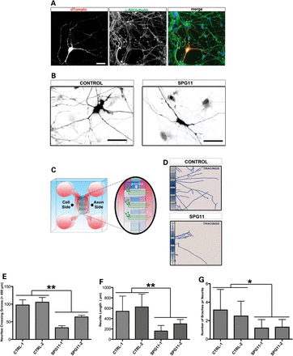
Figure 3. Significant reduction in axonal complexity of hiPSC-dNeurons from SPG11 patients. (A) Representative figure ...
Notes:
Figure 3. Significant reduction in axonal complexity of hiPSC-dNeurons from SPG11 patients. (A) Representative figure of hiPSC-dNeuron cultures transfected with pEF1-dTomato. The cells analyzed were coexpressing dTomato and the neuronal marker βIII-tubulin. Scale bar = 20 µm. (B) Neuronal cells from control and SPG11 patient, transfected with pEF1-dTomato, showing a marked decrease in neurite complexity. Scale bars = 50 µm. (C) Schematic representation of the microfluidic chamber showing the cell soma side and axonal side; inset shows the grooves in the chamber along which axons unidirectionally pass through. (D) Tracing of control and SPG11 neurites reaching the axonal side. Neurites in SPG11-dNeurons are shorter and have less branches compared with controls. (E–G) Graphs representing (E) the reduced number of neurites crossing the grooves, (F) the reduced total neurite length (µm) and (G) the reduced number of branching points in SPG11 compared with controls. Data are represented as mean ± SD (*P < 0.05 and **P ≤ 0.005); n ≥ 20 axonal processes per each cell line; two lines from CTRL-1 and CTRL-2 and two lines from SPG11-1 and SPG11-2 were employed.
Unless provided in the caption above, the following copyright applies to the content of this slide: © The Author 2014. Published by Oxford University Press.This is an Open Access article distributed under the terms of the Creative Commons Attribution License (http://creativecommons.org/licenses/by/4.0/), which permits unrestricted reuse, distribution, and reproduction in any medium, provided the original work is properly cited.

Slide 4
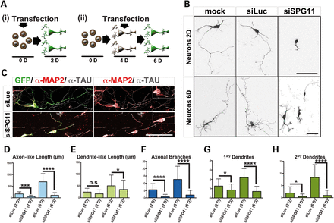
Figure 4. Knockdown of spatacsin impaired neurite outgrowth. (A) Scheme showing the two experimental strategies ...
Notes:
Figure 4. Knockdown of spatacsin impaired neurite outgrowth. (A) Scheme showing the two experimental strategies employed on mouse cortical neurons: (i) Dissociated mouse cortical neurons were transfected with siRNA together with GFP prior to seeding (Day 0) and then cultured for 2 days (Day 2). (ii) Neurons were transfected after 4 days in culture (Day 4). After transfection, cells were maintained for two additional days in culture (Day 6). (B) Photographs of mouse cortical neurons transfected with GFP (MOCK) only or together with either siLuc or siSPG11. The panel included examples of transfected neurons kept in culture for Day 2 (Neurons 2D, experiment i) and Day 6 (Neurons 6D, experiment ii). Scale bars = 50 µm. (C) Cortical neurons transfected with GFP (green) together with either siLuc or siSPG11 were colabeled with α-MAP2 (red) and α-TAU (gray). Scale bar = 50 µm. Note the abnormal MAP2-TAU overlap (insets) observed in siSPG11+ neurons in contrast to siLuc+ neurons. (D–H) Diagrams showing axonal length (D), dendrite length (E), number of branches per axon (F), number of dendrites per neuron (G) and the total number of secondary dendrites (H) in neurons transfected with siLuc or siSPG11 and cultured for Day 2 or 6. Measurements are presented as mean ± SD (*P < 0.05, ***P < 0.001 and ****P < 0.0001); n = 50–100 neurons per experimental condition.
Unless provided in the caption above, the following copyright applies to the content of this slide: © The Author 2014. Published by Oxford University Press.This is an Open Access article distributed under the terms of the Creative Commons Attribution License (http://creativecommons.org/licenses/by/4.0/), which permits unrestricted reuse, distribution, and reproduction in any medium, provided the original work is properly cited.

Slide 5
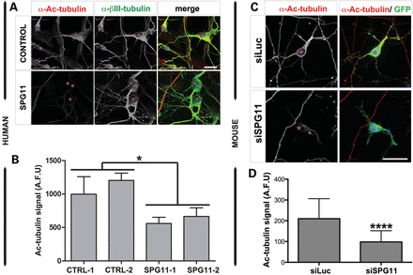
Figure 5. Reduction of acetyl-tubulin in hiPSC-dNeurons from SPG11 patients and spatacsin-silenced mouse neurons. (A) ...
Notes:
Figure 5. Reduction of acetyl-tubulin in hiPSC-dNeurons from SPG11 patients and spatacsin-silenced mouse neurons. (A) Cultures of hiPSC-dNeurons of SPG11 patients (SPG11) and healthy subjects (CONTROL) were colabeled with acetyl-tubulin (α-Ac-tubulin, red) and βIII-tubulin (α-βIII-tubulin, green). Scale bar = 10 µm. (B) Graph for acetylated tubulin signal (Ac-tubulin) in cultures of hiPSC-dNeurons of two controls (CTRL-1 and CTRL-2) and two SPG11 patients (SPG11-1 and SPG11-2). Levels of acetylated tubulin signal were significantly decreased in hiPSC-dNeurons of SPG11 patients compared with controls. Data were expressed as arbitrary fluorescent units (AFU), and represented as mean ± SD (*P < 0.05); n ≥ 100 neurons per experimental condition were evaluated. (C) Mouse cortical neurons transfected with pCMV-GFP (GFP, green) and either siLuc or siSPG11. Neurons were stained with α-acetyl-tubulin (red, α-Ac-tubulin). Scale bar = 20 µm. (D) Graph for acetylated tubulin signal (Ac-tubulin) in siLuc and siSPG11-transfected mouse cortical neurons. Levels of Ac-tubulin signal were significantly decreased following knockdown of spatacsin. Data were expressed as arbitrary fluorescent units (AFU) and represented as mean ± SD (***P < 0.001); n ≥ 50 neurons per experimental condition were evaluated.
Unless provided in the caption above, the following copyright applies to the content of this slide: © The Author 2014. Published by Oxford University Press.This is an Open Access article distributed under the terms of the Creative Commons Attribution License (http://creativecommons.org/licenses/by/4.0/), which permits unrestricted reuse, distribution, and reproduction in any medium, provided the original work is properly cited.

Slide 6
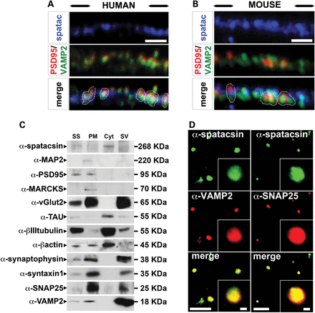
Figure 6. Characterization of spatacsin expression in synapses. (A and B) Spatacsin (blue) partially overlapped ...
Notes:
Figure 6. Characterization of spatacsin expression in synapses. (A and B) Spatacsin (blue) partially overlapped (indicated in white dotted lines) with the presynaptic marker VAMP2 (green) and the postsynaptic marker PSD95 (red) in HUES6-dNeurons (A) and in mouse cortical cultures (B). Scale bars = 1 µm. (C) Blots of samples from mouse synaptosome (SS) and the following synaptosomal factions: synaptosomal plasmatic membrane (PM), synaptosomal cytosol (Cyt) and synaptic vesicles (SV). Blots were probed with α-spatacsin, the postsynaptic markers α-PSD95 and α-MARCKS, the presynaptic markers α-SNAP25 and α-syntaxin1, the vesicle markers α-vGlut2, α-synaptophysin, and α-VAMP2; and the cytoskeleton markers α-MAP2, α-TAU, α-β-actin and a-βIII-tubulin. Spatacsin was predominantly in the Cyt fraction. (D) Purified mouse synaptosomes probed with α-spatacsin (green) together with either α-VAMP2 or α-SNAP25 (red). Scale bars = 40 and 1 µm in overviews and insets, respectively.
Unless provided in the caption above, the following copyright applies to the content of this slide: © The Author 2014. Published by Oxford University Press.This is an Open Access article distributed under the terms of the Creative Commons Attribution License (http://creativecommons.org/licenses/by/4.0/), which permits unrestricted reuse, distribution, and reproduction in any medium, provided the original work is properly cited.

Slide 7
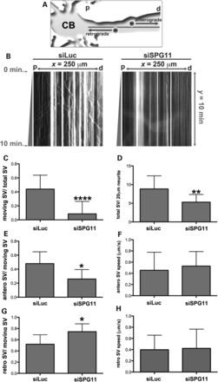
Figure 7. Knockdown of spatacsin disrupts SV transport. (A) Illustration of time-lapse monitoring of SV transport. SVs ...
Notes:
Figure 7. Knockdown of spatacsin disrupts SV transport. (A) Illustration of time-lapse monitoring of SV transport. SVs were visualized in neurons by expressing synaptophysin-mCherry. The neuronal cell body (CB) was used as a reference to regionalize proximal (p) and distal (d) neurite regions, and thereby distinguish the directions of anterograde and retrograde transports. (B) Kymographs representing SV transport in neurites transfected with synaptophysin-mCherry together with siLuc or siSPG11. The x-axis represents the neurite length (x = 250 µm) from proximal (p) to distal (d) areas. The y-axis indicates time-lapse duration in min (y = 10 min). Vertical lines exemplified stationary SVs (x < 5 µm), trajectories with × ≥ 5 µm considered moving SVs. Movements toward ‘p’ or ‘d’ revealed retrograde or anterograde transport, respectively. (C–H) Graphs indicate a significant decrease in the number of moving SVs and the average SV speed. All data were represented as mean ± SD; n ≥ 20 axons per experimental condition. (C) The ratio of total moving SVs in relation to the total number of SVs (****P < 0.0001). (D) The ratio of total SVs (total SV) per each 20 µm of neurite (**P ≤ 0.005). (E) The ratio between SVs moving anterogradely (antero SV) in relation to the total number of moving SVs (*P 0.05). (G) The ratio between SVs moving retrogradely (retro SV) in relation to the total number of moving SVs (*P 0.05).
Unless provided in the caption above, the following copyright applies to the content of this slide: © The Author 2014. Published by Oxford University Press.This is an Open Access article distributed under the terms of the Creative Commons Attribution License (http://creativecommons.org/licenses/by/4.0/), which permits unrestricted reuse, distribution, and reproduction in any medium, provided the original work is properly cited.

Slide 8
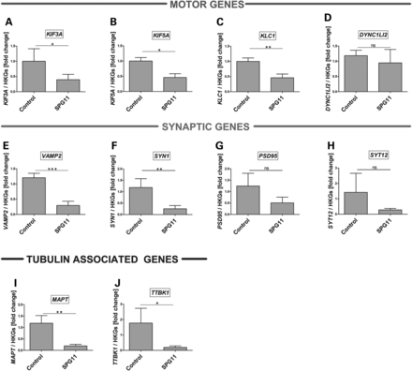
Figure 8. Expression analysis of transport-related genes in hiPSCs-derived neurons. RT-PCR analysis of genes in SPG11 ...
Notes:
Figure 8. Expression analysis of transport-related genes in hiPSCs-derived neurons. RT-PCR analysis of genes in SPG11 patient-derived neurons revealed a significant reduction in the mRNA expression of kinesin-related genes, KIF3A (A), KIF5A (B) and KLC1 (C), but no difference in the expression level of DYNC1LI2 (D) compared with control. Similarly, expression of synaptic genes, VAMP2 (E), SYN1 (F), but not postsynaptic density protein 95 (PSD95) (G) and synaptotagmin 12 (SYT12) (H) are strongly reduced in patient neurons. A strong downregulation of the cytoskeletal tubulin-associated genes, MAPTAU (I) and TAU tubulin kinase 1 (TTBK1) (J) further suggested dysregulation of transport activity in the patient neurons. Plotted are means of each line performed in triplicates, from two independent experiments. Data shown as mean ± SD. mRNA levels were normalized against two housekeeping genes (HKGs = GAPDH and β2M).
Unless provided in the caption above, the following copyright applies to the content of this slide: © The Author 2014. Published by Oxford University Press.This is an Open Access article distributed under the terms of the Creative Commons Attribution License (http://creativecommons.org/licenses/by/4.0/), which permits unrestricted reuse, distribution, and reproduction in any medium, provided the original work is properly cited.

Slide 9
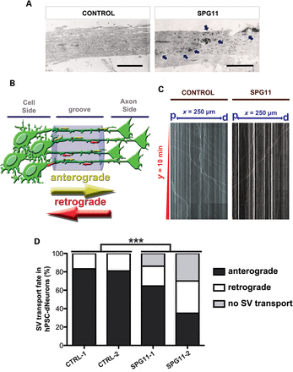
Figure 9. Human neurons derived from SPG11 iPSCs accumulate membrane-like deposits within neurites and compromise ...
Notes:
Figure 9. Human neurons derived from SPG11 iPSCs accumulate membrane-like deposits within neurites and compromise anterograde transport of SVs. (A) Ultrastructural analysis of the axonal processes of hiPSC-dNeurons from control (CTRL-1) and SPG11 patient (SPG11-1). Arrows indicate the presence of membranous inclusions in SPG11 neurons. Scale bars = 2 µm. (B) Illustration of time-lapse monitoring for SV transport in synaptophysin-mCherry+ hiPSC-dNeurons grown in microfluidic chambers. SVs mowing towards either the axon or the cell side were considered as anterograde and retrograde transports, respectively. (C) Kymographs representing SV transport in synaptophysin-mCherry+ axonal processes of neurons derived from controls (CONTROL) and SPG11 (SPG11) hiPSCs . The x-axis represents the distance (x = 250 µm) between cell side (p) and axon (d) sides. The y-axis indicates time-lapse duration in min (y = 10 min). Vertical lines exemplified stationary SVs (x < 5 µm), trajectories with x ≥ 5 µm were considered moving SVs. Movements toward ‘p’ or ‘d’ revealed retrograde or anterograde transport, respectively. (D) Graphs indicated a significant difference in the transport fate of SPG11 neurons (SPG11-1 and SPG11-2) in comparison to controls (CTRL-1 and CTRL-2). All data were represented as mean ± SD; ***P < 0.005; n ≥ 20 axons per experimental condition.
Unless provided in the caption above, the following copyright applies to the content of this slide: © The Author 2014. Published by Oxford University Press.This is an Open Access article distributed under the terms of the Creative Commons Attribution License (http://creativecommons.org/licenses/by/4.0/), which permits unrestricted reuse, distribution, and reproduction in any medium, provided the original work is properly cited.

