Slide 1
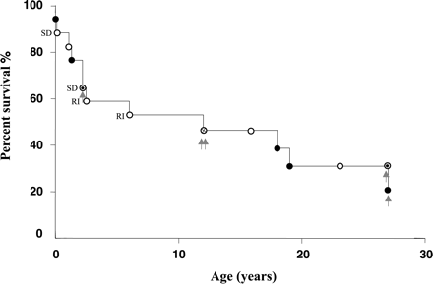
Fig. 1 The overall survival curve for children with mitochondrial disease and cardiomyopathy. Closed and open ...
Notes:
Fig. 1 The overall survival curve for children with mitochondrial disease and cardiomyopathy. Closed and open circles represent patients with and without heart failure, respectively. Circles with dots represent one patient each with and without heart failure. The circle with a cross represents one patient who underwent heart transplantation due to heart failure and one patient without heart failure. The arrows represent possible candidates for heart transplantation. SD, sudden death; RI, respiratory insufficiency.
Unless provided in the caption above, the following copyright applies to the content of this slide: The European Society of Cardiology

Slide 2
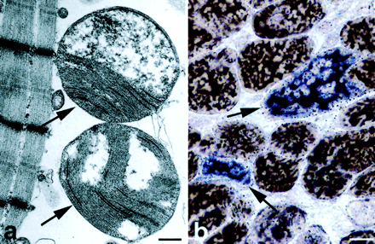
Fig. 2 (a) Ultrastructural investigation of cardiomyocytes from an explanted heart in patient no. 11 reveals ...
Notes:
Fig. 2 (a) Ultrastructural investigation of cardiomyocytes from an explanted heart in patient no. 11 reveals enlarged mitochondria (arrows) with an abnormal arrangement of cristae. Bar=1/2μm (b) Enzyme–histochemical investigation of endomyocardial biopsy of patient no. 17 reveals focal cytochrome-c oxidase deficiency (blue cells, arrows). The section was double stained for cytochrome-c oxidase and succinate dehydrogenase. Cells with cytochrome-c oxidase deficiency are blue and normal cells are brown. Bar=10μm.
Unless provided in the caption above, the following copyright applies to the content of this slide: The European Society of Cardiology

