Slide 1
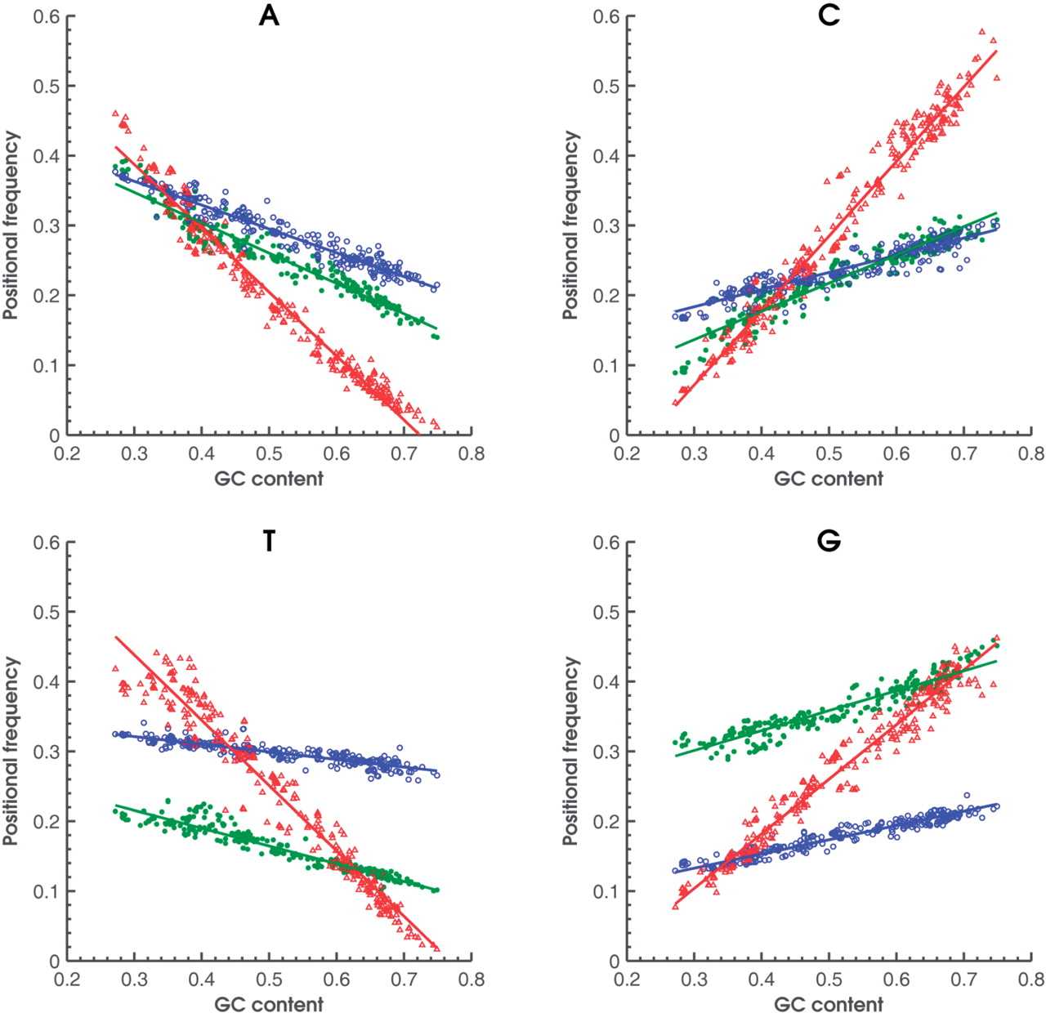
Figure 1. Observed frequencies of 4 nt in the three codon positions (first: green; second: blue; third: red) as ...
Notes:
Figure 1. Observed frequencies of 4 nt in the three codon positions (first: green; second: blue; third: red) as functions of genome GC content for 319 bacterial genomes. Nucleotides G and T have more contrast in frequencies in the first and second position in comparison with A and C. Frequencies in the third codon position are most sensitive to genome GC content.
Unless provided in the caption above, the following copyright applies to the content of this slide: © The Author(s) 2010. Published by Oxford University Press.This is an Open Access article distributed under the terms of the Creative Commons Attribution Non-Commercial License (http://creativecommons.org/licenses/by-nc/2.5), which permits unrestricted non-commercial use, distribution, and reproduction in any medium, provided the original work is properly cited.

Slide 2
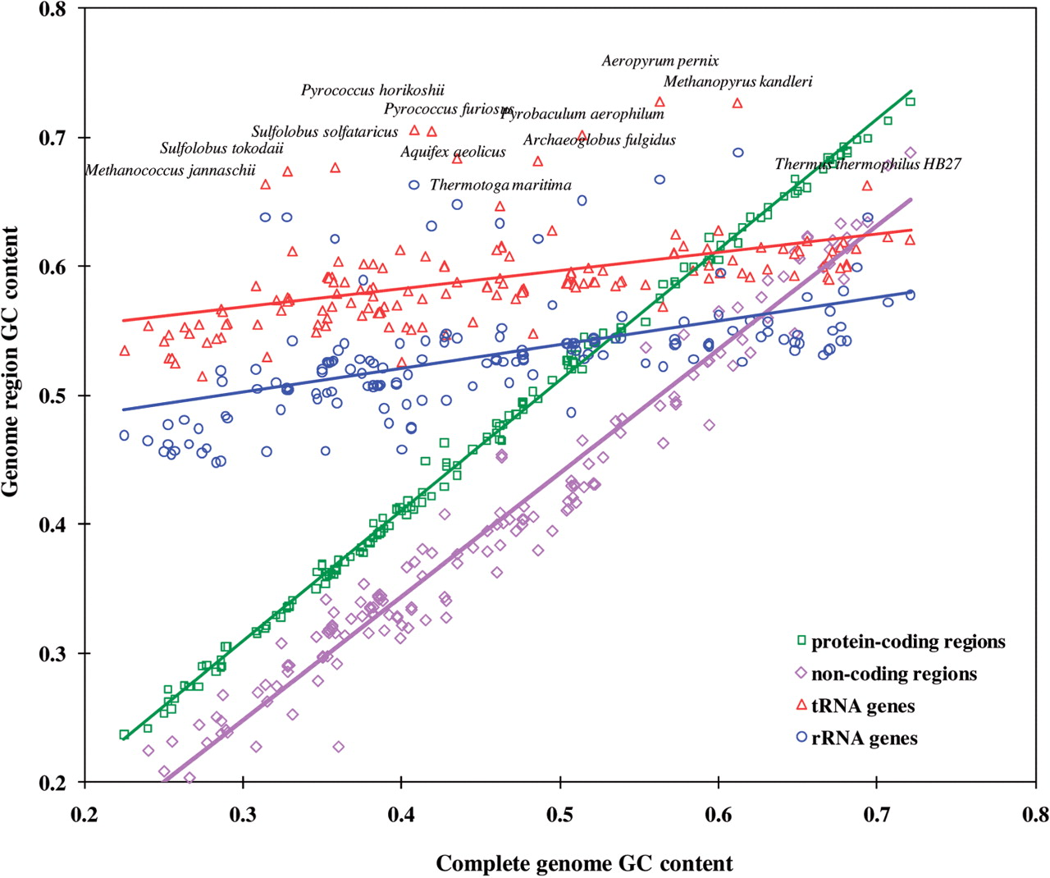
Figure 2. Dependence of GC content of genomic functional regions on genome-wide GC content. Protein-coding and ...
Notes:
Figure 2. Dependence of GC content of genomic functional regions on genome-wide GC content. Protein-coding and non-coding regions were identified by GeneMarkS in randomly selected 155 bacterial and 16 archaeal genomes; tRNA genes by tRNAScan-SE, while rRNA genes were selected as annotated in RefSeq. Triangles and circles with species names indicate GC content of tRNA and rRNA genes of archaeal thermophiles.
Unless provided in the caption above, the following copyright applies to the content of this slide: © The Author(s) 2010. Published by Oxford University Press.This is an Open Access article distributed under the terms of the Creative Commons Attribution Non-Commercial License (http://creativecommons.org/licenses/by-nc/2.5), which permits unrestricted non-commercial use, distribution, and reproduction in any medium, provided the original work is properly cited.

Slide 3
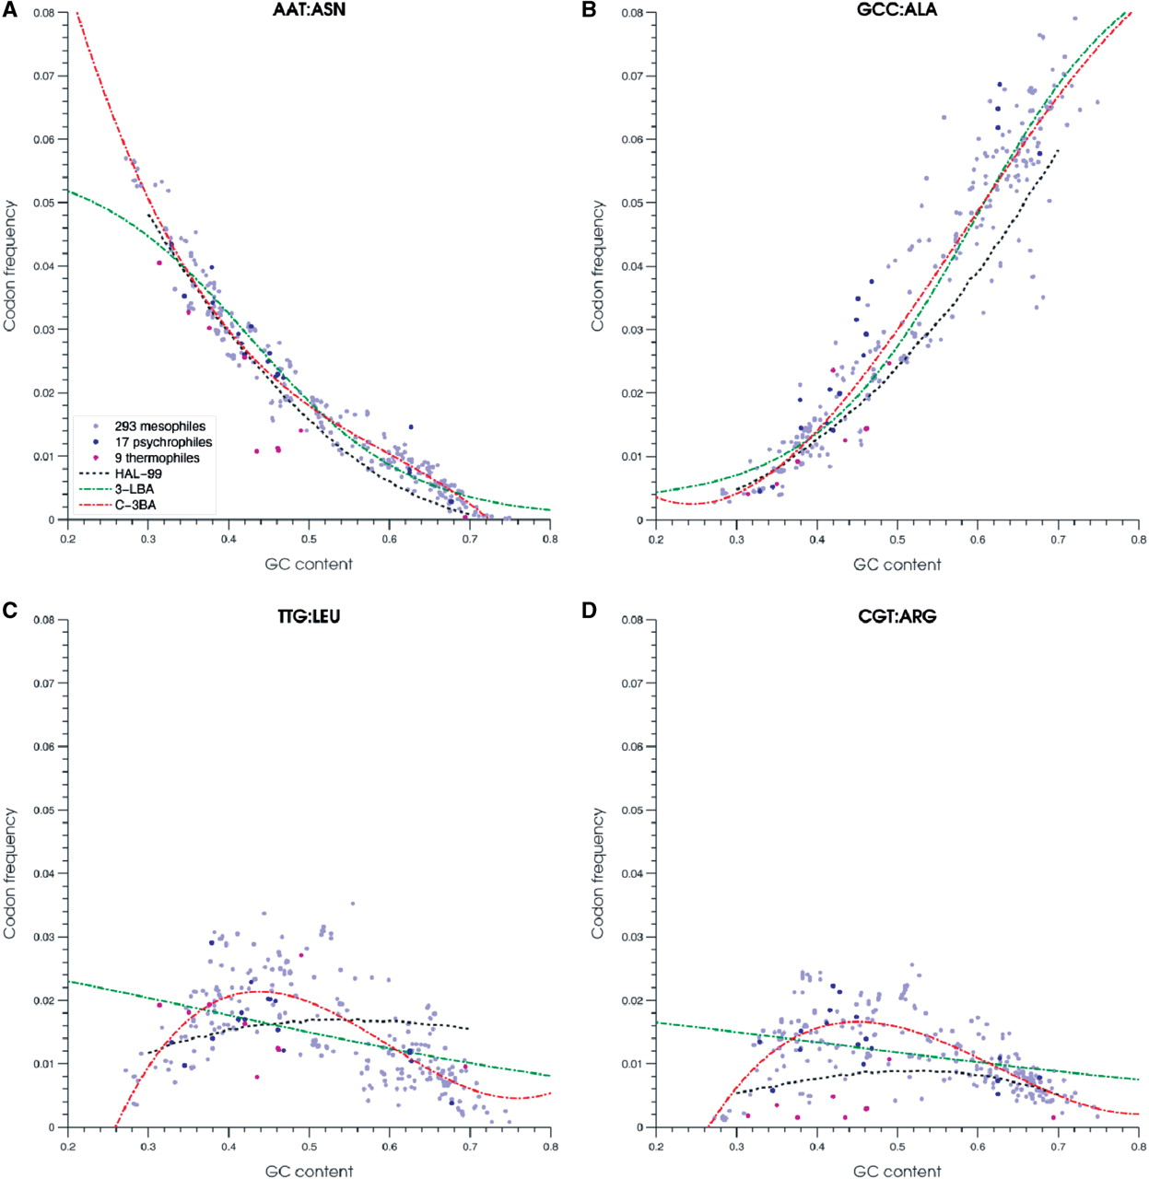
Figure 3. Characteristic cases of codon frequency dependence on genome GC content. Each panel shows observed ...
Notes:
Figure 3. Characteristic cases of codon frequency dependence on genome GC content. Each panel shows observed frequencies of a given codon in 319 bacterial genomes. Mesophilic, psychrophilic and thermophilic species are shown as light blue, dark blue and purple dots, respectively. Three techniques of approximating dependence of codon frequency from genome GC content are illustrated: 1999 heuristic model (HAL-99, black dotted line); logistic regression (3-L, green dotted line); and order three polynomial regression (C-3, red dotted line). Plots for 61 codons are available at http://exon.gatech.edu/GeneMark/metagenome/Training/PlotPDF/BAC2D.pdf .
Unless provided in the caption above, the following copyright applies to the content of this slide: © The Author(s) 2010. Published by Oxford University Press.This is an Open Access article distributed under the terms of the Creative Commons Attribution Non-Commercial License (http://creativecommons.org/licenses/by-nc/2.5), which permits unrestricted non-commercial use, distribution, and reproduction in any medium, provided the original work is properly cited.

Slide 4
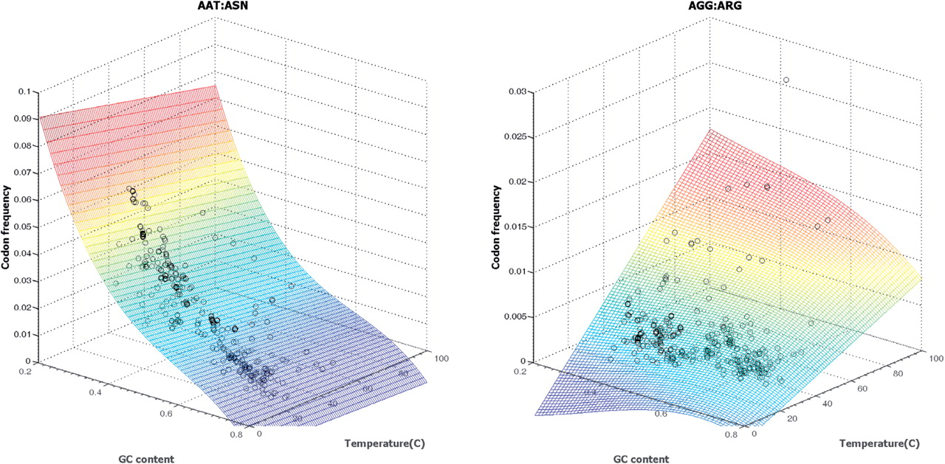
Figure 4. Result of multiple regression polynomial fitting of codon frequency as a function of both genomic GC content ...
Notes:
Figure 4. Result of multiple regression polynomial fitting of codon frequency as a function of both genomic GC content and optimal growth temperature. Note that the scales in Z -axes are not the same. Frequency of AAT mostly depends on genomic GC content, adding one more predictor variable explained just additional 1% variance (R 2 value increased from 96% to 97%). Frequency of AGG largely depends on the optimal growth temperature; 30% of variance was explained by the temperature predictor. (R 2 value increased to 31% from 1%.) The surface plot indicates a codon frequency change by color, from low (blue) to high (red). Plots for all 61 codons are available at http://exon.gatech.edu/GeneMark/metagenome/Training/PlotPDF/BAC3Dmulti.pdf .
Unless provided in the caption above, the following copyright applies to the content of this slide: © The Author(s) 2010. Published by Oxford University Press.This is an Open Access article distributed under the terms of the Creative Commons Attribution Non-Commercial License (http://creativecommons.org/licenses/by-nc/2.5), which permits unrestricted non-commercial use, distribution, and reproduction in any medium, provided the original work is properly cited.

Slide 5
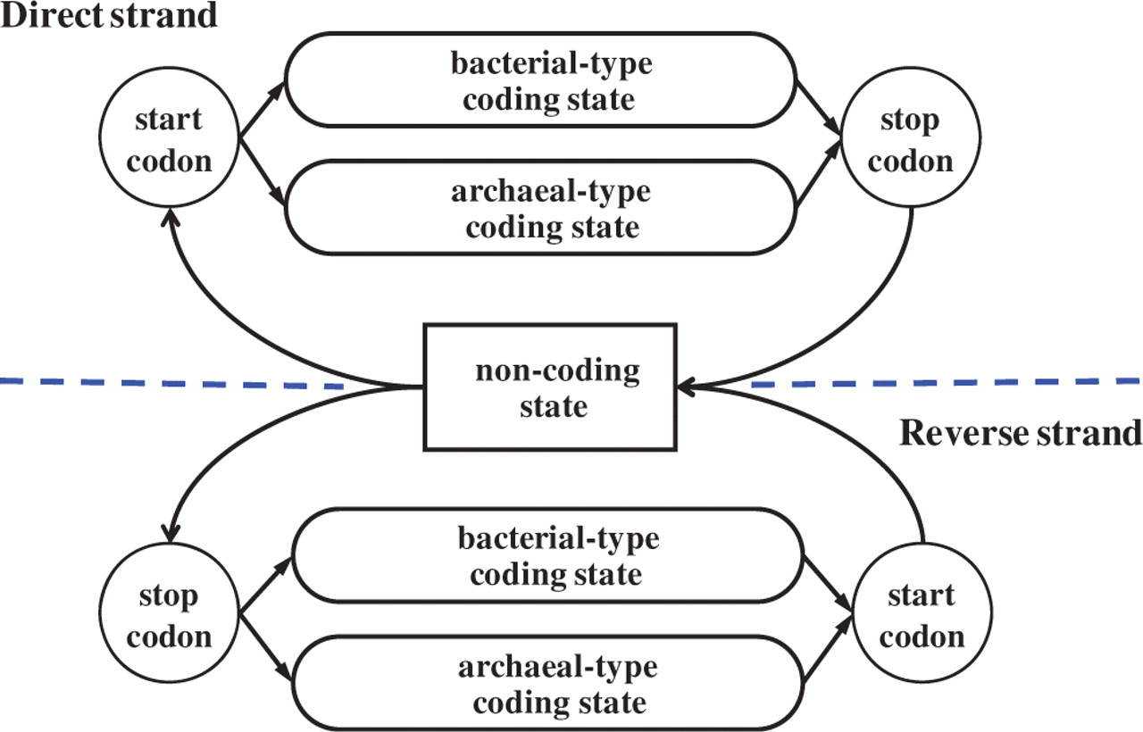
Figure 5. Hidden states diagram of the generalized hidden Markov model (HMM) used in the GeneMark.hmm algorithm; this ...
Notes:
Figure 5. Hidden states diagram of the generalized hidden Markov model (HMM) used in the GeneMark.hmm algorithm; this is the case of using bacterial and archaeal model pair (a similar diagram would be valid for use of mesophilic and thermophilic model pair).
Unless provided in the caption above, the following copyright applies to the content of this slide: © The Author(s) 2010. Published by Oxford University Press.This is an Open Access article distributed under the terms of the Creative Commons Attribution Non-Commercial License (http://creativecommons.org/licenses/by-nc/2.5), which permits unrestricted non-commercial use, distribution, and reproduction in any medium, provided the original work is properly cited.

Slide 6
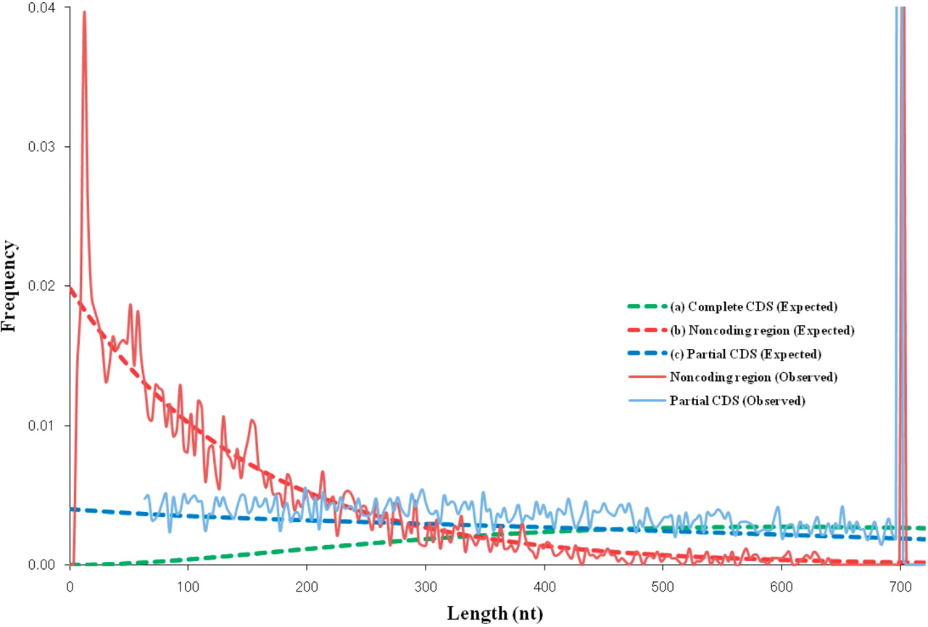
Figure 6. Length distributions of coding and non-coding regions observed and expected in 700-nt long fragments of E. ...
Notes:
Figure 6. Length distributions of coding and non-coding regions observed and expected in 700-nt long fragments of E. coli K12 genome. An average E. coli gene length is about 900 nt. Therefore, some of the 700-nt fragments are 100% coding, hence the peak of frequency of partial CDS length (light blue) at 700-nt point. Similarly, the frequency of length of non-coding region has two peaks at 15 and 700 nt. ( a ) Complete CDS length distribution is approximated by function g ( d ) = N c ( d / d c ) 2 exp(− d / d c ), d c = 300; ( b ) Non-coding region length distribution is approximated by function f ( d )= N n exp(− d / d n ), d n = 150; ( c ) Partial CDS length distribution is approximated by function p ( d ) = N p ( p ( d ) = N p ( d 2 + d c d +2 d2c )exp(− d / d c ), d c = 300.
Unless provided in the caption above, the following copyright applies to the content of this slide: © The Author(s) 2010. Published by Oxford University Press.This is an Open Access article distributed under the terms of the Creative Commons Attribution Non-Commercial License (http://creativecommons.org/licenses/by-nc/2.5), which permits unrestricted non-commercial use, distribution, and reproduction in any medium, provided the original work is properly cited.

Slide 7
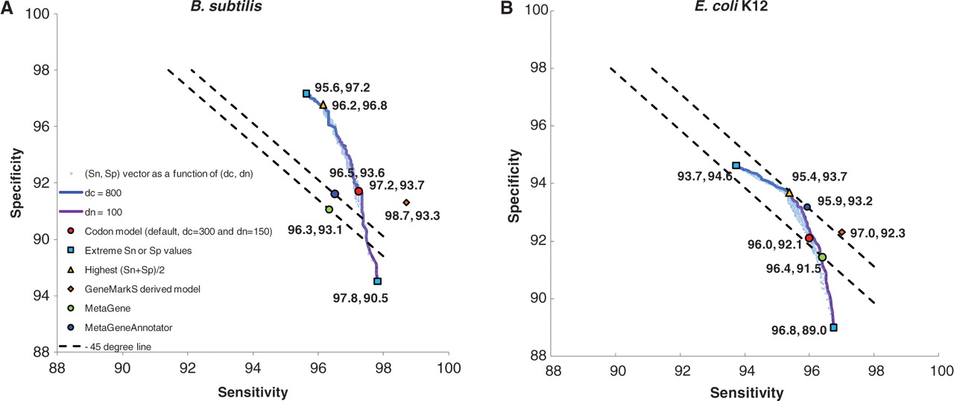
Figure 7. Values of Sn and Sp obtained upon variations of parameters d _{n} and d _{c} . Light blue ...
Notes:
Figure 7. Values of Sn and Sp obtained upon variations of parameters d n and d c . Light blue dots represent Sn and Sp values obtained for each of 1491 combinations of ( d n , d c ) parameters. Blue and purple lines correspond to variation of d n with d c = 800 and variation of d c with d n = 100, respectively. Red dots correspond to ( d n , d c ) setting (150, 300) that is used by default for complete genomes. Also shown are the highest Sn and the highest Sp (blue squares), the highest ( Sn + Sp )/2 (yellow triangles). Use of pair of models, the native model (derived by the GeneMarkS from a complete genome) and the heuristic model HAL-99, produced the Sn and Sp values shown by orange diamonds. The Sn and Sp of the MetaGene and MetaGeneAnnotator predictions are shown by green and blue dots, respectively.
Unless provided in the caption above, the following copyright applies to the content of this slide: © The Author(s) 2010. Published by Oxford University Press.This is an Open Access article distributed under the terms of the Creative Commons Attribution Non-Commercial License (http://creativecommons.org/licenses/by-nc/2.5), which permits unrestricted non-commercial use, distribution, and reproduction in any medium, provided the original work is properly cited.

Slide 8
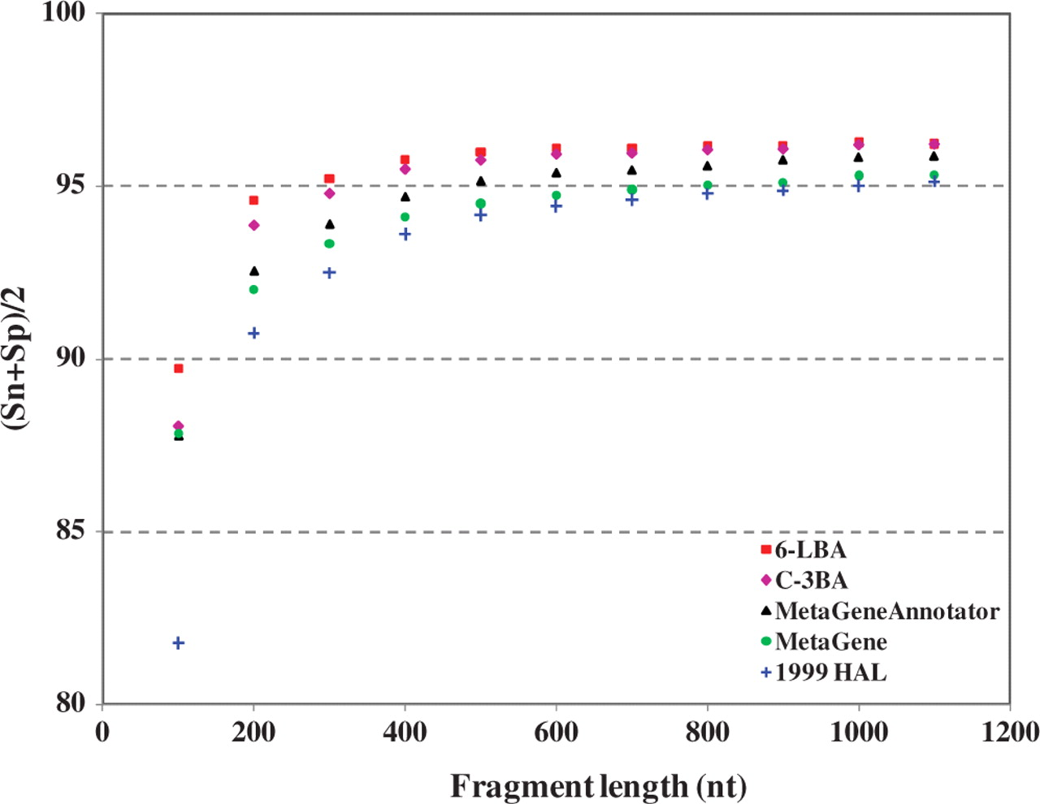
Figure 8. Gene prediction accuracy of GeneMark.hmm with three different heuristic models, as well as MetaGene and ...
Notes:
Figure 8. Gene prediction accuracy of GeneMark.hmm with three different heuristic models, as well as MetaGene and MetaGeneAnnotator observed on the sets of sequence fragments with length from 100 to 1100 nt from 50 microbial chromosomes.
Unless provided in the caption above, the following copyright applies to the content of this slide: © The Author(s) 2010. Published by Oxford University Press.This is an Open Access article distributed under the terms of the Creative Commons Attribution Non-Commercial License (http://creativecommons.org/licenses/by-nc/2.5), which permits unrestricted non-commercial use, distribution, and reproduction in any medium, provided the original work is properly cited.

Slide 9
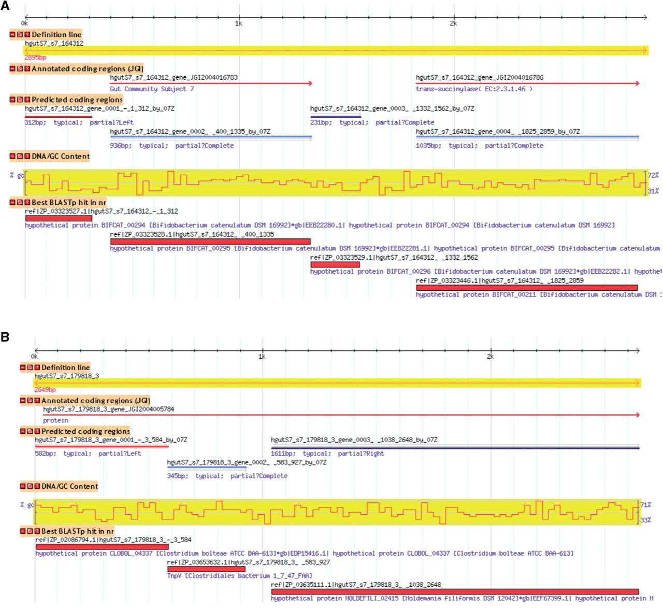
Figure 9. Genome Browser view for two sequences from Subject 7 human microbiome. The C-3BA model was used to predict ...
Notes:
Figure 9. Genome Browser view for two sequences from Subject 7 human microbiome. The C-3BA model was used to predict coding regions. ( a ) The first and third genes shown in panel ‘Predicted coding regions’ were not previously annotated. Protein products of both predicted genes have sequence similarity to proteins in the nr database with E -value of 8e-44 and 2e-35, respectively. ( b ) In a 2649-nt microbiome sequence, a single partial gene was annotated in positive strand in frame +3, starting from nucleotide position 39. New to annotation, three genes were predicted in frames −3, +1 and +3, respectively. Sequences analyzed can be found in Microbiome DB: http://exon.gatech.edu/cgi-bin/gbrowse/microbiome_human_sub7/?name=hgutS7_s7_164312 ; http://exon.gatech.edu/cgi-bin/gbrowse/microbiome_human_sub7/?name=hgutS7_s7_179818_3 .
Unless provided in the caption above, the following copyright applies to the content of this slide: © The Author(s) 2010. Published by Oxford University Press.This is an Open Access article distributed under the terms of the Creative Commons Attribution Non-Commercial License (http://creativecommons.org/licenses/by-nc/2.5), which permits unrestricted non-commercial use, distribution, and reproduction in any medium, provided the original work is properly cited.

