Slide 1
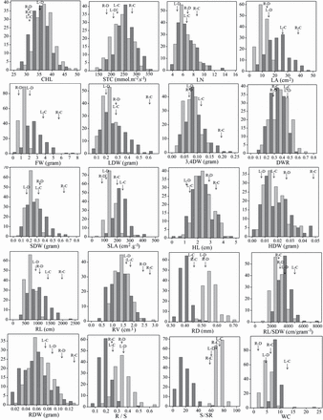
Fig. 1. Frequency distributions of the non-normalized trait values for the L58 × R-o-18 recombinant inbred line ...
Notes:
Fig. 1. Frequency distributions of the non-normalized trait values for the L58 × R-o-18 recombinant inbred line population under control (C) (dark grey), and drought (D) (light grey) conditions. Vertical axes indicate the number of lines per trait value class, and horizontal axes indicate the different trait value classes. L, L58; R, R-o-18. Trait abbreviations are given with Table 1.
Unless provided in the caption above, the following copyright applies to the content of this slide: © The Author 2014. Published by Oxford University Press on behalf of the Society for Experimental Biology.This is an Open Access article distributed under the terms of the Creative Commons Attribution License (http://creativecommons.org/licenses/by/3.0/), which permits unrestricted reuse, distribution, and reproduction in any medium, provided the original work is properly cited.

Slide 2
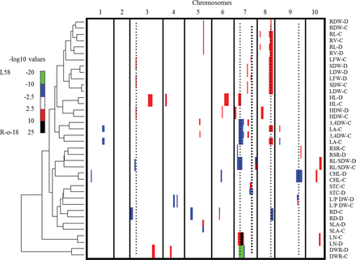
Fig. 2. A clustered heat map showing the –log10P profiles of the measured traits. Columns indicate the 10 chromosomes ...
Notes:
Fig. 2. A clustered heat map showing the –log10P profiles of the measured traits. Columns indicate the 10 chromosomes in centiMorgans, ascending from left to right; rows indicate individual trait –log10P profiles. A colour scale is used to indicate the QTL significance corresponding to the –log10P score: red and black represent a positive effect on the trait value from the R-o-18 allele; blue and green represent a positive effect on the trait value from the L58 allele. Bar width indicates the significance interval of the QTL. Hierarchical clustering, shown on the left, reflects the correlation between traits based on the QTL profiles. Right dotted line of heavier weight in A7 indicates the QTL with an antagonistic fitness effect; the other five dotted lines refer to QTLs confirmed in the reproducibility experiment. C and D refer to control and drought environments, respectively. Trait abbreviations are given with Table 1.
Unless provided in the caption above, the following copyright applies to the content of this slide: © The Author 2014. Published by Oxford University Press on behalf of the Society for Experimental Biology.This is an Open Access article distributed under the terms of the Creative Commons Attribution License (http://creativecommons.org/licenses/by/3.0/), which permits unrestricted reuse, distribution, and reproduction in any medium, provided the original work is properly cited.

