Slide 1
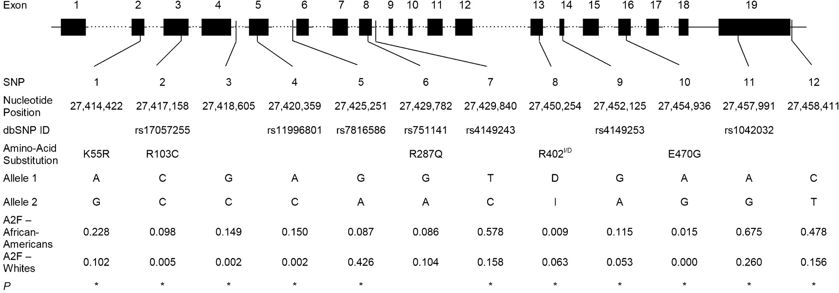
Figure 1. Gene location and minor allele frequency (in CRS only) of 12 genotyped polymorphisms in the EPHX2 ...
Notes:
Figure 1. Gene location and minor allele frequency (in CRS only) of 12 genotyped polymorphisms in the EPHX2 gene by race. Exons are indicated by boxes and are numbered. Polymorphism position is given relative to the NCBI35 chromosome 8 sequence. Non-synonymous substitutions are shown. I/D corresponds to the presence or absence of three nucleotides (TCG) at positions 27, 450 and 254 resulting in the insertion of an arginine residue at position 402 of the enzyme. A2F: frequency of allele 2. *P<0.05 for difference in genotype distributions between the two races.
Unless provided in the caption above, the following copyright applies to the content of this slide: © The Author 2005. Published by Oxford University Press. All rights reserved. The online version of this article has been published under an open access model. Users are entitled to use, reproduce, disseminate, or display the open access version of this article for non-commercial purposes provided that: the original authorship is properly and fully attributed; the Journal and Oxford University Press are attributed as the original place of publication with the correct citation details given; if an article is subsequently reproduced or disseminated not in its entirety but only in part or as a derivative work this must be clearly indicated. For commercial re-use, please contact: journals.permissions@oupjournals.org

Slide 2
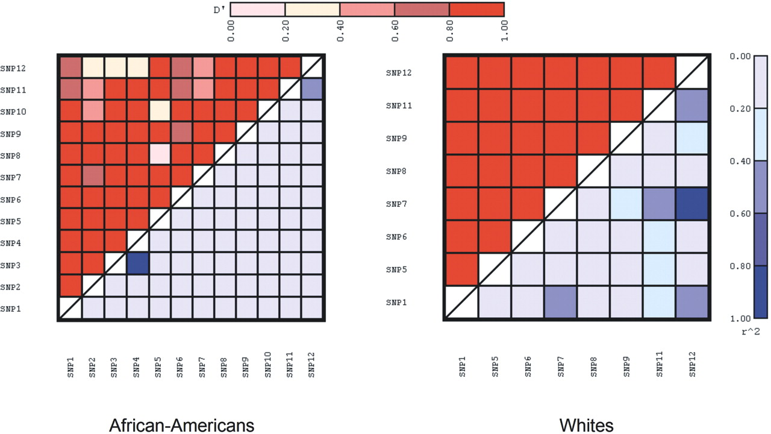
Figure 2. Pairwise estimates of LD by race (left panel, African-Americans and right panel, Whites). D′ is ...
Notes:
Figure 2. Pairwise estimates of LD by race (left panel, African-Americans and right panel, Whites). D′ is shown in the upper diagonal and r2 in the lower diagonal. SNP2, SNP3, SNP4, and SNP10 (E470G) were not included in Whites.
Unless provided in the caption above, the following copyright applies to the content of this slide: © The Author 2005. Published by Oxford University Press. All rights reserved. The online version of this article has been published under an open access model. Users are entitled to use, reproduce, disseminate, or display the open access version of this article for non-commercial purposes provided that: the original authorship is properly and fully attributed; the Journal and Oxford University Press are attributed as the original place of publication with the correct citation details given; if an article is subsequently reproduced or disseminated not in its entirety but only in part or as a derivative work this must be clearly indicated. For commercial re-use, please contact: journals.permissions@oupjournals.org

