Slide 1
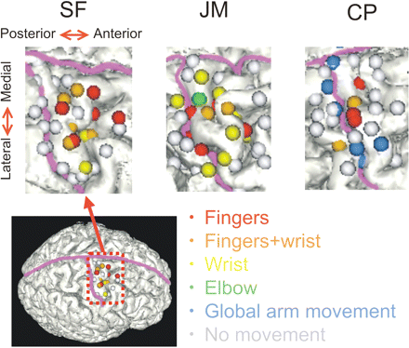
Fig. 1 Sensations of movement in the phantom limb evoked at different stimulation sites. The inter-hemispheric ...
Notes:
Fig. 1 Sensations of movement in the phantom limb evoked at different stimulation sites. The inter-hemispheric fissure and the central sulcus are traced in purple. This shows that stimulation sites evoking movement perceptions are concentrated on the anterior part of the central sulcus, that is, over the primary motor cortex. TMS evoked sensations of movement at numerous phantom joints and, significantly, even at joints for which voluntary movement was impossible Note that the image of CP's brain (right arm amputee) has been flipped for comparison with the other subjects (left arm amputees). Different colours represent movements of different phantom joints.
Unless provided in the caption above, the following copyright applies to the content of this slide: © The Author (2006). Published by Oxford University Press on behalf of the Guarantors of Brain. All rights reserved. For Permissions, please email: journals.permissions@oxfordjournals.org

Slide 2
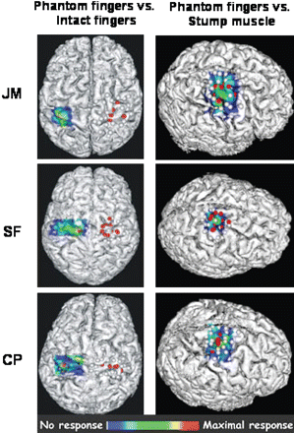
Fig. 2 Functional topography of phantom sensations. On the left panel, the map of stimulation sites evoking ...
Notes:
Fig. 2 Functional topography of phantom sensations. On the left panel, the map of stimulation sites evoking sensations of movement in the phantom digits is compared with the cortical map of a finger muscle (flexor digitorum superficialis) on the intact side. For the map of evoked phantom movements, red dots indicate stimulation sites from which finger phantom movement perceptions were evoked, while white dots indicate stimulation sites at which no phantom movement perceptions were evoked. Colour scale maps of intact side muscles interpolated from the mean peak-to-peak amplitude of the MEPs at each stimulation site (six stimulations/site); red indicates the maximal response intensity [corresponding respectively to 0.66 mV (JM), 1.11 mV (SF) and 0.38 mV (CP)] and dark blue, no response. Note that there is no interpolation for the phantom movement maps since this variable is dichotomous (movement or no movement). On the right panel maps of stimulation sites evoking sensations of movement in the phantom digits are superimposed on the stump muscle maps (JM and SF: biceps, CP: deltoid; maximal MEP intensity of 0.48, 1.19 and 0.22 mV, respectively). Note that the image of CP's brain (right arm amputee) has been flipped for comparison with the other subjects (left arm amputees).
Unless provided in the caption above, the following copyright applies to the content of this slide: © The Author (2006). Published by Oxford University Press on behalf of the Guarantors of Brain. All rights reserved. For Permissions, please email: journals.permissions@oxfordjournals.org

Slide 3
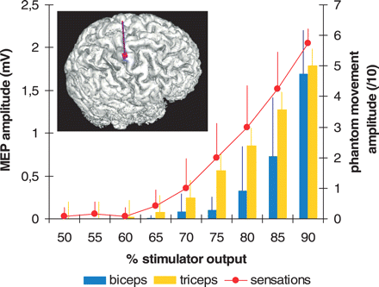
Fig. 3 Effect of the stimulation intensity on the perceived amplitude of phantom finger movements. When a given ...
Notes:
Fig. 3 Effect of the stimulation intensity on the perceived amplitude of phantom finger movements. When a given cortical site (in the presumed hand region of the motor cortex, indicated by the purple arrow) was repeatedly stimulated at different intensities, the perceived amplitude of movement increased accordingly, but the type of movement was unchanged (here a flexion of the fourth and fifth fingers). The close association between MEP amplitude and perceived amplitude of movement experienced during TMS might suggest that the sensation of phantom movement is solely determined by the afferent feedback from stump muscle. However, it is important to note that at different stimulation intensities the co-contraction level between biceps and triceps varied, but this did not alter the type of movement reported, which might have been expected if movement perception was being solely derived from afferent feedback. The mean (and standard deviation) are in millivolts for biceps and triceps MEPs. The perceived movement amplitude (and standard deviation) is reported on a numeric scale [0 (no movement) to 10 (maximal range of motion with intact limb)].
Unless provided in the caption above, the following copyright applies to the content of this slide: © The Author (2006). Published by Oxford University Press on behalf of the Guarantors of Brain. All rights reserved. For Permissions, please email: journals.permissions@oxfordjournals.org

