Slide 1
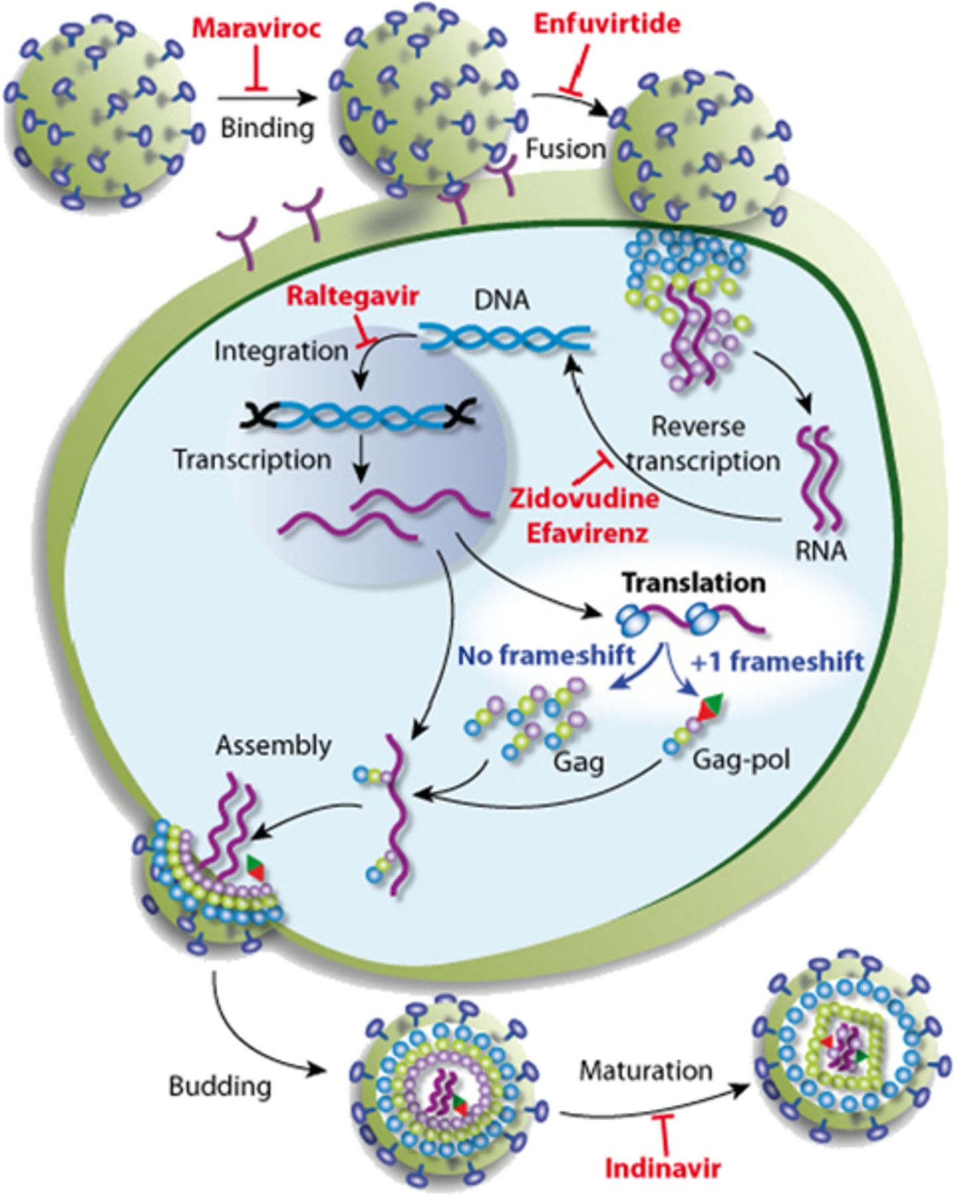
3 Schematic diagram of the virus infection cycle. One example of the drugs in common use is indicated at each ...
Notes:
3 Schematic diagram of the virus infection cycle. One example of the drugs in common use is indicated at each step of the virus cycle. Maraviroc is an entry inhibitor blocking the interaction between the virus and the chemokine receptor CCR5 on host cells. Enfuvirtide blocks fusion by binding to the gp41 subunit of the viral envelope glycoprotein, thereby preventing the conformational changes required for the fusion of viral and cellular membranes. Zidovudine and efavirenz belong to two different classes of reverse transcriptase inhibitors. Raltegravir is an integrase inhibitor. Indinavir inhibits maturation by blocking HIV-1 proteases. This simplified view highlights the lack of drugs targeting the translational step of the virus cycle.
Unless provided in the caption above, the following copyright applies to the content of this slide: © 2010 Federation of European Microbiological Societies. Published by Blackwell Publishing Ltd. All rights reserved

Slide 2
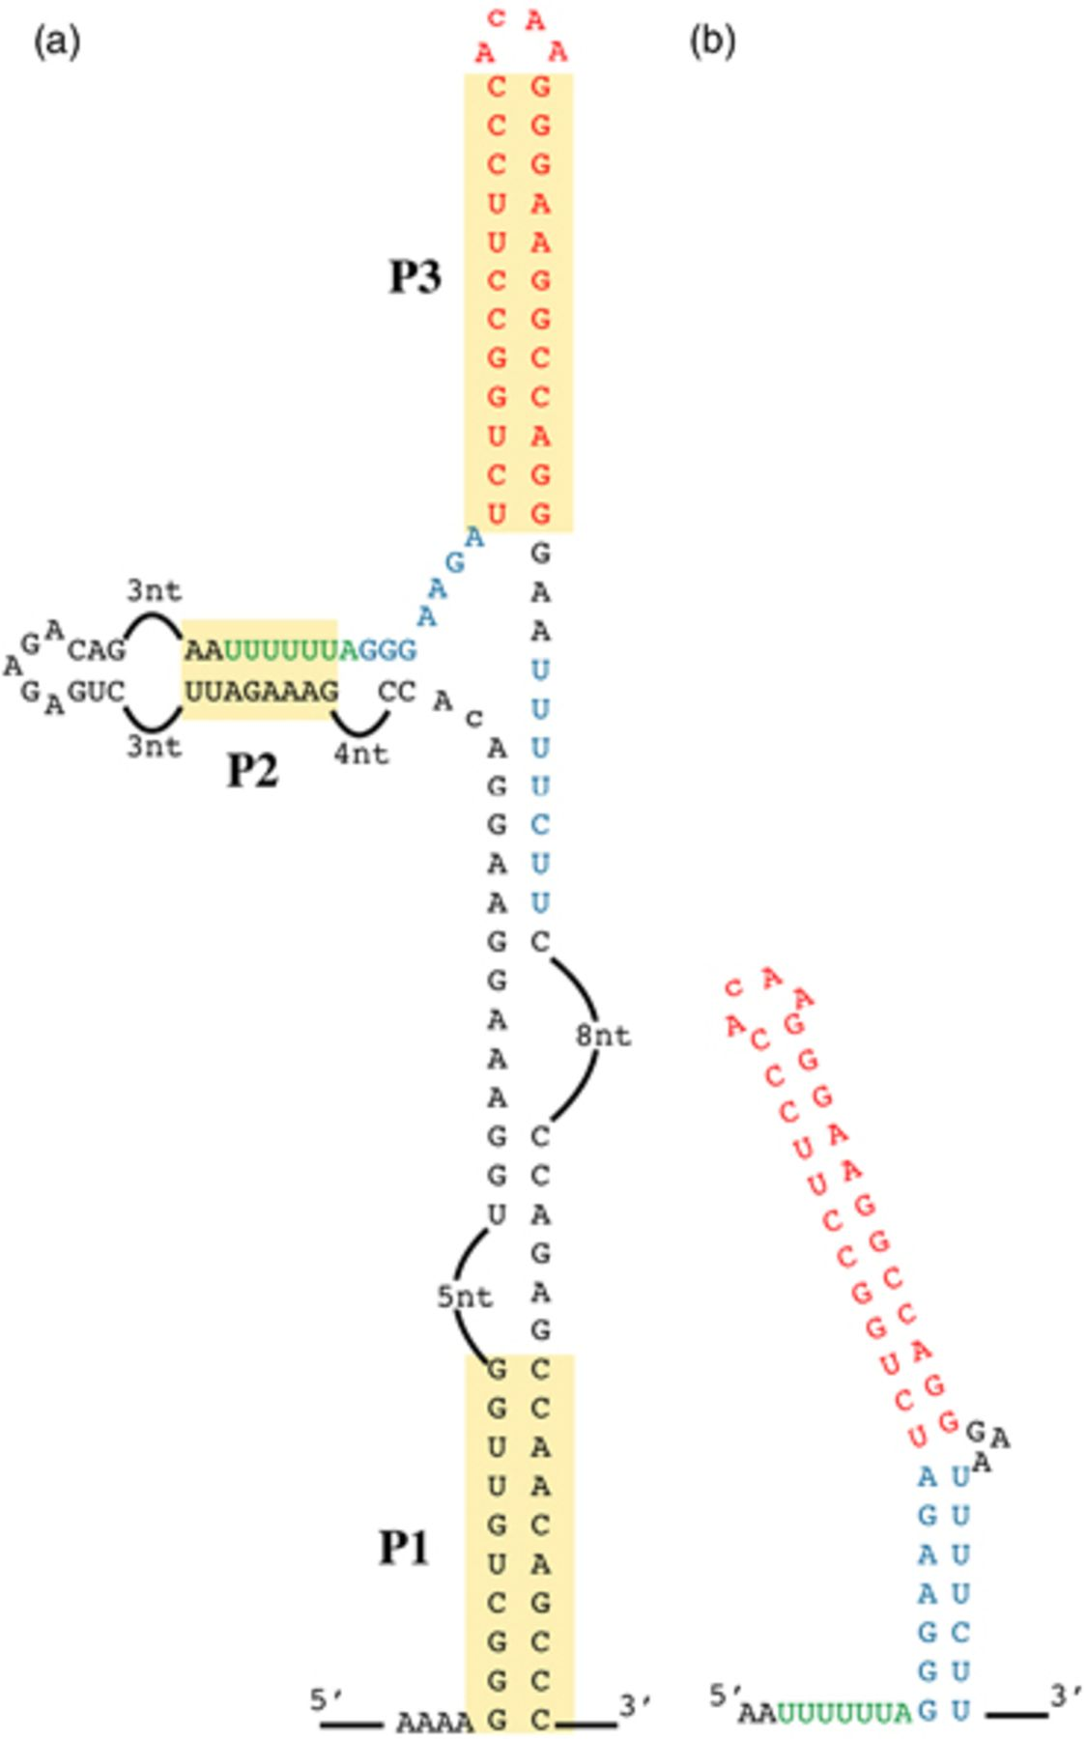
2 Structure of the −1 frameshifting site present in HIV-1. (a) Complete structure of the region of the HIV-1 ...
Notes:
2 Structure of the −1 frameshifting site present in HIV-1. (a) Complete structure of the region of the HIV-1 genome comprising the frameshifting site, as determined by Watts (2009). The three stems, P1, P2 and P3, are highlighted. The slippery sequence is indicated in green, the lower part of the predicted stem of the stimulatory structure is shown in blue and the upper stem is shown in red. (b) Representation of the structure of the stem loop proposed by Dulude and colleagues and confirmed by NMR analysis (Dulude, 2002; Staple & Butcher, 2005). The significance of colours are as in (a).
Unless provided in the caption above, the following copyright applies to the content of this slide: © 2010 Federation of European Microbiological Societies. Published by Blackwell Publishing Ltd. All rights reserved

Slide 3
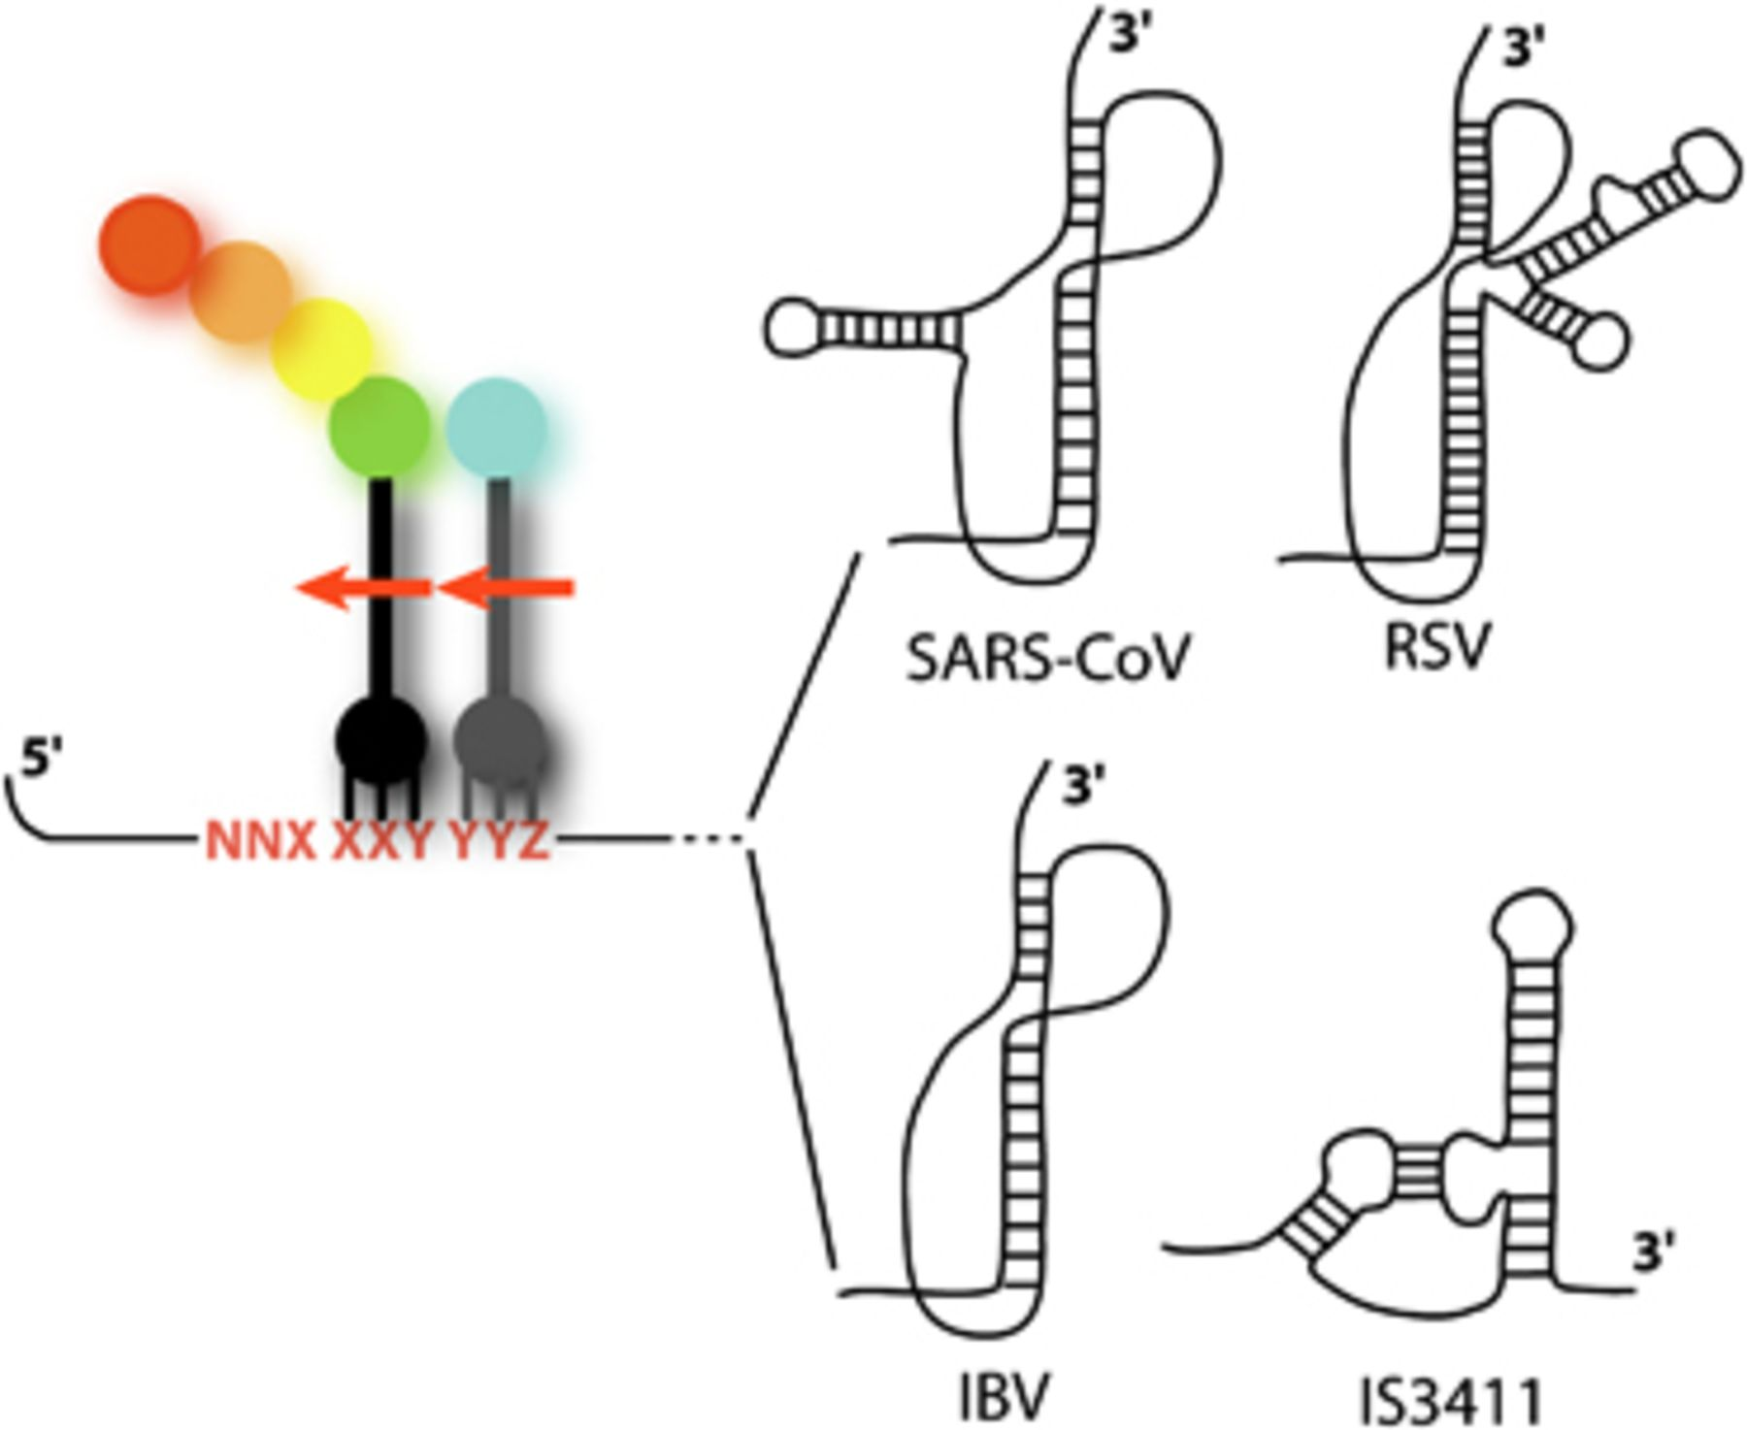
1 Simplified representation of a −1 frameshifting site. The slippery sequence is indicated in red, with the ...
Notes:
1 Simplified representation of a −1 frameshifting site. The slippery sequence is indicated in red, with the initial reading frames indicated by spaces. The P- and A-site tRNAs are shown in black and grey, respectively. The arrows show the direction of the slippage during −1 frameshifting. Four examples of stimulatory secondary structures are shown. Three were identified in viruses [SARS-CoV (Dos Ramos, 2004; Plant & Dinman, 2005), RSV (Jacks, 1988; Marczinke, 1998), IBV (Brierley, 1989; Brierley, 1991)], and the fourth was identified in a bacterial insertion sequence [IS3411 (Mazauric, 2008)].
Unless provided in the caption above, the following copyright applies to the content of this slide: © 2010 Federation of European Microbiological Societies. Published by Blackwell Publishing Ltd. All rights reserved

Slide 4
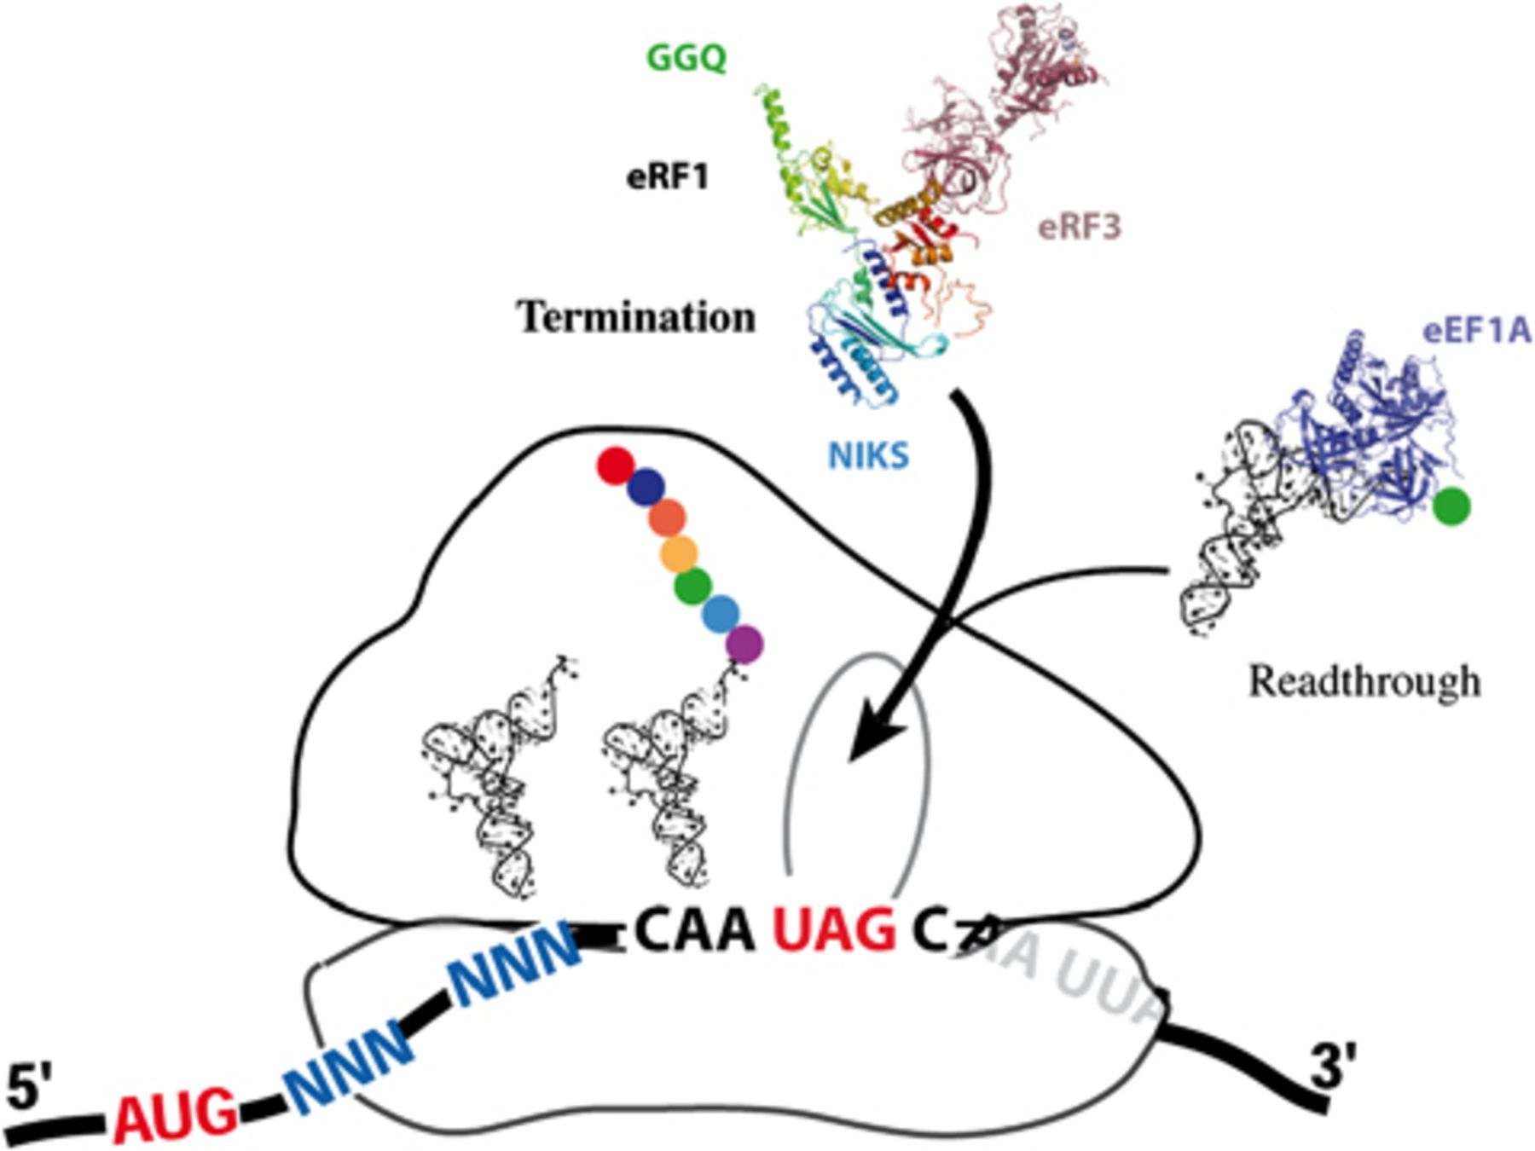
4 Schematic diagram of the competition between termination and readthrough. Release factors are represented by ...
Notes:
4 Schematic diagram of the competition between termination and readthrough. Release factors are represented by their X-ray structures (PDB: 3E1Y). The stop codon (UAG) is located in the A-site, whereas the P- and E- sites are occupied by tRNAs. The incoming natural suppressor tRNA is shown bound to the elongation factor (PDB: 1B23). Aminoglycosides facilitate the acceptance of natural suppressor tRNAs by the ribosome.
Unless provided in the caption above, the following copyright applies to the content of this slide: © 2010 Federation of European Microbiological Societies. Published by Blackwell Publishing Ltd. All rights reserved

