Slide 1
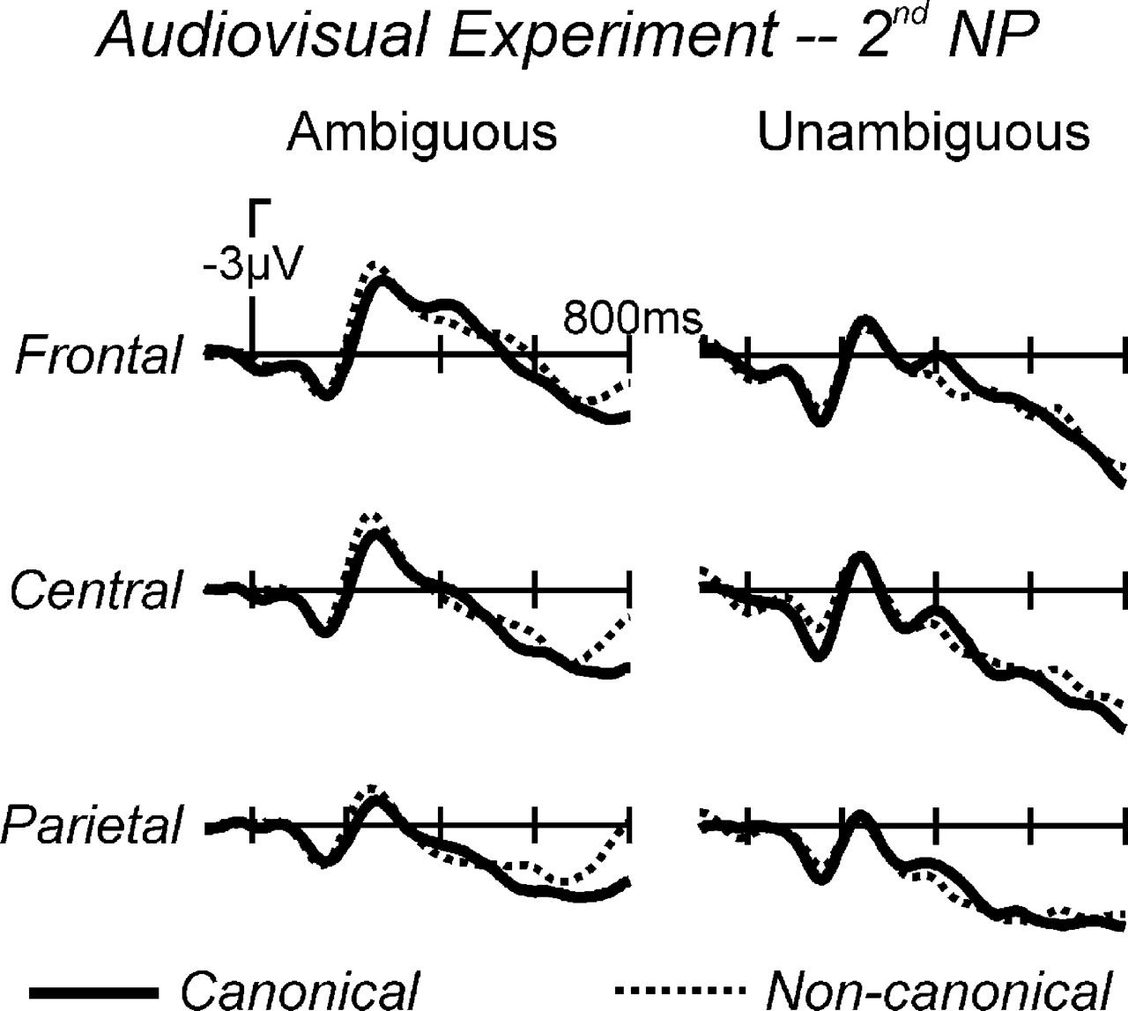
Figure 3. Grand average ERPs from the audiovisual experiment (Experiment 1) for 3 midline electrodes at the NP2 ...
Notes:
Figure 3. Grand average ERPs from the audiovisual experiment (Experiment 1) for 3 midline electrodes at the NP2 position.
Unless provided in the caption above, the following copyright applies to the content of this slide: © The Author 2007. Published by Oxford University Press. All rights reserved. For permissions, please e-mail: journals.permissions@oxfordjournals.org

Slide 2
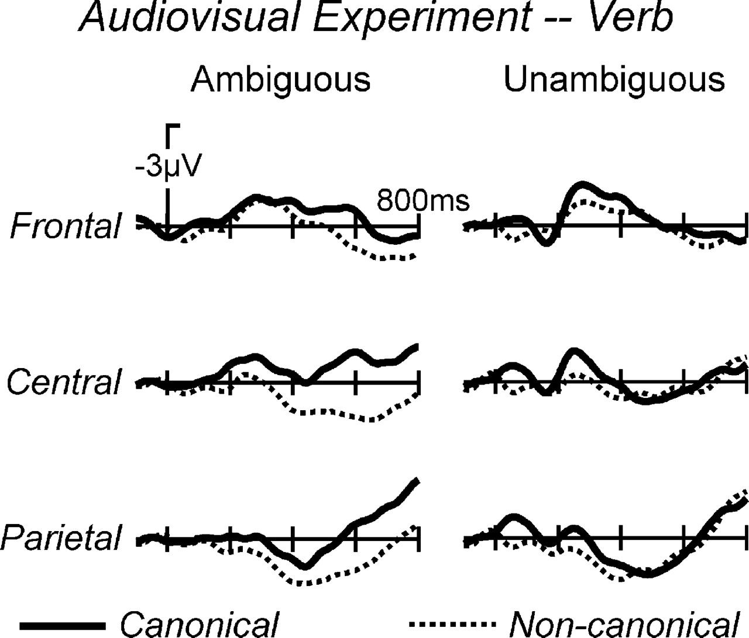
Figure 2. Grand average ERPs from the audiovisual experiment (Experiment 1) for 3 midline electrodes at the verb ...
Notes:
Figure 2. Grand average ERPs from the audiovisual experiment (Experiment 1) for 3 midline electrodes at the verb position. Waveforms were subjected to a digital lowpass (half amplitude cutoff 8 Hz) for visualization. A clear positivity emerges for ambiguous noncanonical relative to canonical sentences at the verb when disambiguating visual information is given.
Unless provided in the caption above, the following copyright applies to the content of this slide: © The Author 2007. Published by Oxford University Press. All rights reserved. For permissions, please e-mail: journals.permissions@oxfordjournals.org

Slide 3
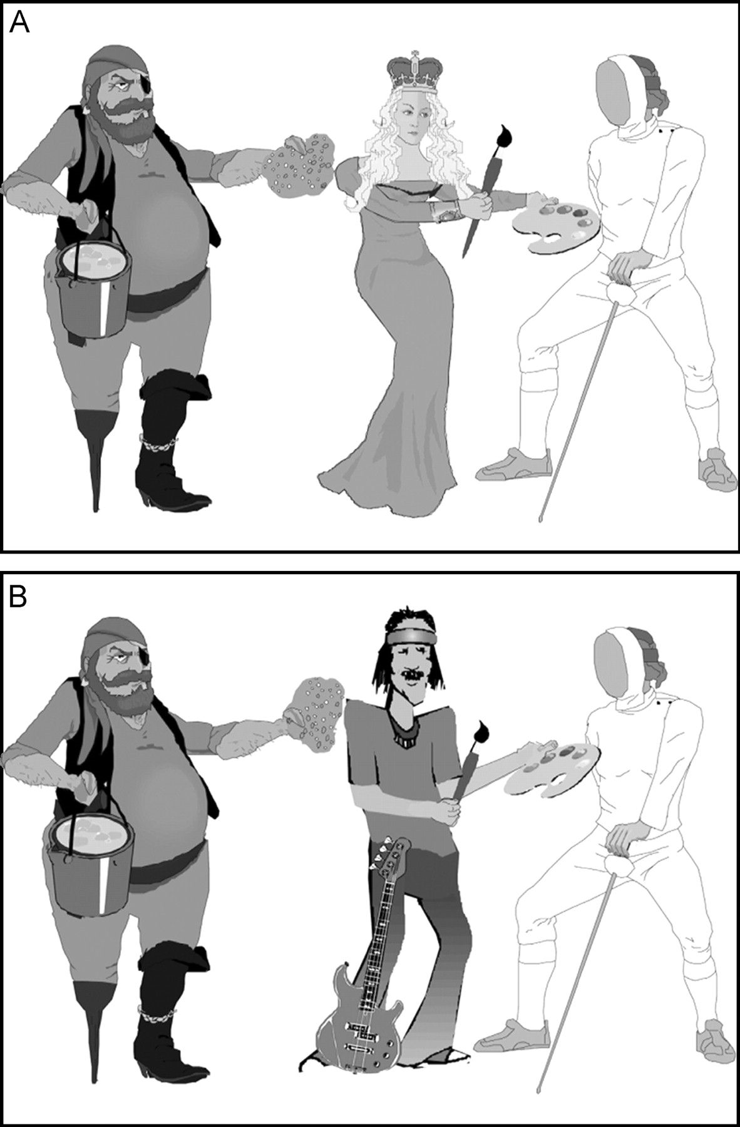
Figure 1. Images for an example item.
Notes:
Figure 1. Images for an example item.
Unless provided in the caption above, the following copyright applies to the content of this slide: © The Author 2007. Published by Oxford University Press. All rights reserved. For permissions, please e-mail: journals.permissions@oxfordjournals.org

Slide 4
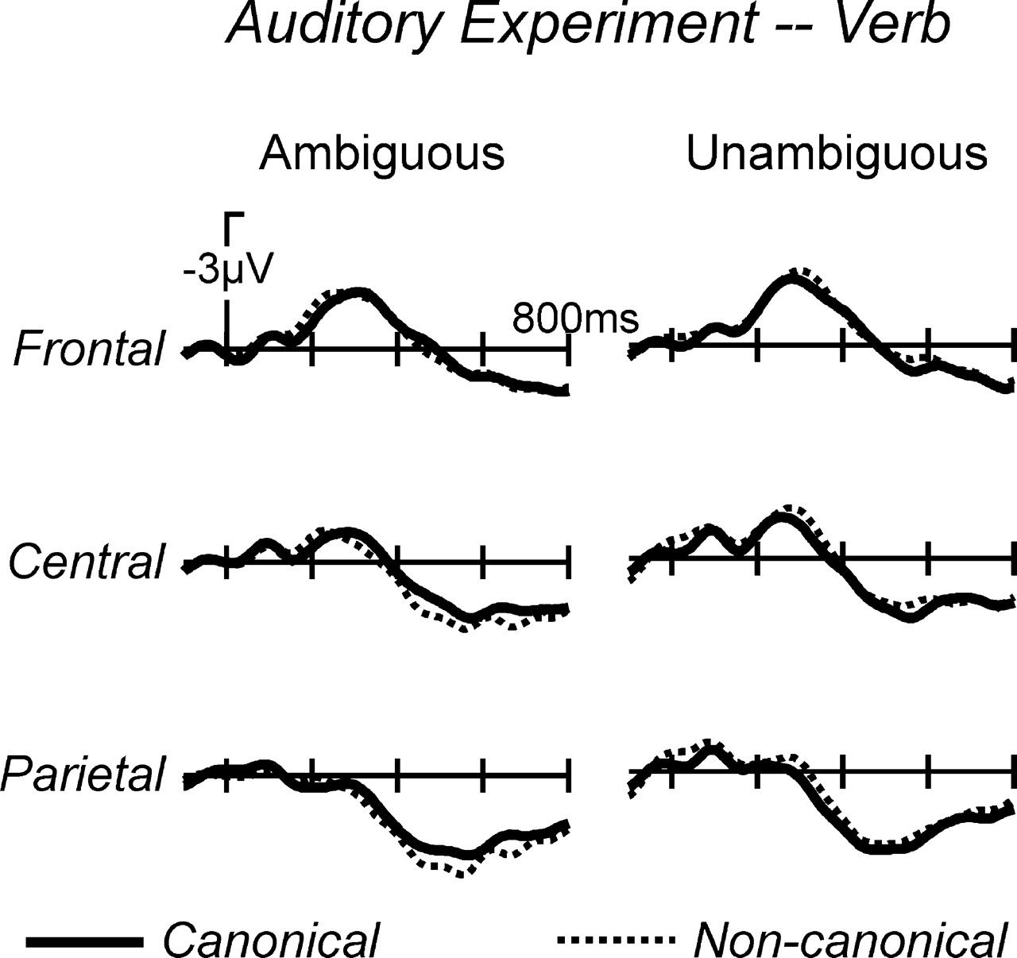
Figure 4. Grand average ERPs from the auditory control experiment for 3 midline electrodes at the verb position. No ...
Notes:
Figure 4. Grand average ERPs from the auditory control experiment for 3 midline electrodes at the verb position. No P600 activity is observed at this position for the noncanonical ambiguous sentences, as information for the disambiguation is not yet available at this position.
Unless provided in the caption above, the following copyright applies to the content of this slide: © The Author 2007. Published by Oxford University Press. All rights reserved. For permissions, please e-mail: journals.permissions@oxfordjournals.org

Slide 5
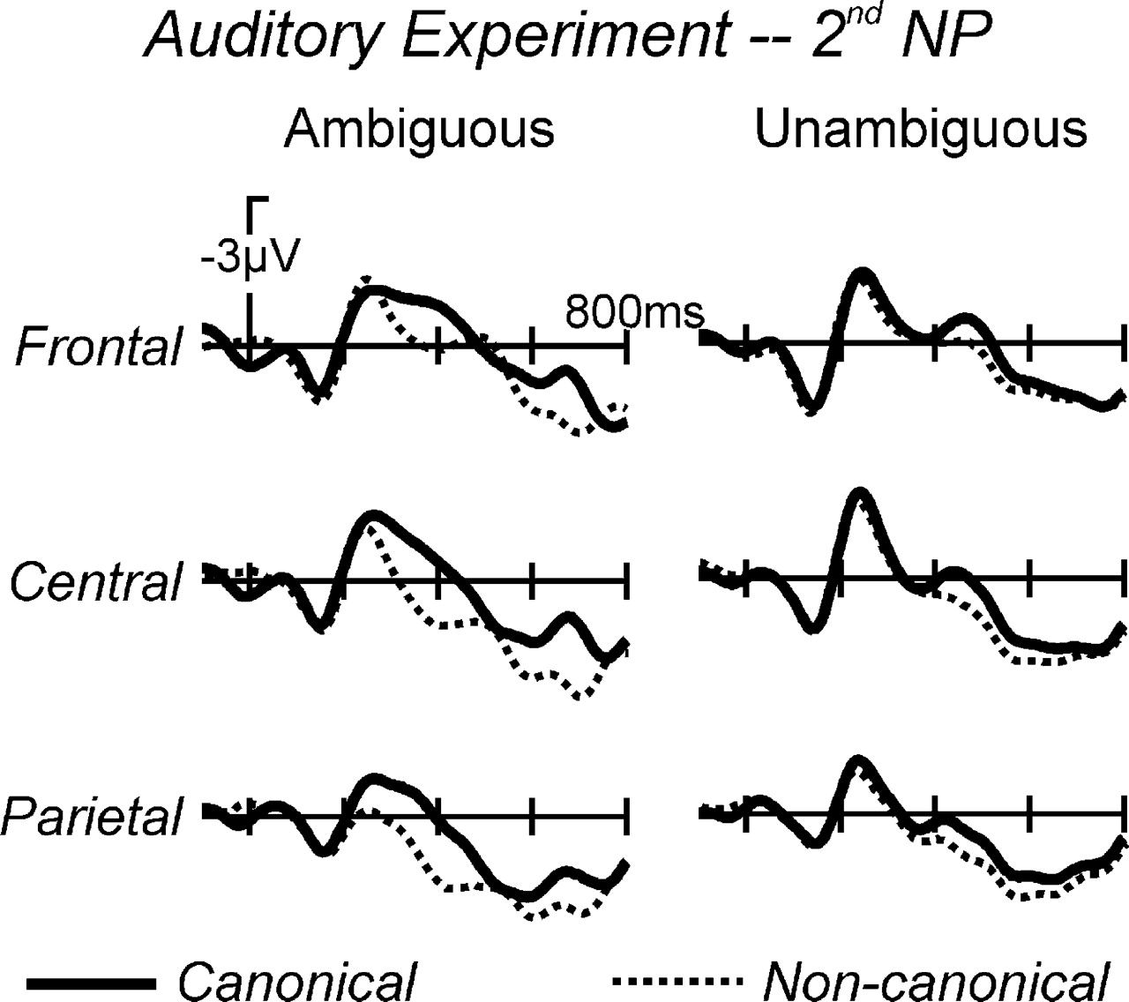
Figure 5. Grand average ERPs from the auditory control experiment (Experiment 2) for 3 midline electrodes at the NP2 ...
Notes:
Figure 5. Grand average ERPs from the auditory control experiment (Experiment 2) for 3 midline electrodes at the NP2 position. A clear P600 emerges for the noncanonical ambiguous sentences, as case marking information identifying the noun phrase as the subject of the sentence becomes available at this position.
Unless provided in the caption above, the following copyright applies to the content of this slide: © The Author 2007. Published by Oxford University Press. All rights reserved. For permissions, please e-mail: journals.permissions@oxfordjournals.org

Slide 6
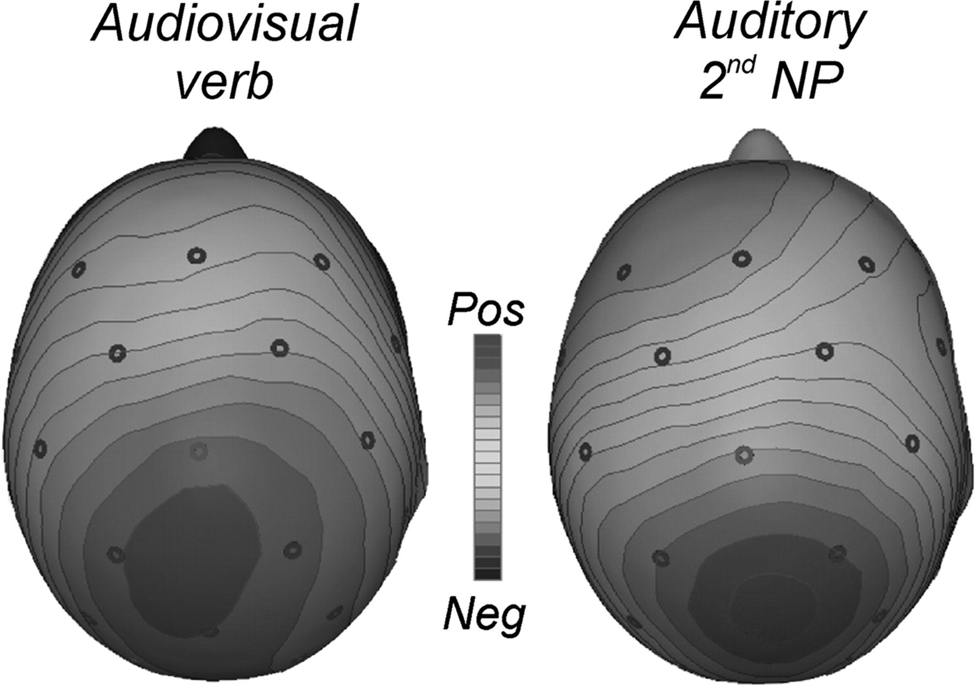
Figure 6. Spline interpolated isovoltage maps depicting the canonical minus noncanonical difference at 400 ms after ...
Notes:
Figure 6. Spline interpolated isovoltage maps depicting the canonical minus noncanonical difference at 400 ms after stimulus onset for the ambiguous sentences. The positivity at the verb position in the audiovisual experiment and its counterpart at the second NP position in the auditory experiment have a virtually identical scalp distribution.
Unless provided in the caption above, the following copyright applies to the content of this slide: © The Author 2007. Published by Oxford University Press. All rights reserved. For permissions, please e-mail: journals.permissions@oxfordjournals.org

