Slide 1
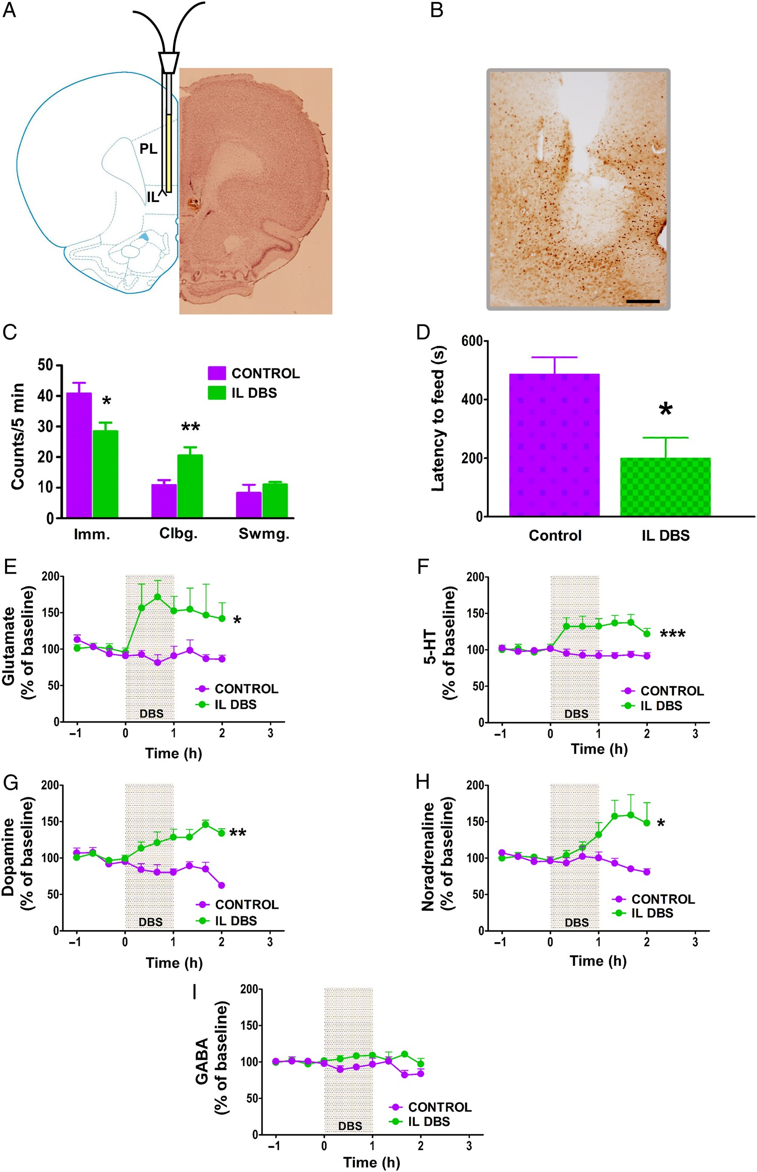
Figure 1. Antidepressant-like action of IL DBS. (A) Scheme and cresyl violet staining of a section of a rat brain ...
Notes:
Figure 1. Antidepressant-like action of IL DBS. (A) Scheme and cresyl violet staining of a section of a rat brain showing the implantation of bilateral electrodes and unilateral dialysis probe. (B) c-Fos immunostaining of the electrode tip area. (C) IL DBS exhibited antidepressant-like response in the FST measured as immobility (Imm.), climbing (Clbg.) and swimming (Swmg.). (D) IL DBS also reduced the latency to feed in the NSFT. Results expressed as mean ± SEM of n = 6–9 rats/group, *P < 0.05, **P < 0.01 (Student's t-test in C and D). (E) Changes in the mPFC efflux of glutamate after IL DBS. (F) Changes in the mPFC efflux of 5-HT after IL DBS. (G) Changes in the mPFC efflux of dopamine after IL DBS. (H) Changes in the mPFC efflux of noradrenaline after IL DBS. (I) IL DBS did not alter the efflux of GABA in the mPFC. Results expressed as mean ± SEM of n = 5–7 rats/group, *P < 0.05, **P < 0.005, ***P < 0.0001 (Newman–Keuls test following significant two-way repeated-measures ANOVA in E, F, G, and H). Scale bar in B, 200 µm.
Unless provided in the caption above, the following copyright applies to the content of this slide: © The Author 2015. Published by Oxford University Press. All rights reserved. For Permissions, please e-mail: journals.permissions@oup.com

Slide 2
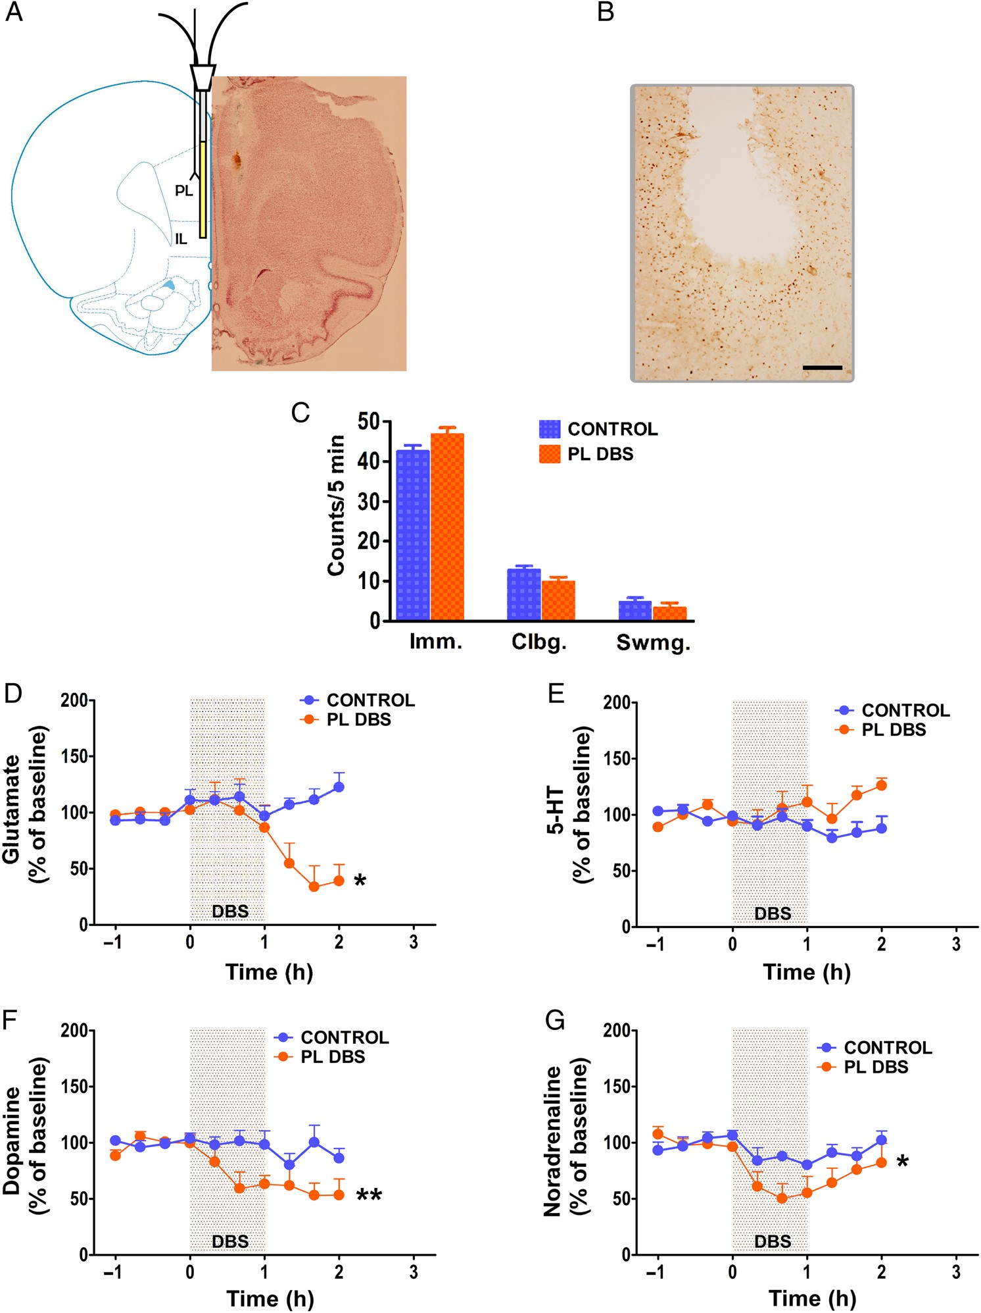
Figure 2. Effects of 1 h DBS (130 Hz, 200 µA, 90 µs) in the PL. (A) Scheme and cresyl violet staining of a section of a ...
Notes:
Figure 2. Effects of 1 h DBS (130 Hz, 200 µA, 90 µs) in the PL. (A) Scheme and cresyl violet staining of a section of a rat brain showing the implantation of bilateral electrodes and unilateral dialysis probe. (B) c-Fos immunostaining of the electrode tip area. (C) PL DBS did not produce any behavioral change in the FST (Student's t-test). (D) PL DBS decreased the mPFC efflux of glutamate. (E) PL DBS did not change the mPFC efflux of 5-HT. (F) PL DBS decreased the mPFC efflux of dopamine. (G) PL DBS decreased the mPFC efflux of noradrenaline. Results are expressed as mean ± SEM of n = 5–9 rats per group (Newman–Keuls test following significant two-way repeated-measures ANOVA, *P < 0.05, **P < 0.001 in D, F, and G). Scale bar in B, 200 µm.
Unless provided in the caption above, the following copyright applies to the content of this slide: © The Author 2015. Published by Oxford University Press. All rights reserved. For Permissions, please e-mail: journals.permissions@oup.com

Slide 3
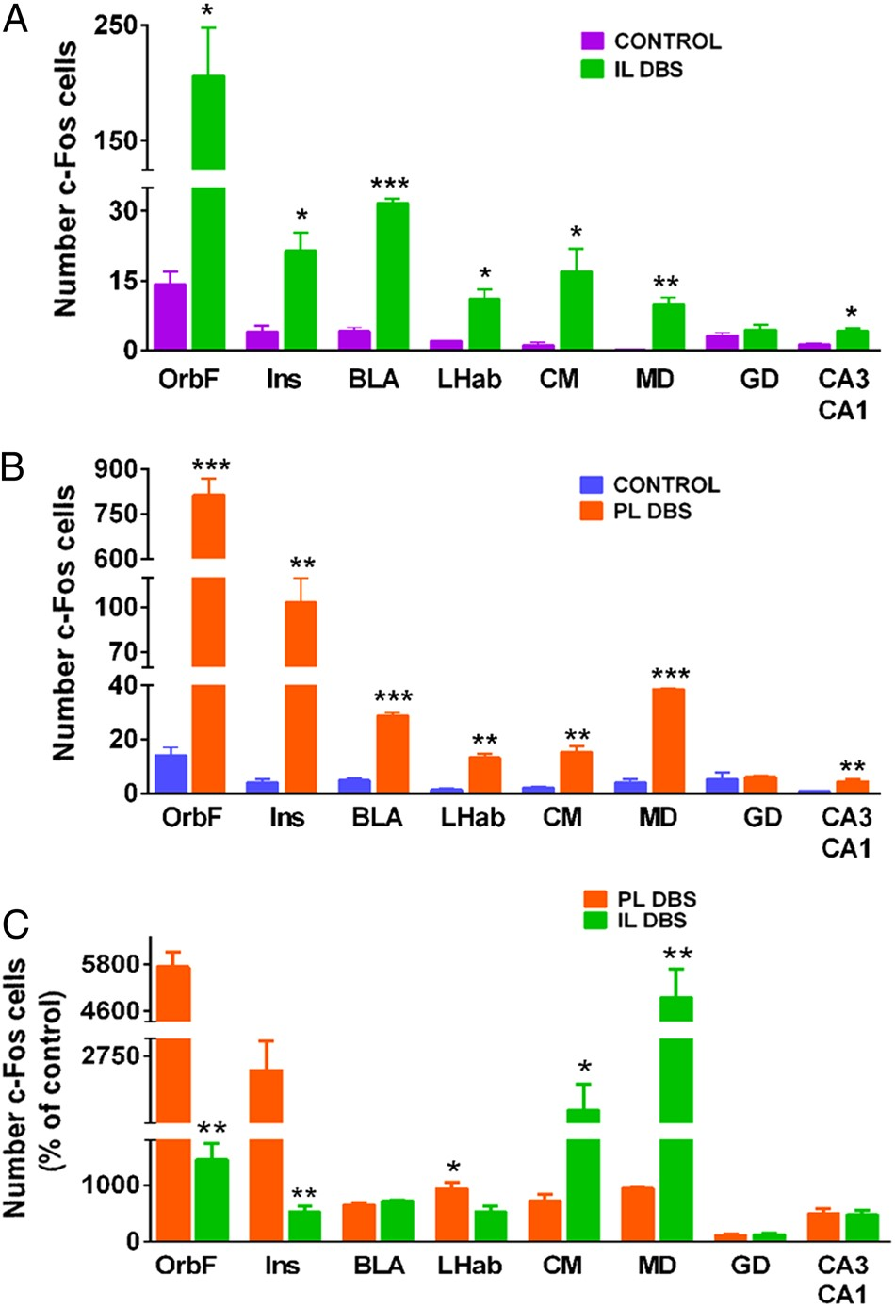
Figure 3. c-Fos immunolabeling after IL and PL DBS. (A) IL DBS increased the number of cells immunolabeled with c-Fos ...
Notes:
Figure 3. c-Fos immunolabeling after IL and PL DBS. (A) IL DBS increased the number of cells immunolabeled with c-Fos in different brain regions. (B) PL DBS also increased the number of cells immunolabeled with c-Fos in the same brain regions. (C) Comparative changes in c-Fos immunolabeling between IL and PL after DBS expressed as percentage of their respective controls. Student's t-test, *P < 0.005, **P < 0.0005, ***P < 0.0001 n = 4–7 rats per group. OrbF, orbitofrontal cortex; Ins, insula; BLA, basolateral amygdala; LHb, lateral habenula; CM, centromedial thalamic nucleus; MD, mediodorsal thalamic nucleus; DG, dentate gyrus; CA3-CA1, CA subregions of the hippocampus.
Unless provided in the caption above, the following copyright applies to the content of this slide: © The Author 2015. Published by Oxford University Press. All rights reserved. For Permissions, please e-mail: journals.permissions@oup.com

Slide 4
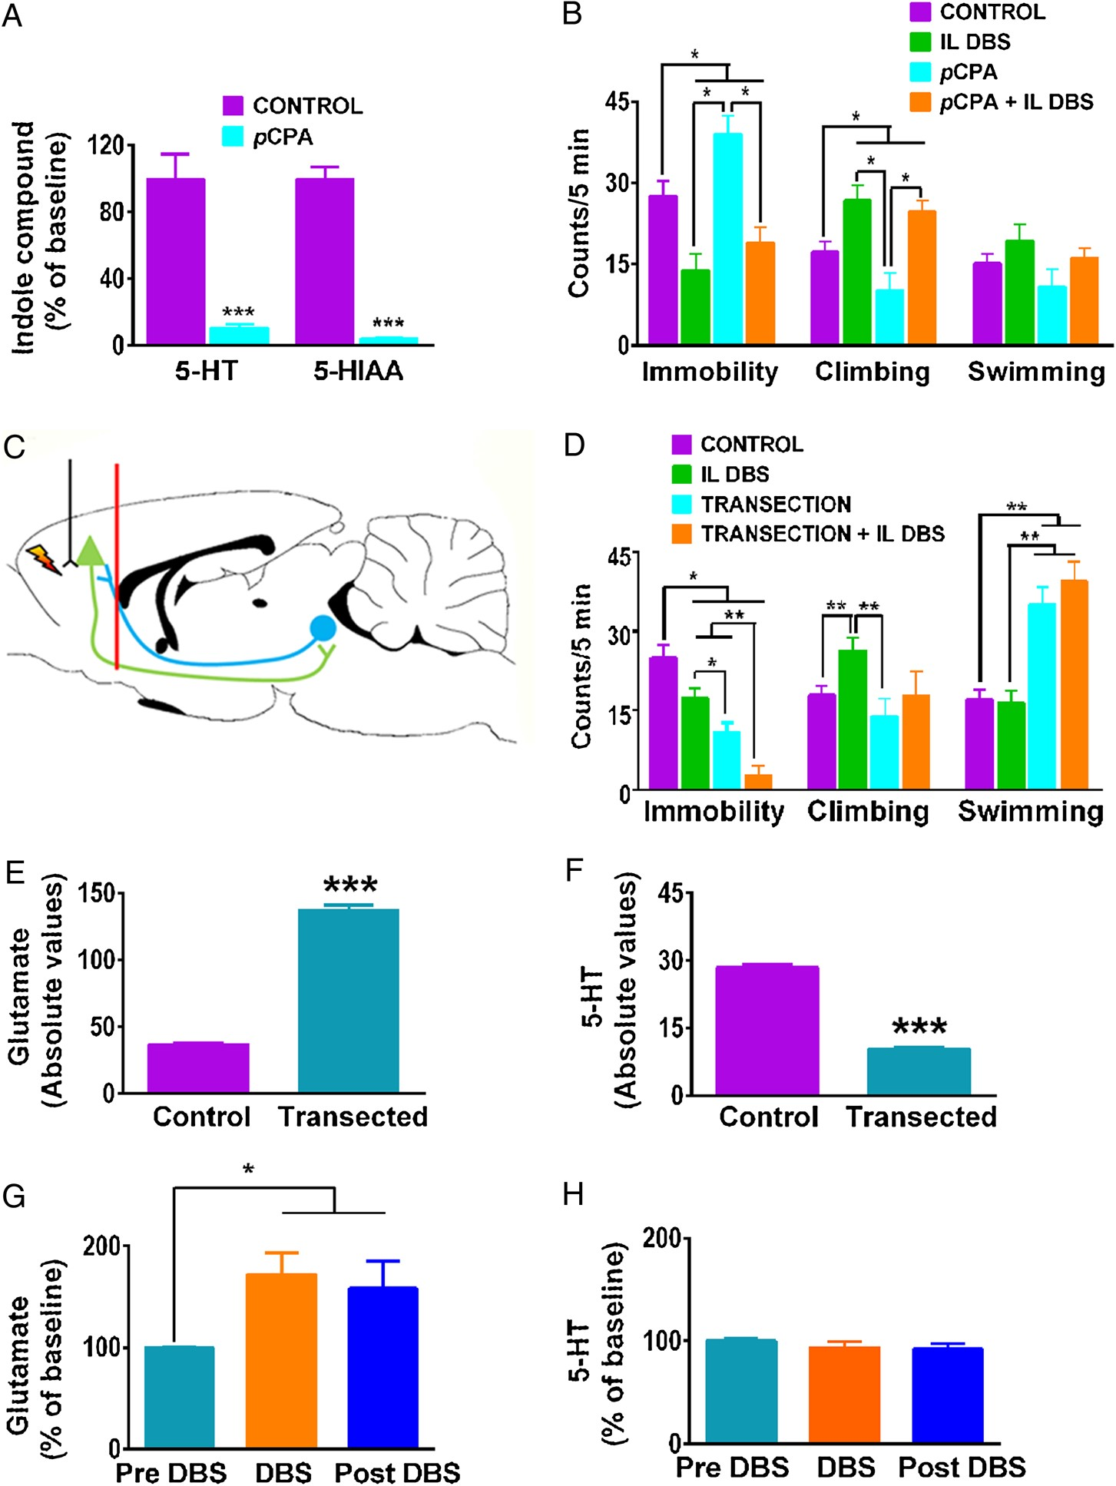
Figure 4. Role of 5-HT in the antidepressant-like action of IL DBS. (A) Pretreatment with pCPA depleted the levels of ...
Notes:
Figure 4. Role of 5-HT in the antidepressant-like action of IL DBS. (A) Pretreatment with pCPA depleted the levels of 5-HT and its metabolite (5-hydoxyindoleacetic acid, 5-HIAA) in the brainstem by 90% and 96%, respectively, two-tailed Student's t-test, ***P < 0.001, n = 4 rats per group. (B) Pretreatment with pCPA did not alter the changes in antidepressant-like behaviors evoked by IL DBS, one-way ANOVA followed by Newman–Keuls test, *P < 0.05, n = 6–7 rats per group. (C) Scheme of a brain section illustrating the level of cortical transection (red line). Pyramidal neurons of the mPFC projecting to the DR are depicted in green whereas serotonergic neurons projecting back to the mPFC are depicted in blue. (D) Antidepressant-like actions of transection and IL DBS in the FST, one-way ANOVA followed by Newman–Keuls test, *P < 0.05, **P < 0.01 or less, n = 7–11 rats per group. (E) Transection increased basal absolute values of dialysate glutamate, Student's t-test, ***P < 0.0001, n = 9–10 rats per group. (F) Transection decreased basal absolute values of extracellular 5-HT. (G) IL DBS elevated glutamate in transected animals, one-way ANOVA followed by Newman–Keuls test, *P < 0.05, n = 7–8 rats per group. (H) IL DBS did not increase 5-HT in transected animals, n = 7–8 rats per group.
Unless provided in the caption above, the following copyright applies to the content of this slide: © The Author 2015. Published by Oxford University Press. All rights reserved. For Permissions, please e-mail: journals.permissions@oup.com

Slide 5
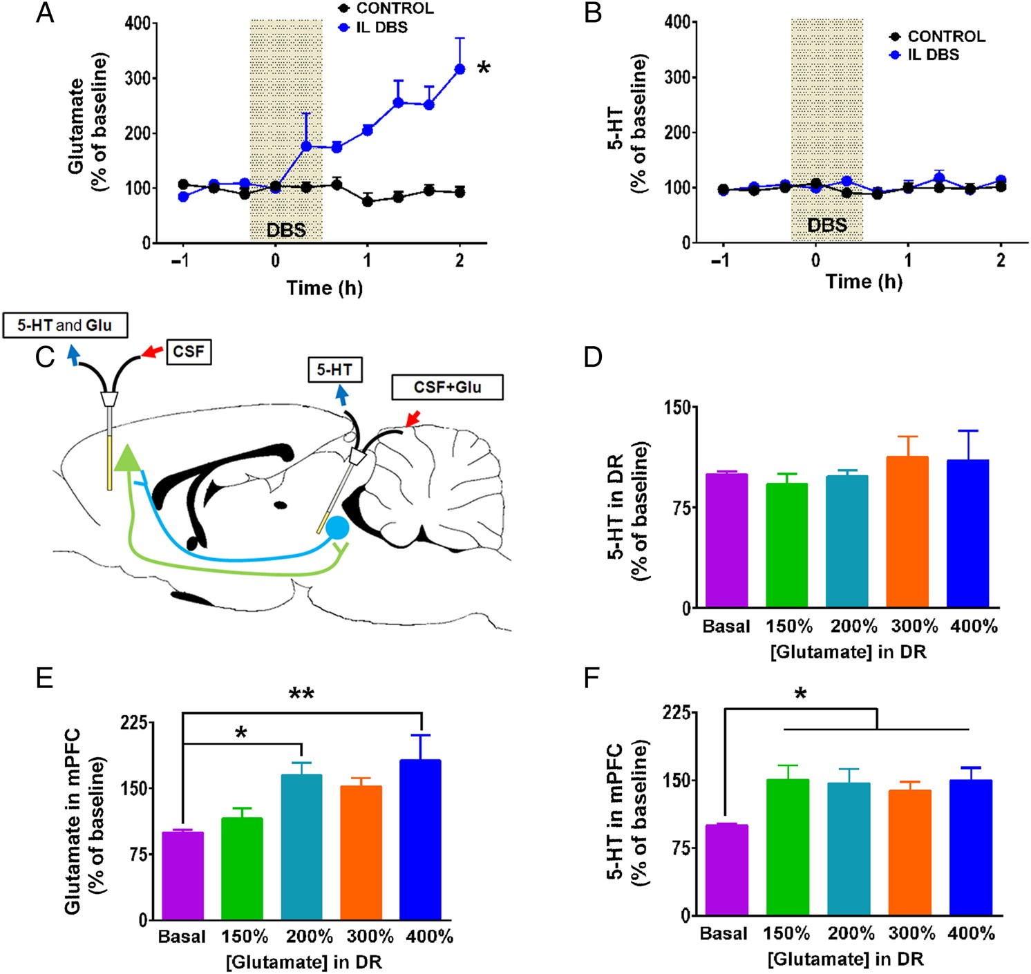
Figure 5. Role of cortico-raphe projection in the effects of IL DBS. (A) One hour of IL DBS increased glutamate efflux ...
Notes:
Figure 5. Role of cortico-raphe projection in the effects of IL DBS. (A) One hour of IL DBS increased glutamate efflux in the DR. (B) One hour of IL DBS did not change 5-HT efflux in the DR. Repeated-measures two-way ANOVA followed by Newman–Keuls test, *P < 0.05, n = 5–6 rats per group. (C) Drawing representing the setting of the dual probe (DR + mPFC) experiment. (D) The perfusion of increasing concentrations of glutamate in the DR (expressed as percentage of baseline levels in the DR) had no effect on the local efflux of 5-HT. (E) The perfusion of increasing concentrations of glutamate in the DR elevated glutamate efflux in the mPFC. (F) The perfusion of increasing concentrations of glutamate in the DR elevated 5-HT efflux in the mPFC. One-way ANOVA followed by Newman–Keuls test, *P < 0.05, **P < 0.01 or less, n = 7 rats per group.
Unless provided in the caption above, the following copyright applies to the content of this slide: © The Author 2015. Published by Oxford University Press. All rights reserved. For Permissions, please e-mail: journals.permissions@oup.com

Slide 6
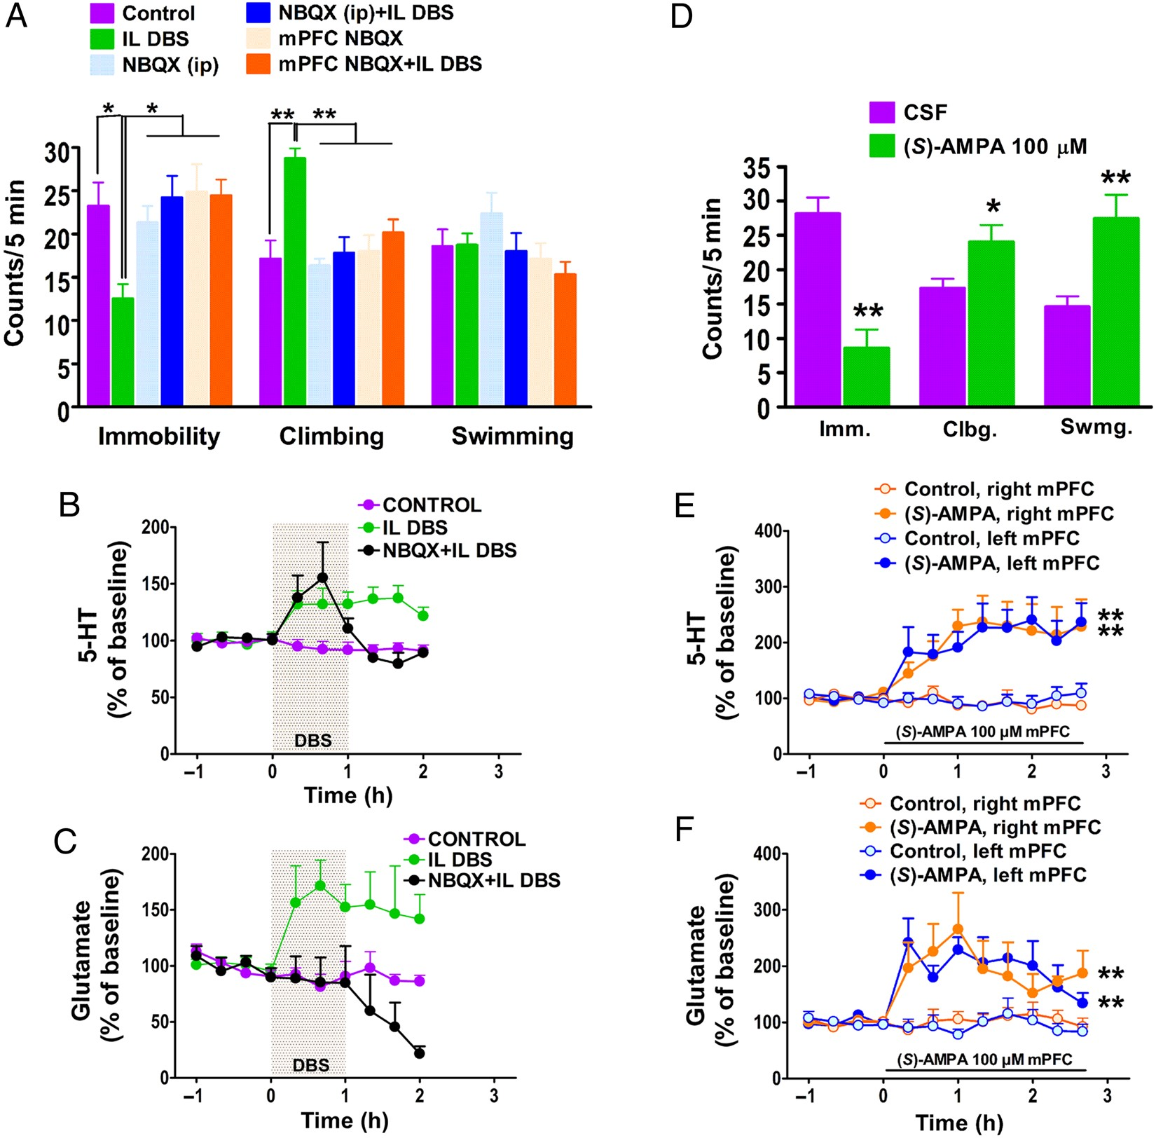
Figure 6. Role of AMPARs in the antidepressant effects of IL DBS. (A) Systemic (10 mg/kg i.p., 5 min before FST) and ...
Notes:
Figure 6. Role of AMPARs in the antidepressant effects of IL DBS. (A) Systemic (10 mg/kg i.p., 5 min before FST) and bilateral, prefrontal (300 µM, 1 h during IL DBS) administration of NBQX blocked the IL DBS-induced antidepressant-like behavior in the FST. Results are expressed as mean ± SEM of n = 6–9 rats per group (Newman–Keuls test following significant one-way ANOVA, *P < 0.05, **P < 0.001). (B) Systemic NBQX blocked the IL DBS-induced increase in mPFC 5-HT only after DBS offset. Results are expressed as mean ± SEM of n = 5–6 rats per group (Newman–Keuls test following significant two-way repeated-measures ANOVA, P < 0.05). (C) Systemic NBQX abolished completely the increase in mPFC glutamate induced by IL DBS. Results are expressed as mean ± SEM of n = 4–7 rats per group (Newman–Keuls test following significant two-way repeated-measures ANOVA, P < 0.05). (D) Bilateral intra-mPFC perfusion of 100 µM (S)-AMPA for 1 h evoked an antidepressant-like response in the FST carried out immediately thereafter. Results expressed as mean ± SEM of n = 7 rats per group, *P < 0.05, **P < 0.001 (Student's t-test). (E) Bilateral intra-mPFC perfusion of 100 µM (S)-AMPA in the mPFC for 1 h increased the local concentration of 5-HT in both hemispheres. Results are expressed as mean ± SEM of n = 4–6 rats per group (Newman–Keuls test following significant two-way repeated-measures ANOVA, **P < 0.005). (F) Bilateral intra-mPFC perfusion of 100 µM (S)-AMPA in the mPFC for 1 h increased the local concentration of glutamate in both hemispheres. Results are expressed as mean ± SEM of n = 5–8 rats per group (Newman–Keuls test following significant two-way repeated-measures ANOVA, **P < 0.005).
Unless provided in the caption above, the following copyright applies to the content of this slide: © The Author 2015. Published by Oxford University Press. All rights reserved. For Permissions, please e-mail: journals.permissions@oup.com

