Slide 1
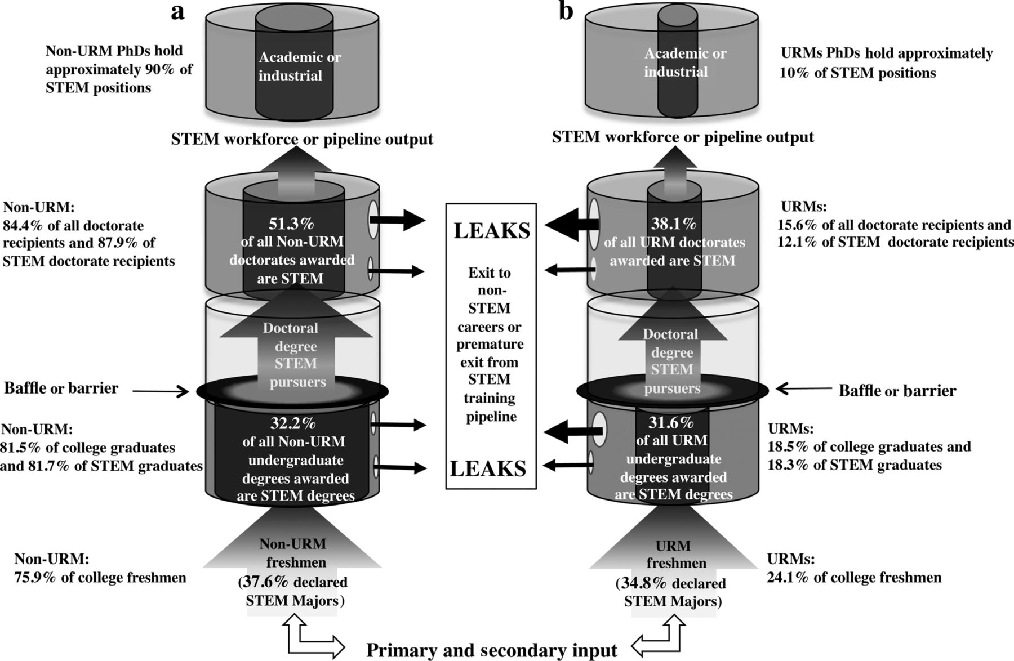
Figure 1. The reimagined science, technology, engineering, and mathematics (STEM) pipeline for US underrepresented ...
Notes:
Figure 1. The reimagined science, technology, engineering, and mathematics (STEM) pipeline for US underrepresented racial and ethnic minorities (URMs) and nonminorities: the progression of non-URM and URM trainees from undergraduate to postdegree career training stages. For illustrative purposes only, the pipeline population has been divided to show the progression of non-URM and URM trainees separately. The shaded upward arrows indicate advancement through the STEM training pipeline. The baffle between the undergraduate and graduate segments of the pipeline highlights the greatest barrier to the advancement of STEM training. Gaps or discontinuities between segments illustrate that the pipeline can be discontinuous for trainees who take breaks before advancing. Leaks represents trainee attrition.
Unless provided in the caption above, the following copyright applies to the content of this slide: © The Author(s) 2014. Published by Oxford University Press on behalf of the American Institute of Biological Sciences. All rights reserved. For Permissions, please e-mail: journals.permissions@oup.com.

