Slide 1
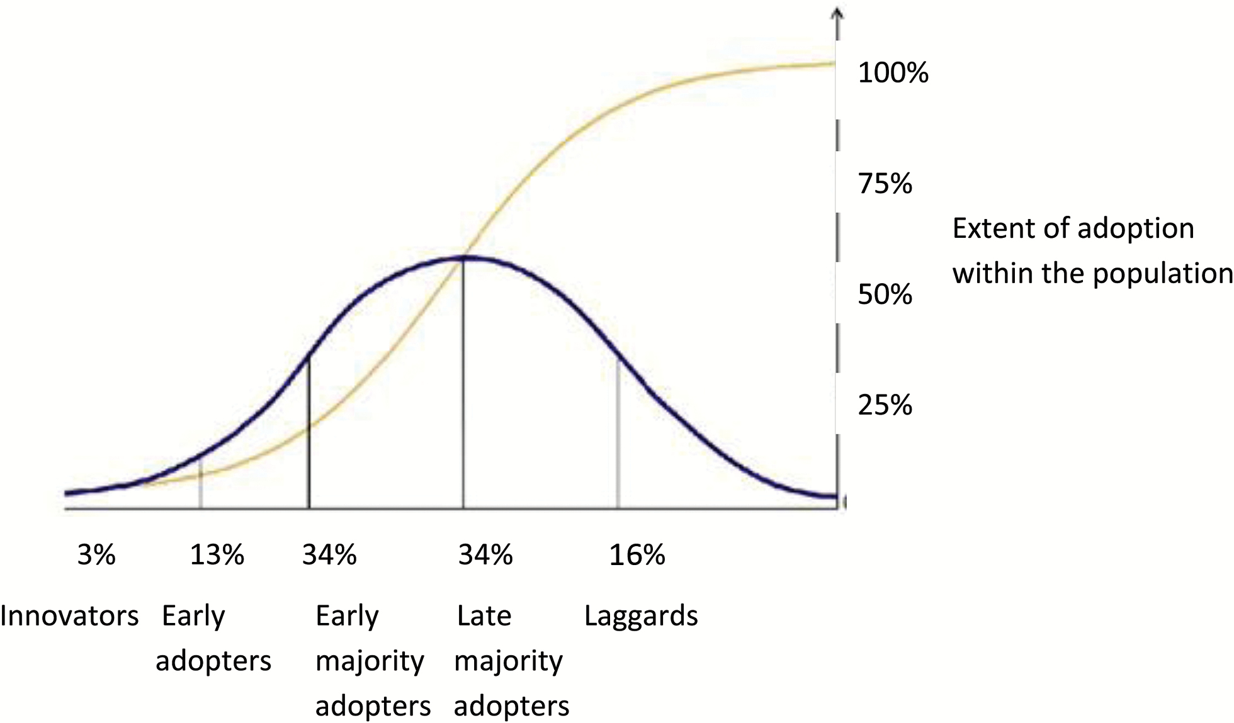
Figure 1. Normal curve showing the characteristics of the innovation-adopting population as defined by Rogers (2003), ...
Notes:
Figure 1. Normal curve showing the characteristics of the innovation-adopting population as defined by Rogers (2003), and sigmoidal cumulative distribution curve showing the total number of adopters as the adoption spreads. Note that innovators, early adopters, and early-majority adopters comprise the first 50% of the sample of adopters. Late-majority adopters and laggards comprise the remaining 50%.
Unless provided in the caption above, the following copyright applies to the content of this slide: © The Author(s) 2017. Published by Oxford University Press on behalf of The Gerontological Society of America. All rights reserved. For permissions, please e-mail: journals.permissions@oup.com.This article is published and distributed under the terms of the Oxford University Press, Standard Journals Publication Model (https://academic.oup.com/journals/pages/about_us/legal/notices)

