Slide 1
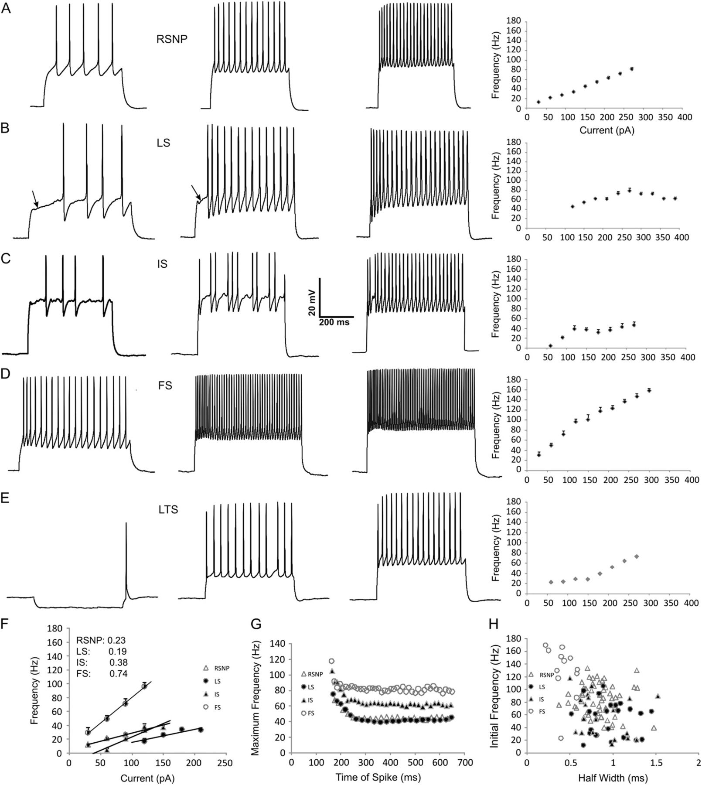
Figure 1. Electrophysiological parameters of PPC interneurons. Representative membrane responses to a 500-ms ...
Notes:
Figure 1. Electrophysiological parameters of PPC interneurons. Representative membrane responses to a 500-ms depolarizing current injection in RSNP (A), LS (B), IS (C), FS (D), and LTS (E) cells (from left to right) at threshold (100 pA), suprathreshold (200 pA), and maximal (300 pA) values (from left to right), except for (E), which indicates the threshold for rebound spiking following hyperpolarizing current (−50 pA), threshold following depolarizing current (100 pA), and suprathreshold (200 pA) value (from left to right). Note the typical regular spiking profile of low frequency, adapting spike trains of RSNP cells (A). Note the slow, ramp depolarization prior to the first spike (arrows)—a hallmark of the LS cell (B). Note the high-frequency, nonadapting spike trains of FS cells (D). Note the rebound excitation following hyperpolarizing current injection of LTS cells (E). A frequency–current (F–I) plot is shown following each of the maximal traces and represents an average from cells of each firing type (RSNP n = 51, LS n = 24, IS n = 19, FS n = 12, LTS n = 1). The first 4 points of the F–I plot (F) were used to calculate the slope of the F–I curve (F inset). A representative chart of maximum frequency versus its time point within the depolarizing train (G) illustrates the differences in adaptation between firing types (see also Table 1). A plot of initial frequency versus the half width of individual cells (H) illustrates segregation between firing types. Scale bar applies to all traces.
Unless provided in the caption above, the following copyright applies to the content of this slide: © The Author 2009. Published by Oxford University Press. All rights reserved. For permissions, please e-mail: journals.permissions@oxfordjournals.org

Slide 2
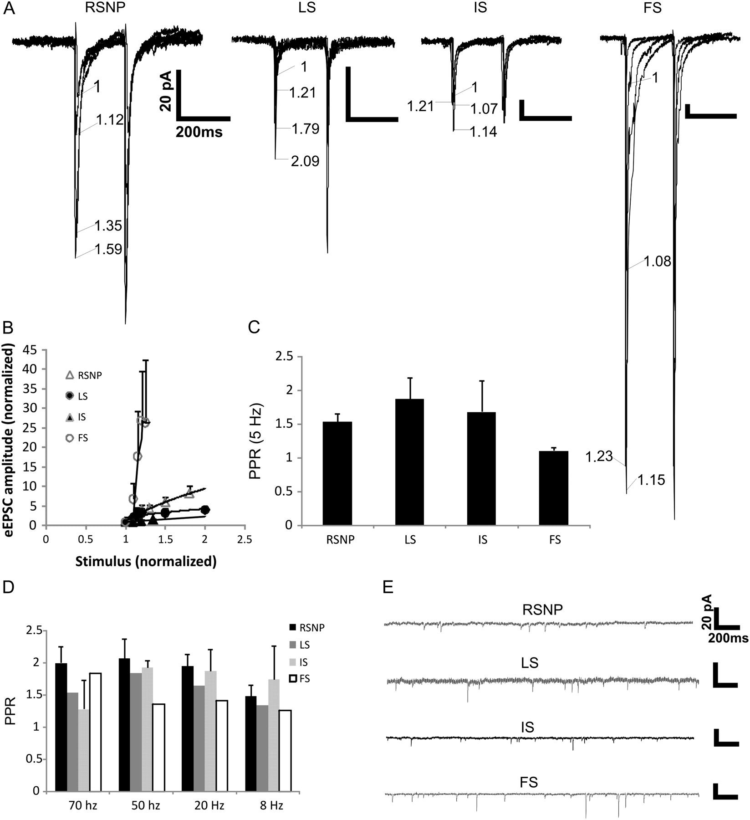
Figure 2. Synaptic properties of PPC interneurons. Representative traces of eEPSCs from each of the cell firing types ...
Notes:
Figure 2. Synaptic properties of PPC interneurons. Representative traces of eEPSCs from each of the cell firing types (A), the numbers represent the amount of extracellular stimulation applied to each trace, with “1” as the minimally suprathreshold stimulation and each consecutive number representing the normalized stimulation increase. An average of the input–output (I–O) curve (B) averaged from cells of each firing type (RSNP n = 5, LS n = 6, IS n = 3, FS n = 2). The PPR averaged from each firing type (RSNP n = 21, LS n = 10, IS n = 7, FS n = 4) represented in bar graph form (C). The PPR averaged from each firing type (RSNP n = 4, IS n = 3, LS n = 1, FS n = 1) at various interspike frequencies (D). Representative traces of spontaneous postsynaptic currents from each firing type (E). Scale bar applies to all traces.
Unless provided in the caption above, the following copyright applies to the content of this slide: © The Author 2009. Published by Oxford University Press. All rights reserved. For permissions, please e-mail: journals.permissions@oxfordjournals.org

Slide 3
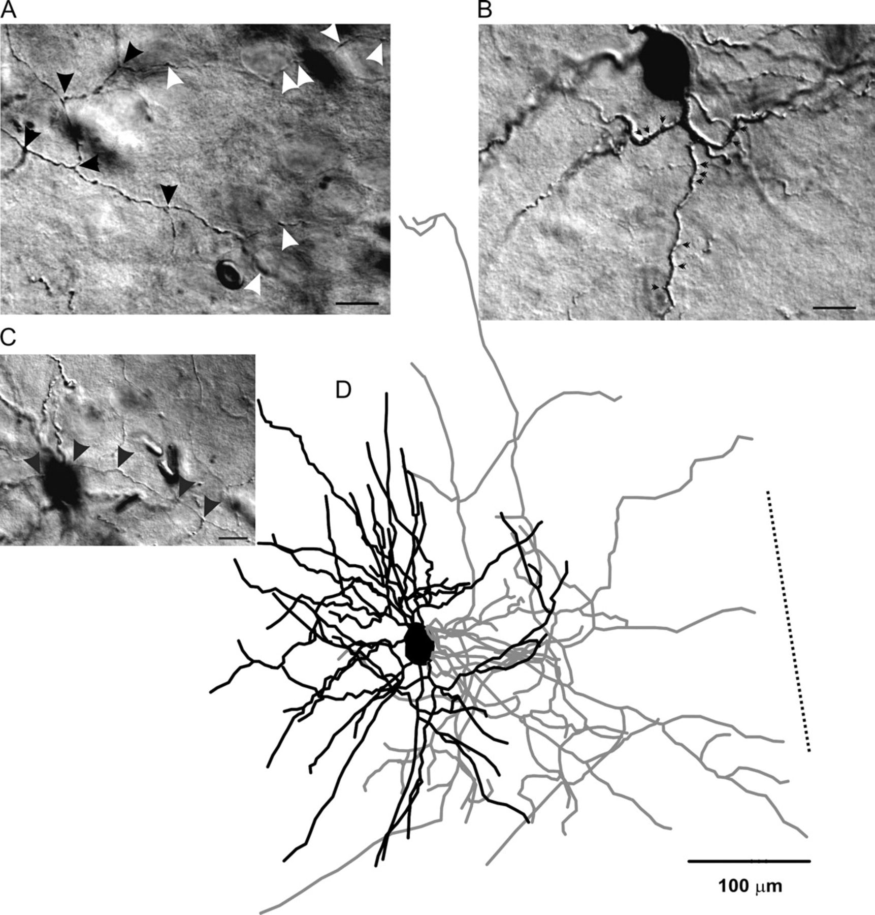
Figure 3. RSNP interneuron of the PPC. A typical example of a Neurolucida reconstruction of an RSNP cell (D). Dendrites ...
Notes:
Figure 3. RSNP interneuron of the PPC. A typical example of a Neurolucida reconstruction of an RSNP cell (D). Dendrites (black lines, for all figures) and axons (gray lines, for all figures) showed a neurogliaform-like morphology. Scale bar in (A, B, C) = 20 μm. (A, C) Highlight the unique axonal morphology found in these cells. Axons with distinct puncta were visible (black arrowheads), as well as putative perisomatic contacts (white arrowheads). Spines (B, small black arrowheads) were also visible on some of the larger dendritic processes. Dotted line in panel (D) represents the orientation toward the pial surface, but the distance to the cell is not represented to scale (for Fig. 1–4). The spiking patterns for this cell are represented in Figure 1A. Scale bar in (D) = 100 μm.
Unless provided in the caption above, the following copyright applies to the content of this slide: © The Author 2009. Published by Oxford University Press. All rights reserved. For permissions, please e-mail: journals.permissions@oxfordjournals.org

Slide 4
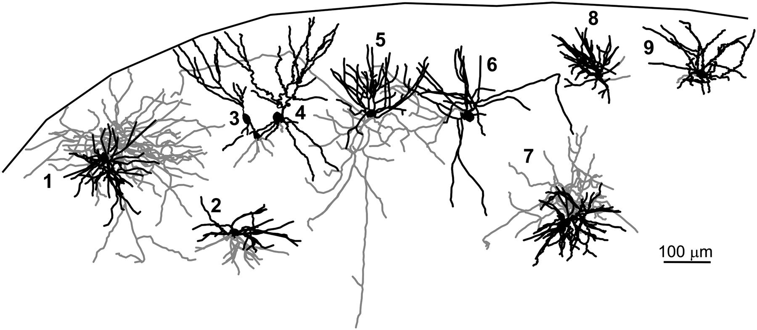
Figure 4. Morphological diversity of RSNP interneurons within the PPC. Stylized slice showing the location and ...
Notes:
Figure 4. Morphological diversity of RSNP interneurons within the PPC. Stylized slice showing the location and morphology of RSNP PPC interneurons. Scale bar = 100 μm.
Unless provided in the caption above, the following copyright applies to the content of this slide: © The Author 2009. Published by Oxford University Press. All rights reserved. For permissions, please e-mail: journals.permissions@oxfordjournals.org

Slide 5
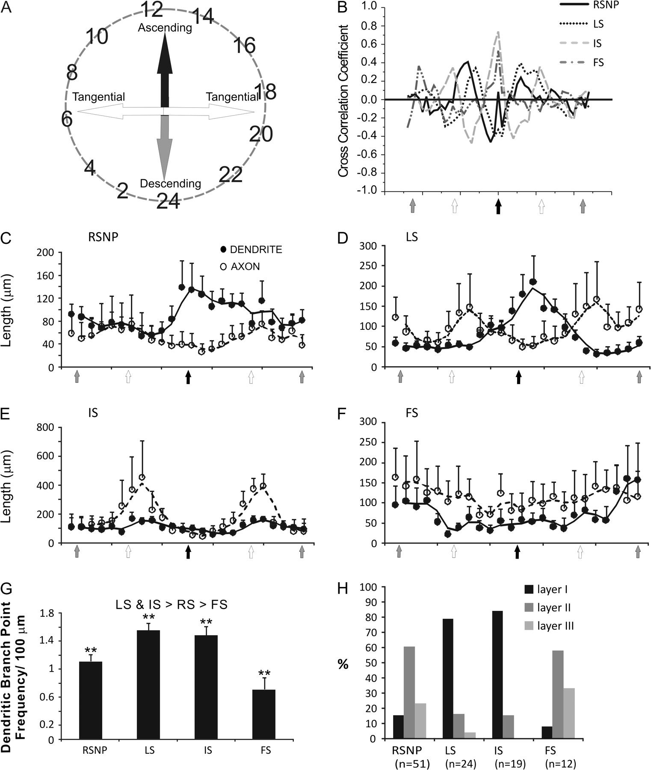
Figure 5. Interneuron axon and dendritic projection trajectory analysis. This figure was derived from the axonal and ...
Notes:
Figure 5. Interneuron axon and dendritic projection trajectory analysis. This figure was derived from the axonal and dendritic polar histogram data from cells of the 4 firing types that were morphologically reconstructed. Data, which, originally appeared in a circular fashion (A, see Materials and methods) were converted to 2 column data sets with the angular value representing the “X” axis and axonal (or dendritic) length representing the “Y” axis. The data from same group of interneurons were then averaged and analyzed. Open circles represent axons, and closed circles represent dendrites. The cell types include: RSNP (C), LS (D), IS (E), and FS cells (F). The CCC for each of the 4 firing types (B) indicates that the greater the CCC value for a given direction the greater the overlap between axons and dendrites for that direction. Note that dendrites and axons of IS cells (gray dashed line) had the largest CCC value toward the pial surface (black arrow in X axis), indicating that their axons and dendrites overlap the most when ascending, but the longest projections (but with less overlap) for both axons and dendrites occur tangentially (E). A bar graph indicates the average dendritic node frequency for each of the 4 firing types (G). Firing types were also segregated by their percentage per laminar location (H). **P < 0.01.
Unless provided in the caption above, the following copyright applies to the content of this slide: © The Author 2009. Published by Oxford University Press. All rights reserved. For permissions, please e-mail: journals.permissions@oxfordjournals.org

Slide 6
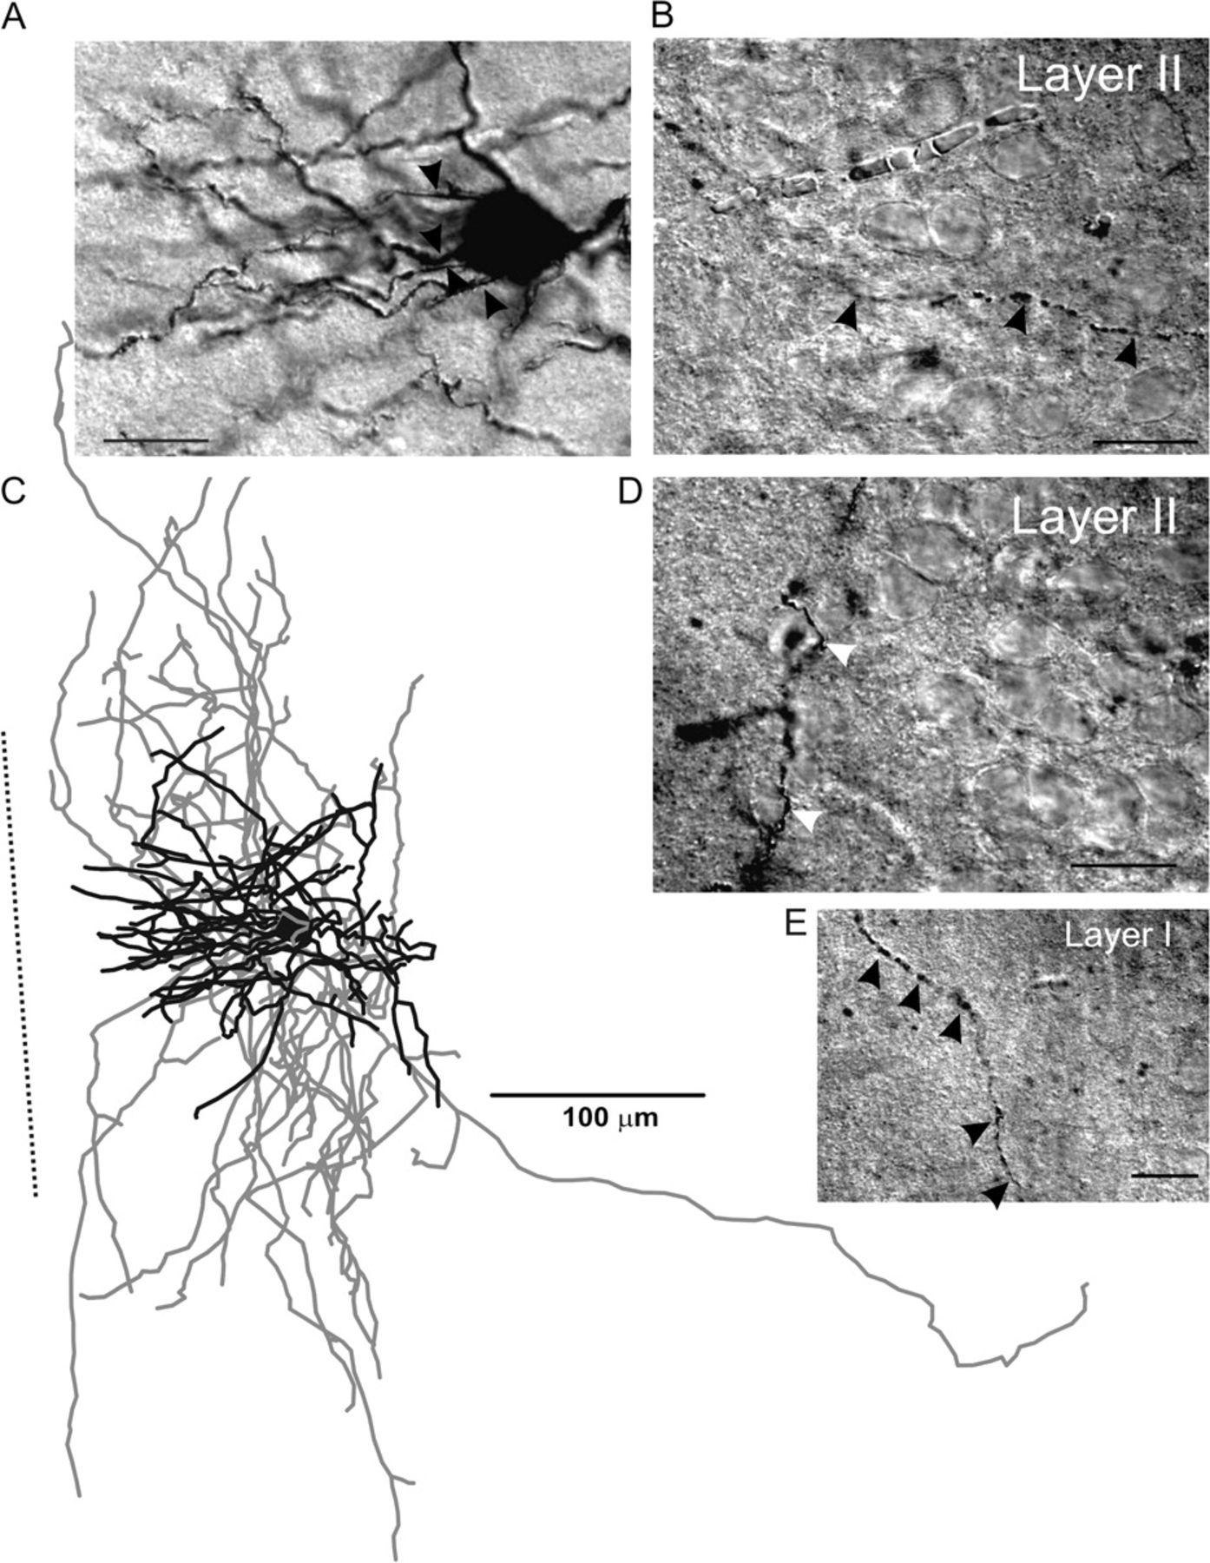
Figure 6. LS interneuron of the PPC. A typical example of a Neurolucida reconstruction of an LS cell (C). The dendrites ...
Notes:
Figure 6. LS interneuron of the PPC. A typical example of a Neurolucida reconstruction of an LS cell (C). The dendrites leave the cell body in clustered groups (A, black arrowhead), and the axons show distinct boutons present within both layer I (E) and layer II (B, D), with putative perisomatic synapses being formed rarely (D, white arrowheads). The spiking patterns for this cell are represented in Figure 1B. Scale bars in (A, B, D, E) = 20 μm; Scale bar in (C) = 100 μm.
Unless provided in the caption above, the following copyright applies to the content of this slide: © The Author 2009. Published by Oxford University Press. All rights reserved. For permissions, please e-mail: journals.permissions@oxfordjournals.org

Slide 7
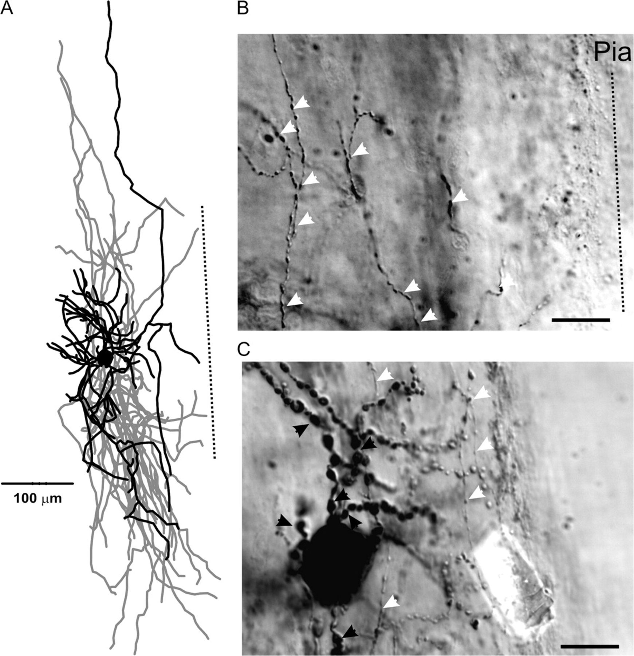
Figure 7. IS interneuron of the PPC. A typical example of a Neurolucida reconstruction of an IS cell (A). Dendrites ...
Notes:
Figure 7. IS interneuron of the PPC. A typical example of a Neurolucida reconstruction of an IS cell (A). Dendrites present a large beaded appearance, with numerous swellings (black arrowheads) along the extent of the processes. Axons possess numerous boutons (white arrowheads, C) at both proximal (C) and distal (B) locations from the cell body. The spiking patterns for this cell are represented in Figure 1C. Scale bar in panel (A) = 100 μm. Scale bars in panels (B, C) = 20 μm.
Unless provided in the caption above, the following copyright applies to the content of this slide: © The Author 2009. Published by Oxford University Press. All rights reserved. For permissions, please e-mail: journals.permissions@oxfordjournals.org

Slide 8
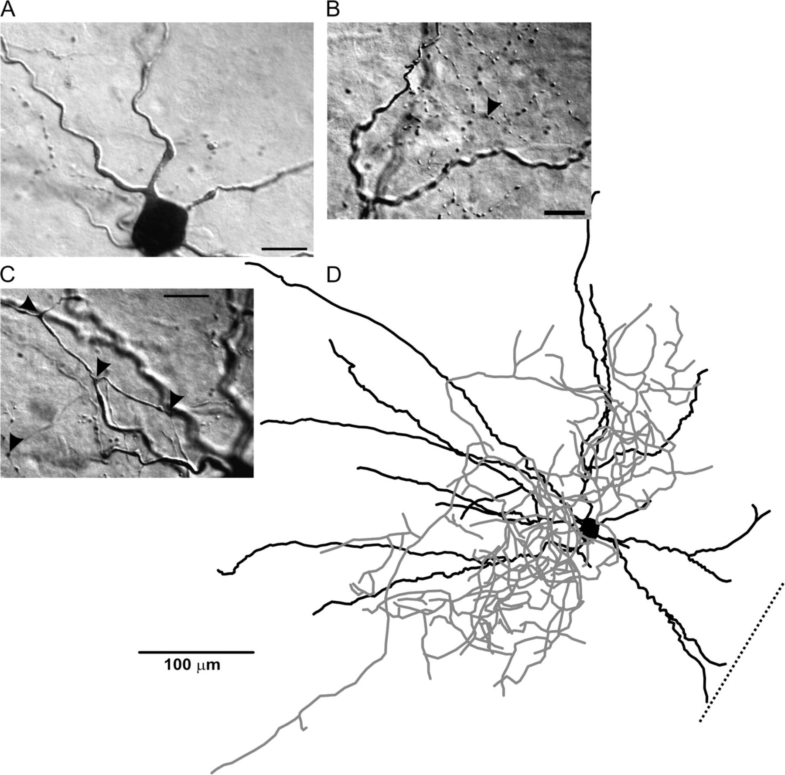
Figure 8. FS interneuron of the PPC. A typical example of a Neurolucida reconstruction of a FS cell (D). The dendrites ...
Notes:
Figure 8. FS interneuron of the PPC. A typical example of a Neurolucida reconstruction of a FS cell (D). The dendrites of FS cells were typically aspiny or smooth in appearance (A), and the axons typically showed numerous boutons (A, B) and enlargements at branching points (C). The spiking patterns for this cell are represented in Figure 1D. Scale bar in panel (D) = 100 μm. Scale bars in panels (A, B, C) = 15 μm.
Unless provided in the caption above, the following copyright applies to the content of this slide: © The Author 2009. Published by Oxford University Press. All rights reserved. For permissions, please e-mail: journals.permissions@oxfordjournals.org

Slide 9
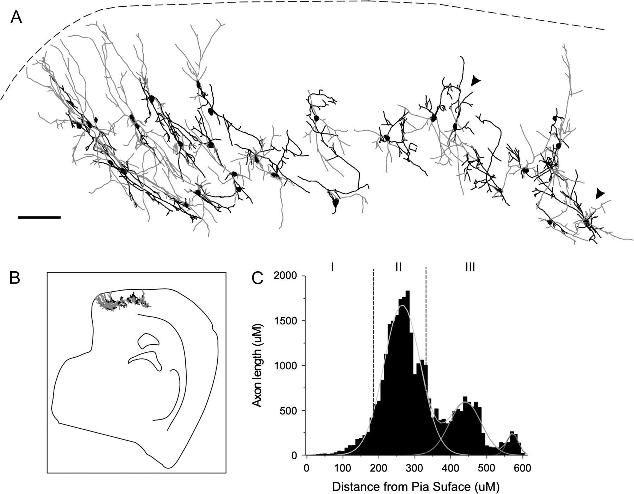
Figure 9. PV-positive interneurons within the PPC. Stylized slice showing reconstructed PV-positive cells found ...
Notes:
Figure 9. PV-positive interneurons within the PPC. Stylized slice showing reconstructed PV-positive cells found throughout the PPC (A). Dendrites are shown in black and axons in gray. These cells share anatomical characteristics with the recorded and reconstructed FS cells. Stylized low-magnification whole slice of the PPC, indicating cellular location (B). Axon length plotted against the distance from the pial surface (C) indicates the laminar distribution of PV-positive interneuron axons in the PPC. Scale bar = 100 μm.
Unless provided in the caption above, the following copyright applies to the content of this slide: © The Author 2009. Published by Oxford University Press. All rights reserved. For permissions, please e-mail: journals.permissions@oxfordjournals.org

Slide 10
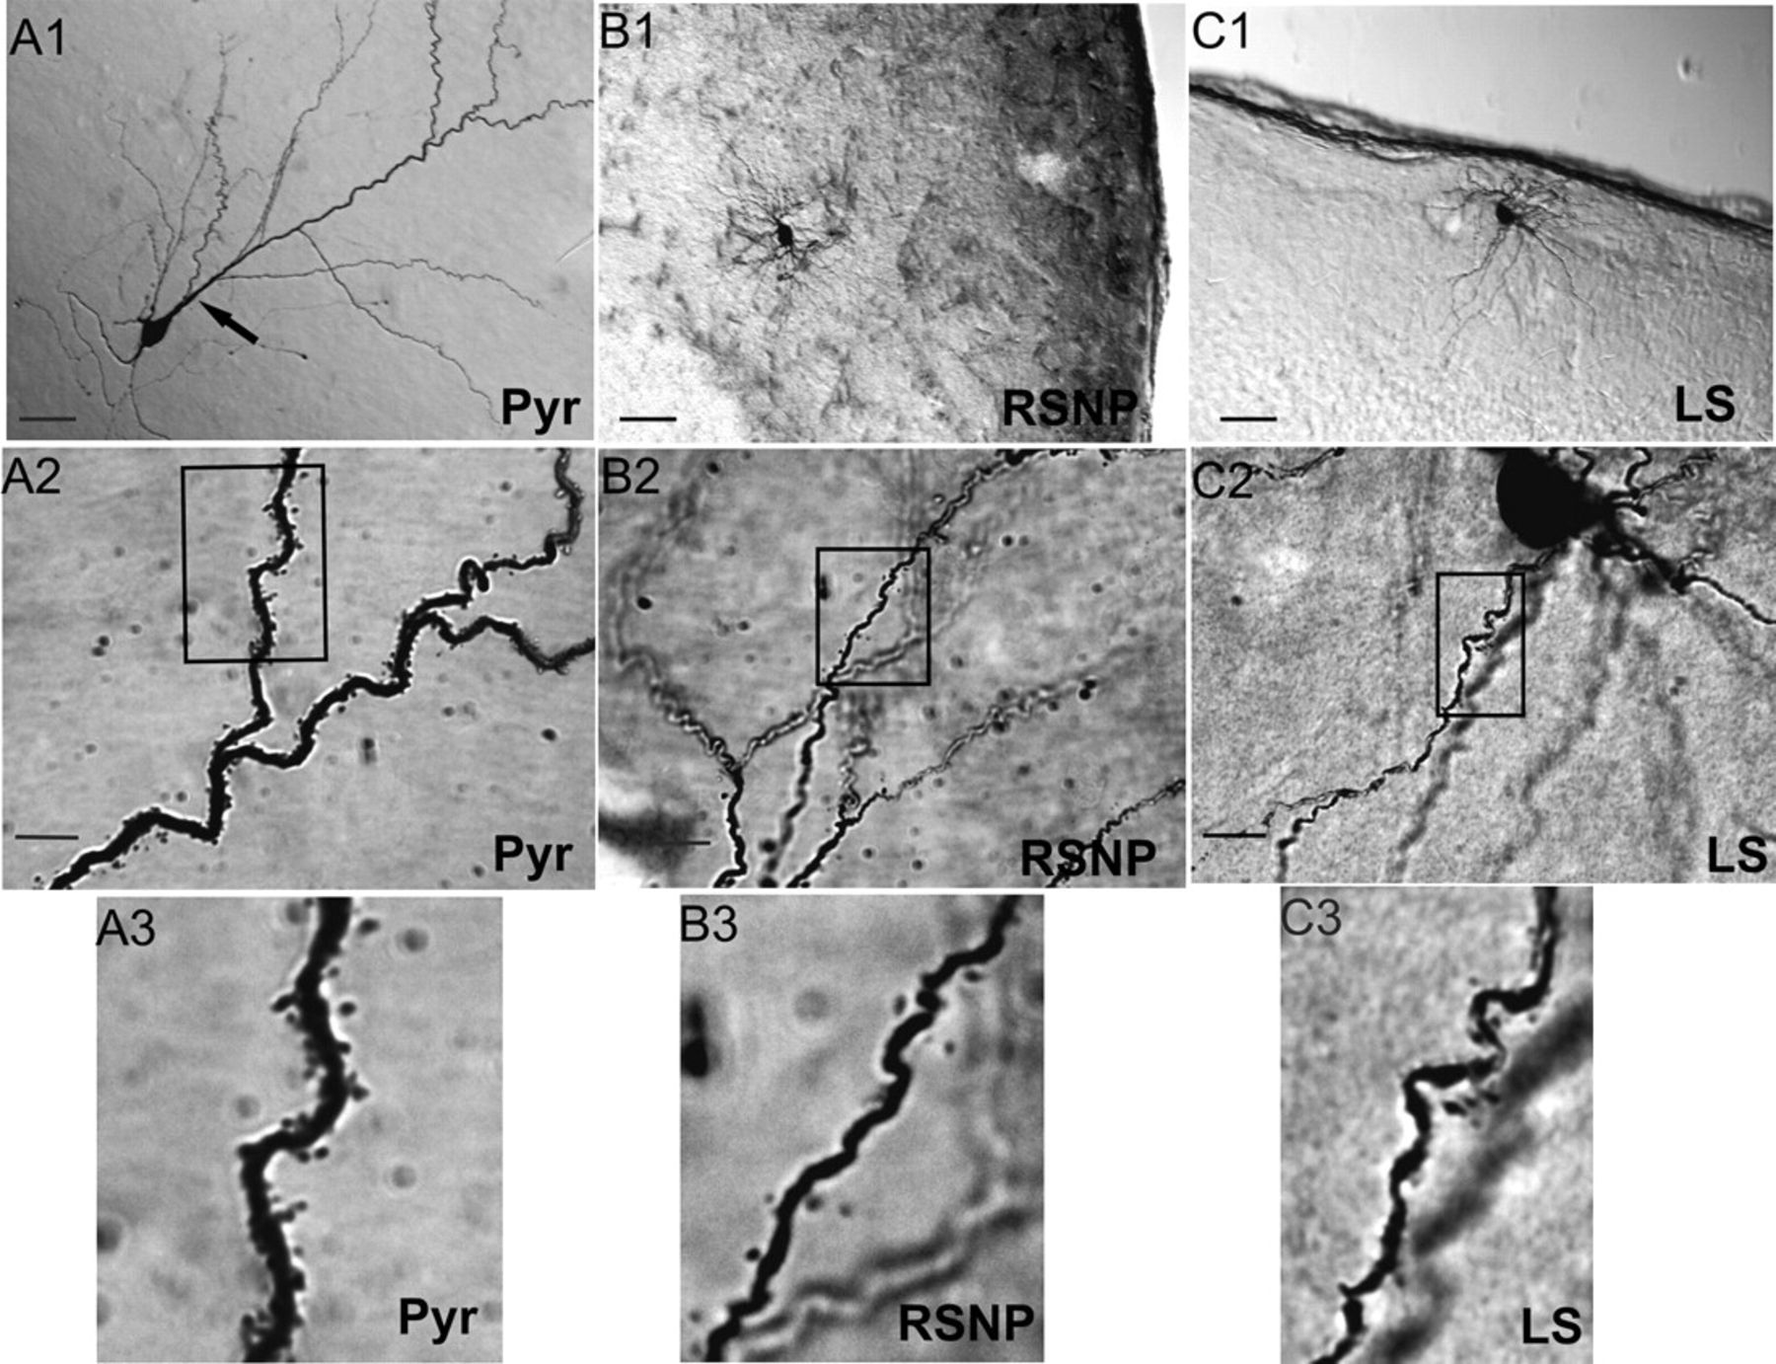
Figure 10. Three physiologically identified spiny neurons within the PPC. DAB-stained photomicrographs from 3 PPC neuron ...
Notes:
Figure 10. Three physiologically identified spiny neurons within the PPC. DAB-stained photomicrographs from 3 PPC neuron cell types: a layer II PYR (A), layer III RSNP (B), and layer I LS (C) cells were obtained with a light microscope using a ×20 objective (A1, B1, C1) or a ×100 oil immersion objective (A2, B2, C2), with the rectangle in these latter panels indicating the area of dendrites highlighted in the final panel (A3, B3, C3). Scale bar = 50 μm in (A1, B1, C1). Scale bar = 10 μm in (A2, B2, C2). Note the large apical dendritic trunk indicated by the black arrow (A1) and the high density of dendritic spines (A3) found on PYR cells.
Unless provided in the caption above, the following copyright applies to the content of this slide: © The Author 2009. Published by Oxford University Press. All rights reserved. For permissions, please e-mail: journals.permissions@oxfordjournals.org

Slide 11
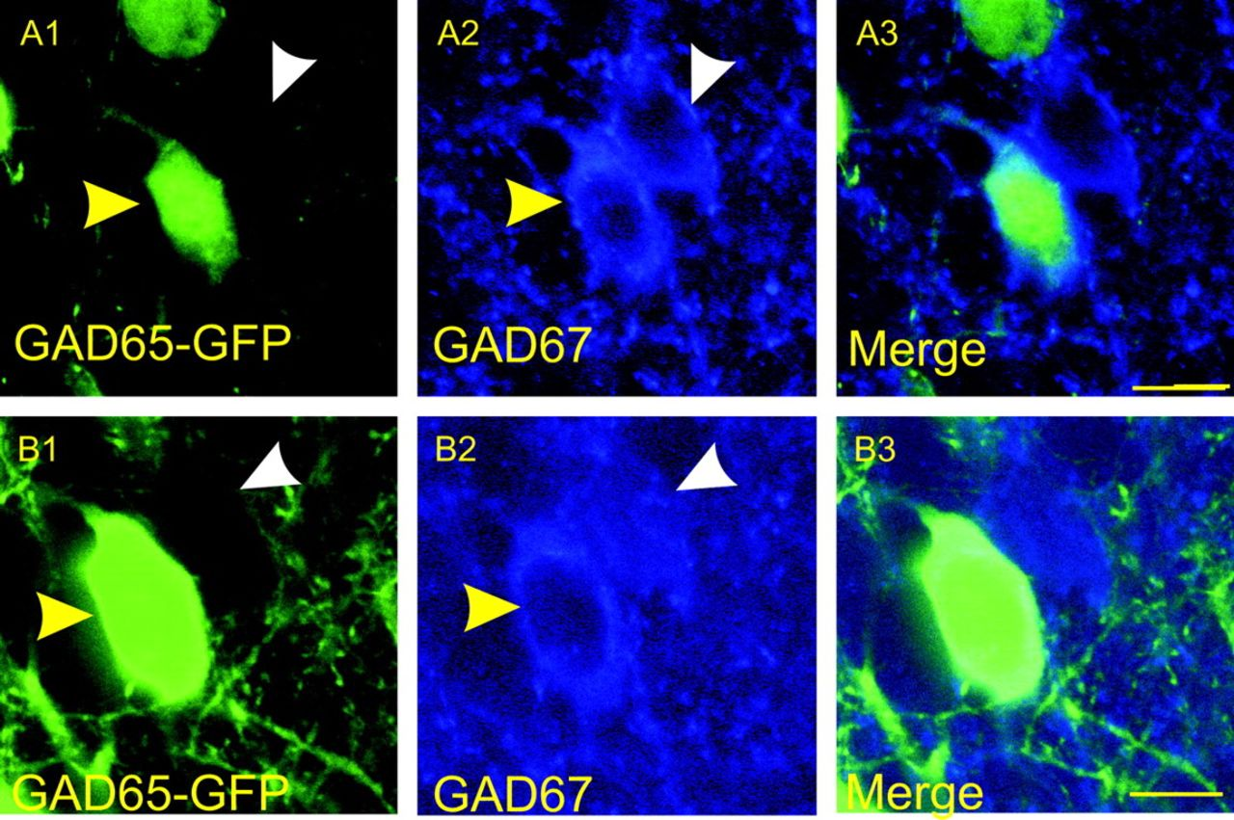
Figure 14. Confocal microscopy images of GAD65–GFP cells stained for GAD67. Images were obtained using a ×60 objective ...
Notes:
Figure 14. Confocal microscopy images of GAD65–GFP cells stained for GAD67. Images were obtained using a ×60 objective and represent cells obtained from a GAD65–GFP mouse and stained for GAD67. The intrinsic GAD65–GFP signal is represented (A1, B1), as well as GAD67-immunopositive cells (A2, B2), along with merged image (A3, B3). Cells that coexpress GAD65 and GAD67 are indicated by yellow arrowheads, whereas cells that express GAD67 with no apparent GAD65 signal are indicated by white arrowheads. Scale bar = 25 μm.
Unless provided in the caption above, the following copyright applies to the content of this slide: © The Author 2009. Published by Oxford University Press. All rights reserved. For permissions, please e-mail: journals.permissions@oxfordjournals.org

Slide 12
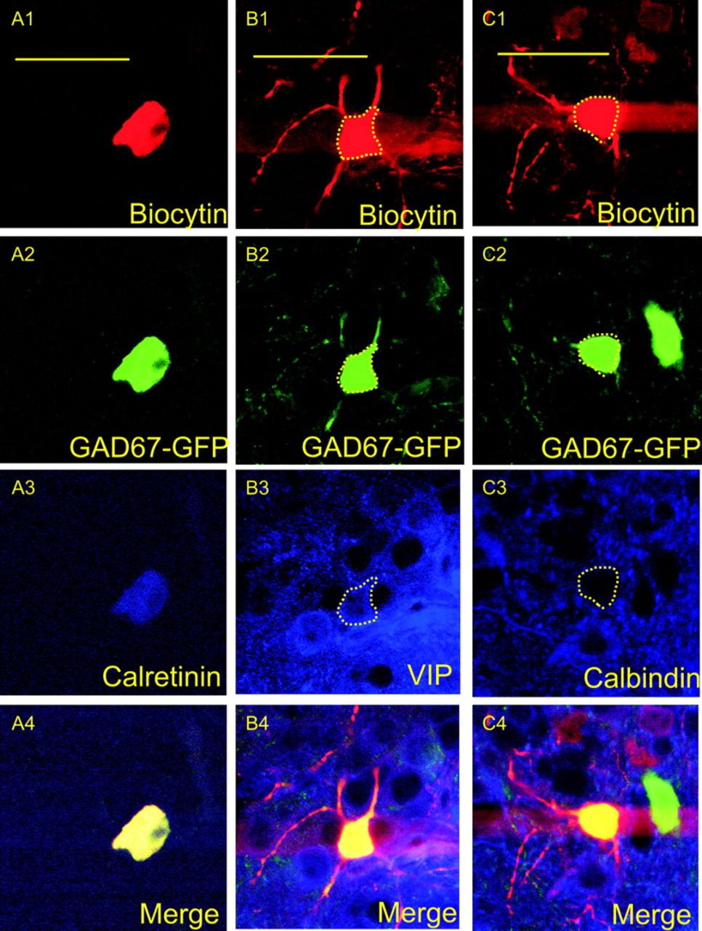
Figure 13. Confocal microscopy images of immunopositive interneurons. Images were obtained using a ×60 objective and ...
Notes:
Figure 13. Confocal microscopy images of immunopositive interneurons. Images were obtained using a ×60 objective and represent a single cell that was triple stained for neurobiotin (A1, B1, C1), GFP (A2, B2, C2), and CR (A3), VIP (B3), or calbindin (C3). The final panels represent the above 3 images merged together (A4, B4, C4). (A1–A4) are from an IS cell found in layer I-B of the PPC, (B1–B4) are from an RSNP cell found in layer II, and (C1–C4) are from an RSNP cell in layer II that was found to show no immunoreactivity for calbindin. Scale bar = 50 μm.
Unless provided in the caption above, the following copyright applies to the content of this slide: © The Author 2009. Published by Oxford University Press. All rights reserved. For permissions, please e-mail: journals.permissions@oxfordjournals.org

Slide 13
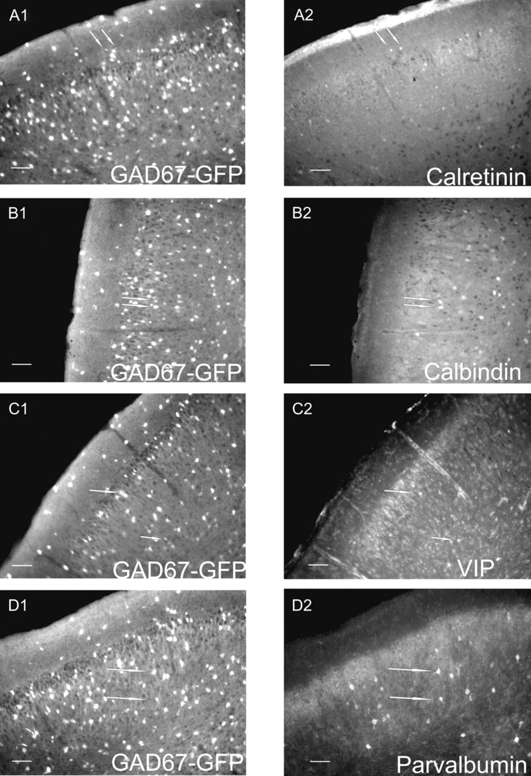
Figure 12. Fluorescent microscopy images of immunopositive interneurons. Whole-brain slices (50 μm) used for ...
Notes:
Figure 12. Fluorescent microscopy images of immunopositive interneurons. Whole-brain slices (50 μm) used for quantitative analysis and demonstrating intrinsic GAD67–GFP signal (A1, B1, C1, D1) and immunoreactivity for various molecular markers including CR (A2), calbindin (B2), VIP (C2), and PV (D2). White arrows are used to identify cells demonstrating coexpression. Scale bars = 100 μm.
Unless provided in the caption above, the following copyright applies to the content of this slide: © The Author 2009. Published by Oxford University Press. All rights reserved. For permissions, please e-mail: journals.permissions@oxfordjournals.org

Slide 14
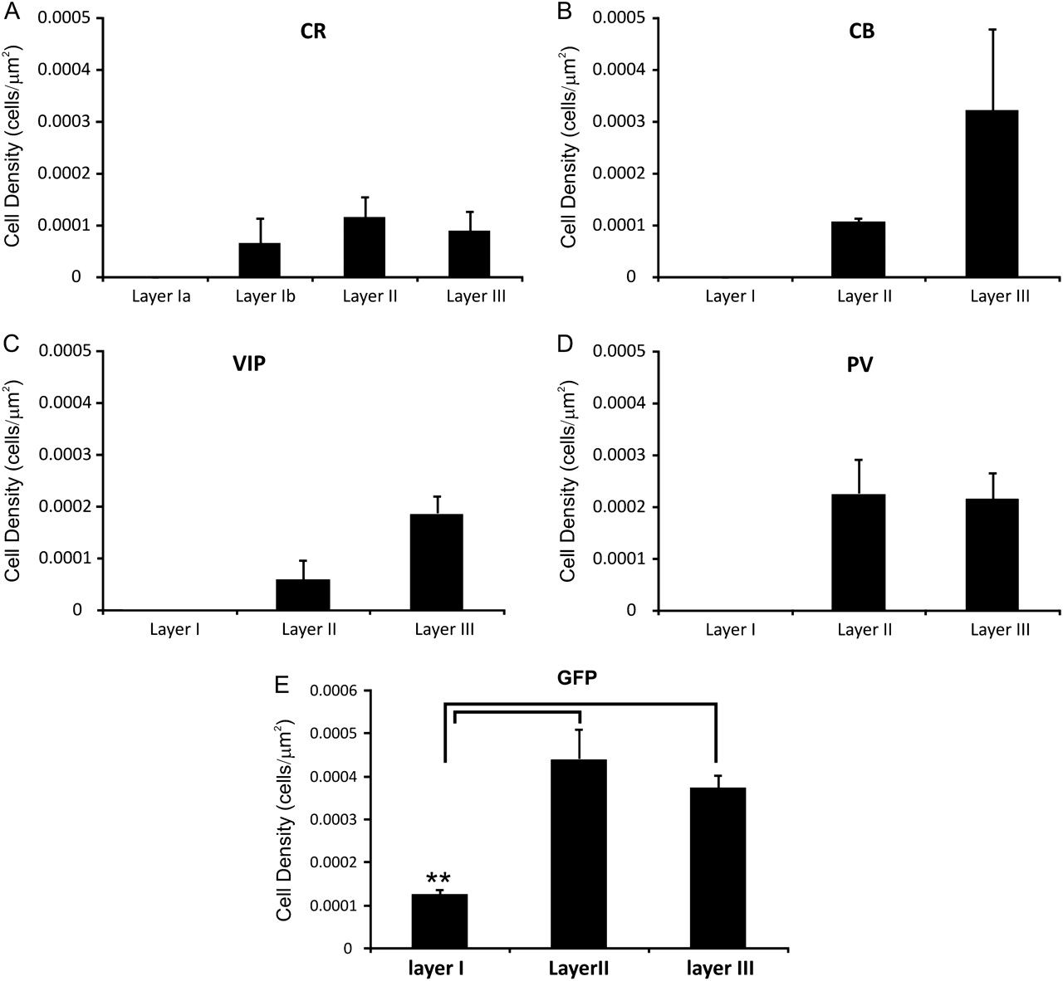
Figure 11. Cell density of immunopositive interneurons by laminar location. Bar graph representation of the number of ...
Notes:
Figure 11. Cell density of immunopositive interneurons by laminar location. Bar graph representation of the number of immunopositive cells found in each layer of the PPC following staining for CR (A), calbindin (B), VIP (C), PV (D), and GFP (E).
Unless provided in the caption above, the following copyright applies to the content of this slide: © The Author 2009. Published by Oxford University Press. All rights reserved. For permissions, please e-mail: journals.permissions@oxfordjournals.org

