Slide 1
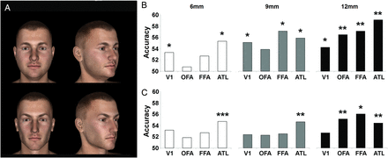
Figure 1. (A) Four example stimuli used for classification, generated with 3D graphics software. All stimuli are shown ...
Notes:
Figure 1. (A) Four example stimuli used for classification, generated with 3D graphics software. All stimuli are shown in Supplementary Figure 1. (B) Specific classification accuracy as a function of ROI size. (C) Tolerant classification accuracy as a function of ROI size. Tolerant classification was performed employing a cross-validation procedure in which a pattern classifier was trained to discriminate 2 face identities with data from 4 of the 5 viewpoints, and tested on the discrimination between the 2 identities seen in the fifth viewpoint, which was not used for training. *P < 0.05, **P < 0.005, ***P < 0.0005.
Unless provided in the caption above, the following copyright applies to the content of this slide: © The Author 2013. Published by Oxford University Press. All rights reserved. For Permissions, please e-mail: journals.permissions@oup.com

Slide 2
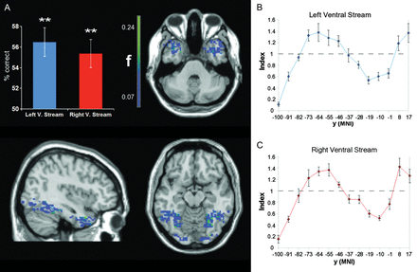
Figure 2. (A) SVM-based multivariate analysis reveals the presence of orientation-tolerant information about individual ...
Notes:
Figure 2. (A) SVM-based multivariate analysis reveals the presence of orientation-tolerant information about individual faces in the ventral stream in both hemispheres (left: accuracy = 56.48%, t(8) = 4.62, P < 0.005; right: accuracy = 55.37%, t(8) = 4.56, P < 0.005). The distribution of orientation-tolerant information in the ventral stream is illustrated with maps depicting the group-averaged frequency (f) with which each voxel was selected as 1 of the 200 optimal voxels for classification (separately for the 2 hemispheres). Maps are thresholded at the frequency with which a voxel would be selected if the optimal voxels were chosen randomly with a uniform distribution: (number of voxels selected)/(number of voxels in the mask). Error bars represent the standard error of the mean. **P < 0.005. (B) The ventral stream was divided into bins extending over a span of 3 voxels along the posterior to anterior dimension. The plots show an index given by the average probability with which voxels in a bin were among the 200 optimal voxels divided by the probability expected from a uniform distribution.
Unless provided in the caption above, the following copyright applies to the content of this slide: © The Author 2013. Published by Oxford University Press. All rights reserved. For Permissions, please e-mail: journals.permissions@oup.com

Slide 3
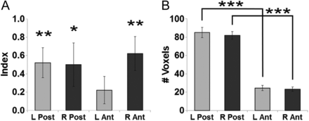
Figure 3. (A) The ratio of the above chance classification accuracy shown in Figure 2 (ratio index) is shown for the 4 ...
Notes:
Figure 3. (A) The ratio of the above chance classification accuracy shown in Figure 2 (ratio index) is shown for the 4 clusters considered individually. As the bars denote a ratio of the above chance classification accuracy, chance level is not at 0.5 but at 0. All clusters showed above chance classification, which reached significance in the right anterior cluster (P < 0.01), in the left posterior cluster (P < 0.01), and in the right posterior cluster (P < 0.05), and trended to significance in the left anterior cluster (P = 0.09). **P < 0.01, *P < 0.05. (B) Number of voxels in the individual clusters. Anterior clusters contain a smaller number of voxels than posterior clusters. ***P < 0.0001. Error bars represent the standard error of the mean.
Unless provided in the caption above, the following copyright applies to the content of this slide: © The Author 2013. Published by Oxford University Press. All rights reserved. For Permissions, please e-mail: journals.permissions@oup.com

Slide 4
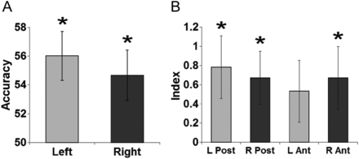
Figure 4. (A) Tolerant classification in the ventral stream of the 2 hemispheres when excluding from the training set ...
Notes:
Figure 4. (A) Tolerant classification in the ventral stream of the 2 hemispheres when excluding from the training set the views that are mirror symmetrical to the testing views; (B) ratio index for the 4 clusters of informative voxels when excluding the mirror symmetrical views from the training set. Error bars represent the standard error of the mean.
Unless provided in the caption above, the following copyright applies to the content of this slide: © The Author 2013. Published by Oxford University Press. All rights reserved. For Permissions, please e-mail: journals.permissions@oup.com

