Slide 1
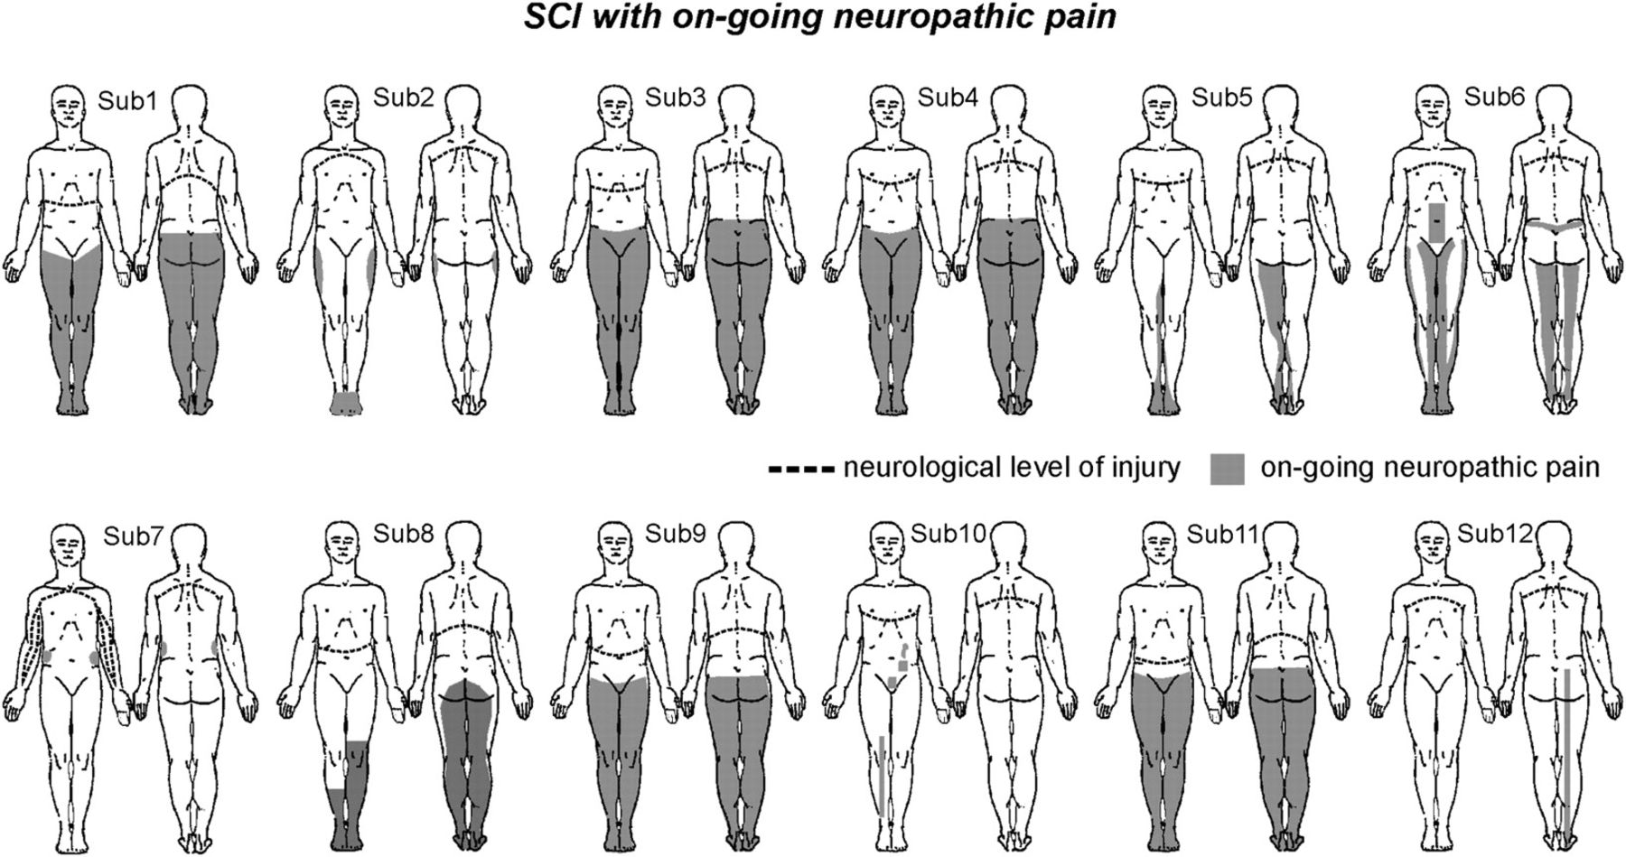
Figure 1. Diagrams illustrating the locations of ongoing pain in SCI subjects. The dark gray shading indicates the ...
Notes:
Figure 1. Diagrams illustrating the locations of ongoing pain in SCI subjects. The dark gray shading indicates the regions of ongoing pain and the dashed lines the neurological level of complete spinal injury. Note that the pain is always well below the neurological level of injury.
Unless provided in the caption above, the following copyright applies to the content of this slide: © The Author 2009. Published by Oxford University Press. All rights reserved. For permissions, please e-mail: journals.permissions@oxfordjournals.org

Slide 2
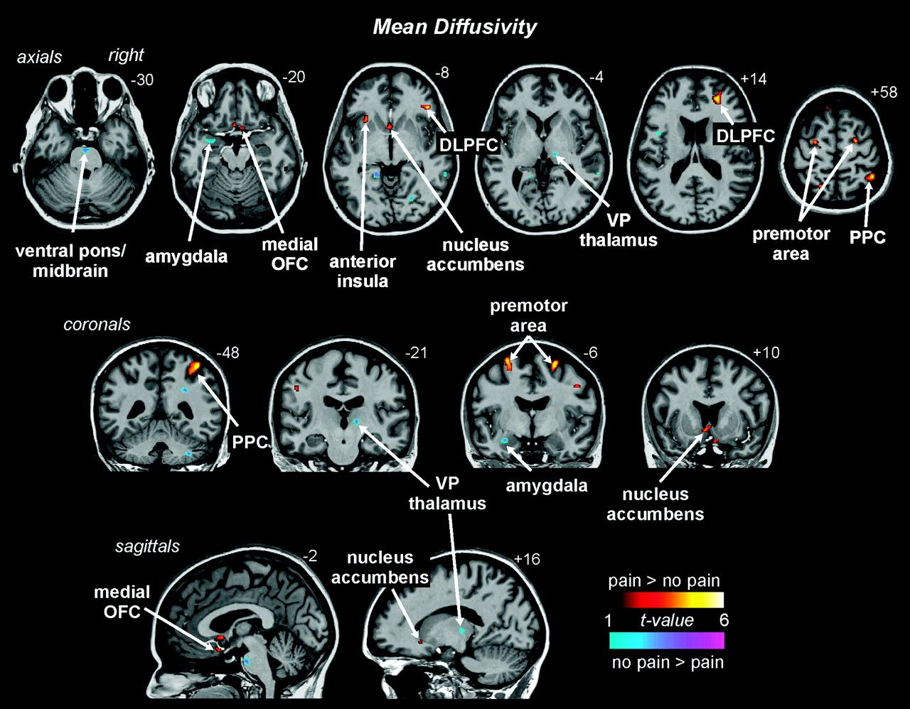
Figure 2. Regions showing significant differences in MD in SCI subjects with pain compared with SCI subjects without ...
Notes:
Figure 2. Regions showing significant differences in MD in SCI subjects with pain compared with SCI subjects without pain. The hot color scale indicates areas in which the MD values were higher in SCI subjects with pain and the cool color scale where MD values were lower in SCI subjects with pain. Significant clusters are overlaid onto a single subject's T1-weighted anatomical scan. The location of each slice in Montreal Neurological Institute space is shown at the top right of each section.
Unless provided in the caption above, the following copyright applies to the content of this slide: © The Author 2009. Published by Oxford University Press. All rights reserved. For permissions, please e-mail: journals.permissions@oxfordjournals.org

Slide 3
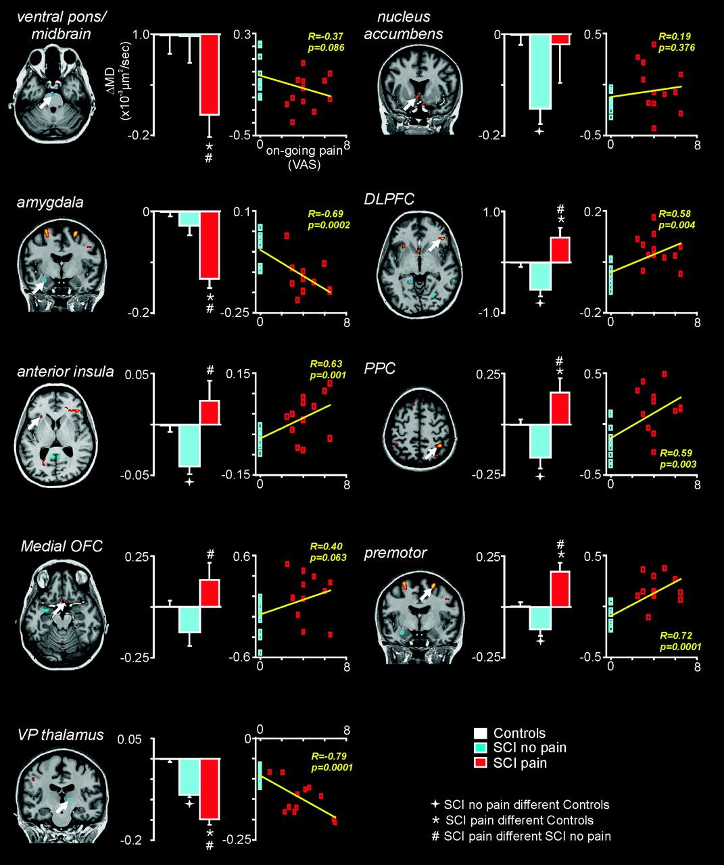
Figure 3. Bar graphs of MD (mean ± SEM) in control, SCI no pain, and SCI pain groups, calculated from the clusters of ...
Notes:
Figure 3. Bar graphs of MD (mean ± SEM) in control, SCI no pain, and SCI pain groups, calculated from the clusters of significant difference between SCI pain and SCI no pain subjects determined by the whole-brain voxel-by-voxel analysis (corrected for the effects of age). The location of each cluster is shown to the left of each bar graph. In addition, for the SCI no pain and SCI pain groups, each individual subjects’ MD value is plotted against ongoing pain intensity.
Unless provided in the caption above, the following copyright applies to the content of this slide: © The Author 2009. Published by Oxford University Press. All rights reserved. For permissions, please e-mail: journals.permissions@oxfordjournals.org

Slide 4
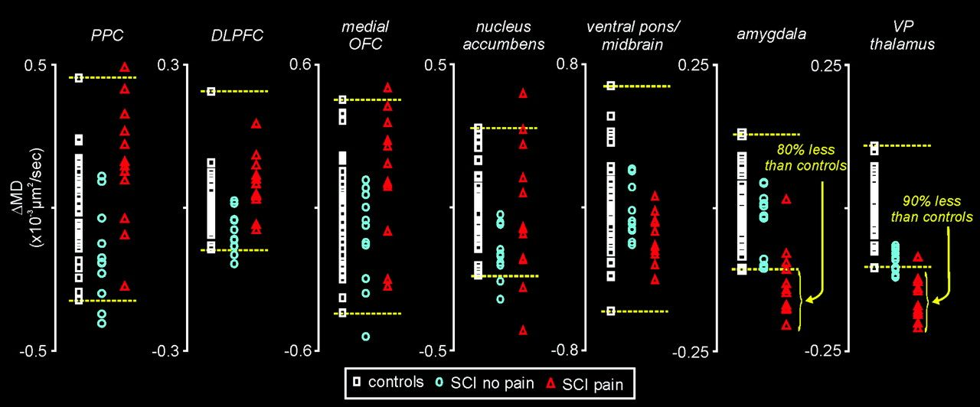
Figure 4. Graphs of individual subjects MD for each significant cluster. Note that for each cluster except for the VP ...
Notes:
Figure 4. Graphs of individual subjects MD for each significant cluster. Note that for each cluster except for the VP thalamus and amygdala, the individual SCI subjects’ MD values lay within the range of MD values for control subjects. In contrast, in the amygdala, the MD values of more than 80% of the SCI pain subjects were less than the lowest control MD value. Similarly, for the VP thalamus over 90% of the SCI pain subjects were also lower than the lowest control MD value. The horizontal dashed lines indicate the highest and lower MD value for control subjects.
Unless provided in the caption above, the following copyright applies to the content of this slide: © The Author 2009. Published by Oxford University Press. All rights reserved. For permissions, please e-mail: journals.permissions@oxfordjournals.org

Slide 5
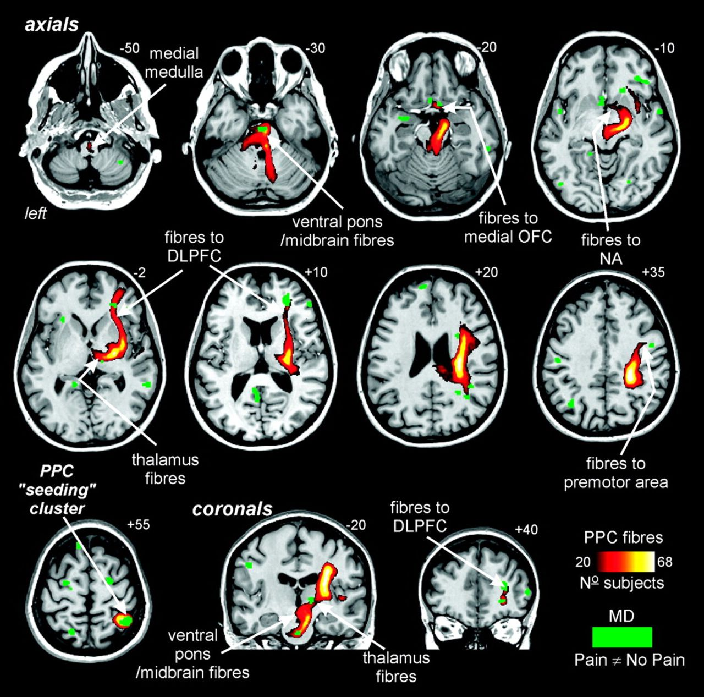
Figure 5. Overlay showing the output pathways of the right PPC. The hot color scale represents the frequency of ...
Notes:
Figure 5. Overlay showing the output pathways of the right PPC. The hot color scale represents the frequency of subjects displaying an output fiber originating in the PPC. The green shading represents the clusters of significant MD differences derived from the whole-brain analysis. Note that the PPC projects directly to other clusters of significant difference such as the ventral pons/midbrain, medial OFC, DLPFC, and VP thalamus.
Unless provided in the caption above, the following copyright applies to the content of this slide: © The Author 2009. Published by Oxford University Press. All rights reserved. For permissions, please e-mail: journals.permissions@oxfordjournals.org

Slide 6
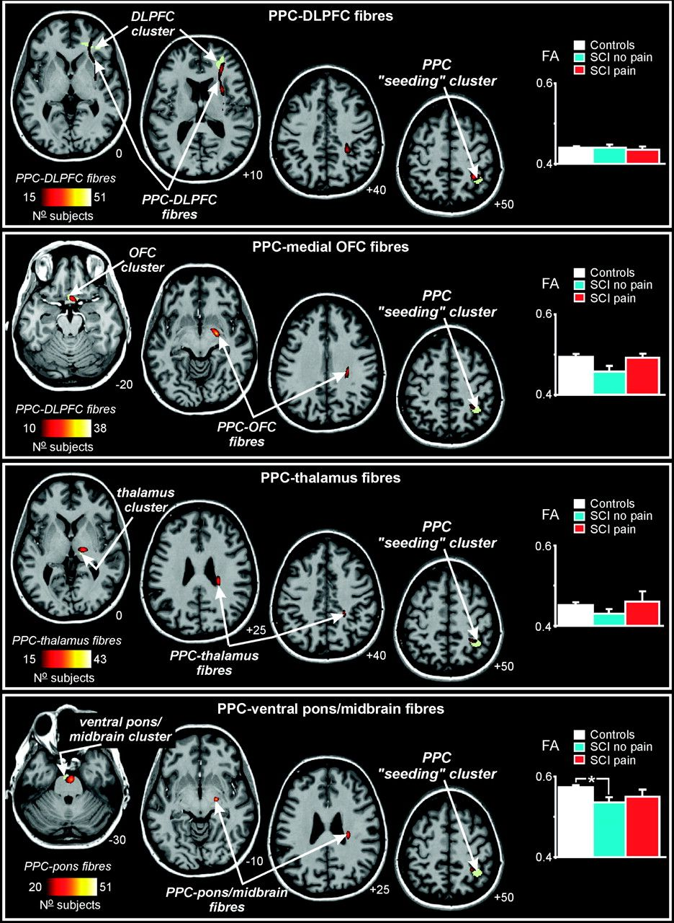
Figure 6. Overlay showing individual output pathways of the right PPC to other clusters displaying significantly ...
Notes:
Figure 6. Overlay showing individual output pathways of the right PPC to other clusters displaying significantly different MD values in SCI pain compared with SCI no pain subjects. The hot color scale represents the frequency of subjects displaying an output fiber originating in the PPC. The green shading represents the clusters of significant MD differences derived from the whole-brain analysis. For each fiber pathway, the FA (mean ± SEM) is plotted as a bar graph in the left side of each panel.
Unless provided in the caption above, the following copyright applies to the content of this slide: © The Author 2009. Published by Oxford University Press. All rights reserved. For permissions, please e-mail: journals.permissions@oxfordjournals.org

