Slide 1
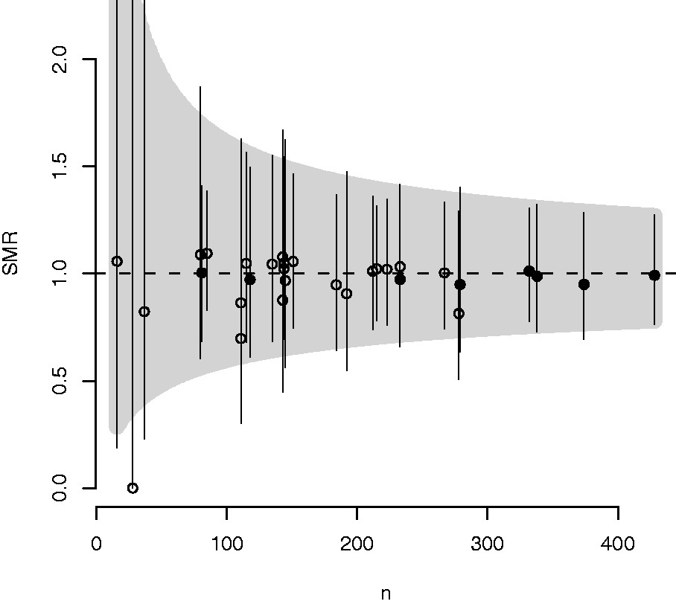
Figure 1 Funnel plot of the SMR against total number of observations in study period (12 years) for 31 hospitals with ...
Notes:
Figure 1 Funnel plot of the SMR against total number of observations in study period (12 years) for 31 hospitals with 95% control region around the reference of 1. Control limits as well as local control intervals are constructed using the the Wilson score method. Units with an average total annual number of admissions (<1250 g) ≥30 neonates are shown as solid circles, and those <30 as open circles. Because of the exclusion criteria, some of the larger units (solid fill) have smaller number of oservations (n), and thus appear shifted to the left. This is mainly the consequence of high rates of transferrals for these units
Unless provided in the caption above, the following copyright applies to the content of this slide: © The Author 2013. Published by Oxford University Press on behalf of the European Public Health Association. All rights reserved.

