Slide 1
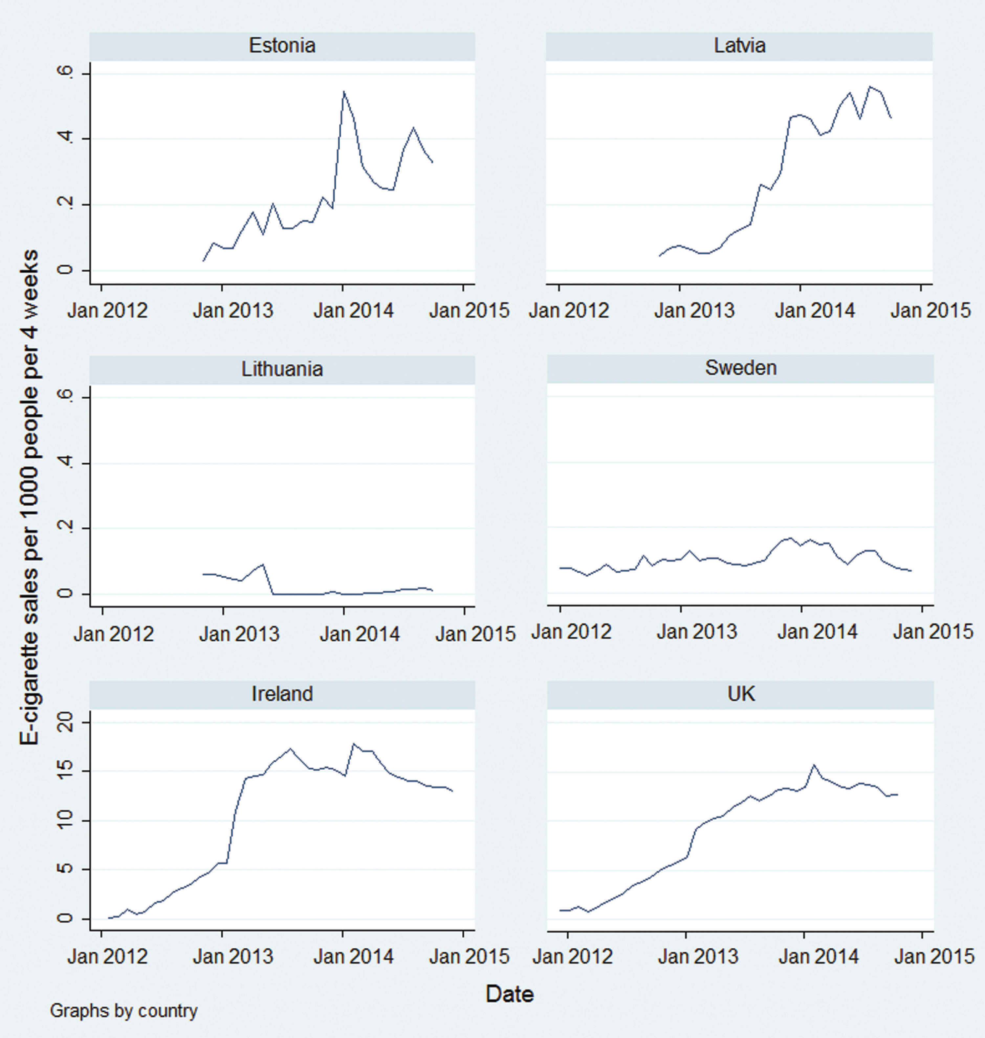
Figure 1. E-cigarette sales. Note: E-cigarette sales volumes presented in this figure are for Nielsen-affiliated ...
Notes:
Figure 1. E-cigarette sales. Note: E-cigarette sales volumes presented in this figure are for Nielsen-affiliated vendors only.
Unless provided in the caption above, the following copyright applies to the content of this slide: © The Author 2016. Published by Oxford University Press on behalf of the Society for Research on Nicotine and Tobacco. All rights reserved. For permissions, please e-mail: journals.permissions@oup.com.

