Slide 1
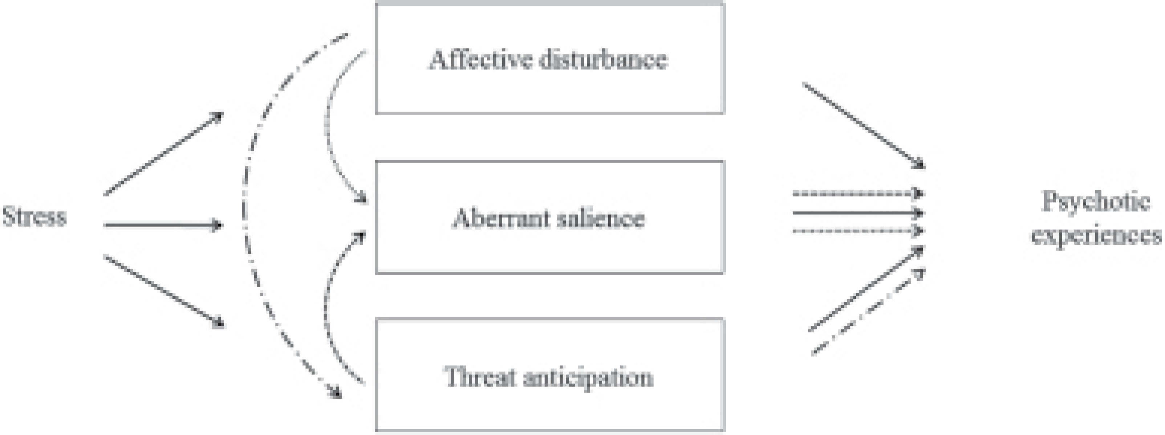
Fig. 1. Schematic representation of pathways tested within each group: the following hypotheses were tested within ...
Notes:
Fig. 1. Schematic representation of pathways tested within each group: the following hypotheses were tested within each group: (1) stressful contexts and experiences in daily life increase the intensity of psychotic experiences through their impact on affective disturbance, enhanced threat anticipation, and aberrant salience (); (2) affective disturbance increases the intensity of psychotic experiences through enhanced threat anticipation () and aberrant salience (); and (3) enhanced threat anticipation increases intensity of psychotic experiences through their impact on experiences of aberrant salience (), while controlling for age, gender, ethnicity, level of education, employment status, area-related stress, and outsider status as potential confounders.
Unless provided in the caption above, the following copyright applies to the content of this slide: © The Author 2017. Published by Oxford University Press on behalf of the Maryland Psychiatric Research Center. All rights reserved. For permissions, please email: journals.permissions@oup.com

Slide 2
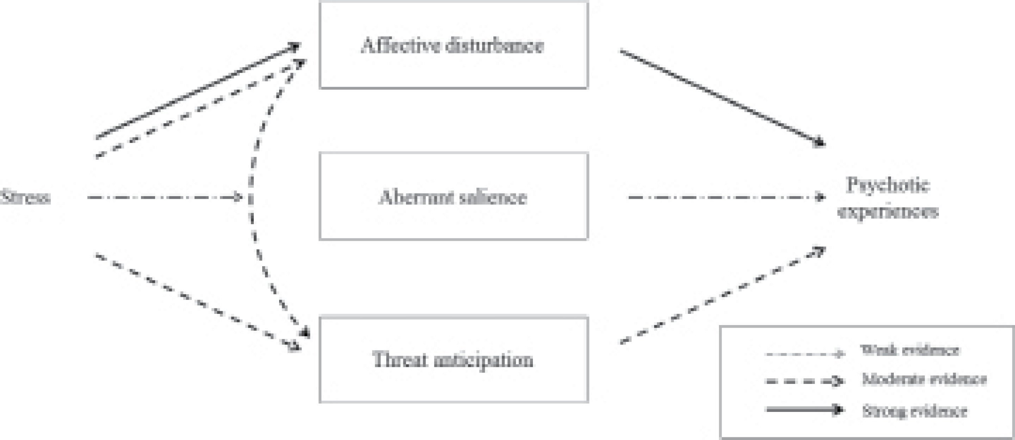
Fig. 2. Schematic representation of main findings across groups. This figure gives an overview of indirect effects of ...
Notes:
Fig. 2. Schematic representation of main findings across groups. This figure gives an overview of indirect effects of stress on psychotic experiences via pathways through affective disturbance, enhanced threat anticipation, and aberrant salience. Only findings with at least one significant indirect path in at least one group were considered in this representation. See supplementary figure 1 for a detailed breakdown of significant (P < .05) indirect effects for each group and marker of stress. For pathways through affective disturbance, strong and consistent evidence () was observed across all 3 groups. For pathways through threat anticipation as well as through affective disturbance and threat anticipation (), the strength and consistency of evidence was, overall, moderate across the 3 groups. Overall, weak and inconsistent evidence was found for pathways through aberrant salience ().
Unless provided in the caption above, the following copyright applies to the content of this slide: © The Author 2017. Published by Oxford University Press on behalf of the Maryland Psychiatric Research Center. All rights reserved. For permissions, please email: journals.permissions@oup.com

