Slide 1
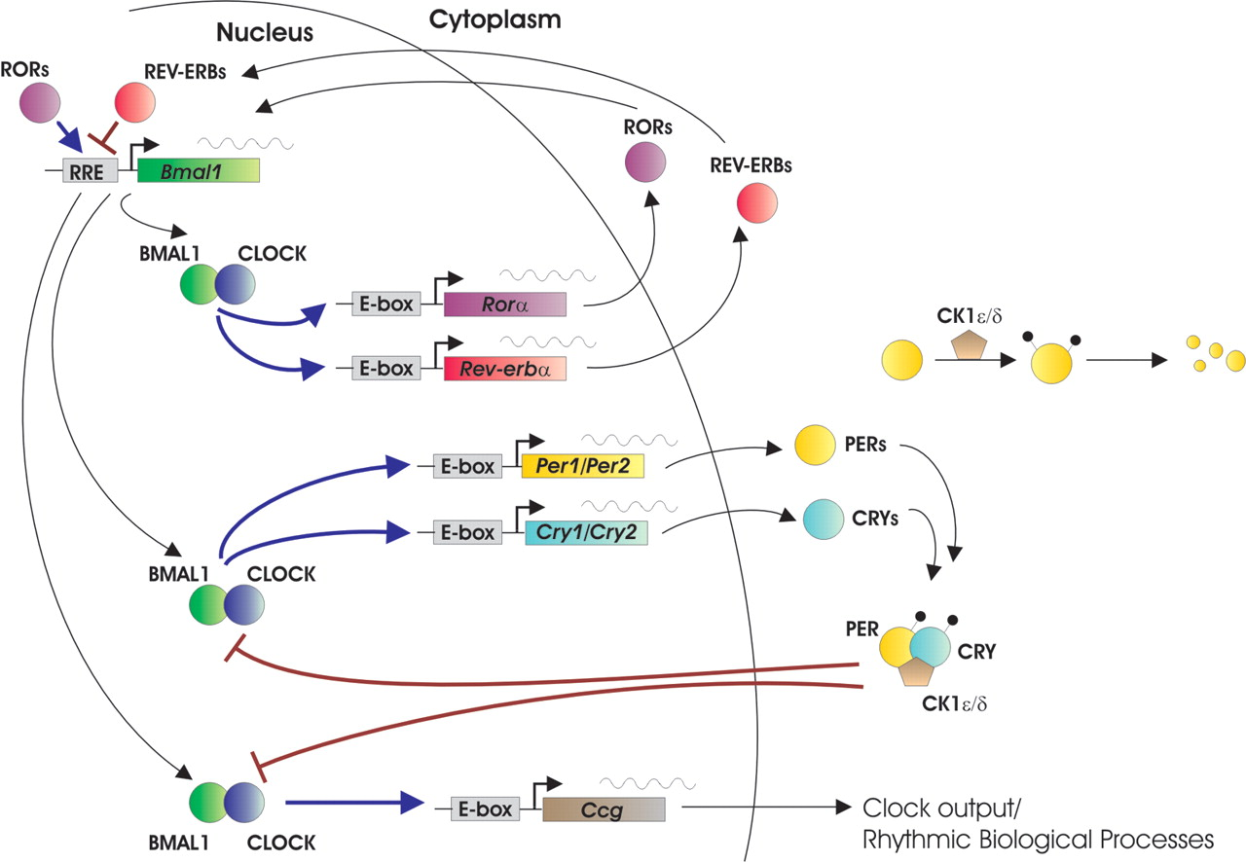
Figure 1. A network of transcriptional–translational feedback loops constitutes the mammalian circadian clock.
Notes:
Figure 1. A network of transcriptional–translational feedback loops constitutes the mammalian circadian clock.
Unless provided in the caption above, the following copyright applies to the content of this slide: © The Author 2006. Published by Oxford University Press. All rights reserved. For Permissions, please email: journals.permissions@oxfordjournals.org

