Slide 1
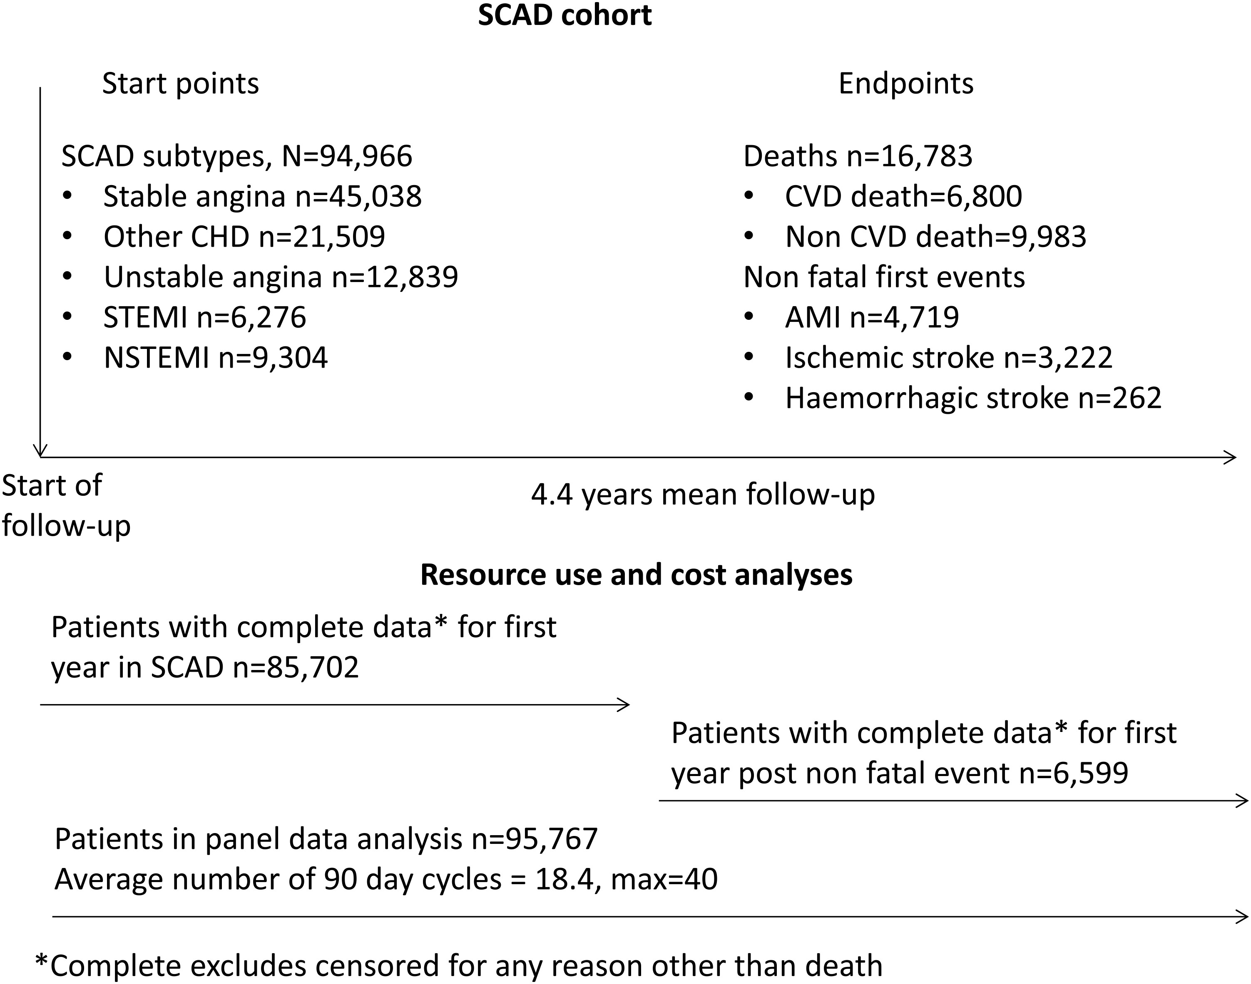
Figure 1 Stable coronary artery disease cohort.
Notes:
Figure 1 Stable coronary artery disease cohort.
Unless provided in the caption above, the following copyright applies to the content of this slide: © The Author 2016. Published by Oxford University Press on behalf of the European Society of Cardiology.This is an Open Access article distributed under the terms of the Creative Commons Attribution License (http://creativecommons.org/licenses/by/4.0/), which permits unrestricted reuse, distribution, and reproduction in any medium, provided the original work is properly cited.

Slide 2
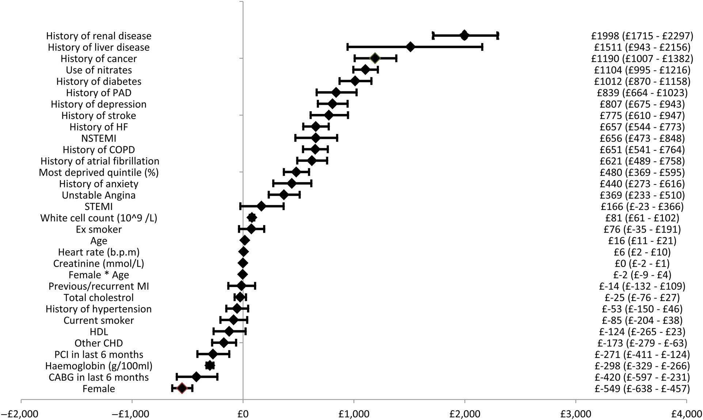
Figure 2 Forest plot of incremental costs associated with covariates.
Notes:
Figure 2 Forest plot of incremental costs associated with covariates.
Unless provided in the caption above, the following copyright applies to the content of this slide: © The Author 2016. Published by Oxford University Press on behalf of the European Society of Cardiology.This is an Open Access article distributed under the terms of the Creative Commons Attribution License (http://creativecommons.org/licenses/by/4.0/), which permits unrestricted reuse, distribution, and reproduction in any medium, provided the original work is properly cited.

Slide 3
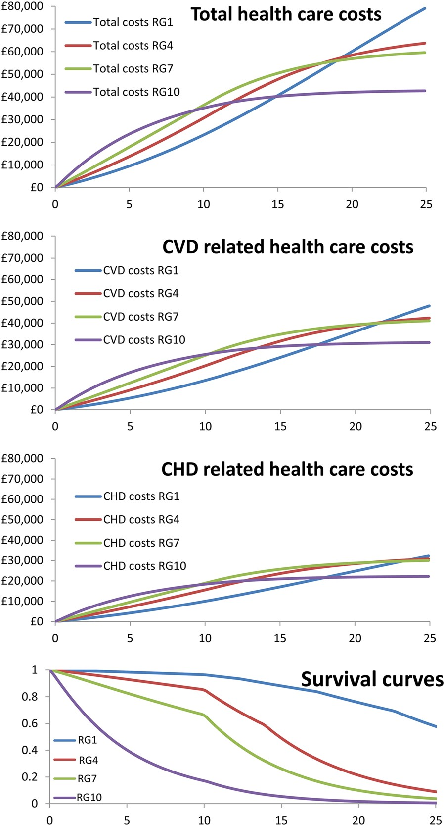
Figure 3 Expected costs and survival over time for patients representative of risk deciles 1, 4, 7, and 10. CHD, ...
Notes:
Figure 3 Expected costs and survival over time for patients representative of risk deciles 1, 4, 7, and 10. CHD, coronary heart disease; CVD, cardiovascular disease; RG, risk decile.
Unless provided in the caption above, the following copyright applies to the content of this slide: © The Author 2016. Published by Oxford University Press on behalf of the European Society of Cardiology.This is an Open Access article distributed under the terms of the Creative Commons Attribution License (http://creativecommons.org/licenses/by/4.0/), which permits unrestricted reuse, distribution, and reproduction in any medium, provided the original work is properly cited.

Slide 4
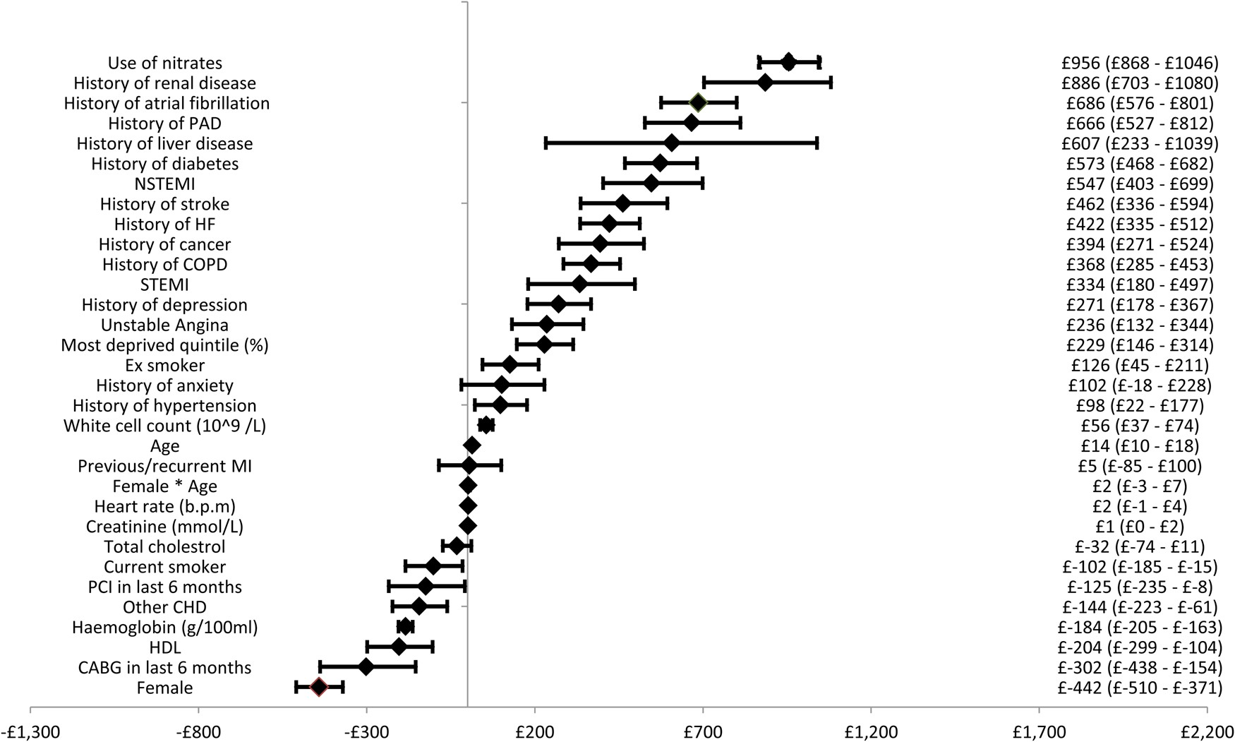
Figure A1 Forest plot of cardiovascular disease costs.
Notes:
Figure A1 Forest plot of cardiovascular disease costs.
Unless provided in the caption above, the following copyright applies to the content of this slide: © The Author 2016. Published by Oxford University Press on behalf of the European Society of Cardiology.This is an Open Access article distributed under the terms of the Creative Commons Attribution License (http://creativecommons.org/licenses/by/4.0/), which permits unrestricted reuse, distribution, and reproduction in any medium, provided the original work is properly cited.

Slide 5
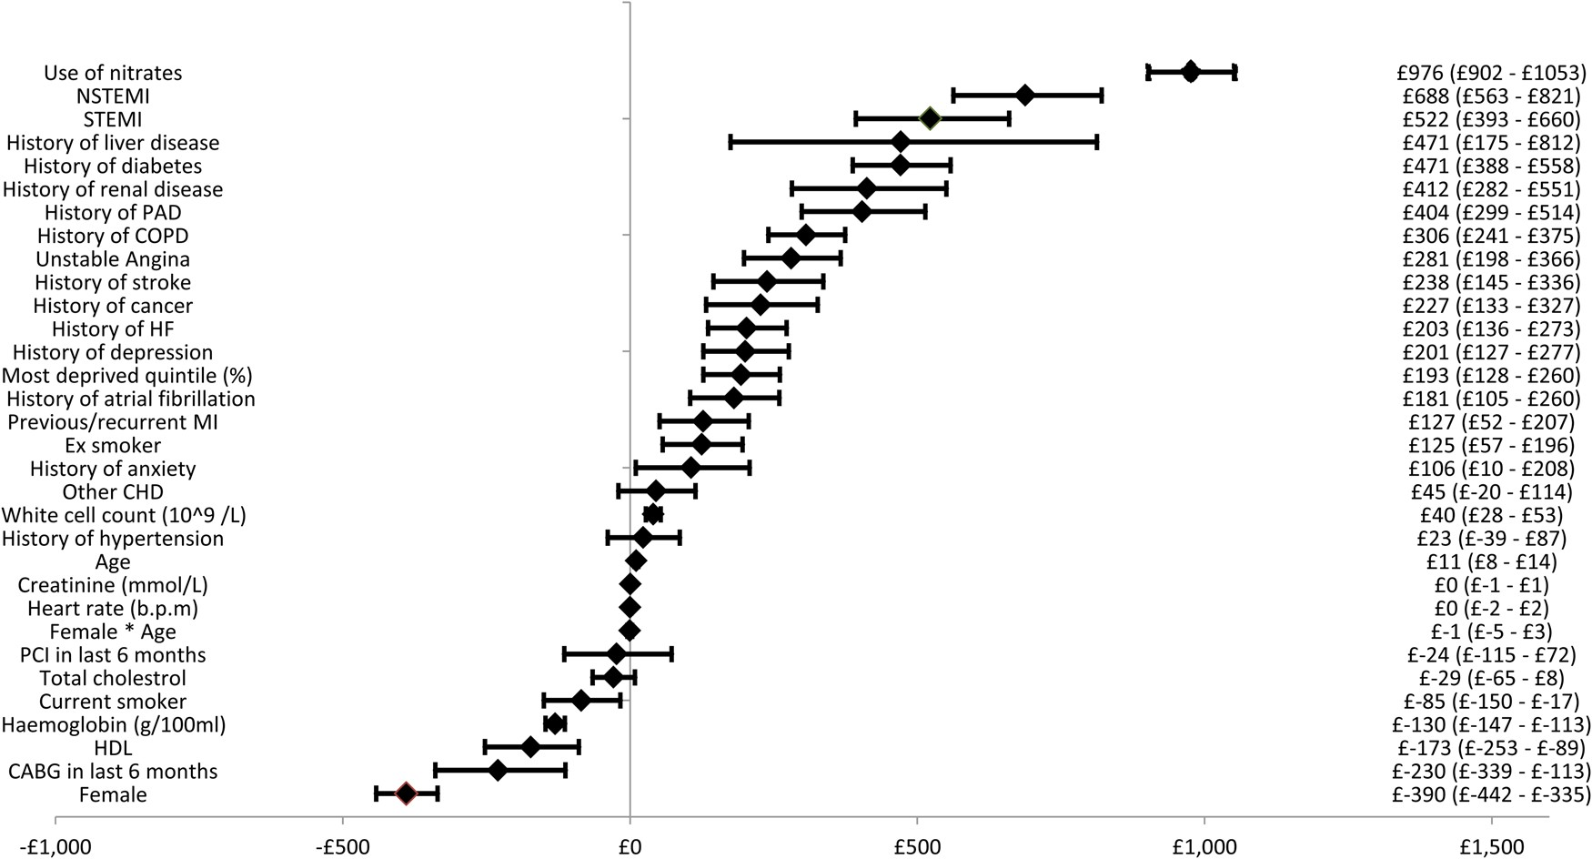
Figure A2 Forest plot of coronary heart disease costs.
Notes:
Figure A2 Forest plot of coronary heart disease costs.
Unless provided in the caption above, the following copyright applies to the content of this slide: © The Author 2016. Published by Oxford University Press on behalf of the European Society of Cardiology.This is an Open Access article distributed under the terms of the Creative Commons Attribution License (http://creativecommons.org/licenses/by/4.0/), which permits unrestricted reuse, distribution, and reproduction in any medium, provided the original work is properly cited.

