Slide 1
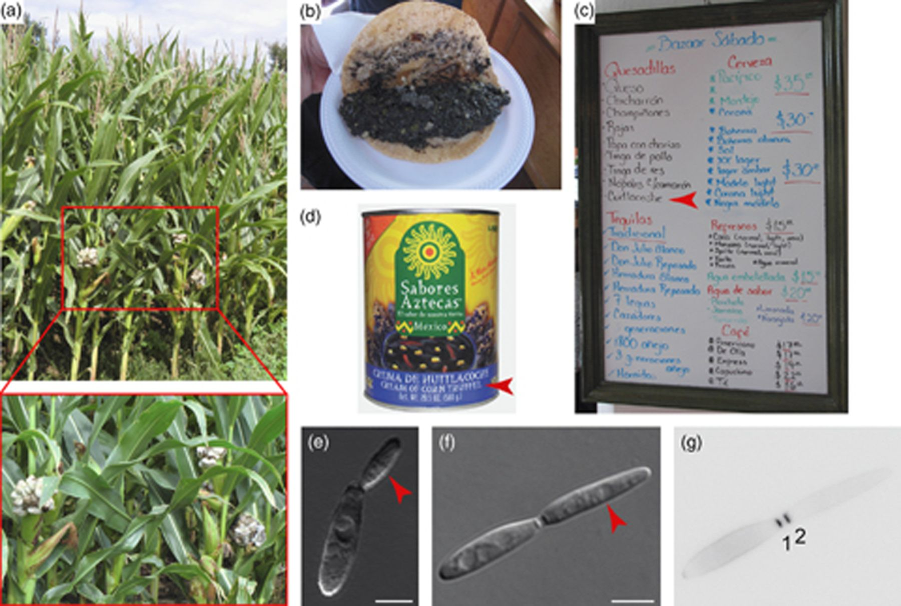
Figure 1 The good and the evil: Ustilago maydis as a delicacy and a pathogen. (a) Corn field close to Marburg, ...
Notes:
Figure 1 The good and the evil: Ustilago maydis as a delicacy and a pathogen. (a) Corn field close to Marburg, Germany. Infected plants can be seen in the foreground and enlarged at the bottom (picture taken by R. Kellner). (b) Quesadilla cuitlacoche (open) from the street restaurant ‘Bazaar Sábado’ in Mexico City. (c) Menu of the restaurant (2009). Arrowhead indicates Quesadilla cuitlacoche. (d) Tin filled with U. maydis-infected corn sold as ‘cream of corn truffle’ (arrowhead). (e, f) Haploid cells proliferate by budding (arrowheads indicate buds, two different stages are shown; size bar=5 μm). (g) Primary (1) and secondary (2) septum were stained with Calcofluor white (inverted image).
Unless provided in the caption above, the following copyright applies to the content of this slide: © 2011 Federation of European Microbiological Societies.

Slide 2
Figure 2 Mating on the plant surface. Two haploid cells (coloured yellow and red in the middle panel) landed in close ...
Notes:
Figure 2 Mating on the plant surface. Two haploid cells (coloured yellow and red in the middle panel) landed in close proximity on the plant surface. Conjugation tubes (coloured yellow and red in the right panel) grew towards each other and fused at their tips. The resulting filament (coloured orange in the right panel) with two nuclei (coloured yellow and red in the right panel; note that their position is an approximation) grows on the plant surface [the uncoloured figure on the left is reprinted from Kämper et al. (2006) with permission from the Nature Publishing Group].
Unless provided in the caption above, the following copyright applies to the content of this slide: © 2011 Federation of European Microbiological Societies.

Slide 3
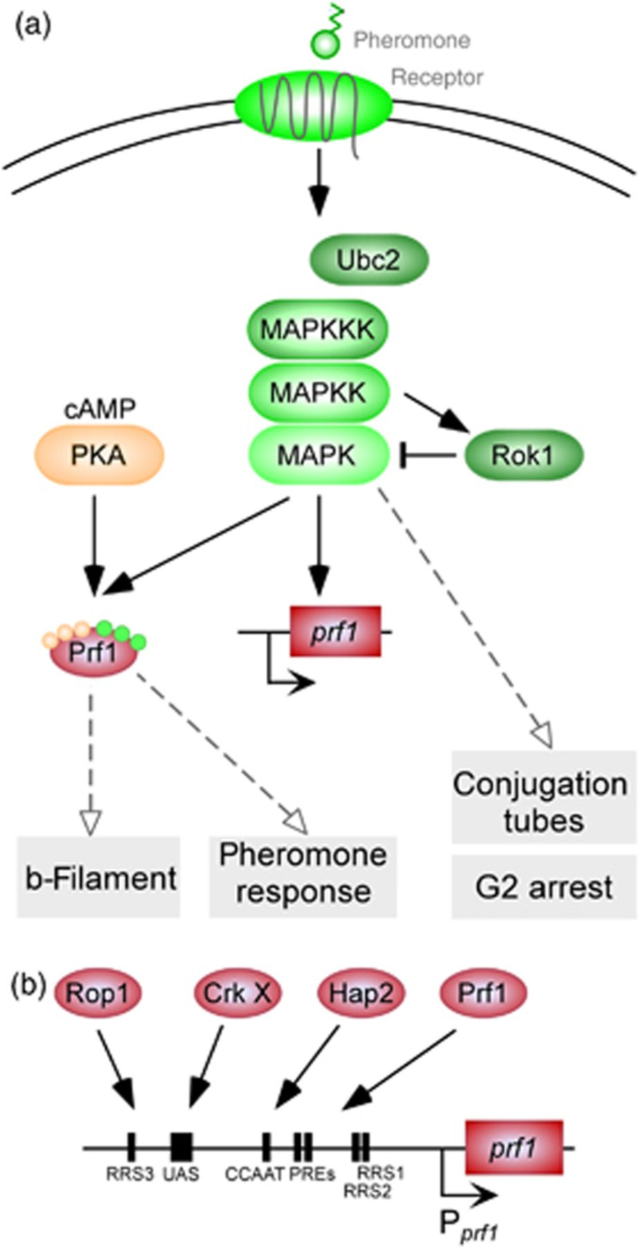
Figure 3 Networks of signalling and transcription factors regulate the pheromone response. (a) Schematic ...
Notes:
Figure 3 Networks of signalling and transcription factors regulate the pheromone response. (a) Schematic representation of the pheromone signalling network. Lipopeptide pheromone (a1 or a2, encoded by mfa1 or mfa2, respectively) activates its cognate seven-transmembrane domain receptor (Pra2 or Pra1, respectively). The activated receptor triggers a signalling pathway containing the scaffold protein Ubc2 and a pheromone-responsive MAPK module (MAPKKK Kpp4, MAPKK Fuz7 and MAPK Kpp2). The MAPK regulates Prf1 via phosphorylation and at the transcriptional level. In addition, the MAPK module regulates two Prf1-independent events: conjugation tube formation and cell cycle arrest in G2. MAPK activity is counteracted by phosphatase Rok1, which is activated at the transcriptional level by the MAPK module, resulting in negative feedback regulation. Crosstalk occurs at the level of cAMP signalling. cAMP-dependent PKA phosphorylates Prf1. This is apparently a prerequisite for signalling and a connection to environmental signals (see text). (b) At least four different transcription factors, Rop1, Crk X (yet unknown Crk1-dependent transcription factor) Hap2 and Prf1 (shown as ovals), recognize defined cis-active elements in the prf1 promoter (RRS1–3, Rop1-responsive sequence; CCAAT, CAT box; PREs, pheromone response elements; UAS, upstream activating sequence; bent arrow, transcriptional start site). Thereby, various environmental and nutritional signals could be funnelled into the pheromone response.
Unless provided in the caption above, the following copyright applies to the content of this slide: © 2011 Federation of European Microbiological Societies.

Slide 4
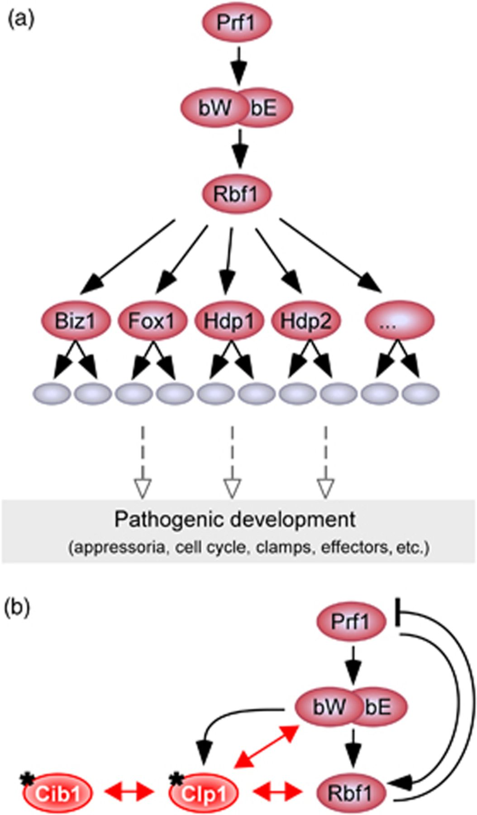
Figure 4 Intensive transcriptional networking determines pathogenicity. (a) Schematic representation showing a cascade ...
Notes:
Figure 4 Intensive transcriptional networking determines pathogenicity. (a) Schematic representation showing a cascade of transcription factors (red ovals) during the regulation of filamentous growth and further pathogenic development. Various target genes encoding regulatory, structural and enzymatic factors are indicated by grey ovals. (b) The central transcription factor cascade Prf1>bW/bE>Rbf1 is subject to intensive regulation. At the transcriptional level, Prf1 activates Rbf1 during pheromone response, whereas Rbf1 mediates the repression of Prf1 at later stages. The clp1 gene is one of the few direct targets of bW/bE. Moreover, Clp1 regulates the activity of bW/bE and Rbf1 at the level of protein/protein interaction (red arrowheads). Clp1 activity is influenced by its interaction with Cib1. Another level of complexity (symbolized by asterisks) is the regulation of Cib1 and Clp1 expression at the post-transcriptional level.
Unless provided in the caption above, the following copyright applies to the content of this slide: © 2011 Federation of European Microbiological Societies.

Slide 5
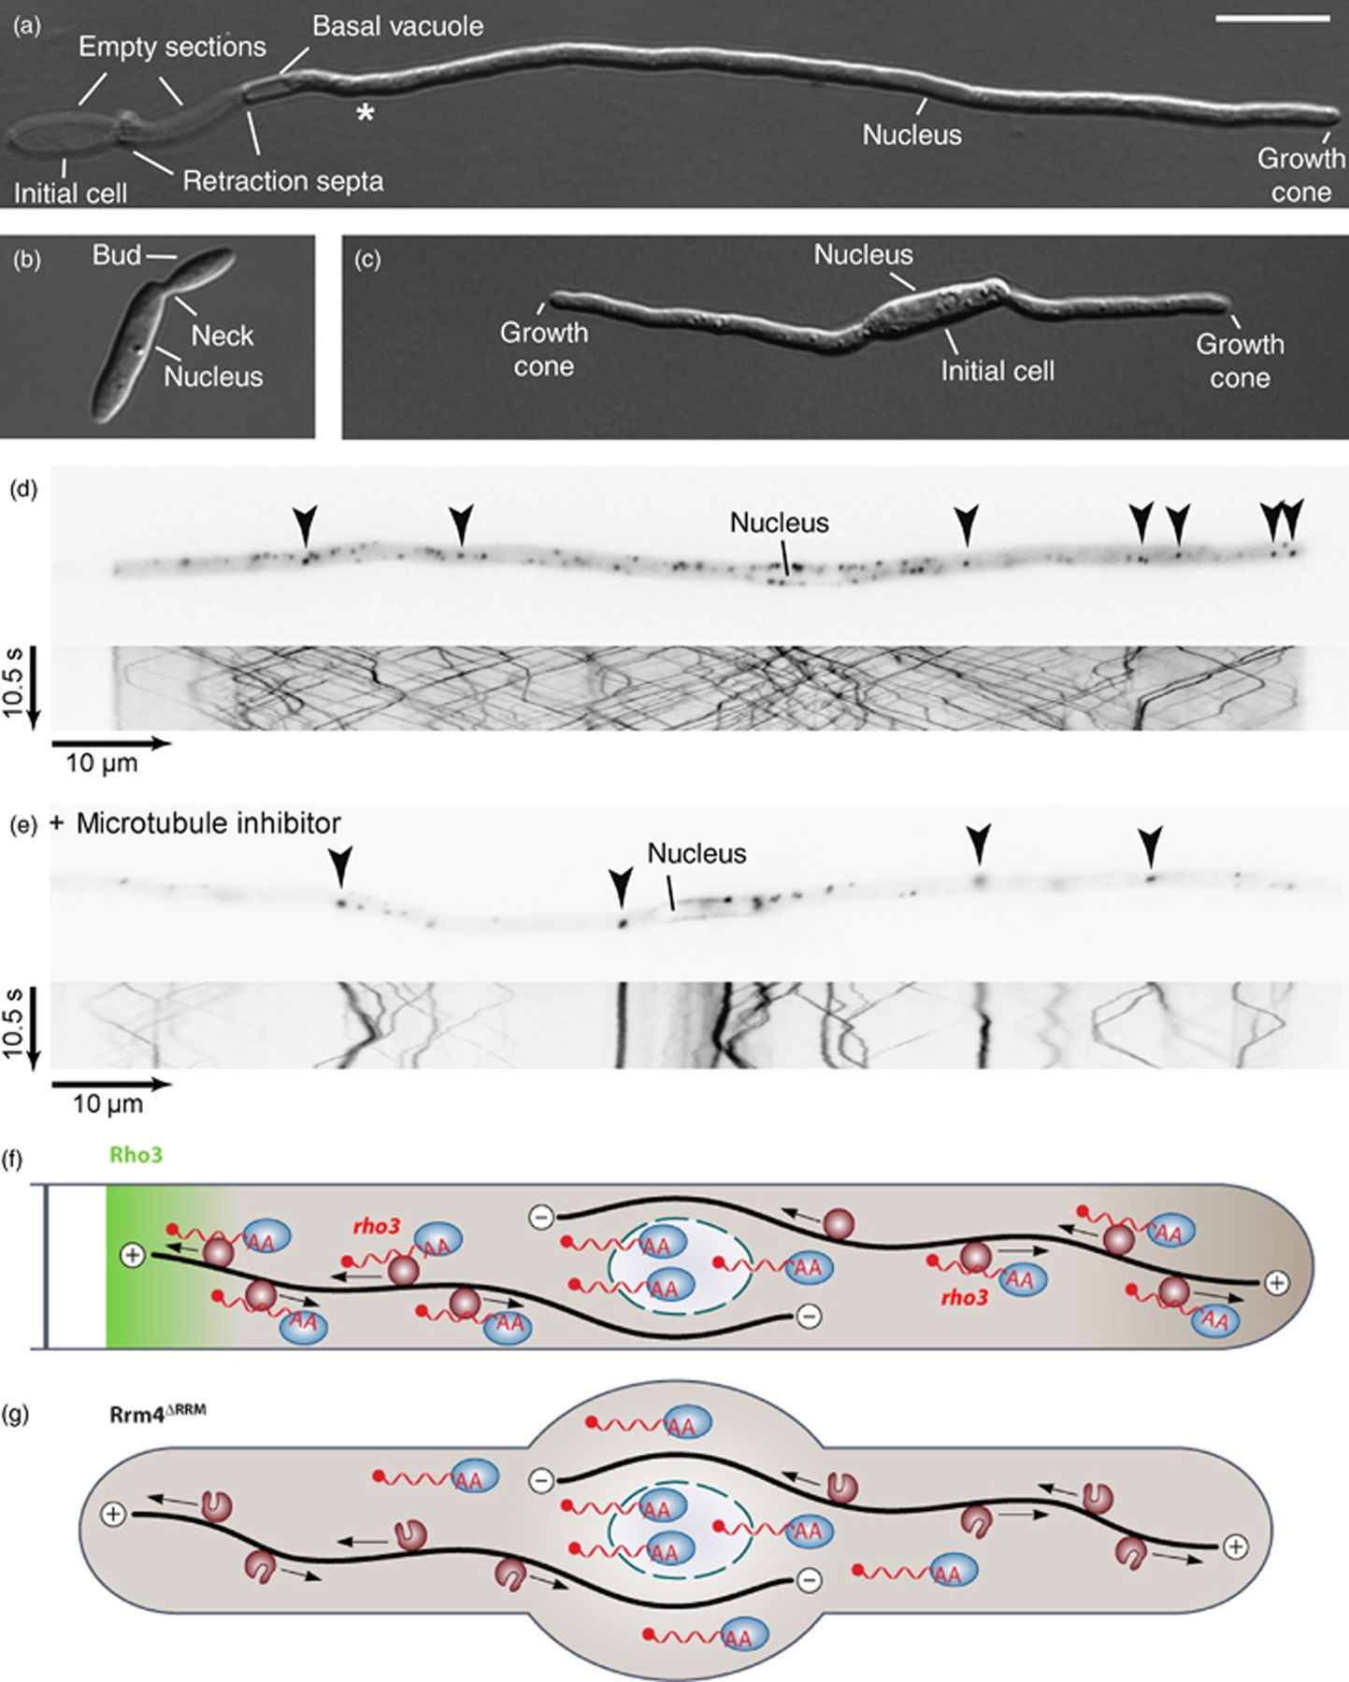
Figure 5 Microtubule-dependent shuttling of Rrm4-containing mRNPs is important for filamentous growth. (a) Filament of ...
Notes:
Figure 5 Microtubule-dependent shuttling of Rrm4-containing mRNPs is important for filamentous growth. (a) Filament of a monokaryotic strain expressing active bW2/bE1 variants under the control of a nitrogen-source-regulated promoter. Filaments are grown for 6 h under inducing conditions. Asterisk marks the predicted position of the next retraction septum (size bar=10 μm). (b) rrm4Δ cells show no aberrant growth phenotype. (c) rrm4Δ filament exhibits defects in the formation of a single axis of polarity. The initial cell forms two growth cones and fails to insert a retraction septum (Becht et al., 2006). (d) Filament expressing Rrm4 fused to Gfp. The fusion protein accumulates in defined cytoplasmic particles (arrowheads in the inverted image detecting Gfp fluorescence) that shuttle bidirectionally along microtubules (kymograph in the lower part). In the kymograph, time is plotted vs. distance. Thus, motion of Rrm4 particles is visible as defined tracks (note the reversal of shuttling at the poles). Picture and kymograph correspond to Movie S1. (e) Filament expressing Rrm4 fused to Gfp was treated with the microtubule inhibitor benomyl (Fuchs et al., 2005). Presented as described in (d). Picture and kymograph correspond to Movie S2. (f) Model depicting microtubule-dependent transport of mRNAs. Rrm4-containing particles (dark red circles) transport mRNAs (red wavy lines) carrying the poly(A)-binding protein (blue ovals) bidirectionally along microtubules (black lines). The transport of rho3 mRNA might promote the accumulation of Rho3 at the retraction septum. (g) Deletion of RRM1 to RRM3 in Rrm4 causes a loss-of-function phenotype. Filaments grow mostly bipolar and target mRNAs are no longer transported along microtubules. The mutant Rrm4 is still part of the shuttling units, indicating that Rrm4 is an integral component of the transport machinery and does not just hitchhike like the poly(A)-binding protein [(f), (g) are reprinted from Zarnack & Feldbrügge (2010) with permission from the American Society of Microbiology].
Unless provided in the caption above, the following copyright applies to the content of this slide: © 2011 Federation of European Microbiological Societies.

Slide 6
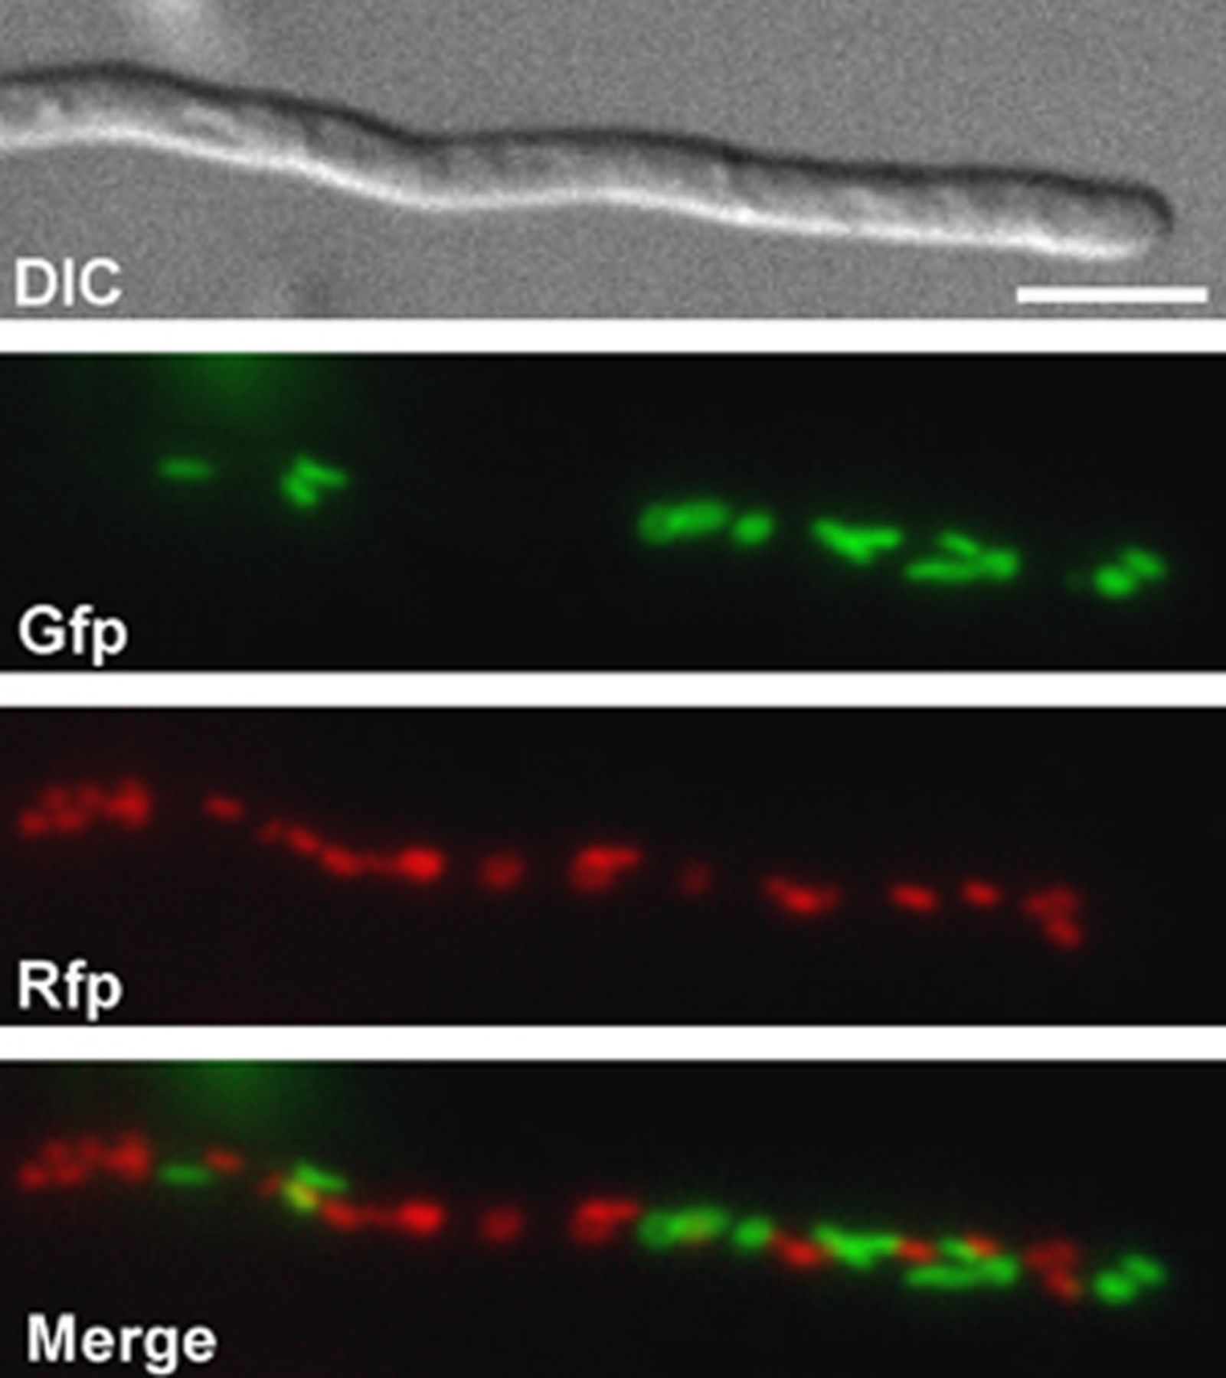
Figure 6 Separate parental populations of mitochondria in dikaryotic filaments. Tip of dikaryon resulting from the ...
Notes:
Figure 6 Separate parental populations of mitochondria in dikaryotic filaments. Tip of dikaryon resulting from the mating of strain FB1 (a1b1) with GF5 (a2b13). These strains express Gfp and Rfp targeted to the mitochondria, respectively (mtGfp and mtRfp). Epifluorescence images show green and red fluorescence as well as a merged picture at the bottom, indicating that mitochondria of the two parental cells do not fuse during filamentous growth [figure reprinted from Fedler et al. (2009) with permission from the Genetics Society of America].
Unless provided in the caption above, the following copyright applies to the content of this slide: © 2011 Federation of European Microbiological Societies.

Slide 7
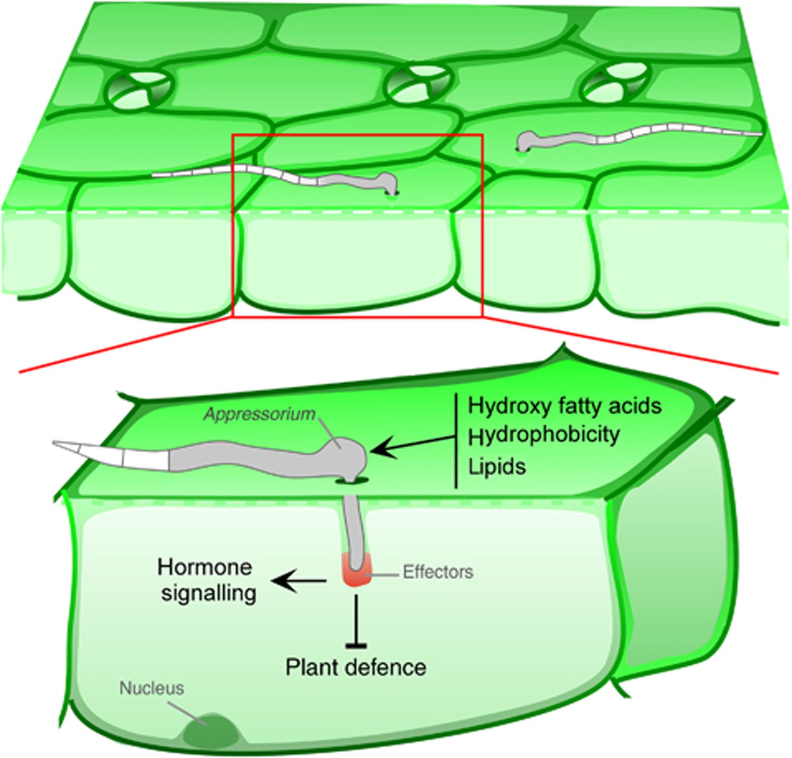
Figure 7 Infectious hyphae enter the plant. A model of the early infection process on the corn epidermis with a single ...
Notes:
Figure 7 Infectious hyphae enter the plant. A model of the early infection process on the corn epidermis with a single plant cell shown in detail (below). Dikaryotic filaments sense plant surface signals, form appressoria and penetrate the surface. Fungal effectors (red), which are thought to counteract plant defence and alter hormone signalling, are secreted into the biotrophic interface.
Unless provided in the caption above, the following copyright applies to the content of this slide: © 2011 Federation of European Microbiological Societies.

