Slide 1
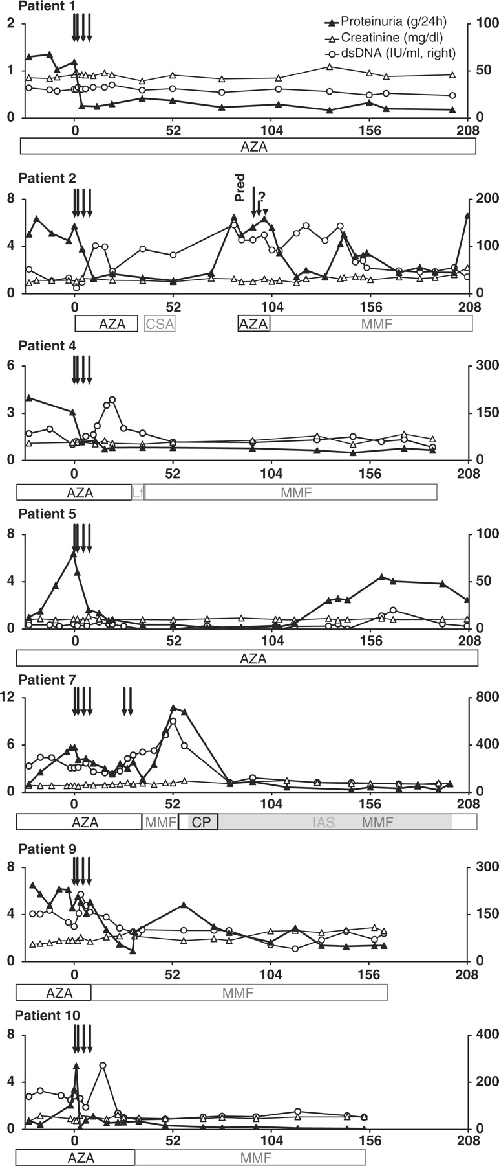
Fig. 1. Long-term follow-up of seven patients with lupus nephritis treated with infliximab. The levels of proteinuria ...
Notes:
Fig. 1. Long-term follow-up of seven patients with lupus nephritis treated with infliximab. The levels of proteinuria (black triangles, left y-axis), serum creatinine (white triangles, left y-axis) and anti-dsDNA antibodies (RIA, right y-axis) are shown. Time is given in weeks (x-axis), with yearly marks. Arrows depict infliximab infusions. Other therapies are depicted as bars below the x-axis.
Unless provided in the caption above, the following copyright applies to the content of this slide: © The Author 2009. Published by Oxford University Press on behalf of the British Society for Rheumatology. All rights reserved. For Permissions, please email: journals.permissions@oxfordjournals.org

