Slide 1
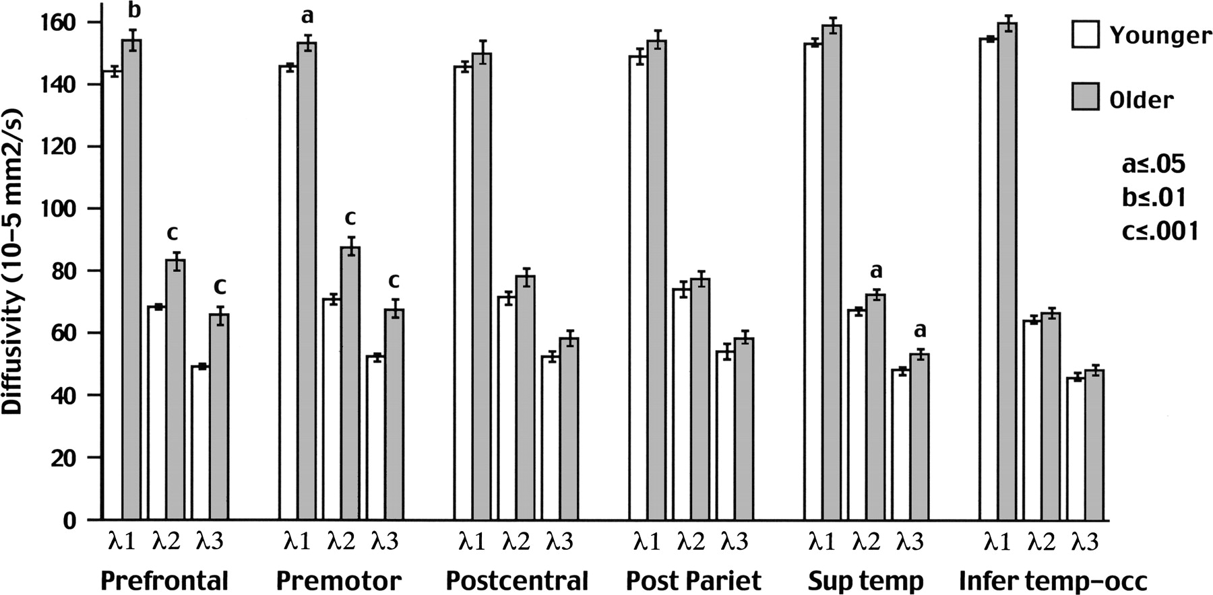
Figure 5. Mean ± SEM diffusivity for λ₁, λ₂, λ₃ across the six fiber bundles for the ...
Notes:
Figure 5. Mean ± SEM diffusivity for λ1, λ2, λ3 across the six fiber bundles for the younger and older groups. Note the relative greater difference (older greater than younger) in diffusivity for λ2 and λ3 in the prefrontal and premotor fiber bundles.
Unless provided in the caption above, the following copyright applies to the content of this slide: © The Author 2005. Published by Oxford University Press. All rights reserved. For permissions, please e-mail: journals.permissions@oxfordjournals.org The online version of this article has been published under an open access model. Users are entitled to use, reproduce, disseminate, or display the open access version of this article for non-commercial purposes provided that: the original authorship is properly and fully attributed; the Journal and Oxford University Press are attributed as the original place of publication with the correct citation details given; if an article is subsequently reproduced or disseminated not in its entirety but only in part or as a derivative work this must be clearly indicated. For commercial re-use, please contact journals.permissions@oxfordjournals.org.

Slide 2
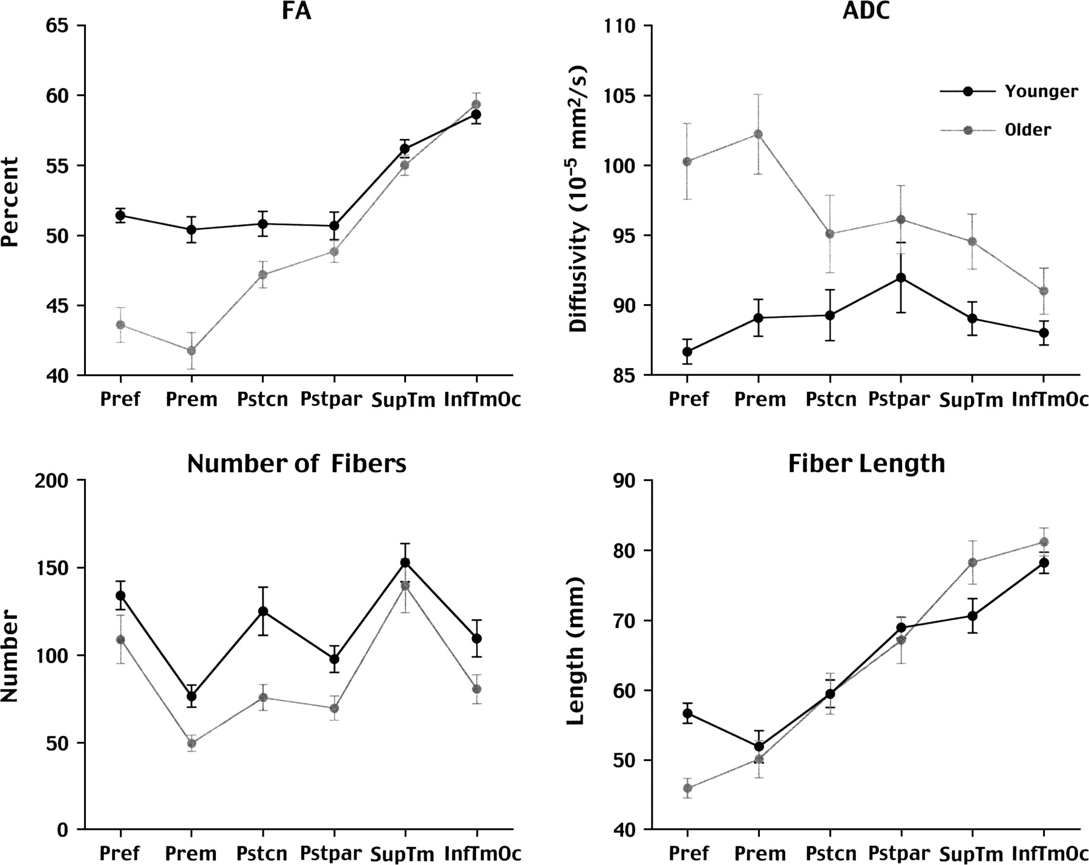
Figure 4. Mean ± SEM for FA, ADC, number of fibers, and fiber length across the six fiber bundles of the younger and ...
Notes:
Figure 4. Mean ± SEM for FA, ADC, number of fibers, and fiber length across the six fiber bundles of the younger and older groups.
Unless provided in the caption above, the following copyright applies to the content of this slide: © The Author 2005. Published by Oxford University Press. All rights reserved. For permissions, please e-mail: journals.permissions@oxfordjournals.org The online version of this article has been published under an open access model. Users are entitled to use, reproduce, disseminate, or display the open access version of this article for non-commercial purposes provided that: the original authorship is properly and fully attributed; the Journal and Oxford University Press are attributed as the original place of publication with the correct citation details given; if an article is subsequently reproduced or disseminated not in its entirety but only in part or as a derivative work this must be clearly indicated. For commercial re-use, please contact journals.permissions@oxfordjournals.org.

Slide 3
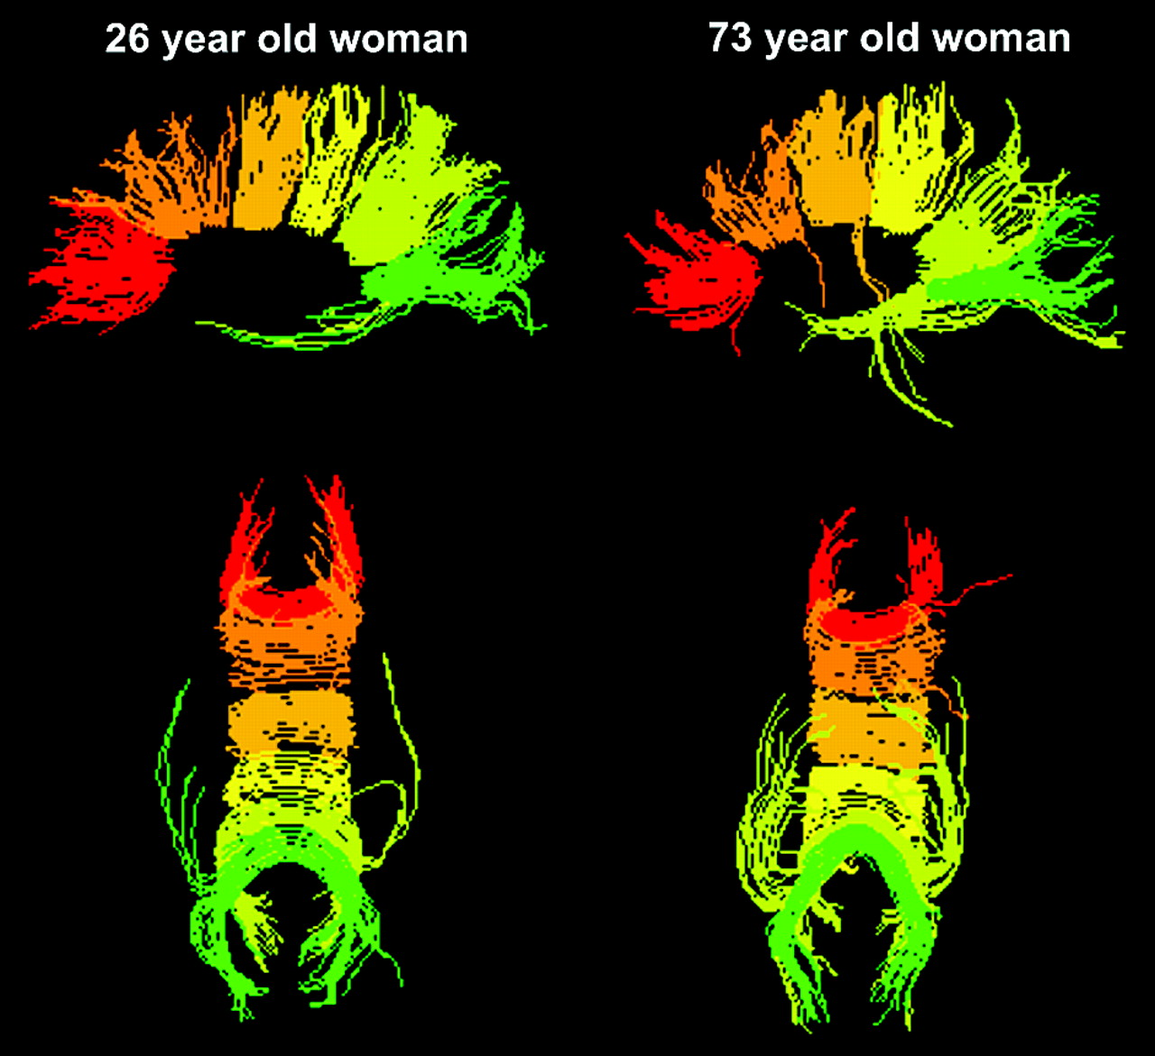
Figure 3. Six fiber bundles projected into common space for a younger and an older woman. The top two images are ...
Notes:
Figure 3. Six fiber bundles projected into common space for a younger and an older woman. The top two images are sagittal views and the bottom two are axial views. Red fibers are the most anterior (prefrontal) and green fibers are the most posterior (inferior temporal/occipital).
Unless provided in the caption above, the following copyright applies to the content of this slide: © The Author 2005. Published by Oxford University Press. All rights reserved. For permissions, please e-mail: journals.permissions@oxfordjournals.org The online version of this article has been published under an open access model. Users are entitled to use, reproduce, disseminate, or display the open access version of this article for non-commercial purposes provided that: the original authorship is properly and fully attributed; the Journal and Oxford University Press are attributed as the original place of publication with the correct citation details given; if an article is subsequently reproduced or disseminated not in its entirety but only in part or as a derivative work this must be clearly indicated. For commercial re-use, please contact journals.permissions@oxfordjournals.org.

Slide 4
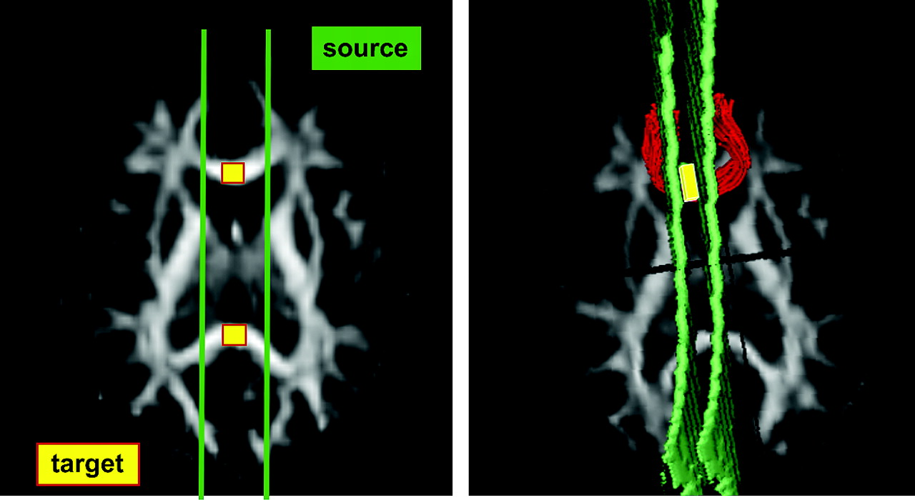
Figure 2. Left: nonlinearly aligned axial FA image from an individual subject with callosal target regions marked in ...
Notes:
Figure 2. Left: nonlinearly aligned axial FA image from an individual subject with callosal target regions marked in yellow and bilateral fiber sources in green. Right: same subject's FA image, fiber sources and target, in native (unwarped) space, with one fiber bundle identified.
Unless provided in the caption above, the following copyright applies to the content of this slide: © The Author 2005. Published by Oxford University Press. All rights reserved. For permissions, please e-mail: journals.permissions@oxfordjournals.org The online version of this article has been published under an open access model. Users are entitled to use, reproduce, disseminate, or display the open access version of this article for non-commercial purposes provided that: the original authorship is properly and fully attributed; the Journal and Oxford University Press are attributed as the original place of publication with the correct citation details given; if an article is subsequently reproduced or disseminated not in its entirety but only in part or as a derivative work this must be clearly indicated. For commercial re-use, please contact journals.permissions@oxfordjournals.org.

Slide 5
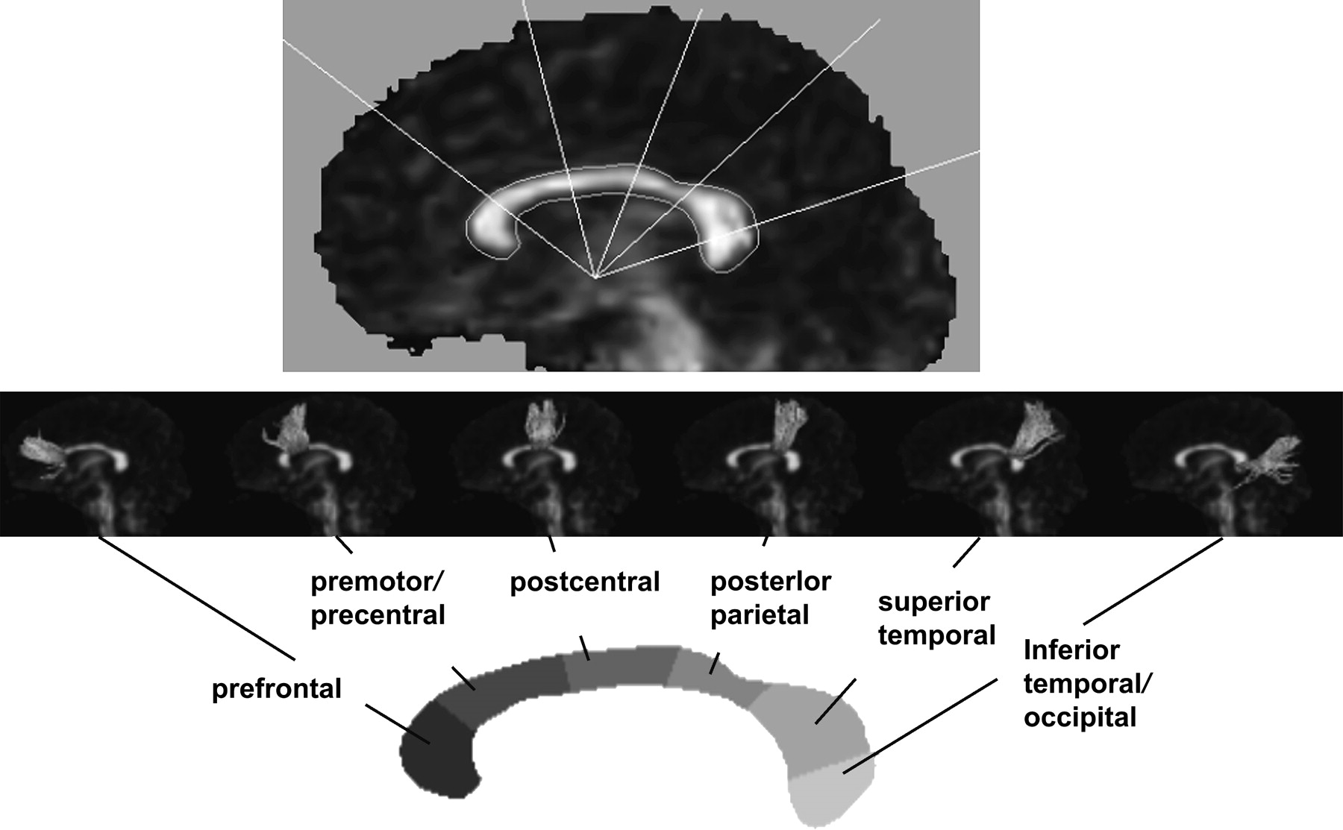
Figure 1. Midsagittal grand average FA image with callosal sector division lines superimposed. The divisions define the ...
Notes:
Figure 1. Midsagittal grand average FA image with callosal sector division lines superimposed. The divisions define the six callosal regions, which served as fiber bundle targets.
Unless provided in the caption above, the following copyright applies to the content of this slide: © The Author 2005. Published by Oxford University Press. All rights reserved. For permissions, please e-mail: journals.permissions@oxfordjournals.org The online version of this article has been published under an open access model. Users are entitled to use, reproduce, disseminate, or display the open access version of this article for non-commercial purposes provided that: the original authorship is properly and fully attributed; the Journal and Oxford University Press are attributed as the original place of publication with the correct citation details given; if an article is subsequently reproduced or disseminated not in its entirety but only in part or as a derivative work this must be clearly indicated. For commercial re-use, please contact journals.permissions@oxfordjournals.org.

Slide 6
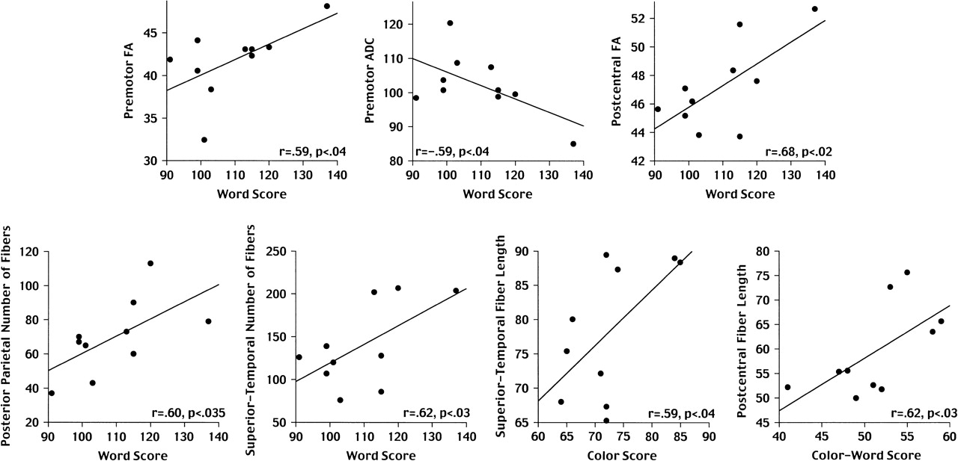
Figure 6. Correlations between conditions of the Stroop Color–Word Test and regional callosal DTI metrics.
Notes:
Figure 6. Correlations between conditions of the Stroop Color–Word Test and regional callosal DTI metrics.
Unless provided in the caption above, the following copyright applies to the content of this slide: © The Author 2005. Published by Oxford University Press. All rights reserved. For permissions, please e-mail: journals.permissions@oxfordjournals.org The online version of this article has been published under an open access model. Users are entitled to use, reproduce, disseminate, or display the open access version of this article for non-commercial purposes provided that: the original authorship is properly and fully attributed; the Journal and Oxford University Press are attributed as the original place of publication with the correct citation details given; if an article is subsequently reproduced or disseminated not in its entirety but only in part or as a derivative work this must be clearly indicated. For commercial re-use, please contact journals.permissions@oxfordjournals.org.

