Slide 1
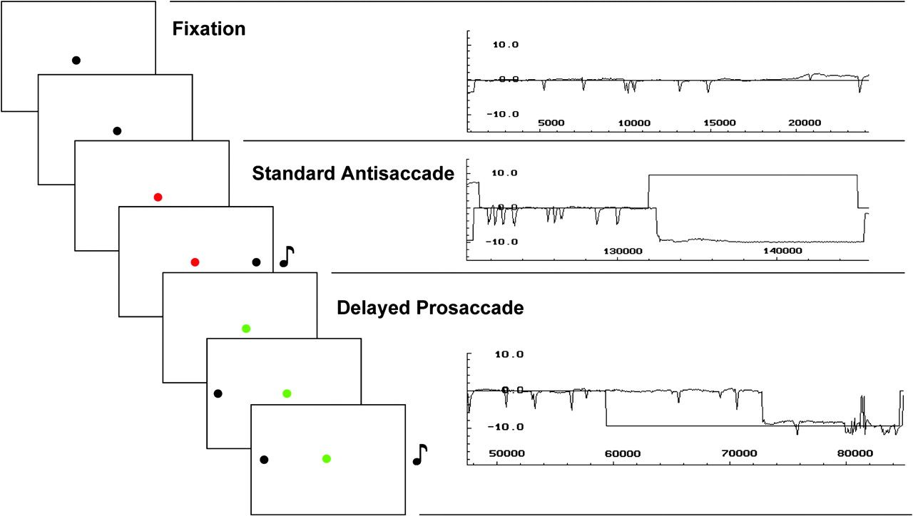
Figure 1. Example trials in the saccadetasks. Note: The figure illustrates 3 example trials and corresponding ...
Notes:
Figure 1. Example trials in the saccadetasks. Note: The figure illustrates 3 example trials and corresponding recordings taken from a single participant's eye movements in the fMRI scanner. The frames on the left depict the epochs of 3 consecutive trials, consisting of a fixation trial (black central target), a standard antisaccade trial (red central target), and a delayed prosaccade trial (green prosaccade trial). Each frame on the left is 11, 12, or 13 s (average 12 s). The auditory cue in the saccade trials, symbolized by the note (), is presented at the beginning of each from for 200 ms. Time flow is from top left to bottom right. The 3 panels on the right represent recordings with the infrared limbus tracker corresponding to the trials in the frames on the left (fixation, standard antisaccade, and delayed prosaccade).
Unless provided in the caption above, the following copyright applies to the content of this slide: © The Author 2007. Published by Oxford University Press. All rights reserved. For permissions, please e-mail: journals.permissions@oxfordjournals.org

Slide 2
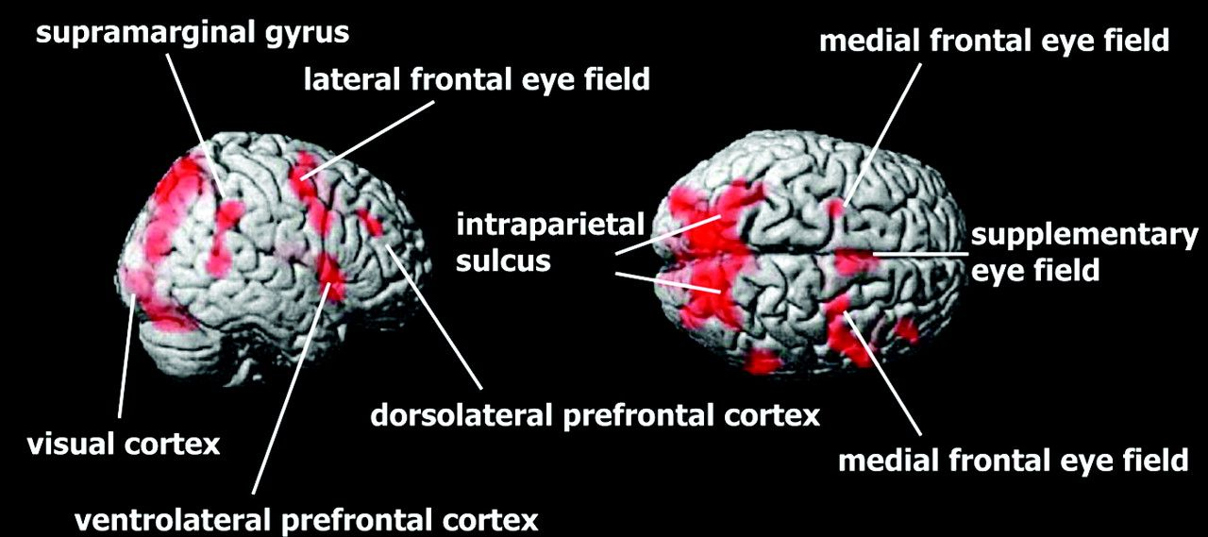
Figure 2. Cortical activation during the standard antisaccade task. Note: The figure shows areas of activation in ...
Notes:
Figure 2. Cortical activation during the standard antisaccade task. Note: The figure shows areas of activation in cortex during antisaccades (compared with fixation). Statistical significance is set at P < 0.1 corrected cluster level. Activation in thalamus and caudate (see Table 2) is not shown here.
Unless provided in the caption above, the following copyright applies to the content of this slide: © The Author 2007. Published by Oxford University Press. All rights reserved. For permissions, please e-mail: journals.permissions@oxfordjournals.org

Slide 3
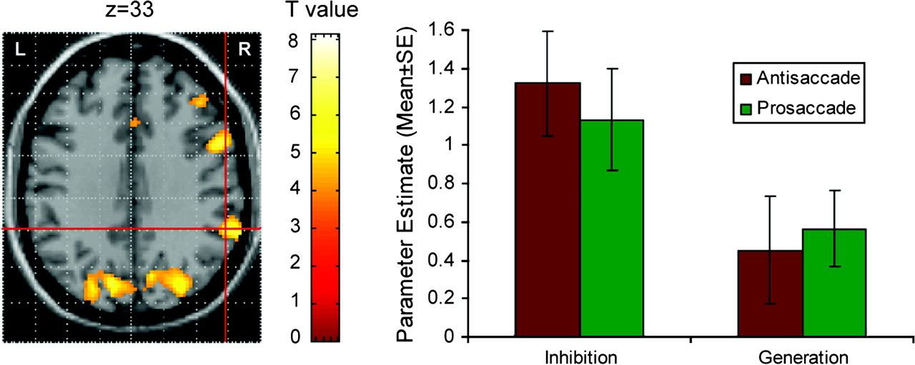
Figure 3. SMG activation in the delayed saccade experiment. Note: The center of the cross-hair is the activation peak ...
Notes:
Figure 3. SMG activation in the delayed saccade experiment. Note: The center of the cross-hair is the activation peak within the right SMG (see Table 2). Parameter estimates for the right SMG are shown on the right. The parameter estimates equate to percent change in the global mean BOLD signal. Higher coefficients indicate greater activation levels. The figure shows the results of the ANOVA using SaccadeTask (prosaccade and antisaccade) and DelayCondition (inhibition and generation) as repeated measures factors.
Unless provided in the caption above, the following copyright applies to the content of this slide: © The Author 2007. Published by Oxford University Press. All rights reserved. For permissions, please e-mail: journals.permissions@oxfordjournals.org

Slide 4
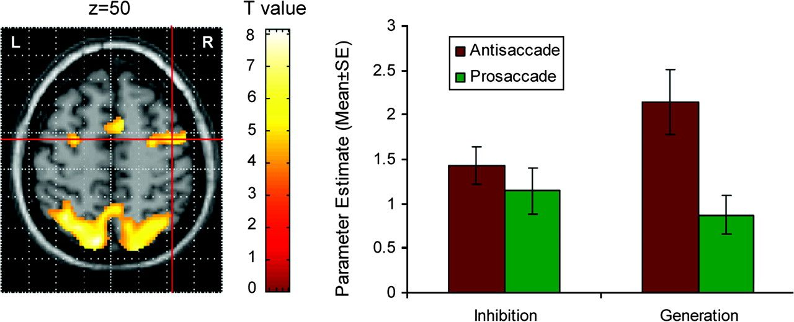
Figure 4. LatFEF activation in the delayed saccade experiment. Note: The center of the cross-hair is the activation ...
Notes:
Figure 4. LatFEF activation in the delayed saccade experiment. Note: The center of the cross-hair is the activation peak within the right latFEF (see Table 2). Parameter estimates for the right latFEF are shown on the right. The parameter estimates equate to percent change in the global mean BOLD signal. Higher coefficients indicate greater activation levels. The figure shows the results of the ANOVA using SaccadeTask (prosaccade and antisaccade) and DelayCondition (inhibition and generation) as repeated measures factors.
Unless provided in the caption above, the following copyright applies to the content of this slide: © The Author 2007. Published by Oxford University Press. All rights reserved. For permissions, please e-mail: journals.permissions@oxfordjournals.org

Slide 5
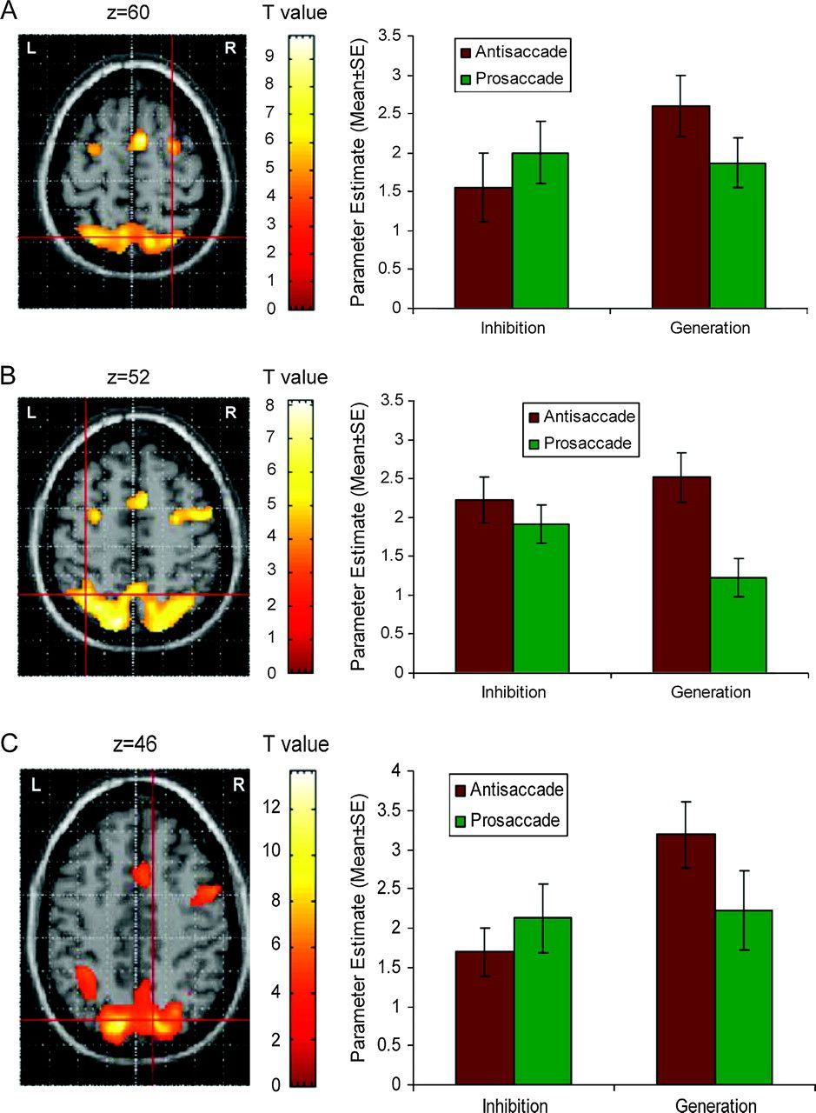
Figure 5. IPS activation in the delayed saccade experiment. Note: The centers of the cross-hairs are activation peaks ...
Notes:
Figure 5. IPS activation in the delayed saccade experiment. Note: The centers of the cross-hairs are activation peaks within the IPS (see Table 2). Parameter estimates for the IPS are shown on the right. The parameter estimates equate to percent change in the global mean BOLD signal. Higher coefficients indicate greater activation levels. The figure shows the results of the ANOVA using SaccadeTask (prosaccade and antisaccade) and DelayCondition (inhibition and generation) as repeated measures factors. Panel A: right aIPS; Panel B: left aIPS; Panel C: right pIPS.
Unless provided in the caption above, the following copyright applies to the content of this slide: © The Author 2007. Published by Oxford University Press. All rights reserved. For permissions, please e-mail: journals.permissions@oxfordjournals.org

Slide 6
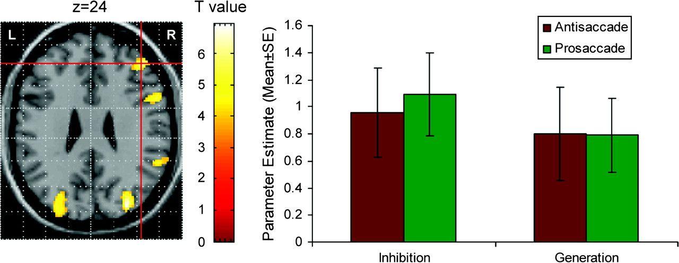
Figure 6. DLPFC activation in the delayed saccade experiment. Note: The center of the cross-hair is the activation peak ...
Notes:
Figure 6. DLPFC activation in the delayed saccade experiment. Note: The center of the cross-hair is the activation peak within the DLPFC (see Table 2). Parameter estimates for the DLPFC are shown on the right. The parameter estimates equate to percent change in the global mean BOLD signal. Higher coefficients indicate greater activation levels. The figure shows the results of the ANOVA using SaccadeTask (prosaccade and antisaccade) and DelayCondition (inhibition and generation) as repeated measures factors.
Unless provided in the caption above, the following copyright applies to the content of this slide: © The Author 2007. Published by Oxford University Press. All rights reserved. For permissions, please e-mail: journals.permissions@oxfordjournals.org

