Slide 1
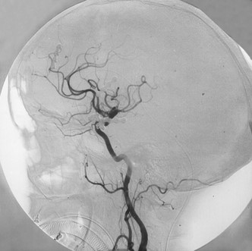
FIGURE 2. Immediate postoperative angiogram for the same patient as in Figure 1, obtained with the patient still ...
Notes:
FIGURE 2. Immediate postoperative angiogram for the same patient as in Figure 1, obtained with the patient still anesthetized, demonstrating successful direct clipping of the aneurysm. Note that the ophthalmic artery originates in the cavernous sinus.
Unless provided in the caption above, the following copyright applies to the content of this slide:

Slide 2
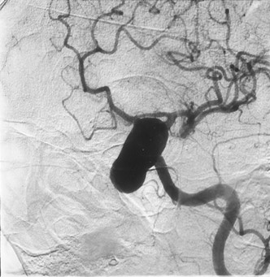
FIGURE 1. Preoperative angiogram, demonstrating a clinoidal segment aneurysm in a 67-year-old woman who presented with ...
Notes:
FIGURE 1. Preoperative angiogram, demonstrating a clinoidal segment aneurysm in a 67-year-old woman who presented with subarachnoid hemorrhage (Hunt and Hess Grade I). The aneurysm neck was more than 5 mm in size. During trial balloon occlusion, there was more than 50% reduction in CBF.
Unless provided in the caption above, the following copyright applies to the content of this slide:

Slide 3
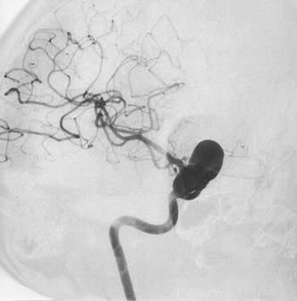
FIGURE 3. Angiogram demonstrating a clinoidal segment aneurysm in a 56-year-old woman who presented with visual loss ...
Notes:
FIGURE 3. Angiogram demonstrating a clinoidal segment aneurysm in a 56-year-old woman who presented with visual loss and retro-orbital pain. During preoperative trial balloon occlusion, the patient developed an immediate neurological deficit.
Unless provided in the caption above, the following copyright applies to the content of this slide:

Slide 4
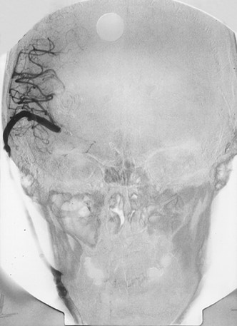
FIGURE 4. Postoperative angiogram, anteroposterior view, for the same patient as in Figure 3. During exploration of the ...
Notes:
FIGURE 4. Postoperative angiogram, anteroposterior view, for the same patient as in Figure 3. During exploration of the aneurysm, the neck was noted to be calcified. Despite multiple attempts at direct repair, the carotid artery was compromised because of the calcification. Therefore, a vein graft was constructed from the cervical external carotid artery to the MCA. The aneurysm was then trapped.
Unless provided in the caption above, the following copyright applies to the content of this slide:

Slide 5
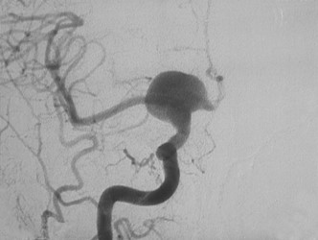
FIGURE 5. Preoperative angiogram for a 67-year-old woman with a clinoidal segment aneurysm. The aneurysm neck was 6 mm ...
Notes:
FIGURE 5. Preoperative angiogram for a 67-year-old woman with a clinoidal segment aneurysm. The aneurysm neck was 6 mm in length.
Unless provided in the caption above, the following copyright applies to the content of this slide:

Slide 6
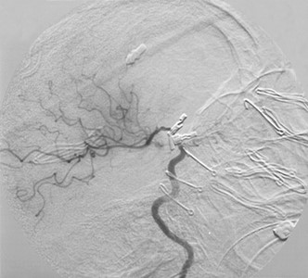
FIGURE 6. Intraoperative angiogram for the same patient as in Figure 5. During dissection, the aneurysm neck began to ...
Notes:
FIGURE 6. Intraoperative angiogram for the same patient as in Figure 5. During dissection, the aneurysm neck began to hemorrhage. The cervical ICA was occluded. The neck was further dissected, and then a clip graft was placed. As illustrated in this angiogram, there was significant compromise of the ICA after initial clip graft placement.
Unless provided in the caption above, the following copyright applies to the content of this slide:

Slide 7
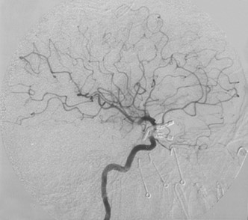
FIGURE 7. Second intraoperative angiogram for the same patient as in Figure 5. The aneurysm clips were repositioned, ...
Notes:
FIGURE 7. Second intraoperative angiogram for the same patient as in Figure 5. The aneurysm clips were repositioned, and the second intraoperative angiogram was obtained. This angiogram demonstrates improved filling through the ICA and better perfusion through the anterior cerebral artery complex. There is still approximately 50% narrowing of the ICA.
Unless provided in the caption above, the following copyright applies to the content of this slide:

Slide 8
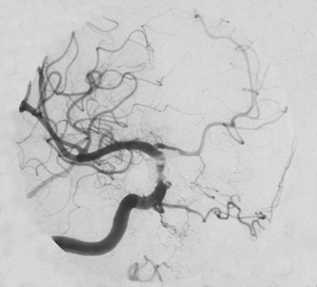
FIGURE 8. Postoperative angiogram for the same patient as in Figure 5, confirming the intraoperative findings of 50% ...
Notes:
FIGURE 8. Postoperative angiogram for the same patient as in Figure 5, confirming the intraoperative findings of 50% luminal stenosis. Despite this narrowing, the patient experienced a good recovery. This sequence of angiograms demonstrates the value of intraoperative angiography for confirmation of satisfactory clip placement for complicated aneurysms.
Unless provided in the caption above, the following copyright applies to the content of this slide:

Slide 9
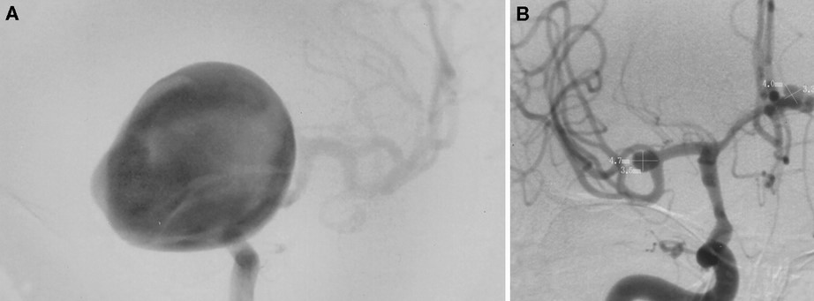
FIGURE 9. Preoperative angiograms. A, anteroposterior view, left ICA injection, demonstrating giant clinoidal segment ...
Notes:
FIGURE 9. Preoperative angiograms. A, anteroposterior view, left ICA injection, demonstrating giant clinoidal segment aneurysm. B, anteroposterior view, right ICA injection, demonstrating anterior communicating artery and MCA aneurysms.
Unless provided in the caption above, the following copyright applies to the content of this slide:

Slide 10
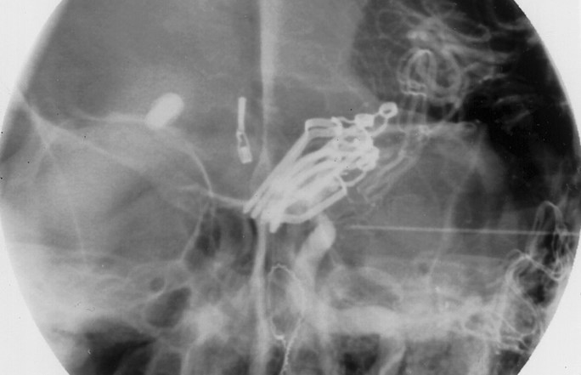
FIGURE 10. Postoperative angiogram for the same patient as in Figure 9, demonstrating a multimodality approach to the ...
Notes:
FIGURE 10. Postoperative angiogram for the same patient as in Figure 9, demonstrating a multimodality approach to the treatment of multiple intracranial aneurysms. There is good flow through the left ICA.
Unless provided in the caption above, the following copyright applies to the content of this slide:

Slide 11
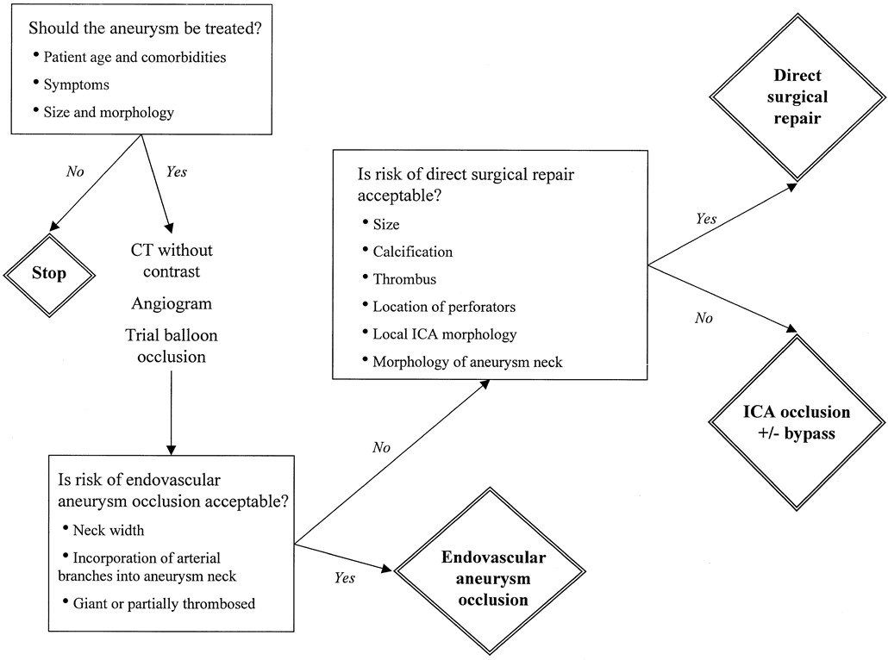
FIGURE 11. Treatment paradigm for the multidisciplinary management of clinoidal segment aneurysms. After determining ...
Notes:
FIGURE 11. Treatment paradigm for the multidisciplinary management of clinoidal segment aneurysms. After determining whether the aneurysm should be treated, the next decision is whether endovascular or direct surgical repair is indicated. Computed tomography (CT) without contrast agent administration identifies neck calcification, which significantly decreases the probability of successful surgical repair. During diagnostic angiography, trial balloon occlusion with CBF studies is valuable for determining collateral blood flow. If direct endovascular repair is considered to involve an acceptably low risk, then that may be the best treatment option. However, if the aneurysm cannot be treated with interventional techniques, then the surgeon must determine whether direct surgical repair can be performed with preservation of the carotid artery, with acceptable risk. If not, then trapping (with or without bypass) should be considered, depending on the results of the trial balloon occlusion and CBF studies.
Unless provided in the caption above, the following copyright applies to the content of this slide:

