Slide 1
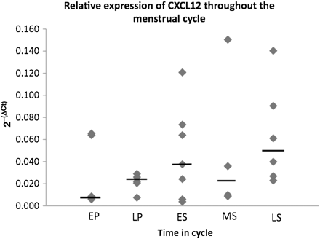
Figure 1 Quantitative analysis of CXCL12 mRNA expression in human endometrium measured by real-time PCR. Levels are ...
Notes:
Figure 1 Quantitative analysis of CXCL12 mRNA expression in human endometrium measured by real-time PCR. Levels are expressed relative to the YWHAZ reference gene. Levels are grouped according to the stage in the menstrual cycle. EP, early proliferative (Days 1–9) (n = 5); LP, late proliferative (Days 10–14) (n = 5); ES, early secretory (Days 15–18) (n = 7); MS, mid-secretory (Days 19–23) (n = 4); LS, late secretory (Days 24–28) (n = 6). Bars represent median values. No significant difference in levels of CXCL12 was found in samples collected at different stages of the cycle.
Unless provided in the caption above, the following copyright applies to the content of this slide: © The Author 2011. Published by Oxford University Press on behalf of the European Society of Human Reproduction and Embryology. All rights reserved. For Permissions, please email: journals.permissions@oup.com

Slide 2
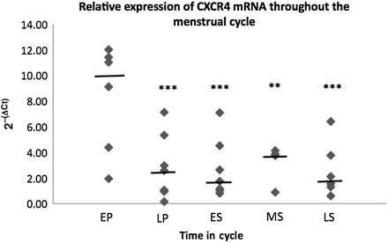
Figure 2 Quantitative analysis of CXCR4 mRNA expression in human endometrium measured by real-time PCR. Levels are ...
Notes:
Figure 2 Quantitative analysis of CXCR4 mRNA expression in human endometrium measured by real-time PCR. Levels are expressed relative to the YWHAZ reference gene. Levels are grouped according to the stage in the menstrual cycle. EP, early proliferative (Days 1–9) (n = 6); LP, late proliferative (Days 10–14) (n = 7); ES, early secretory (Days 15–18) (n = 7); MS, mid-secretory (Days 19–23) (n = 4); LS, late secretory (Days 24–28) (n = 6). Bars represent median values. Expression in the early proliferative phase was significantly higher than that in the late proliferative, early secretory and late secretory phases at P < 0.001 (***). Expression in the early proliferative phase was significantly higher than that in the mid-secretory phase at P < 0.01 (**).
Unless provided in the caption above, the following copyright applies to the content of this slide: © The Author 2011. Published by Oxford University Press on behalf of the European Society of Human Reproduction and Embryology. All rights reserved. For Permissions, please email: journals.permissions@oup.com

Slide 3
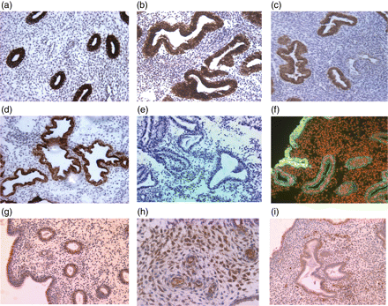
Figure 3 Expression of CXCL12 and CXCR4 in human endometrium. (a) CXCL12 in proliferative endometrium, (b) CXCL12 in ...
Notes:
Figure 3 Expression of CXCL12 and CXCR4 in human endometrium. (a) CXCL12 in proliferative endometrium, (b) CXCL12 in early secretory endometrium, (c) CXCL12 in mid-secretory endometrium, (d) CXCL12 in late secretory endometrium, (e) negative control where primary antibody was replaced with mouse IgG, (f) immunofluorescence for CXCL12 during the secretory phase, (g) CXCR4 in proliferative endometrium, (h) CXCR4 in secretory phase endometrium, (i) CXCR4 in secretory phase endometrium (magnification ×200).
Unless provided in the caption above, the following copyright applies to the content of this slide: © The Author 2011. Published by Oxford University Press on behalf of the European Society of Human Reproduction and Embryology. All rights reserved. For Permissions, please email: journals.permissions@oup.com

Slide 4
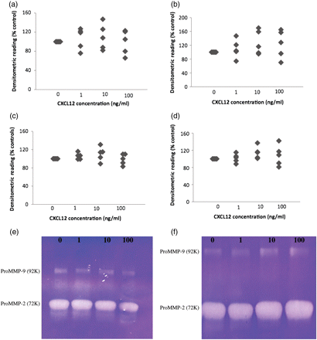
Figure 4 Effect of CXCL12 on MMP-2 and MMP-9 activity in supernatants from endometrial cells. MMP-2 (a and b) and ...
Notes:
Figure 4 Effect of CXCL12 on MMP-2 and MMP-9 activity in supernatants from endometrial cells. MMP-2 (a and b) and MMP-9 (d and e) activity in supernatants from endometrial epithelial (a and d) and stromal (b and e) cells in five different experiments. (c) An example of an activity gel from epithelial cells and (f) an example of an activity gel from stromal cells. No significant differences in MMP activity was seen in the presence of CXCL12 in either cell type.
Unless provided in the caption above, the following copyright applies to the content of this slide: © The Author 2011. Published by Oxford University Press on behalf of the European Society of Human Reproduction and Embryology. All rights reserved. For Permissions, please email: journals.permissions@oup.com

Slide 5
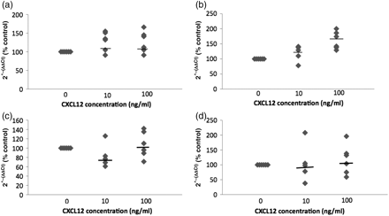
Figure 5 Effect of CXCL12 on MMP mRNA in endometrial cells. MMP-2 mRNA (a) and MMP-9 mRNA and (b) in endometrial ...
Notes:
Figure 5 Effect of CXCL12 on MMP mRNA in endometrial cells. MMP-2 mRNA (a) and MMP-9 mRNA and (b) in endometrial epithelial cells; MMP-2 mRNA (c) and MMP-9 mRNA (d) in endometrial stromal cells. Bars represent median values. No significant difference in MMP mRNA expression was seen in the presence of CXCL12.
Unless provided in the caption above, the following copyright applies to the content of this slide: © The Author 2011. Published by Oxford University Press on behalf of the European Society of Human Reproduction and Embryology. All rights reserved. For Permissions, please email: journals.permissions@oup.com

