Slide 1
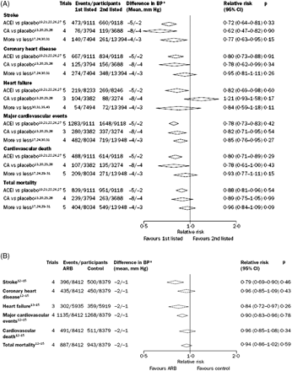
Figure 1 (A) Effect of drug Therapy on Cardiovascular Outcomes in the Blood Pressure Lowering Treatment Trialists’ ...
Notes:
Figure 1 (A) Effect of drug Therapy on Cardiovascular Outcomes in the Blood Pressure Lowering Treatment Trialists’ Collaboration Meta-Analysis. Reprinted with permission from ref. 34. (B) Effect of ARBs on Cardiovascular Outcomes in the Blood Pressure Lowering Treatment Trialists’ Collaboration Meta-Analysis. Reprinted with permission from ref. 34.
Unless provided in the caption above, the following copyright applies to the content of this slide: Published on behalf of the European Society of Cardiology. All rights reserved. © The Author 2008. For permissions please email: journals.permissions@oxfordjournals.org

