Slide 1
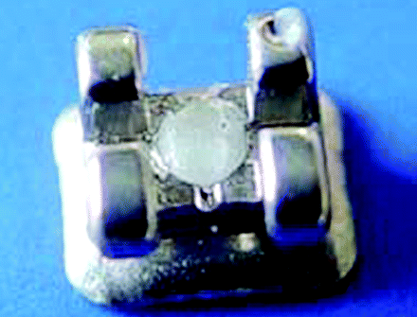
Figure 1 An orthodontic bracket after filling with fluoride-releasing material.
Notes:
Figure 1 An orthodontic bracket after filling with fluoride-releasing material.
Unless provided in the caption above, the following copyright applies to the content of this slide: © The Author 2007. Published by Oxford University Press on behalf of the European Orthodontic Society. All rights reserved. For permissions, please email: journals.permissions@oxfordjournals.org.

Slide 2
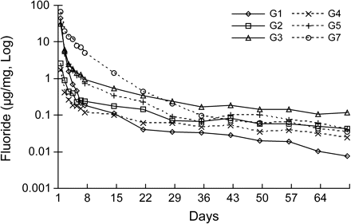
Figure 2 The mean daily free fluoride ions (log) released from six groups over a period of 70 days. See Table 1for key ...
Notes:
Figure 2 The mean daily free fluoride ions (log) released from six groups over a period of 70 days. See Table 1for key to groups.
Unless provided in the caption above, the following copyright applies to the content of this slide: © The Author 2007. Published by Oxford University Press on behalf of the European Orthodontic Society. All rights reserved. For permissions, please email: journals.permissions@oxfordjournals.org.

Slide 3
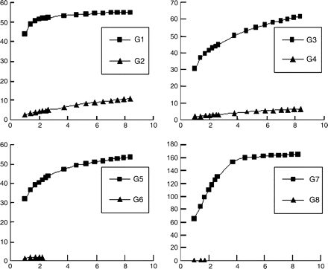
Figure 3 The cumulative fluoride release (mg/g; y-axis) against the square root of time (days)^{1/2}(x-axis). ...
Notes:
Figure 3 The cumulative fluoride release (mg/g; y-axis) against the square root of time (days)1/2(x-axis). See Table 1for key to groups.
Unless provided in the caption above, the following copyright applies to the content of this slide: © The Author 2007. Published by Oxford University Press on behalf of the European Orthodontic Society. All rights reserved. For permissions, please email: journals.permissions@oxfordjournals.org.

