Slide 1
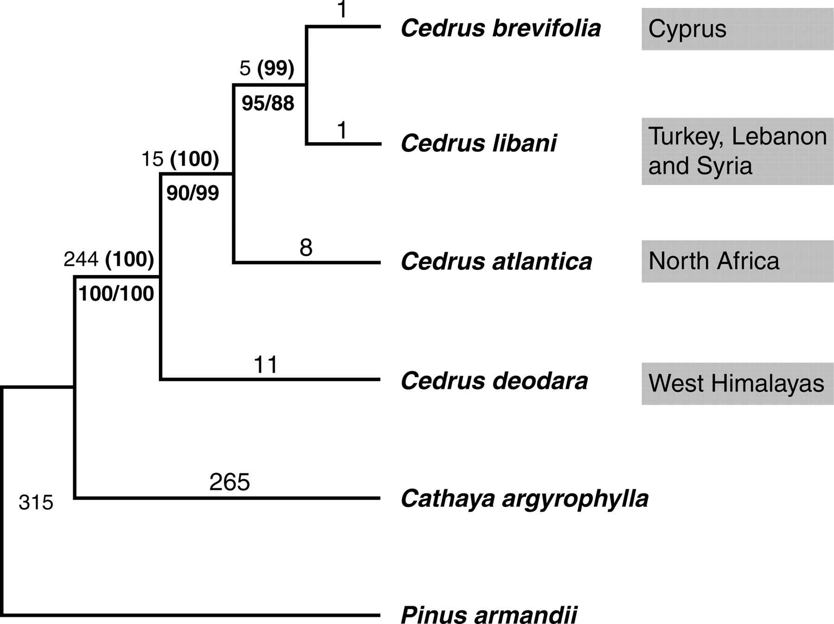
Fig. 1. The single most-parsimonious tree obtained from sequence analysis of combined cp- and mt-DNA regions (length ...
Notes:
Fig. 1. The single most-parsimonious tree obtained from sequence analysis of combined cp- and mt-DNA regions (length = 865, CI = 0·9908, RI = 0·9671). Numbers above the branches denote branch lengths and bootstrap values (in parentheses), respectively. Numbers below the branches are bootstrap values above 50 % yielded in the cp- (left) and mt- (right) DNA trees, respectively. The present distribution of each species was indicated on the right.
Unless provided in the caption above, the following copyright applies to the content of this slide: © The Author 2007. Published by Oxford University Press on behalf of the Annals of Botany Company. All rights reserved. For Permissions, please email: journals.permissions@oxfordjournals.org

Slide 2
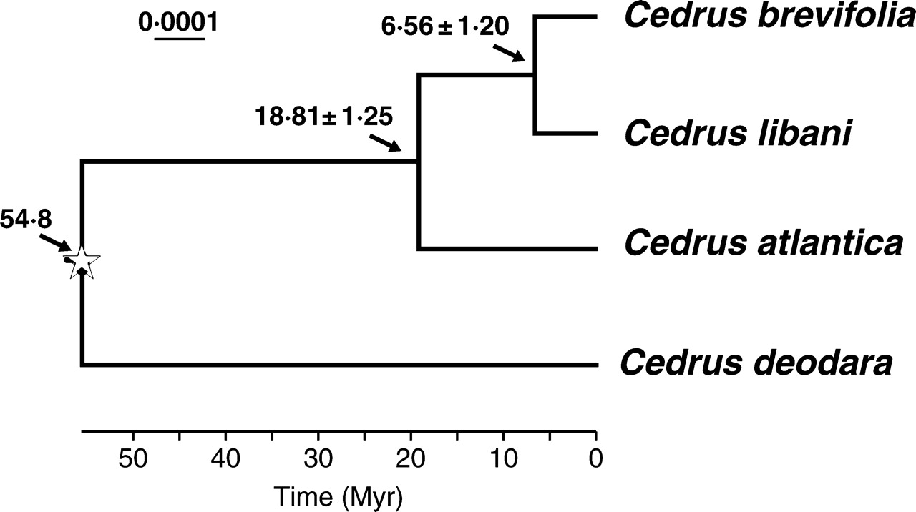
Fig. 2. Cedar phylogeny and time scale of evolution determined by NPRS based on the combined chloroplast DNA data, ...
Notes:
Fig. 2. Cedar phylogeny and time scale of evolution determined by NPRS based on the combined chloroplast DNA data, with a calibration point of 54·8 Myr at the root node (indicated by a star) where Cedrus diverged from the outgroups. Standard errors for estimates of node ages are given for two nodes.
Unless provided in the caption above, the following copyright applies to the content of this slide: © The Author 2007. Published by Oxford University Press on behalf of the Annals of Botany Company. All rights reserved. For Permissions, please email: journals.permissions@oxfordjournals.org

