Slide 1
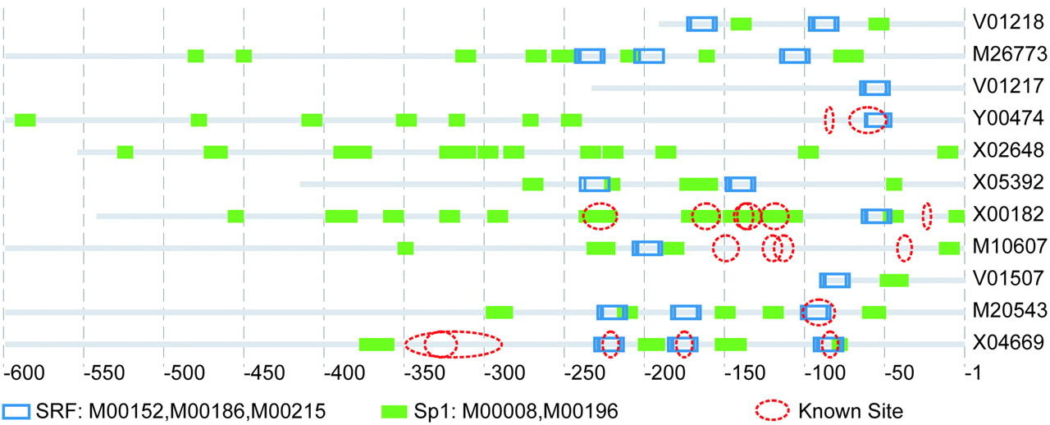
Figure 1. Distribution of two over‐represented motifs and known binding sites in actin promoters. The ...
Notes:
Figure 1. Distribution of two over‐represented motifs and known binding sites in actin promoters. The corresponding TRANSFAC names and matrix accesses of the two over‐represented motifs are: SRF (M00152, M00186, M00215) and Sp1 (M00252). The EMBL accession of each sequence was also included with the image behind each line representing a sequence. Known sites derived from the annotation of EPD and TRANSFAC records were also shown in the figure. The promoters of beta‐actin (V1217, Y00474 and X00182) present a different distribution of the two kinds of putative cis‐elements compared with other promoters of the actin set. The distribution of the two putative motifs in the sequence of V01218, M26773, M20543 and X04669 were conserved, especially the distribution of the putative binding sites of SRF.
Unless provided in the caption above, the following copyright applies to the content of this slide:

Slide 2
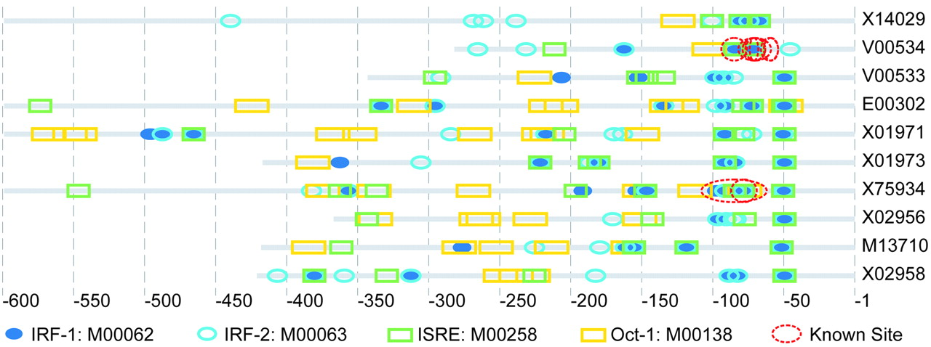
Figure 2. The distribution of putative cis‐elements detected in IFN promoters and known binding sites (the ...
Notes:
Figure 2. The distribution of putative cis‐elements detected in IFN promoters and known binding sites (the red circles). Putative binding sites detected with the TRANSFAC matrix IRF‐1 (M00062), IRF‐2 (M00063), ISRE (M00258) and Oct‐1 (M00138) are shown. The putative binding sites detected with IRF‐1, IRF‐2 and ISRE are partially overlapped.
Unless provided in the caption above, the following copyright applies to the content of this slide:

