Slide 1
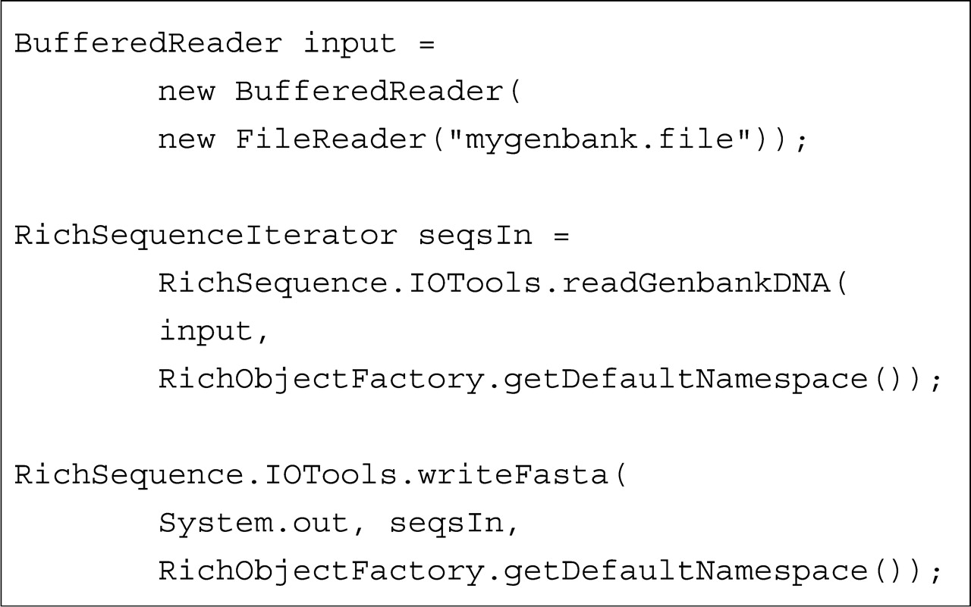
Fig. 1. Loading a GenBank file with BioJava and writing it out as FASTA. The example demonstrates the use of several ...
Notes:
Fig. 1. Loading a GenBank file with BioJava and writing it out as FASTA. The example demonstrates the use of several convenience methods that hide the bulk of the implementation. If the developer desires a more flexible parser it is possible to make use of the interfaces hidden behind the convenience methods to expose a fully customizable, multi-component, event-based parsing model.
Unless provided in the caption above, the following copyright applies to the content of this slide: © 2008 The Author(s)This is an Open Access article distributed under the terms of the Creative Commons Attribution Non-Commercial License (http://creativecommons.org/licenses/by-nc/2.0/uk/) which permits unrestricted non-commercial use, distribution, and reproduction in any medium, provided the original work is properly cited.

