Slide 1
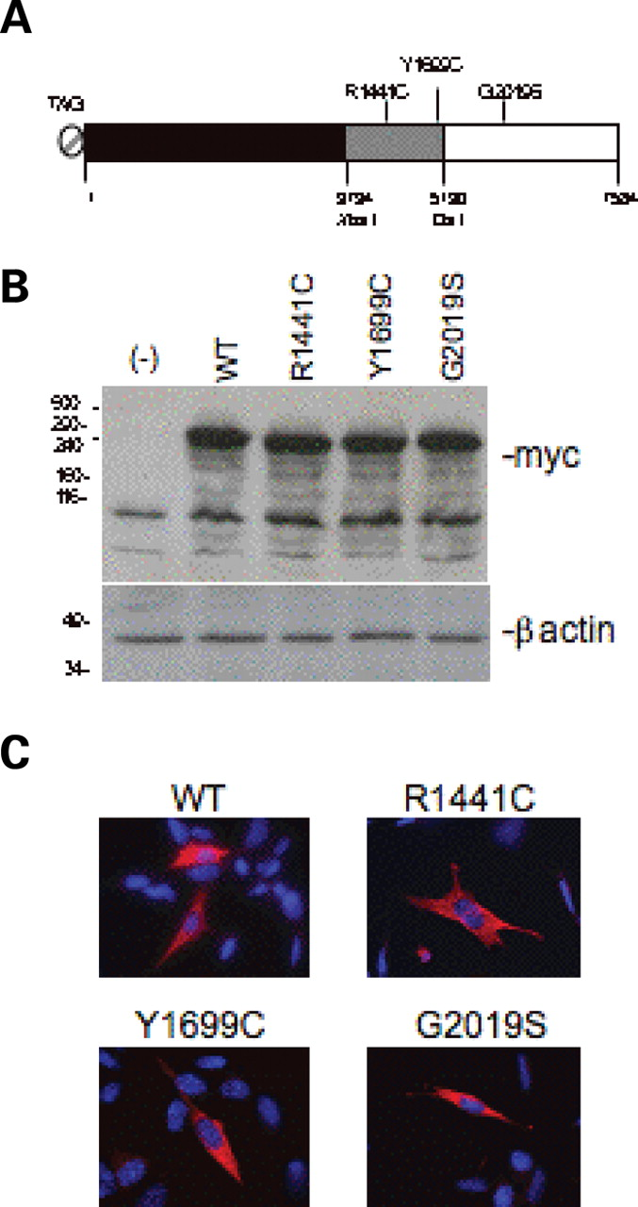
Figure 1. Expression of LRRK2 mutants in neuronal SH-SY5Y cell line. ( A ) Schematic representation of WT and mutant ...
Notes:
Figure 1. Expression of LRRK2 mutants in neuronal SH-SY5Y cell line. ( A ) Schematic representation of WT and mutant LRKK2s used in this work. ( B ) Western blot analysis using anti-myc and anti-β-actin antibodies on protein extracts prepared from SH-SY5Y cells transiently transfected with plasmids coding for wild-type or mutant human LRRK2. ( C ) Direct immunofluorescence using an anti-myc antibody showing the cytoplasmic localization of WT and mutant LRRK2 in SH-SY5Y transfected cells.
Unless provided in the caption above, the following copyright applies to the content of this slide: © The Author 2007. Published by Oxford University Press. All rights reserved. For Permissions, please email: journals.permissions@oxfordjournals.org

Slide 2
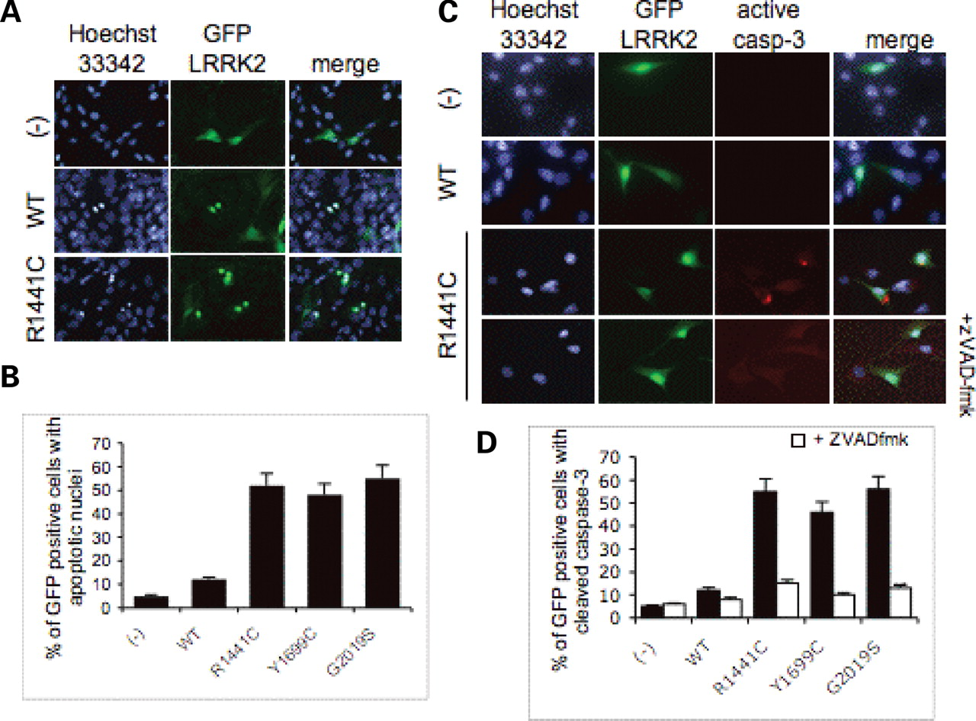
Figure 2. LRRK2 mutants induce cell death in SH-SY5Y cells. SH-SY5Y cells were transiently co-transfected with the ...
Notes:
Figure 2. LRRK2 mutants induce cell death in SH-SY5Y cells. SH-SY5Y cells were transiently co-transfected with the indicated plasmid coding for wild-type or mutant LRRK2 and a pLantern GFP in a ratio 5:1. ( A ) Representative direct immunofluorescence of apoptotic nuclei in co-transfected cells using a fluorescent probe Hoechst 33342. ( B ) Quantification of apoptotic nuclei 48 h after transfection. At least 100 GFP-positive cells from randomly chosen fields for each transfected constructs were counted. ( C ) Direct immunofluorescence using an anti-cleaved-caspase 3 antibody in co-transfected cells 24 h after transfection. Only the mutant R1441C is shown as an example. Use of cell-permeable caspase inhibitor z-VAD-fmk to block caspase 3 activation (lower panel). ( D ) Quantification of cleaved caspase 3-positive cells 48 h after transfection in the presence or absence of z-VAD-fmk treatment.
Unless provided in the caption above, the following copyright applies to the content of this slide: © The Author 2007. Published by Oxford University Press. All rights reserved. For Permissions, please email: journals.permissions@oxfordjournals.org

Slide 3
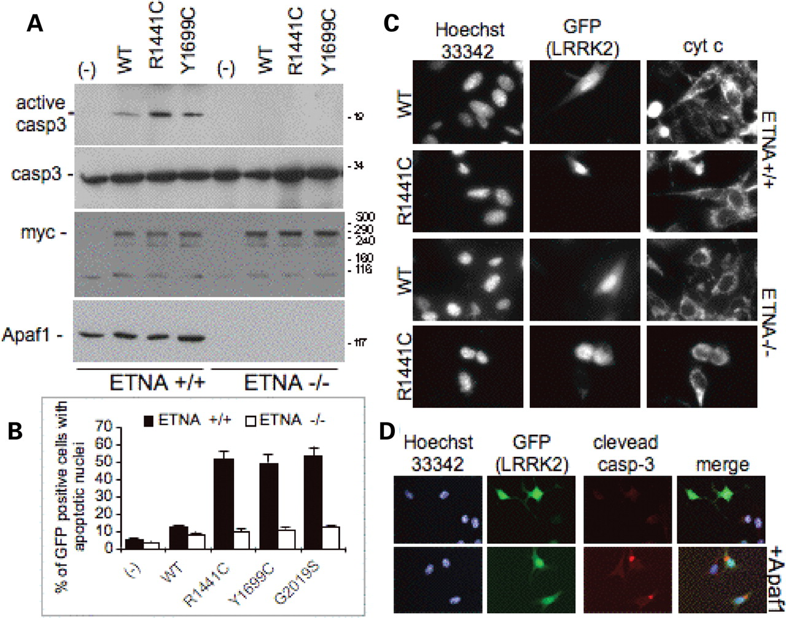
Figure 3. Mutant LRRK2-induced cell death is apoptosome-dependent. ETNA+/+ and −/− cell lines were tranfected with the ...
Notes:
Figure 3. Mutant LRRK2-induced cell death is apoptosome-dependent. ETNA+/+ and −/− cell lines were tranfected with the indicated plasmids. ( A ) Western blot analysis using specific anti-cleaved-caspase 3, -total caspase-3, -myc and -Apaf1 antibodies on protein extracts from transiently transfected cells. ( B ) Percentage of apoptotic nuclei in ETNA+/+ and −/− cell lines after co-transfection with GFP and WT or mutant LRRK2. ( C ) Direct immunofluorescence using anti-cytochrome c antibody. Note the diffuse cytochrome c staining using the LRRK2 R1441C mutant against the dotted staining in the LRRK2 WT in ETNA−/− transfected cells. ( D ) Anti-cleaved caspase 3 staining in ETNA−/− cell lines transfected with mutant R1441C in the presence or absence of Apaf1.
Unless provided in the caption above, the following copyright applies to the content of this slide: © The Author 2007. Published by Oxford University Press. All rights reserved. For Permissions, please email: journals.permissions@oxfordjournals.org

Slide 4
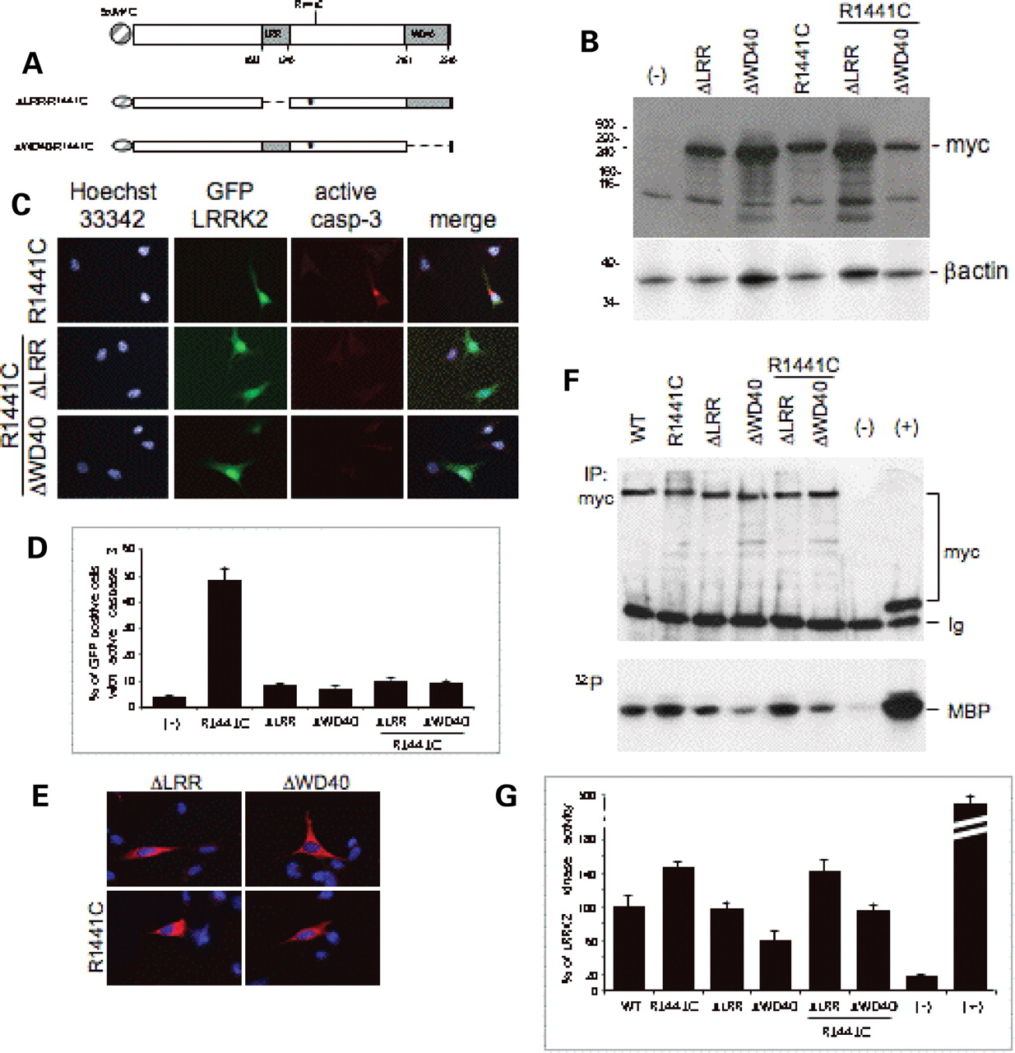
Figure 4. Analysis of deletion mutants in LRRK2-dependent neuronal cell death. ( A ) Schematic representation of DNA ...
Notes:
Figure 4. Analysis of deletion mutants in LRRK2-dependent neuronal cell death. ( A ) Schematic representation of DNA constructs coding for LRKK2 deletion mutants. ( B ) Western blot analysis of LRRK2 ΔLRR and LRRK2 ΔWD40 on protein extracts from transiently transfected SH-SY5Y cells using anti-myc antibody. Equal loading was verified using anti-β-actin antibody. ( C ) Immunofluorescence staining with anti-cleaved caspase 3 antibody on cells transfected with the different mutants. Note the lack of caspase 3 activation using R1441C ΔLRR and R1441C ΔWD40 compared with R1441C mutant. ( D ) Quantification of cleaved caspase 3-positive cells 24 h after transfection with the indicated constructs. ( E ) Representative confocal images of immunolocalization of LRRK2 ΔLRR and LRRK2 ΔWD40 in the presence or absence R1441C point mutation using an anti-myc antibody on transfected SH-SY5Y cells. ( F ) Kinase activity of different LRRK2 constructs. ETNA cells were transfected with expression plasmids encoding Myc-tagged LRRK2 wild type, R1441C, ΔLRR, ΔWD40, ΔLRR-R1441C, ΔWD40-R1441C and Aurora-A as positive control (+); (−) cells transfected with empty vector. Protein extracts prepared from transfected cells were subjected to immunoprecipitation using the anti-Myc antibody. Immunoprecipitated complexes were analysed by western blotting (top panel) to verify the equal expression level of each kinase. In vitro kinase assay performed on immunoprecipitated complexes using MBP as the substrate. Autoradiography (bottom panel) is shown. ( G ) Quantification of three independent experiments is as in (F).
Unless provided in the caption above, the following copyright applies to the content of this slide: © The Author 2007. Published by Oxford University Press. All rights reserved. For Permissions, please email: journals.permissions@oxfordjournals.org

