Slide 1
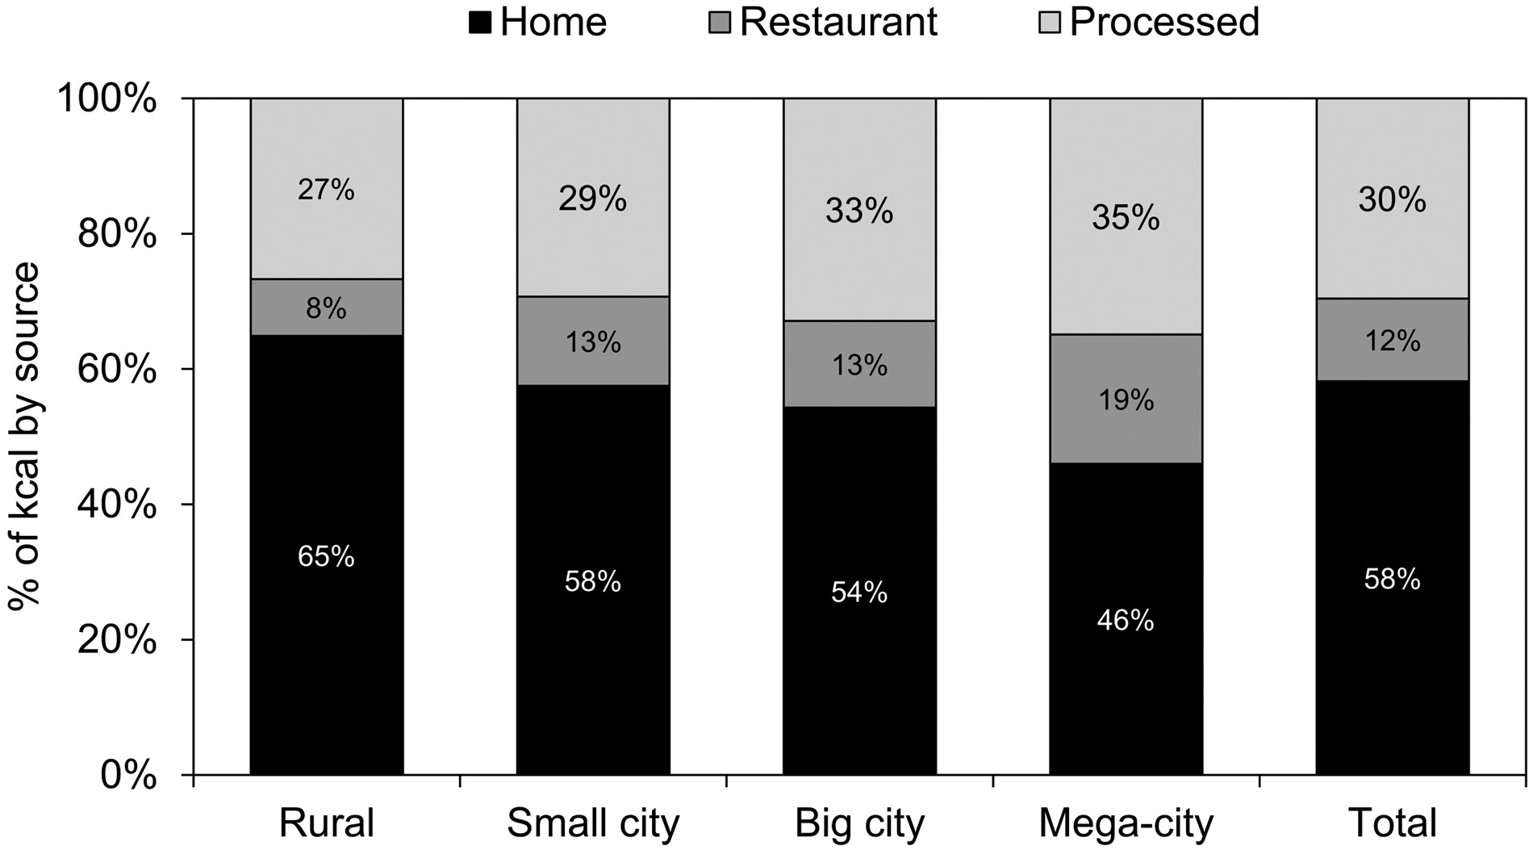
Figure 1 Percentage of foods in China prepared at home, in restaurants, or prepackaged in 2011. Reproduced from Popkin ...
Notes:
Figure 1 Percentage of foods in China prepared at home, in restaurants, or prepackaged in 2011. Reproduced from Popkin (2014)4 with permission.
Unless provided in the caption above, the following copyright applies to the content of this slide: © The Author(s) 2017. Published by Oxford University Press on behalf of the International Life Sciences Institute. All rights reserved. For Permissions, please e-mail: journals.permissions@oup.com.

Slide 2
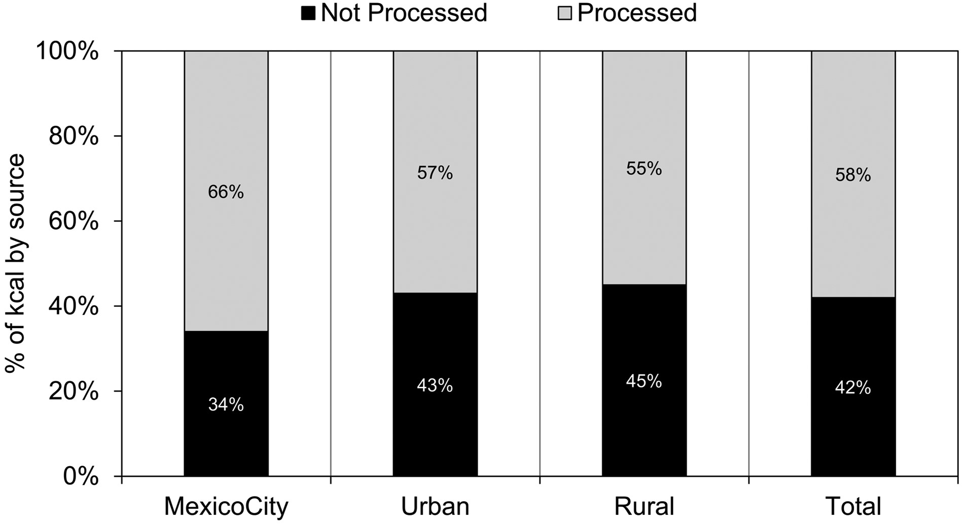
Figure 2 Percentage of non-processed versus processed food consumed in Mexico in 2012. Reproduced from Popkin ...
Notes:
Figure 2 Percentage of non-processed versus processed food consumed in Mexico in 2012. Reproduced from Popkin (2014)4 with permission.
Unless provided in the caption above, the following copyright applies to the content of this slide: © The Author(s) 2017. Published by Oxford University Press on behalf of the International Life Sciences Institute. All rights reserved. For Permissions, please e-mail: journals.permissions@oup.com.

Slide 3
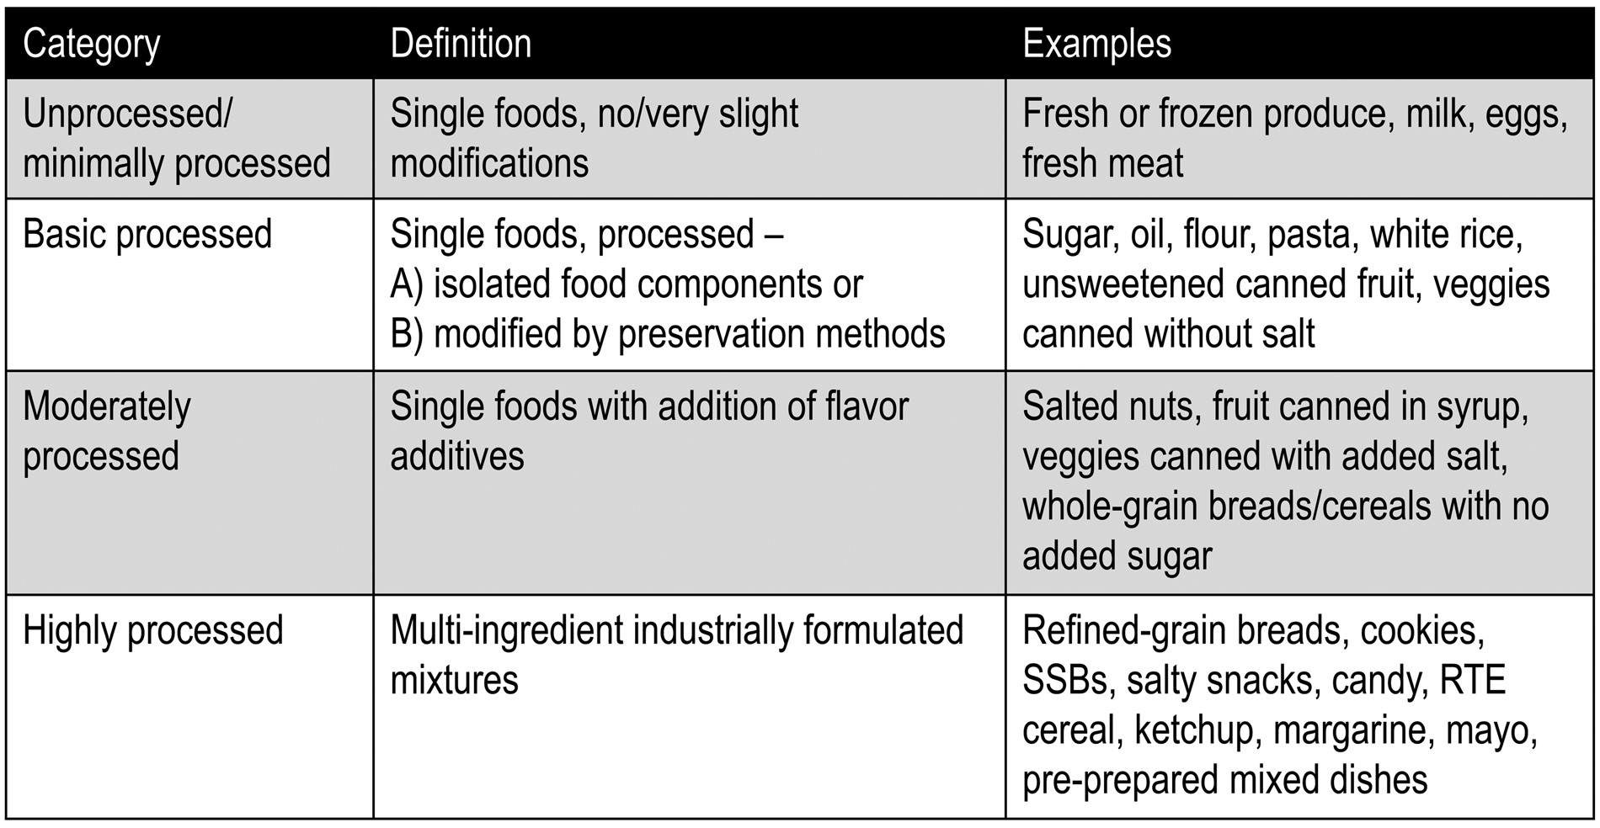
Figure 3 Classifications system for degree of processing of food and beverage products. Data from Poti et al. ...
Notes:
Figure 3 Classifications system for degree of processing of food and beverage products. Data from Poti et al. (2015).2
Unless provided in the caption above, the following copyright applies to the content of this slide: © The Author(s) 2017. Published by Oxford University Press on behalf of the International Life Sciences Institute. All rights reserved. For Permissions, please e-mail: journals.permissions@oup.com.

Slide 4
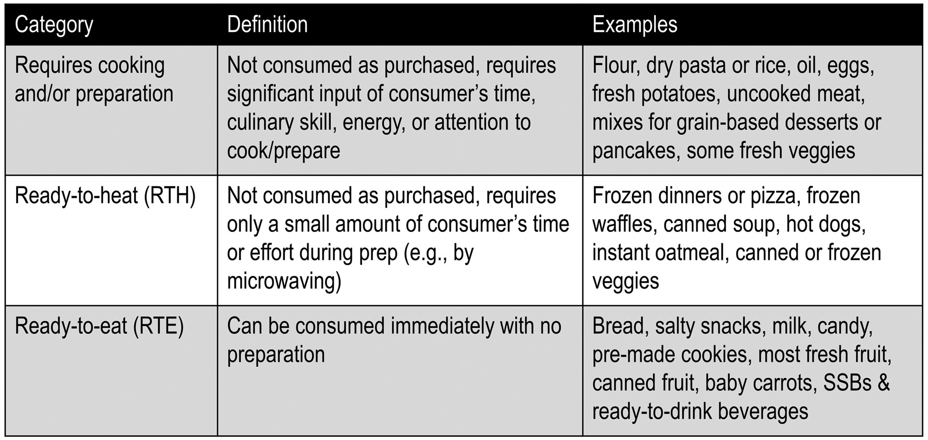
Figure 4 Classification system for convenience of food and beverage products. Data from Poti et al. ...
Notes:
Figure 4 Classification system for convenience of food and beverage products. Data from Poti et al. (2015).2
Unless provided in the caption above, the following copyright applies to the content of this slide: © The Author(s) 2017. Published by Oxford University Press on behalf of the International Life Sciences Institute. All rights reserved. For Permissions, please e-mail: journals.permissions@oup.com.

Slide 5
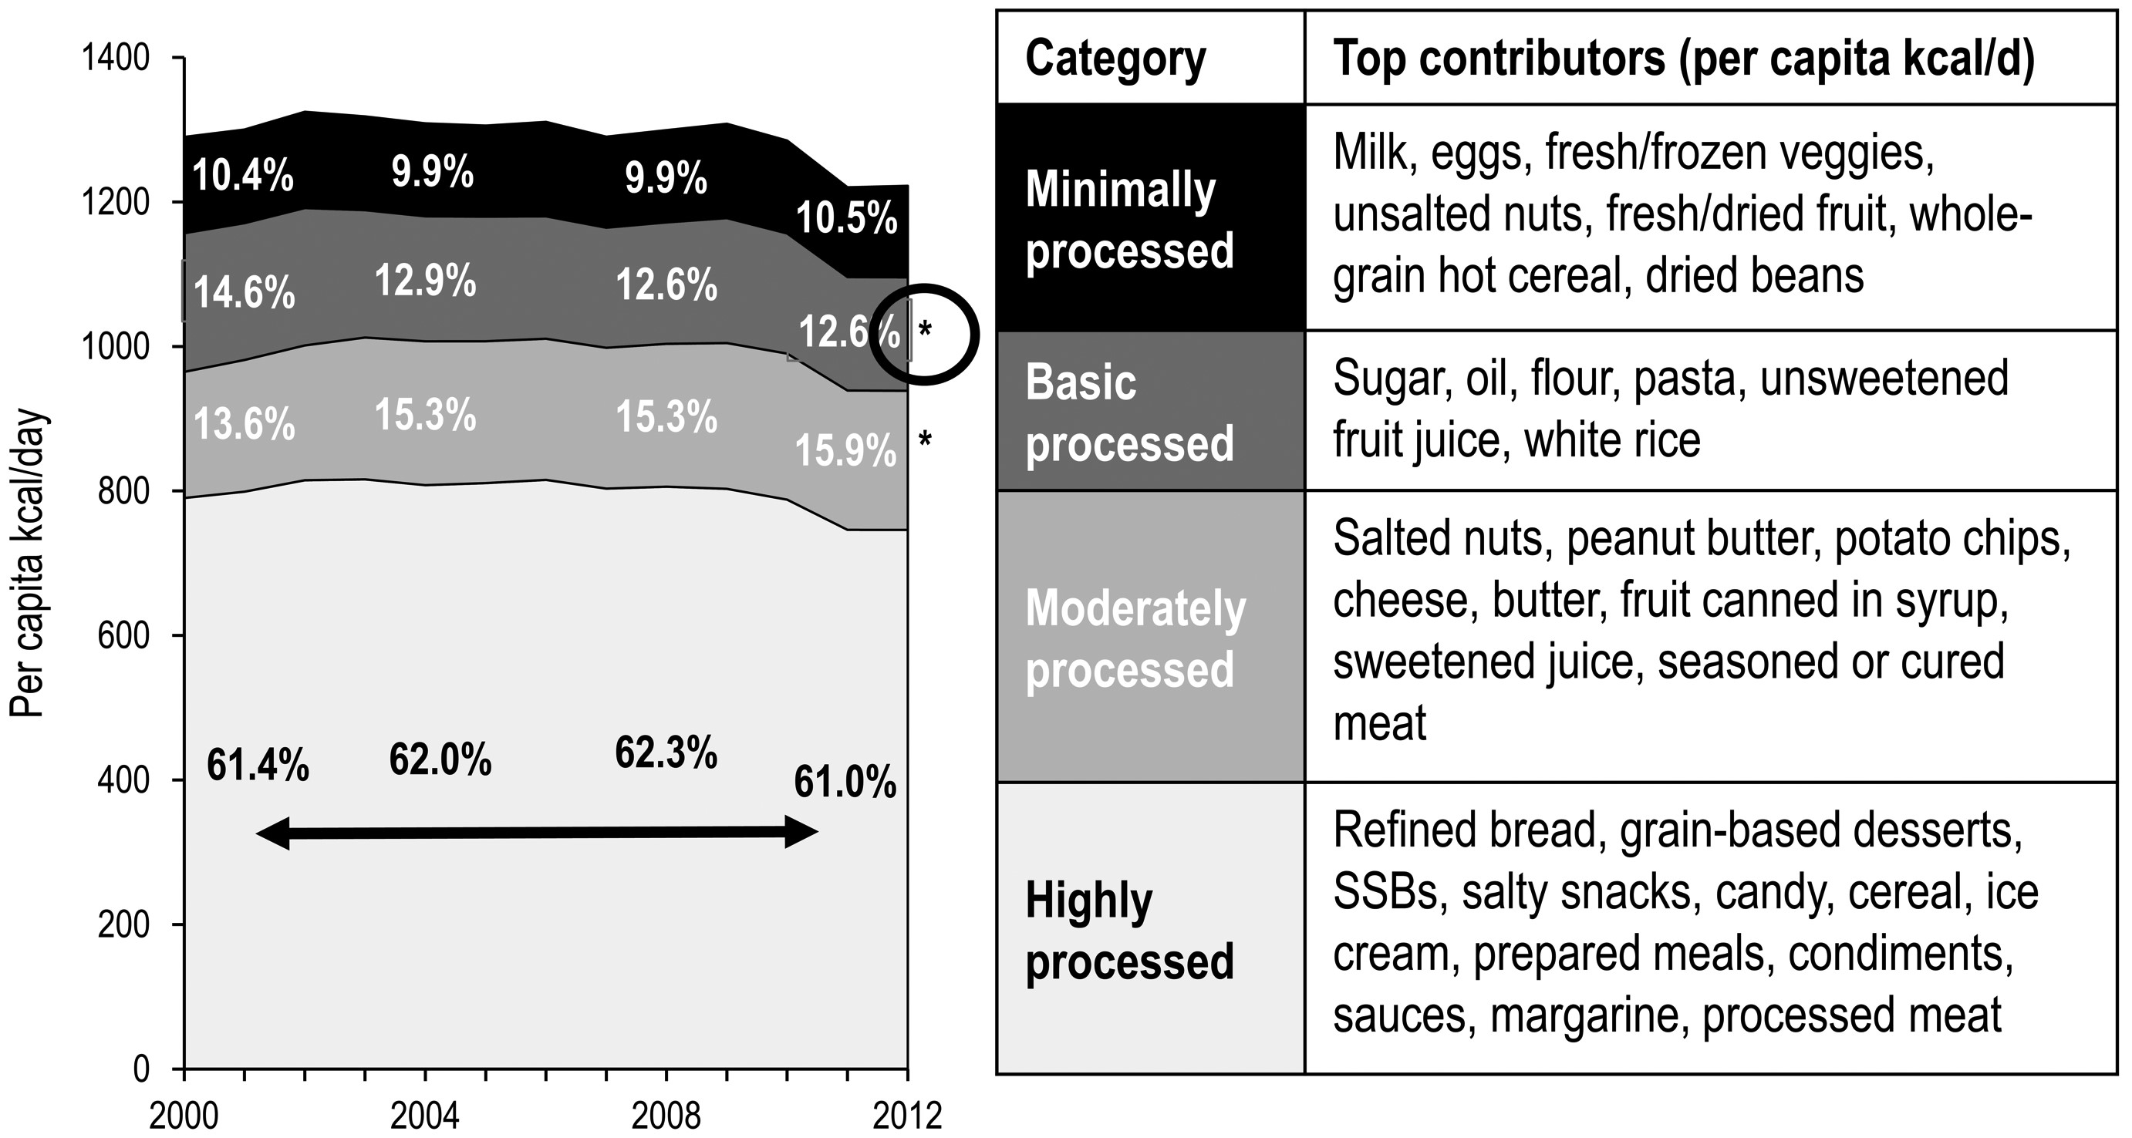
Figure 5 Trends in food and beverage CPG purchases by degree of processing. Data from Poti et al. (2015).²
Notes:
Figure 5 Trends in food and beverage CPG purchases by degree of processing. Data from Poti et al. (2015).2
Unless provided in the caption above, the following copyright applies to the content of this slide: © The Author(s) 2017. Published by Oxford University Press on behalf of the International Life Sciences Institute. All rights reserved. For Permissions, please e-mail: journals.permissions@oup.com.

Slide 6
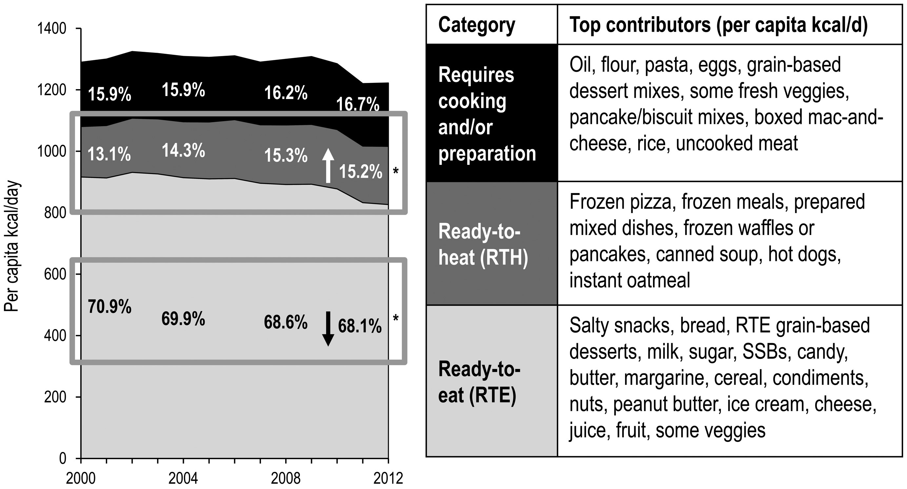
Figure 6 Trends in food and beverage CPG purchases by level of convenience. Data from Poti et al. (2015).²
Notes:
Figure 6 Trends in food and beverage CPG purchases by level of convenience. Data from Poti et al. (2015).2
Unless provided in the caption above, the following copyright applies to the content of this slide: © The Author(s) 2017. Published by Oxford University Press on behalf of the International Life Sciences Institute. All rights reserved. For Permissions, please e-mail: journals.permissions@oup.com.

