Slide 1
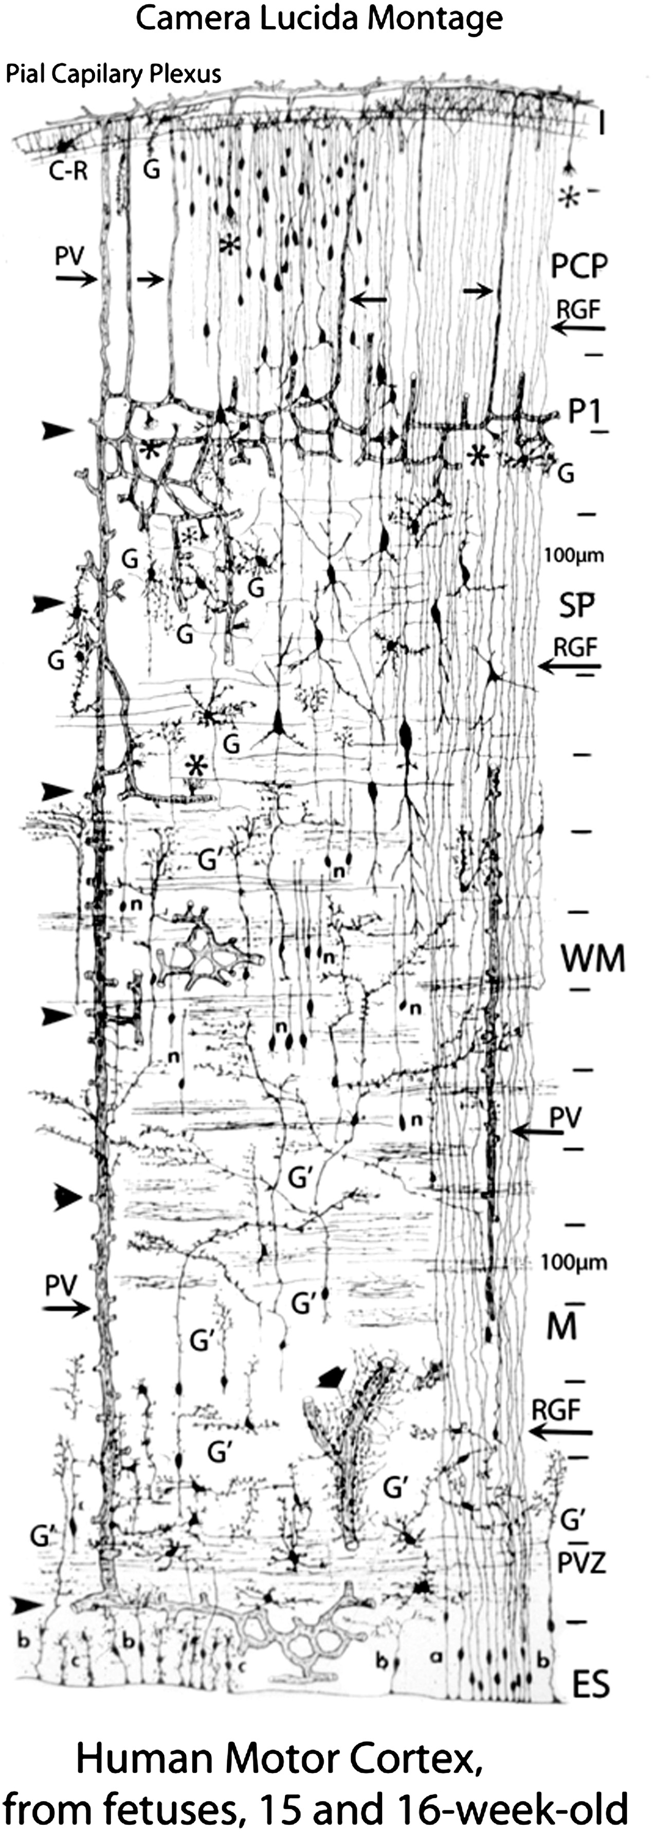
Figure 1. The overall radial organization of the human fetal telencephalon is illustrated for reference in the ...
Notes:
Figure 1. The overall radial organization of the human fetal telencephalon is illustrated for reference in the composite Golgi camera lucida drawing from fetuses at 15 and 16 gestational weeks in the motor cortex by Marin-Padilla (2011) (with permission). The complete telencephalic wall is illustrated from the pial surface to the ventricle. Abbreviations: ES, ependymal surface; G, glia; P1, first pyramidal cell stratum; PCP, pyramidal cell plate; PV, penetrating vessel; PVZ, paraventricular zone; n, ascending neuronal processes; SP, subplate; RGF, radial glial fiber; WM, white matter.
Unless provided in the caption above, the following copyright applies to the content of this slide: © The Author 2012. Published by Oxford University Press. All rights reserved. For Permissions, please e-mail: journals.permissions@oup.com

Slide 2
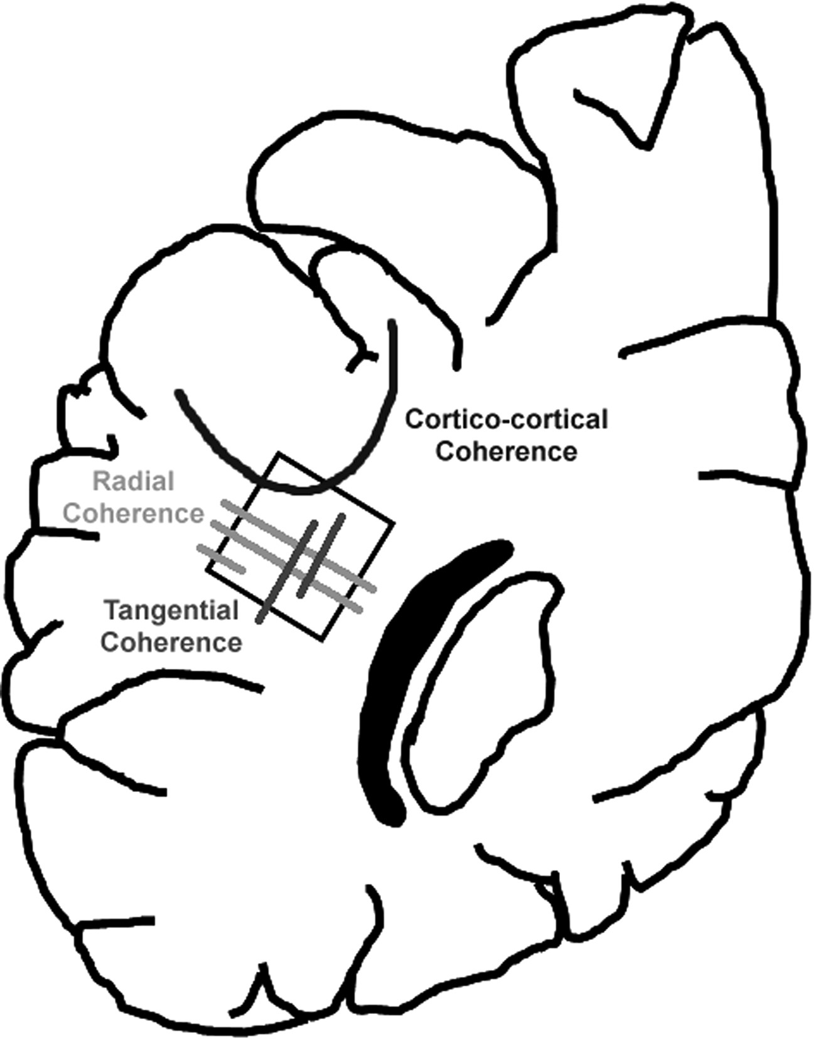
Figure 2. This diagram indicates the site in the central (interstitial) white matter in the occipital lobe that was ...
Notes:
Figure 2. This diagram indicates the site in the central (interstitial) white matter in the occipital lobe that was analyzed by HARDI and tissue-based methods. This level is at the atrium of the lateral ventricle. The square in the interstitial white matter indicates the standardized level of the immunocytochemical analysis. The distal optic radiation is indicated in black for reference. Examples of radial coherence, tangential coherence, and corticocortical coherence are also shown.
Unless provided in the caption above, the following copyright applies to the content of this slide: © The Author 2012. Published by Oxford University Press. All rights reserved. For Permissions, please e-mail: journals.permissions@oup.com

Slide 3
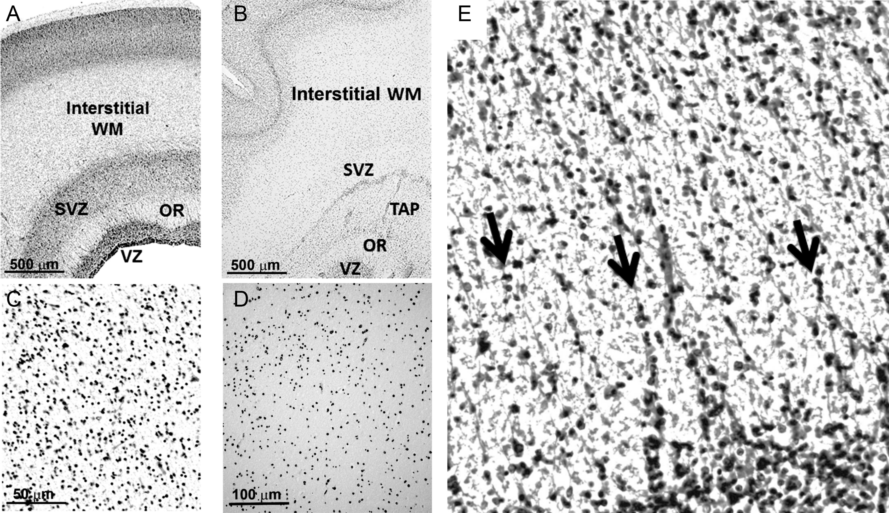
Figure 3. Neuroblastic nuclei do not form linear chains suggestive of migration along RGFs in the interstitial white ...
Notes:
Figure 3. Neuroblastic nuclei do not form linear chains suggestive of migration along RGFs in the interstitial white matter at 20 gestational weeks (A and C) and 31 gestational weeks (B and D) in microscopic sections stained with cresyl violet. Low-power views of the occipital pole are shown at ×4 in A and B. High-power views of the occipital white matter are shown in C and D at ×40 magnification. (E) Radial nuclear chains (arrows) are prominent in the septae of the human optic radiation at midgestation. Cresyl violet, ×40. Abbreviations: OR, optic radiation; SVZ, subventricular zone; TAP, tapetum; V, ventricular zone; WM, interstitial white matter.
Unless provided in the caption above, the following copyright applies to the content of this slide: © The Author 2012. Published by Oxford University Press. All rights reserved. For Permissions, please e-mail: journals.permissions@oup.com

Slide 4
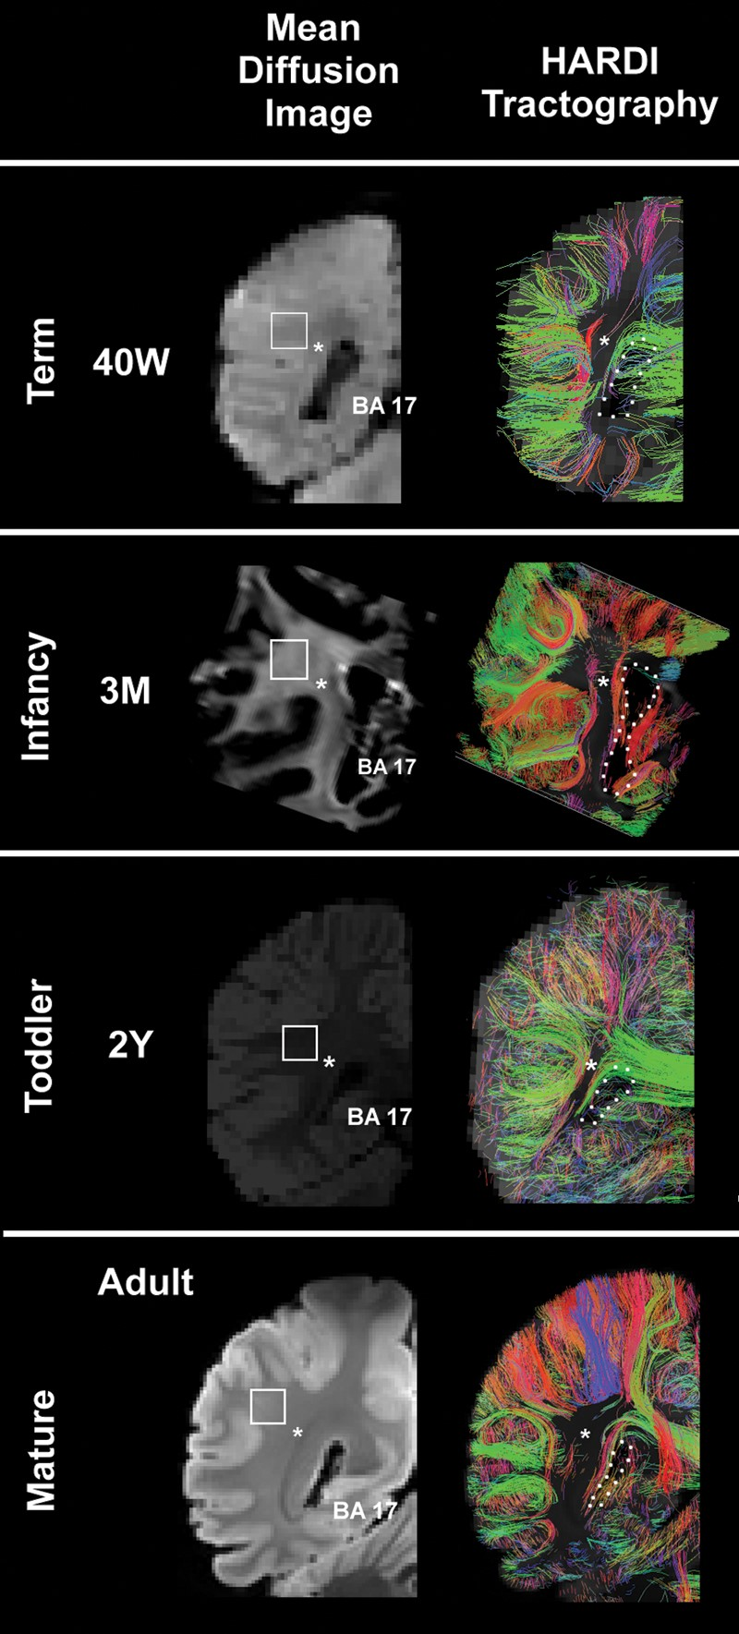
Figure 5. HARDI images (right) are presented with the comparable mean diffusion image (left) at term, infancy, toddler, ...
Notes:
Figure 5. HARDI images (right) are presented with the comparable mean diffusion image (left) at term, infancy, toddler, and adult time points at the level of the atrium of the lateral ventricle of the occipital lobe. Only radial coherence that begins and ends in the occipital tissue slice is displayed. The asterisks indicate the location where tractography pathways run anterior to posterior through the tissue plane. The boundary of the lateral ventricle is shown with a dotted white line. The square represents the tissue sample in the central white matter illustrated in Figures 6 and 7, but rotated 90°. The color-coding of tractography connections is based on a standard red-green-blue (RGB) code applied to the vector between the end-points of each structure (green for right–left, red for dorsal–ventral, and blue for anterior–posterior). Abbreviations: BA, Brodmann area; M, postnatal months; W, weeks. The 3 postnatal month and adult images are from postmortem specimens, and the 40 gestational week and 2-year images are from living subjects.
Unless provided in the caption above, the following copyright applies to the content of this slide: © The Author 2012. Published by Oxford University Press. All rights reserved. For Permissions, please e-mail: journals.permissions@oup.com

Slide 5
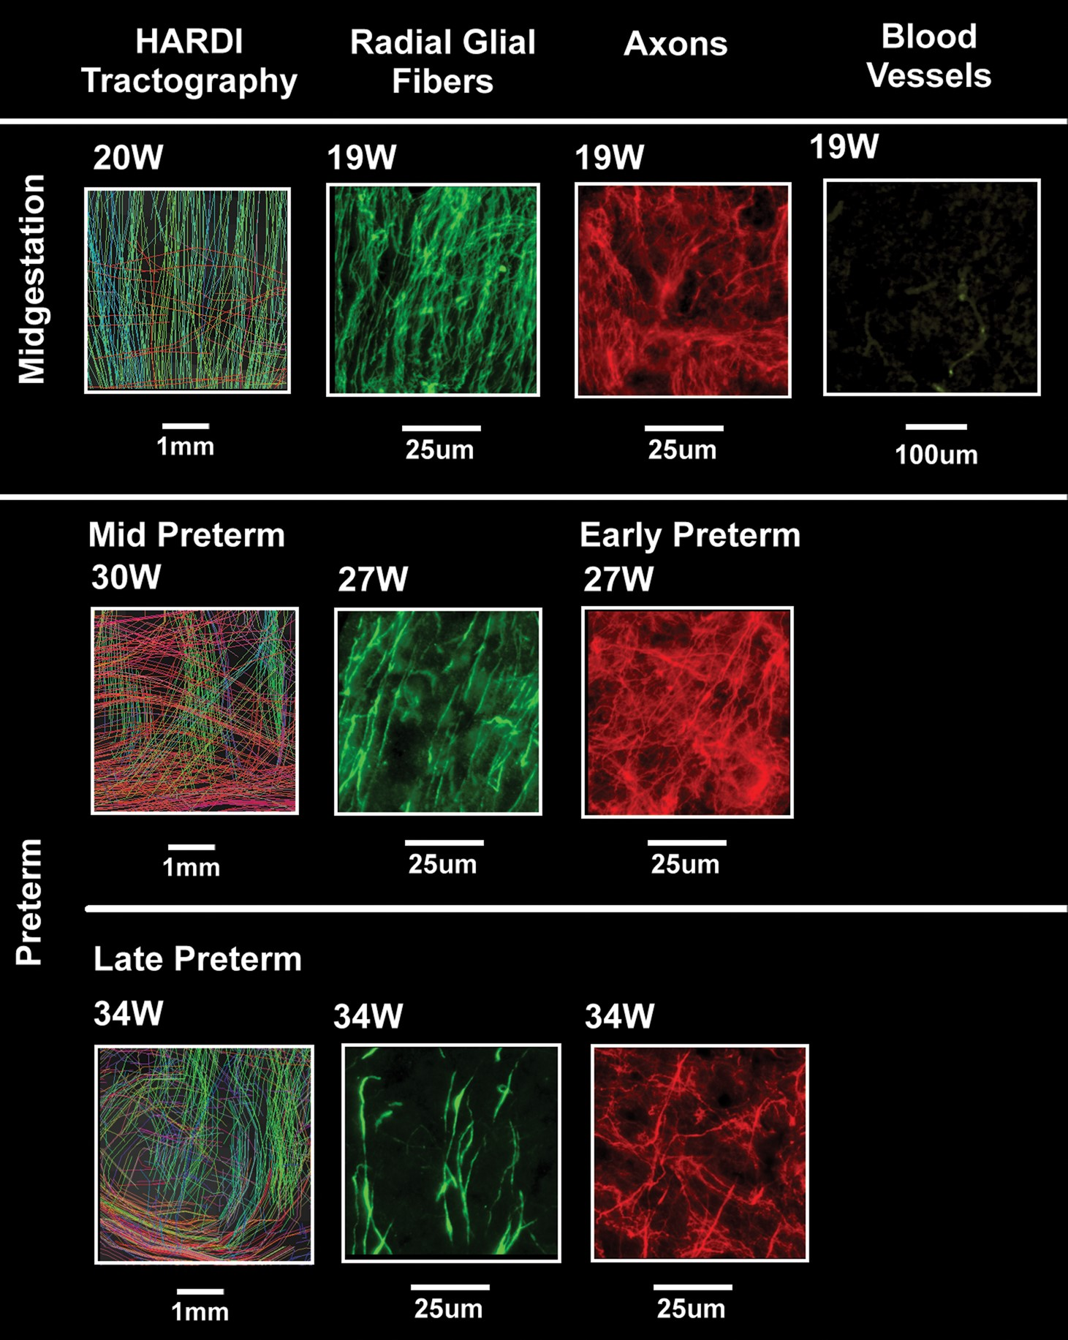
Figure 6. Composite image of HARDI data (left) and tissue data (middle and right) at midgestation and in the preterm ...
Notes:
Figure 6. Composite image of HARDI data (left) and tissue data (middle and right) at midgestation and in the preterm period at the central site of the occipital white matter indicated by squares in Figure 3 but rotated 90°. The tissue analysis was performed with immunocytochemical methods with antibodies to RGFs (vimentin), axons (SMI 312), and blood vessels (CD31. All images are oriented with the pial surface toward the top of the page. HARDI images were magnified images of white rectangles in Figure 4, using standard options of TrackVis software. The field of view of the HARDI images was approximately 5 mm.
Unless provided in the caption above, the following copyright applies to the content of this slide: © The Author 2012. Published by Oxford University Press. All rights reserved. For Permissions, please e-mail: journals.permissions@oup.com

Slide 6
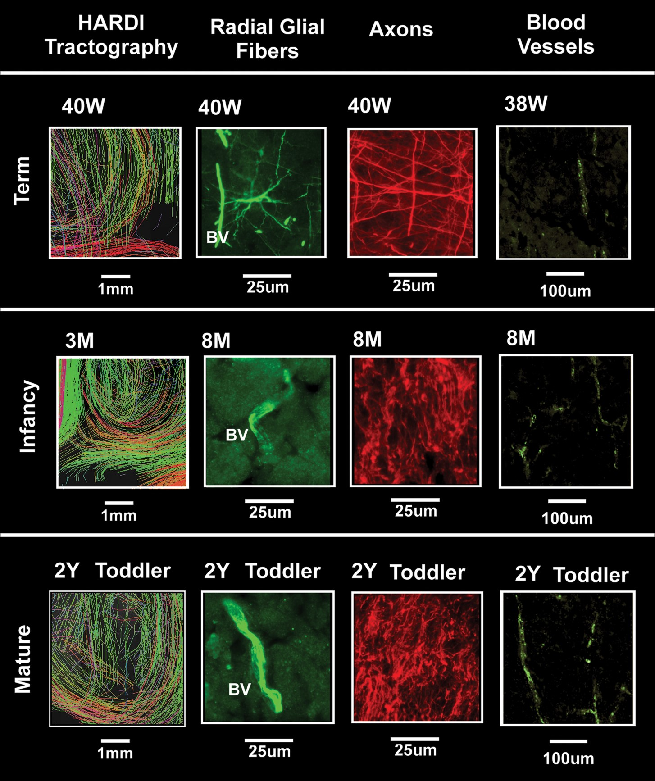
Figure 7. Composite image of HARDI data (left) and tissue data (middle and right) in the term, infant, preschool, and ...
Notes:
Figure 7. Composite image of HARDI data (left) and tissue data (middle and right) in the term, infant, preschool, and adult time-period at the central site of the occipital white matter indicated by squares in Figure 5 but rotated 90°. The tissue analysis was performed with immunocytochemical methods with antibodies to RGFs (vimentin), axons (SMI 312), and blood vessels (CD31). All images are oriented with the pial surface toward the top of the page. The scales vary among the tissue preparations. HARDI images were magnified images of white rectangles in Figure 5 using a standard option of TrackVis software. The field of view of the HARDI images was approximately 5 mm.
Unless provided in the caption above, the following copyright applies to the content of this slide: © The Author 2012. Published by Oxford University Press. All rights reserved. For Permissions, please e-mail: journals.permissions@oup.com

Slide 7
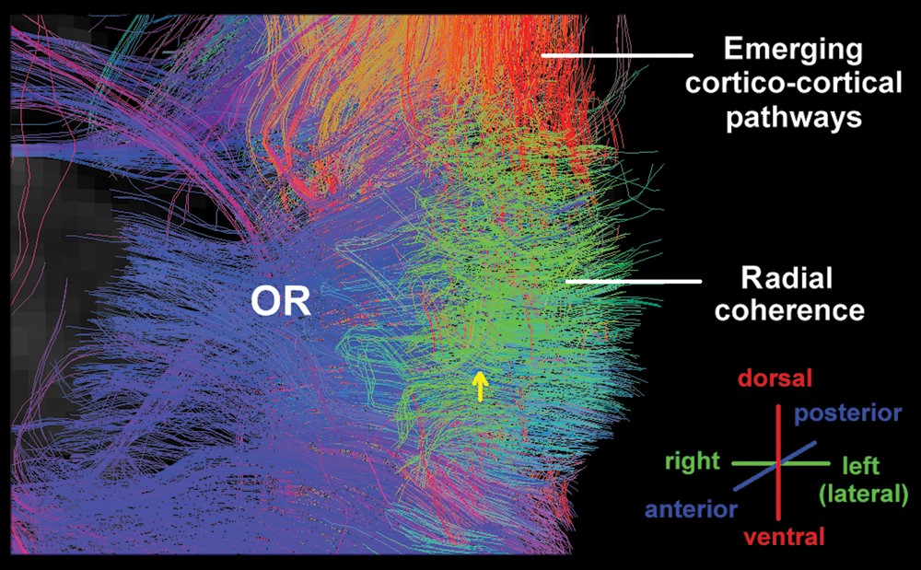
Figure 8. An oblique view of radial coherence with HARDI in the human occipital wall at the level of the atrium of the ...
Notes:
Figure 8. An oblique view of radial coherence with HARDI in the human occipital wall at the level of the atrium of the lateral ventricle at 21 postconceptional weeks. The orientation of the pathways is shown in the lower right corner. Abbreviations: OR, optic radiation.
Unless provided in the caption above, the following copyright applies to the content of this slide: © The Author 2012. Published by Oxford University Press. All rights reserved. For Permissions, please e-mail: journals.permissions@oup.com

Slide 8
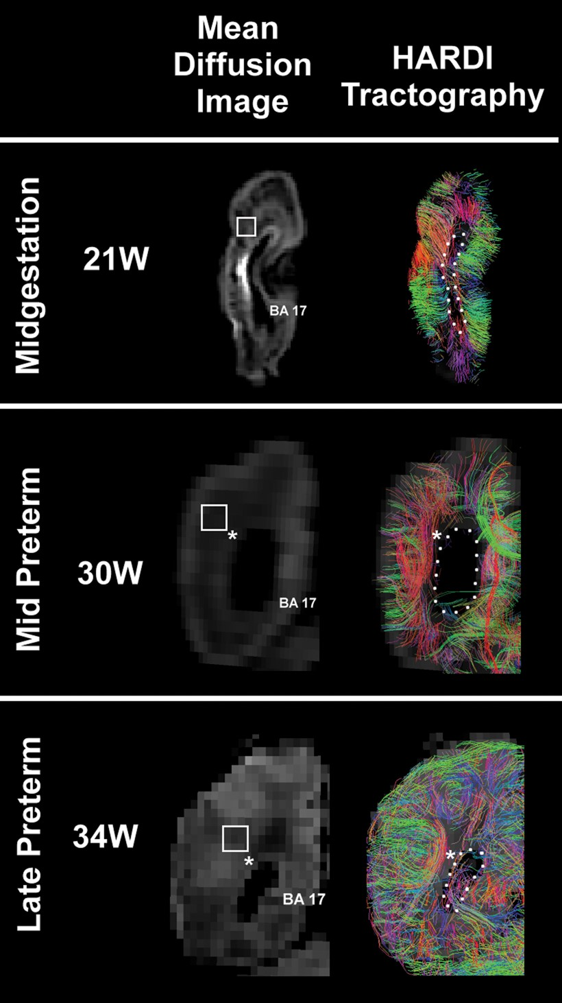
Figure 4. HARDI images (right) are presented with the comparable mean diffusion image (left) at midgestation and the ...
Notes:
Figure 4. HARDI images (right) are presented with the comparable mean diffusion image (left) at midgestation and the mid and late preterm periods at the level of the atrium of the lateral ventricle in the occipital lobe. Only radial coherence that begins and ends in the occipital tissue slice is displayed. The asterisks indicate the location where tractography pathways run anterior to/from posterior through the tissue plane (also shown in black). The boundary of the lateral ventricle is highlighted with a dotted white line. The square represents the tissue sample in the central white matter illustrated in Figures 6 and 7, but rotated 90°. At 30 weeks, the black in region lateral to the atrium of the ventricle represents the site of the optic radiation (asterisk). The color-coding of tractography connections is based on a standard red-green-blue (RGB) code applied to the vector between the end-points of each structure (green for right–left, red for dorsal–ventral, and blue for anterior–posterior). Abbreviations: BA, Brodmann area; W, weeks. The 21-week images are from a postmortem specimen, and the 30-week and 34-week images are from living subjects.
Unless provided in the caption above, the following copyright applies to the content of this slide: © The Author 2012. Published by Oxford University Press. All rights reserved. For Permissions, please e-mail: journals.permissions@oup.com

Slide 9
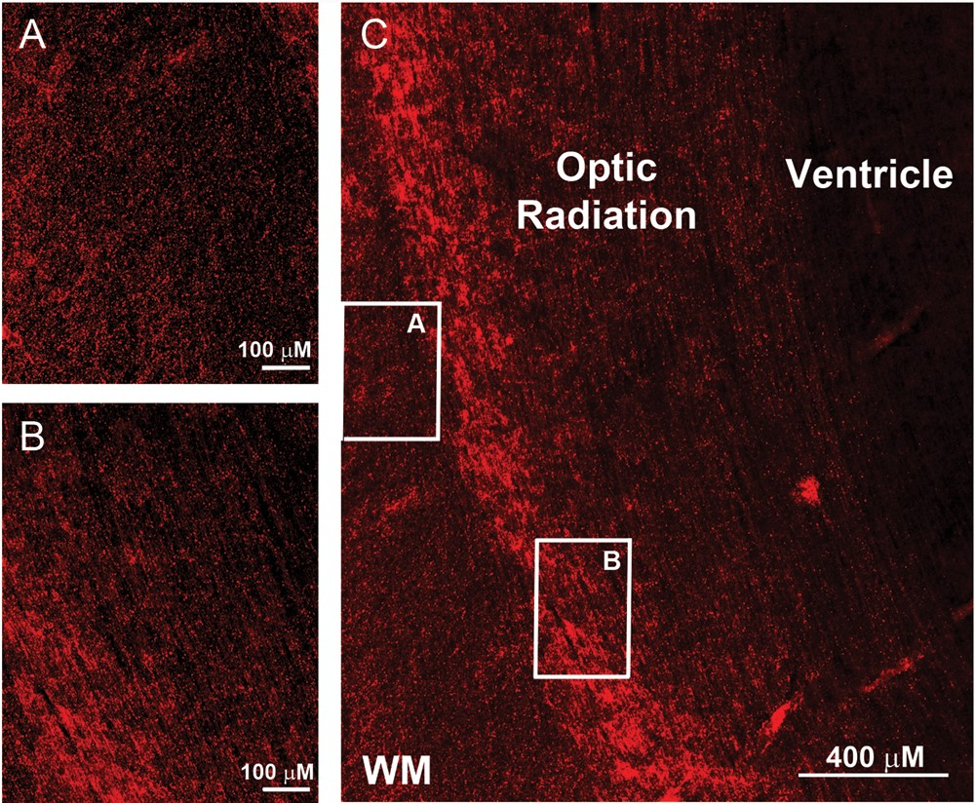
Figure 9. Two distinct axonal patterns are demonstrated by immunocytochemistry with the pan-axonal antibody SMI 312 at ...
Notes:
Figure 9. Two distinct axonal patterns are demonstrated by immunocytochemistry with the pan-axonal antibody SMI 312 at midgestation (C). The axons in the optic radiation are bundled and project in one direction (A), as illustrated in the horizontal plane (B). The axons in the central white matter at this age, however, are multidirectional with projections in the radial, horizontal, and oblique planes (A). Scale bar = 100 μm for panels A and B, 400 μm for panel C.
Unless provided in the caption above, the following copyright applies to the content of this slide: © The Author 2012. Published by Oxford University Press. All rights reserved. For Permissions, please e-mail: journals.permissions@oup.com

Slide 10
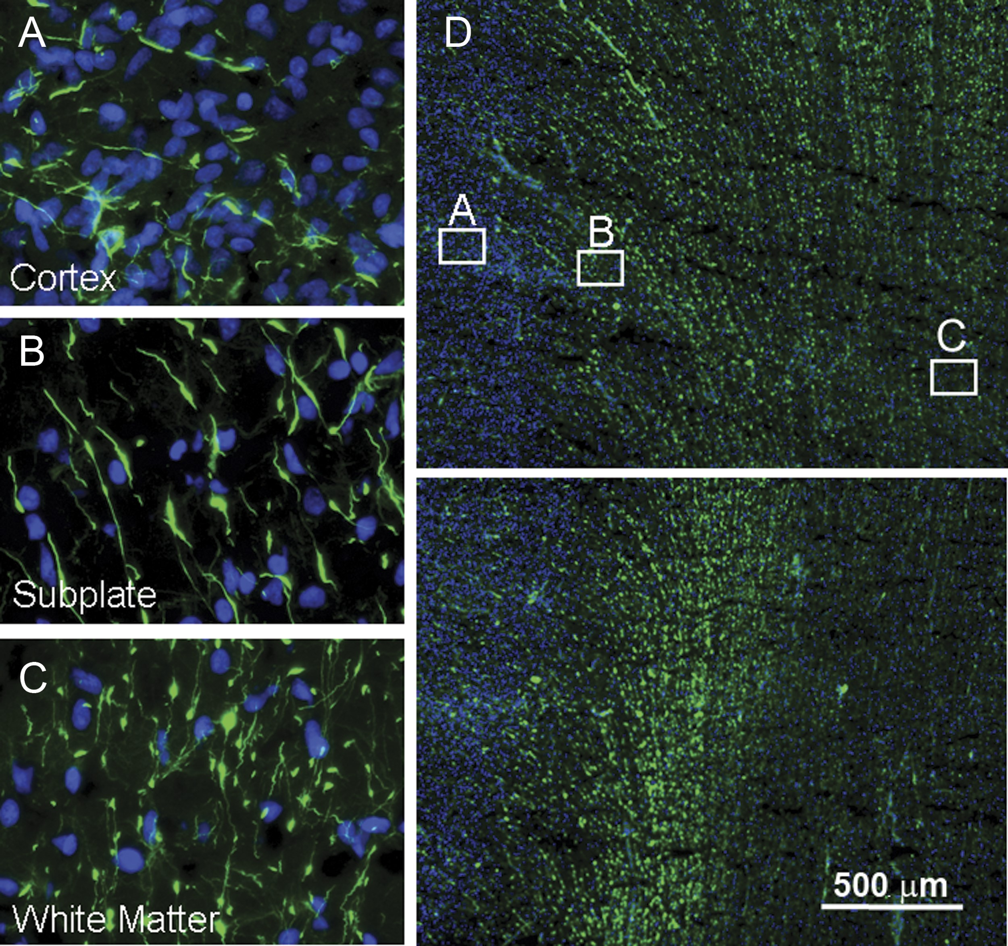
Figure 10. The presence of RGFs is differentially identified in the cerebral cortex (A), subplate region (B), and gyral ...
Notes:
Figure 10. The presence of RGFs is differentially identified in the cerebral cortex (A), subplate region (B), and gyral white matter (C) in the occipital lobe term birth (38 weeks), suggesting that they disappear/transform first in the cerebral cortex followed by the white matter. At low magnification, RGFs are most prominent in the subplate region and superficial white matter, the latter shown at the crest (D) of the gyrus and within the gyrus (E). The RGFs are short and sparse in the cerebral cortex (A), short and thick with large varicosities in the subplate region (B), and thin and dense with small varicosities in the deep white matter (C).
Unless provided in the caption above, the following copyright applies to the content of this slide: © The Author 2012. Published by Oxford University Press. All rights reserved. For Permissions, please e-mail: journals.permissions@oup.com

Slide 11
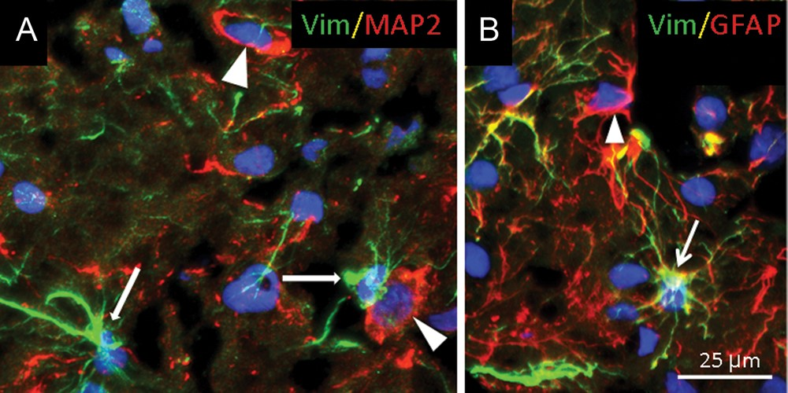
Figure 11. Vimentin-immunopositive cells transform into GFAP-expressing astrocytes (B) but not into neurons that express ...
Notes:
Figure 11. Vimentin-immunopositive cells transform into GFAP-expressing astrocytes (B) but not into neurons that express MAP2 in the central occipital white matter, as demonstrated with double-label immunocytochemistry in a term newborn. A. Vimentin-immunopositive cells (likely astrocytes) (thin arrows) do not colocalize with MAP2 in neurons (arrow heads). B. Vimentin is present in GFAP-positive astrocytes (arrow). There are, however, also GFAP-expressing astrocytes that do not express vimentin (arrow head).
Unless provided in the caption above, the following copyright applies to the content of this slide: © The Author 2012. Published by Oxford University Press. All rights reserved. For Permissions, please e-mail: journals.permissions@oup.com

