Slide 1
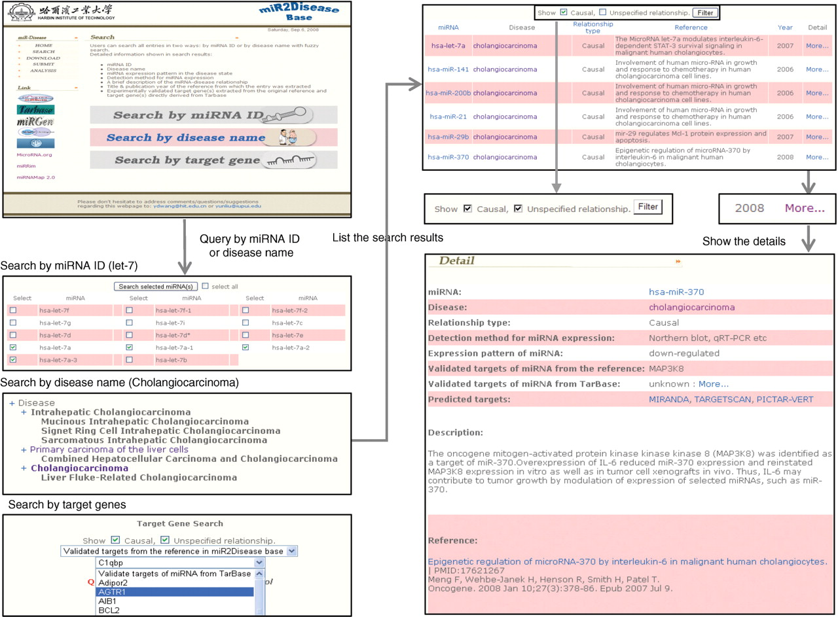
Figure 1. A schematic workflow of miR2Disease.
Notes:
Figure 1. A schematic workflow of miR2Disease.
Unless provided in the caption above, the following copyright applies to the content of this slide: © 2008 The Author(s)This is an Open Access article distributed under the terms of the Creative Commons Attribution Non-Commercial License (http://creativecommons.org/licenses/by-nc/2.0/uk/) which permits unrestricted non-commercial use, distribution, and reproduction in any medium, provided the original work is properly cited.

Slide 2
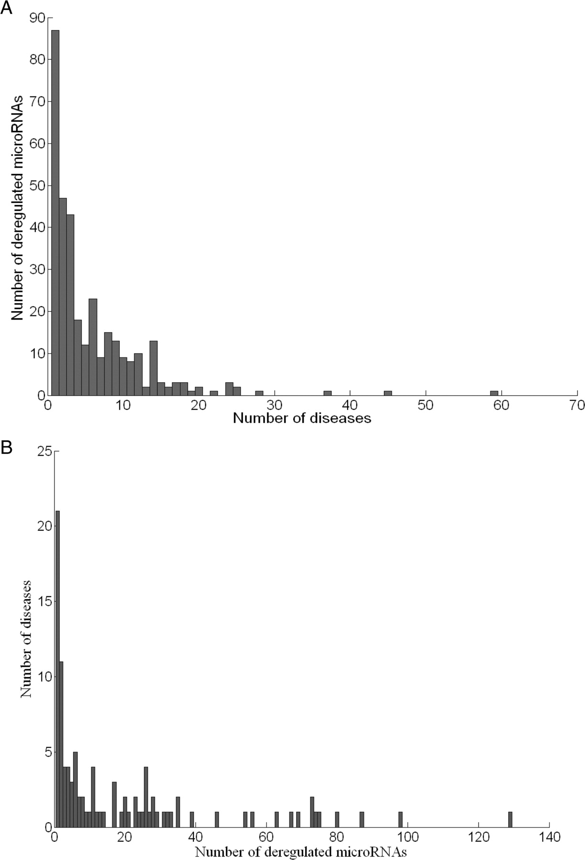
Figure 2. Distribution of diseases and deregulated microRNAs documented in miR2Disease database. (A) Histogram of the ...
Notes:
Figure 2. Distribution of diseases and deregulated microRNAs documented in miR2Disease database. (A) Histogram of the number of diseases associated with individual microRNA. (B) Histogram of the number of deregulated microRNAs associated with individual disease.
Unless provided in the caption above, the following copyright applies to the content of this slide: © 2008 The Author(s)This is an Open Access article distributed under the terms of the Creative Commons Attribution Non-Commercial License (http://creativecommons.org/licenses/by-nc/2.0/uk/) which permits unrestricted non-commercial use, distribution, and reproduction in any medium, provided the original work is properly cited.

Slide 3
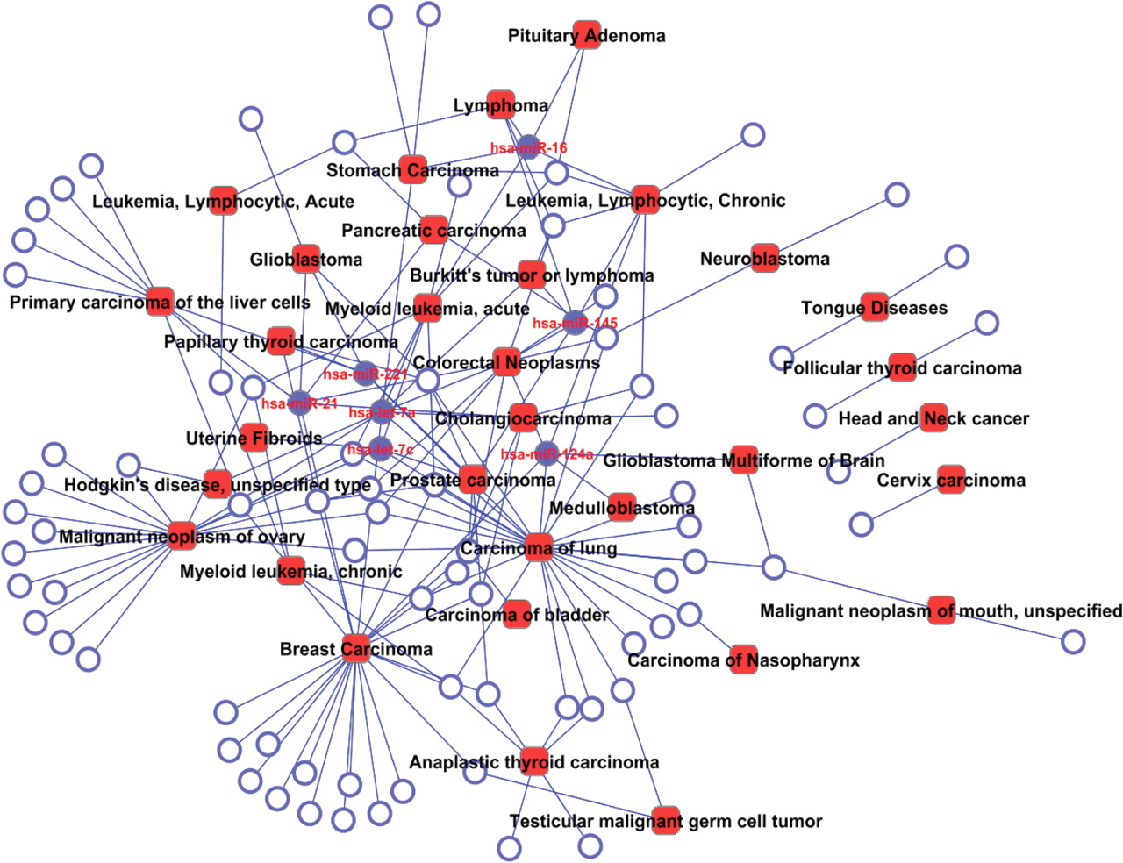
Figure 3. A bipartite network demonstrating the causal relationship between deregulated microRNAs and variety of ...
Notes:
Figure 3. A bipartite network demonstrating the causal relationship between deregulated microRNAs and variety of cancers. Circles and rectangles correspond to microRNAs and diseases, respectively. An edge is placed between a microRNA and a disease if the microRNA deregulation plays causative role in pathogenesis of the disease. Solid circles indicate master microRNAs that potentially cause no less than five types of cancers.
Unless provided in the caption above, the following copyright applies to the content of this slide: © 2008 The Author(s)This is an Open Access article distributed under the terms of the Creative Commons Attribution Non-Commercial License (http://creativecommons.org/licenses/by-nc/2.0/uk/) which permits unrestricted non-commercial use, distribution, and reproduction in any medium, provided the original work is properly cited.

