Slide 1
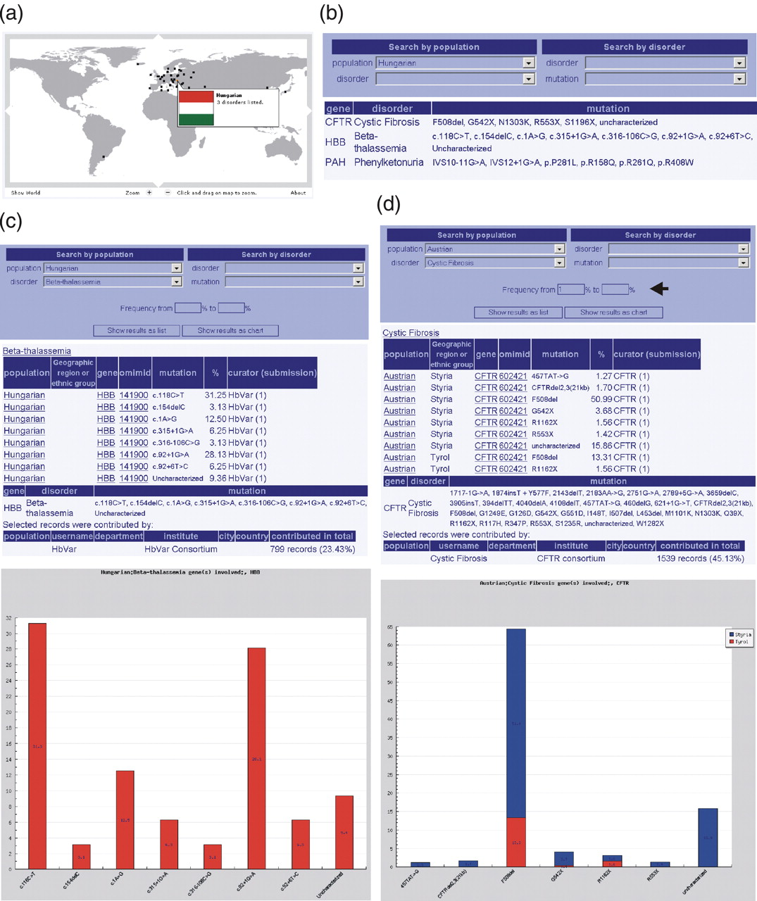
Figure 1 Querying FINDbase for frequencies of mutations leading to inherited disorders in a certain population. (a) ...
Notes:
Figure 1 Querying FINDbase for frequencies of mutations leading to inherited disorders in a certain population. (a) The world map in the Home page, from where the user can quickly select the desired population to query upon by clicking on a country's capital (in this case, Hungary). A communication box automatically appears containing the corresponding national flag and the number of disorders currently documented in FINDbase. (b) Construction of the query ‘Find all inherited disorders in the Hungarian population’. Only parts of the Search page are shown. The user needs either to click on Hungary's capital from the world map (as previously described) or to select for the ‘Hungarian’ population from the population list, located either in the Home page [next to the world map (Supplementary Figure)] or at the left part of the Search page. Query results are in a table format, indicating the disorder, the gene found mutated and the mutations in their official nomenclature. (c) Construction of the query ‘Find all mutations leading to β-thalassemia in the Hungarian population’. By selecting ‘Hungarian’ and ‘Beta-thalassemia’ from the population and disorder's list respectively, the query returns a list of all β-thalassemia mutations found in the Hungarian population together with their frequencies and data source in a table (by selecting the ‘Show results as table’ button) or graphical format (by selecting the ‘Show results as chart’ button). The disorder and gene names and OMIM ID are hyperlinked to further information in the OMIM central database. (d) Sample query ‘Find all mutations leading to Cystic Fibrosis in the Austrian population with a frequency range of 1% and above’. By selecting ‘Austrian’ and ‘Cystic Fibrosis’ from the population and disorder's list respectively and specifying the desired frequency range in the corresponding boxes (indicated with an arrow), the query returns a list of all CFTR mutations with a frequency range of 1% and above found in the Austrian population together with their data source in a table or graphical format. In the latter case, the different CFTR mutation frequencies found in different geographical regions are differentially displayed, with the corresponding mutation frequencies shown in the bars.
Unless provided in the caption above, the following copyright applies to the content of this slide: © 2006 The Author(s)This is an Open Access article distributed under the terms of the Creative Commons Attribution Non-Commercial License (http://creativecommons.org/licenses/by-nc/2.0/uk/) which permits unrestricted non-commercial use, distribution, and reproduction in any medium, provided the original work is properly cited.

Slide 2
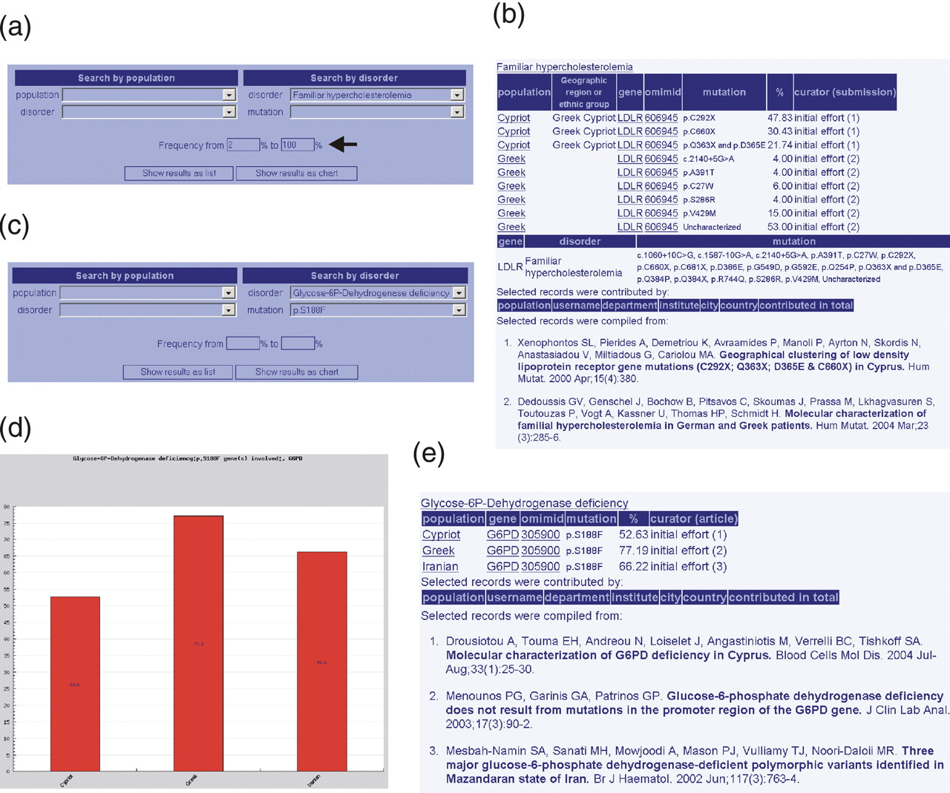
Figure 2 Querying FINDbase for frequencies of mutations leading to a certain inherited disorder in different ...
Notes:
Figure 2 Querying FINDbase for frequencies of mutations leading to a certain inherited disorder in different populations. (a) Construction of the query ‘Find frequent (between 2 and 100%) familial hypercholesterolemia mutations in all populations’. (b) The user needs to select for the ‘Familiar hypercholesterolemia’ disorder from the disorder's menu, located either in the Home page [next to the world map (Supplementary Figure)] or at the right part of the Search page. Query results are in a table format, indicating the populations and ethnic groups (if applicable) where LDLR mutations are found. Information is accompanied by the data source. (c) Construction of the query ‘Find the frequency of the p.S188F mutation leading to Glucose 6P-Dehydrogenase (G6PD) deficiency in all populations’. By selecting ‘Glucose 6P-Dehydrogenase deficiency’ from the disorder's list and ‘p.S188F’ from the mutation's list, the query returns a list of populations in which the p.S188F mutation is found together with the corresponding frequencies. Query output can be in a graphical (d) or table format (e), always accompanied by the data source.
Unless provided in the caption above, the following copyright applies to the content of this slide: © 2006 The Author(s)This is an Open Access article distributed under the terms of the Creative Commons Attribution Non-Commercial License (http://creativecommons.org/licenses/by-nc/2.0/uk/) which permits unrestricted non-commercial use, distribution, and reproduction in any medium, provided the original work is properly cited.

