Slide 1
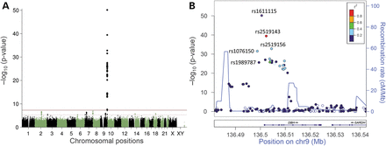
Table 1. Most significant hits in the genome-wide association study ªRandom-effects models were used for ...
Notes:
Table 1. Most significant hits in the genome-wide association study aRandom-effects models were used for SNPs with significant heterogeneity Q values (bold), otherwise fixed-effects models. bAllele 1 is the coding allele. cDirectly genotyped SNP. dRegression analyses including DBH SNPs rs1076150, rs1989787 and rs1611115 as covariates. P-values in bold meet suggestive (P < 5.0E−06) or genome-wide significance (P < 5.0E−08). Figure 1.Results of the GWAS of plasma DBH activity in 341 subjects of European origin. (A) Manhattan plot showing the −log10 (P-values) for SNP associations with plasma DBH activity across the genome. The red horizontal line represents the genome-wide significance threshold at P < 5 × 10−8 and the dashed line represents suggestive evidence for association at P < 5 × 10−6. (B) Regional association plot, showing significant regions in DBH on chromosome 9. Directly genotyped SNPs are indicated by an asterisk (*). The SNPs are color coded based on the linkage disequilibrium with the most significant SNP rs1611115.
Unless provided in the caption above, the following copyright applies to the content of this slide: © The Author 2014. Published by Oxford University Press. All rights reserved. For Permissions, please email: journals.permissions@oup.com

Slide 2
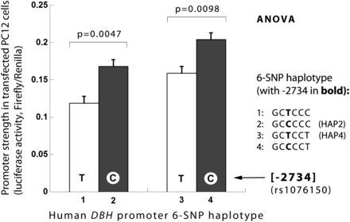
Figure 2. In vitro effects of human DBH promoter variant C-2734T (rs1076150): Balanced mutants on two haplotype ...
Notes:
Figure 2. In vitro effects of human DBH promoter variant C-2734T (rs1076150): Balanced mutants on two haplotype backgrounds (HAP2, HAP4) yield consistent (C > T) effects on transcription in chromaffin cells. Strength of the promoter variants is shown as luciferase activity in PC12 cell type (mean ± SEM). P-values are result of C versus T variant comparison for each haplotype background by ANOVA.
Unless provided in the caption above, the following copyright applies to the content of this slide: © The Author 2014. Published by Oxford University Press. All rights reserved. For Permissions, please email: journals.permissions@oup.com

Slide 3
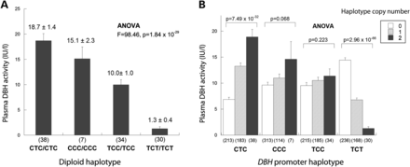
Figure 3. In vivo effects of DBH promoter functional variants T-2734C (rs1076150), C-2073T (rs1989787) and C-970T ...
Notes:
Figure 3. In vivo effects of DBH promoter functional variants T-2734C (rs1076150), C-2073T (rs1989787) and C-970T (rs1611115) on plasma DBH activity (IU/l). (A) DBH promoter diploid haplotype (rs1076150 → rs1989787 → rs1611115) effect on pDBH activity (IU/l). Only subjects homozygous for a given haplotype (rs1076150 → rs1989787 → rs1611115) are shown. (B) Effect of DBH promoter haplotype (rs1076150 → rs1989787 → rs1611115) copy number (0, 1, or 2 copies per genome) on pDBH activity (IU/l, adjusted mean ± SEM).
Unless provided in the caption above, the following copyright applies to the content of this slide: © The Author 2014. Published by Oxford University Press. All rights reserved. For Permissions, please email: journals.permissions@oup.com

