Slide 1
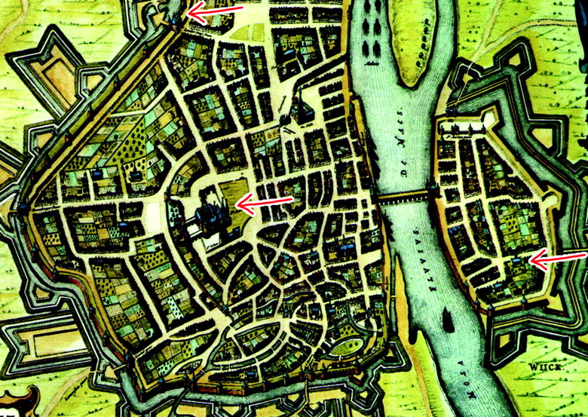
Figure 1. A map of Maestricht is shown. This and other similar maps were shown to the subjects in the active ...
Notes:
Figure 1. A map of Maestricht is shown. This and other similar maps were shown to the subjects in the active conditions in experiment 2. The task was to learn a route from the top to the middle arrow and then to the bottom arrow if there was time.
Unless provided in the caption above, the following copyright applies to the content of this slide:

Slide 2
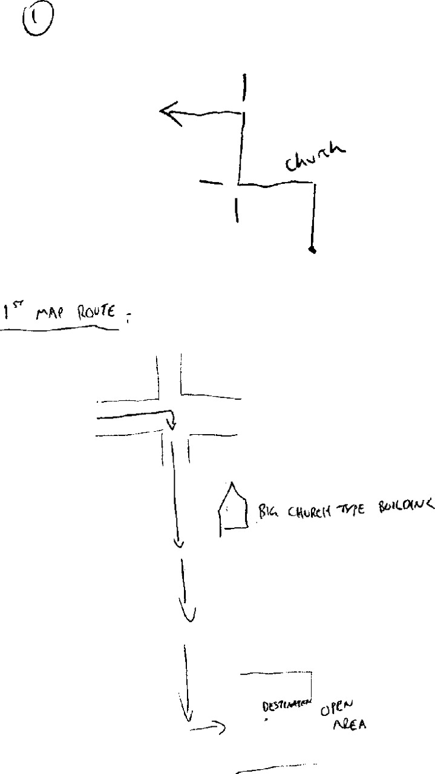
Figure 2. Two maps drawn by two different subjects after the experiments. The top map depicts the first route ...
Notes:
Figure 2. Two maps drawn by two different subjects after the experiments. The top map depicts the first route in experiment 1. It has three turns and a landmark, and so scored 4 points. The bottom map depicts the first route seen in experiment 2. It has all parts of the route correctly orientated, correct directions from the starting point to the destination (middle arrow) and one landmark (the church), and so it scored 3 points.
Unless provided in the caption above, the following copyright applies to the content of this slide:

Slide 3
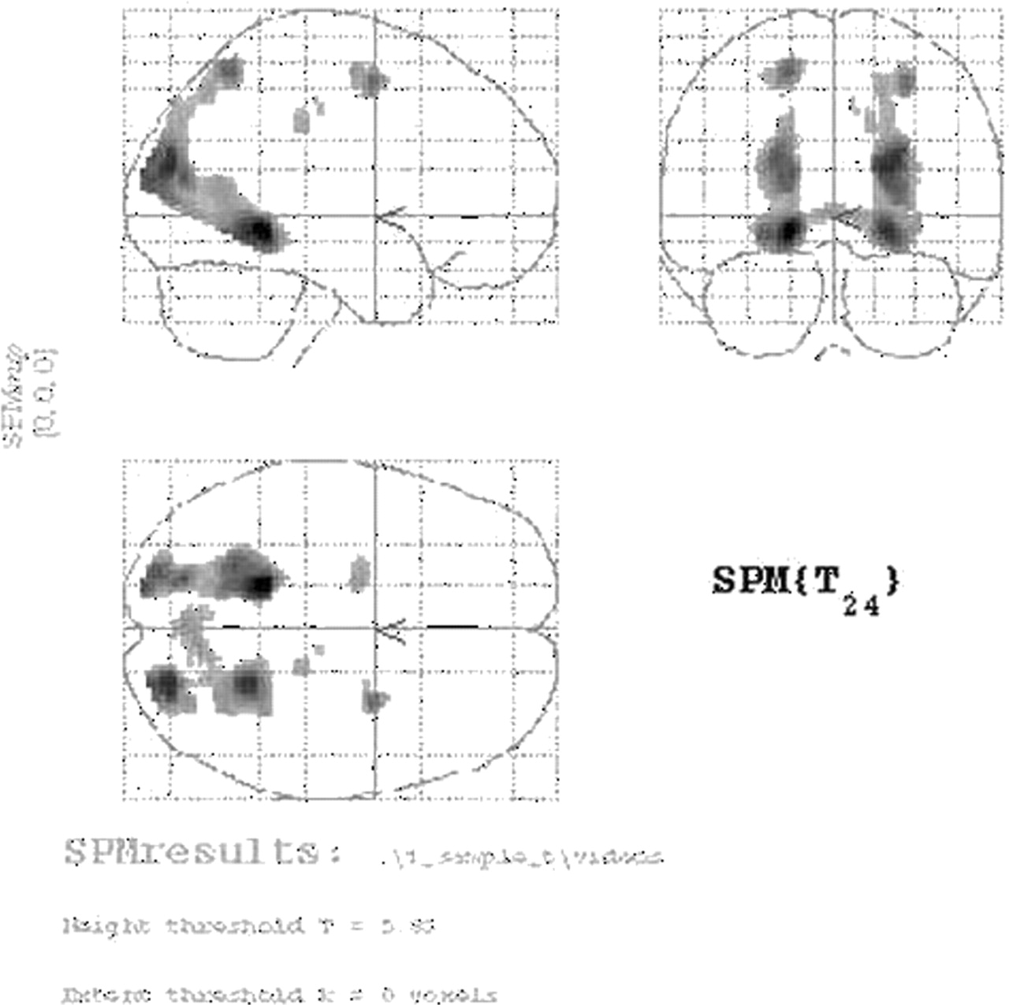
Figure 3. Group data. Activations in experiment 1 (route perspective) at a significance level of 0.05, ...
Notes:
Figure 3. Group data. Activations in experiment 1 (route perspective) at a significance level of 0.05, corrected for multiple comparisons are shown in MNI space. The extensive posterior activation runs from the parahippocampus and lingual gyrus through the retrosplenial area to the cuneus and precuneus.
Unless provided in the caption above, the following copyright applies to the content of this slide:

Slide 4
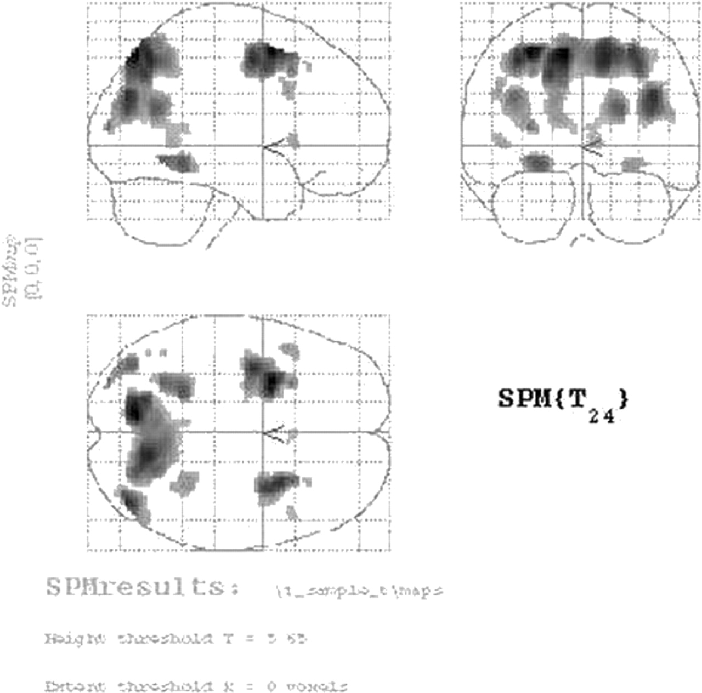
Figure 4. Group data. Activations in experiment 2 (survey perspective) at a significance level of 0.05, ...
Notes:
Figure 4. Group data. Activations in experiment 2 (survey perspective) at a significance level of 0.05, corrected for multiple comparisons are shown in MNI space. A similar distribution of activations to experiment 1 is seen. In addition there is temporal activation not present in the route perspective task and a greater degree of frontal activation.
Unless provided in the caption above, the following copyright applies to the content of this slide:

