Slide 1
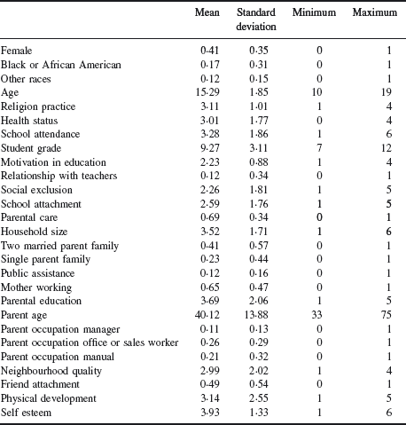
Table 1 Descriptive statistics on selected variables
Notes:
Table 1 Descriptive statistics on selected variables
Unless provided in the caption above, the following copyright applies to the content of this slide: © 2009 The Review of Economic Studies Limited

Slide 2
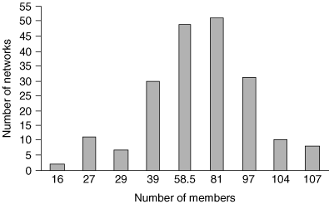
Figure 1 The empirical distribution of adolescent networks
Notes:
Figure 1 The empirical distribution of adolescent networks
Unless provided in the caption above, the following copyright applies to the content of this slide: © 2009 The Review of Economic Studies Limited

Slide 3
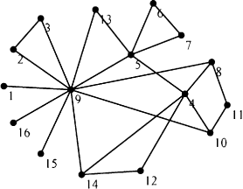
Figure 2 Smallest network of adolescents (n = 16)
Notes:
Figure 2 Smallest network of adolescents (n = 16)
Unless provided in the caption above, the following copyright applies to the content of this slide: © 2009 The Review of Economic Studies Limited

Slide 4
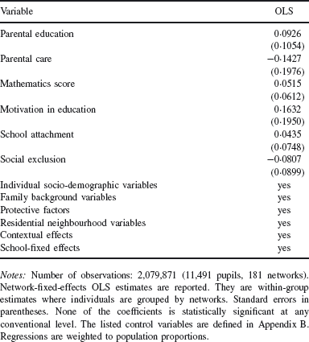
Table 2 Correlation between individual and peer-group level observables
Notes:
Table 2 Correlation between individual and peer-group level observables
Unless provided in the caption above, the following copyright applies to the content of this slide: © 2009 The Review of Economic Studies Limited

Slide 5
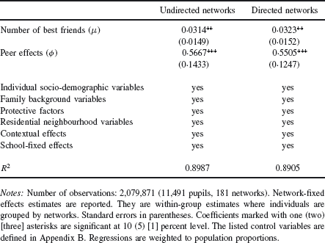
Table 3 Model (9): Maximum Likelihood estimation results Dependent variable: school performance index
Notes:
Table 3 Model (9): Maximum Likelihood estimation results Dependent variable: school performance index
Unless provided in the caption above, the following copyright applies to the content of this slide: © 2009 The Review of Economic Studies Limited

Slide 6
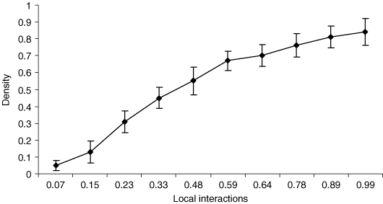
Figure 3 Density in education networks
Notes:
Figure 3 Density in education networks
Unless provided in the caption above, the following copyright applies to the content of this slide: © 2009 The Review of Economic Studies Limited

Slide 7
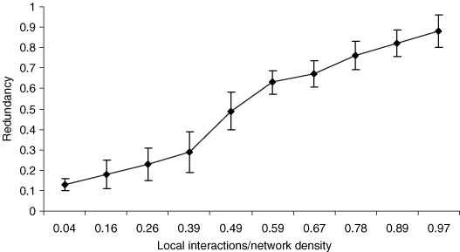
Figure 5 Redundancy in education networks
Notes:
Figure 5 Redundancy in education networks
Unless provided in the caption above, the following copyright applies to the content of this slide: © 2009 The Review of Economic Studies Limited

Slide 8
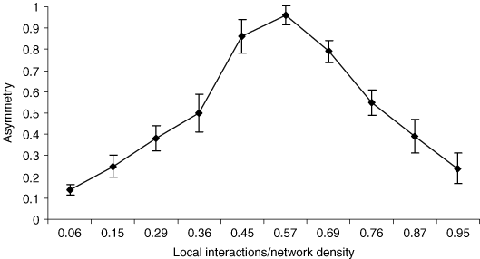
Figure 4 Asymmetry in education networks
Notes:
Figure 4 Asymmetry in education networks
Unless provided in the caption above, the following copyright applies to the content of this slide: © 2009 The Review of Economic Studies Limited

Slide 9
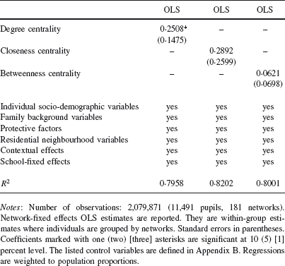
Table 4 Explanatory power of different unit centrality measures Dependent variable: school performance index
Notes:
Table 4 Explanatory power of different unit centrality measures Dependent variable: school performance index
Unless provided in the caption above, the following copyright applies to the content of this slide: © 2009 The Review of Economic Studies Limited

