Slide 1
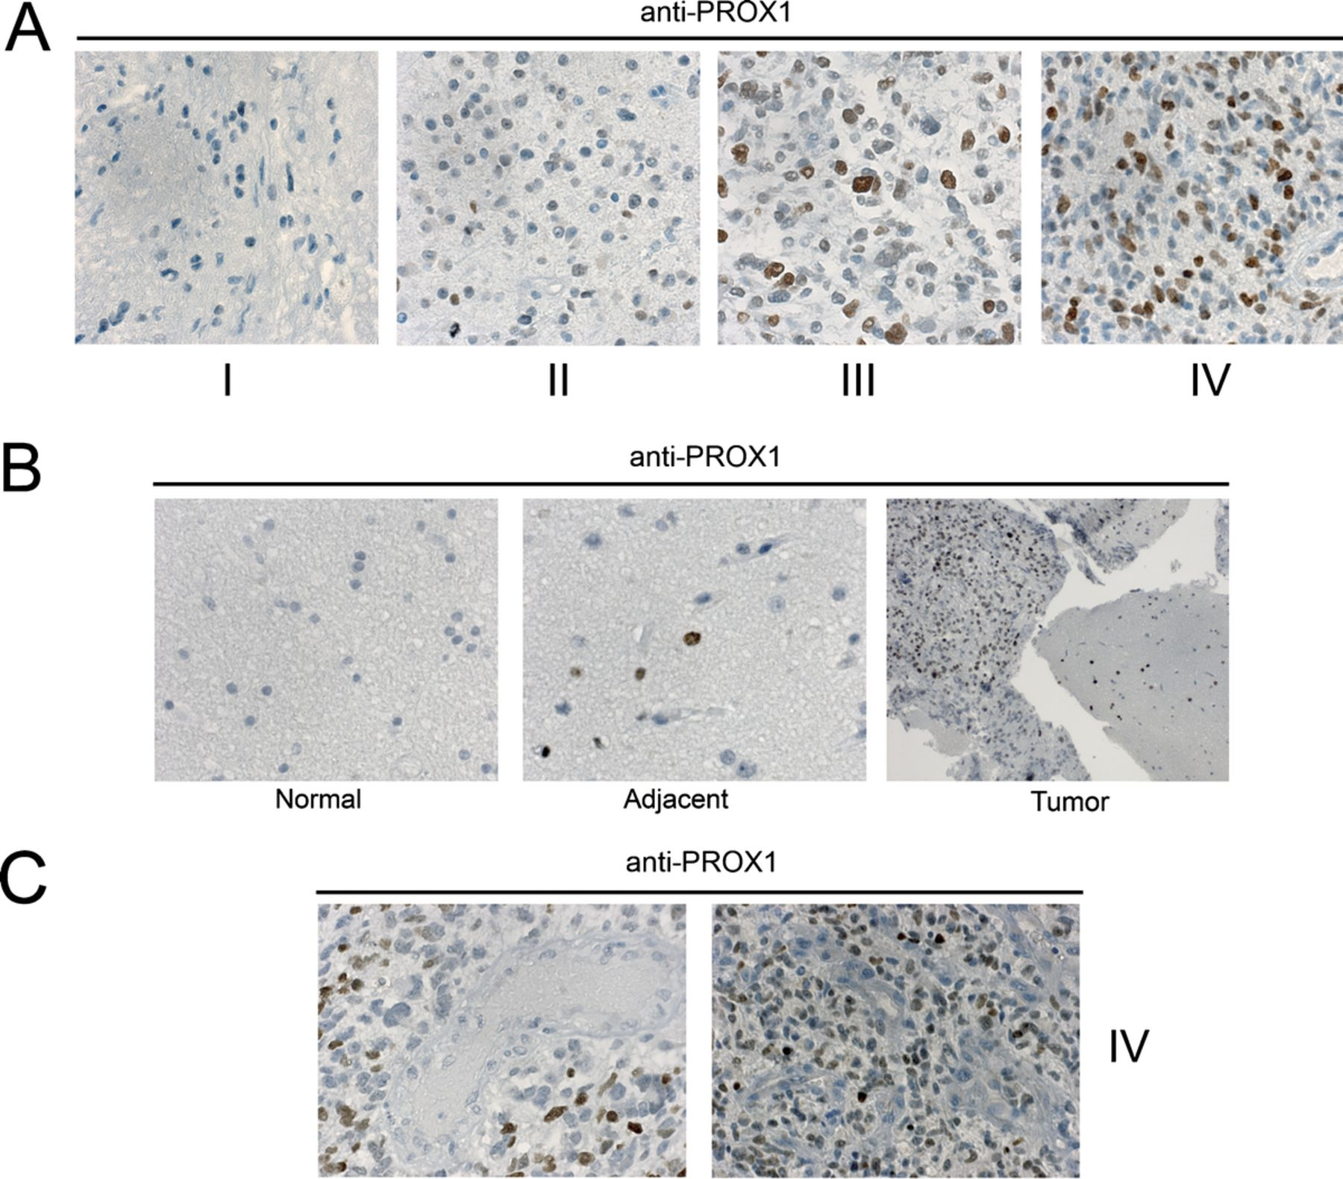
FIGURE 1. Expression of PROX1 in glioma. (A) Immunohistochemical staining of PROX1 (brown) in cells of astrocytic ...
Notes:
FIGURE 1. Expression of PROX1 in glioma. (A) Immunohistochemical staining of PROX1 (brown) in cells of astrocytic glioma tumors of Grades I, II, III, and IV reveals a stepwise increase in expression correlating with tumor grade. Grade II tumors showed mostly negative nuclei but an increased fraction of nuclei with strong positive staining. Grade III showed a significant increase in number and intensity of stained nuclei that was more prominent in Grade IV tumors. Grade I astrocytic gliomas were virtually negative for PROX1, with randomly scattered positive cells in some tumors. (B) Normal-appearing brain tissue proximate to high-grade tumor areas (middle panel) had more numerous PROX1+ cells than the control brain from a case with slight gliosis (leftpanel). Right panel was taken at 100× magnification of peritumoral brain tissue where there is abundant PROX1 expression. (C) PROX1 is absent in tumor vessels in 2 samples of high-grade tumors.
Unless provided in the caption above, the following copyright applies to the content of this slide: Copyright © 2010 by the American Association of Neuropathologists, Inc.

Slide 2
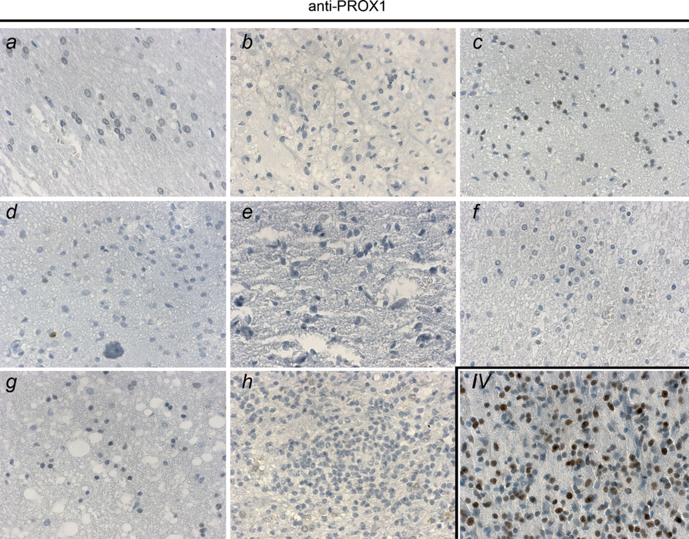
FIGURE 2. Expression of PROX1 in non-neoplastic conditions. Immunohistochemical staining of PROX1 (brown) in brain ...
Notes:
FIGURE 2. Expression of PROX1 in non-neoplastic conditions. Immunohistochemical staining of PROX1 (brown) in brain tissue sections from 8 patients. Diagnoses in these cases were hemorrhage/infarction (A, B, F, G), gliosis (C-E), and inflammatory lesion (H). Several samples were entirely PROX1 negative. A Grade IV tumor serves as a positive control.
Unless provided in the caption above, the following copyright applies to the content of this slide: Copyright © 2010 by the American Association of Neuropathologists, Inc.

Slide 3
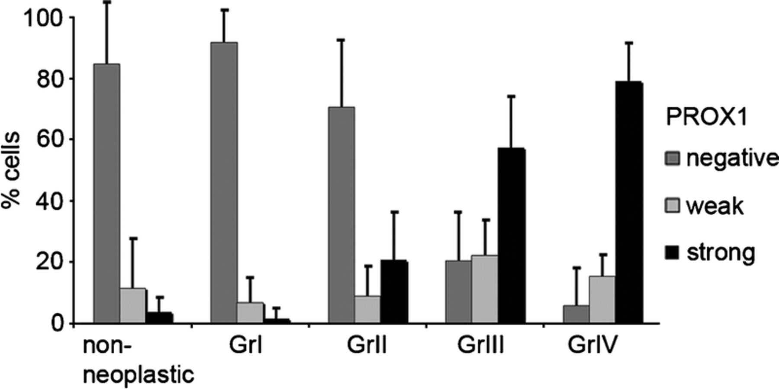
FIGURE 3. Quantitation of PROX1 expression in tumors and non-neoplastic conditions. Results from Tables 1 and 2 and ...
Notes:
FIGURE 3. Quantitation of PROX1 expression in tumors and non-neoplastic conditions. Results from Tables 1 and 2 and also illustrated in Figures 1 and 2 are represented in the graph as percent PROX1+ tumor cells (PROX1 labeling index) for each category of PROX1 staining intensity (negative, weak positive, and strong positive) in the different tumor groups and non-neoplastic conditions. Mean and SEM are shown.
Unless provided in the caption above, the following copyright applies to the content of this slide: Copyright © 2010 by the American Association of Neuropathologists, Inc.

Slide 4
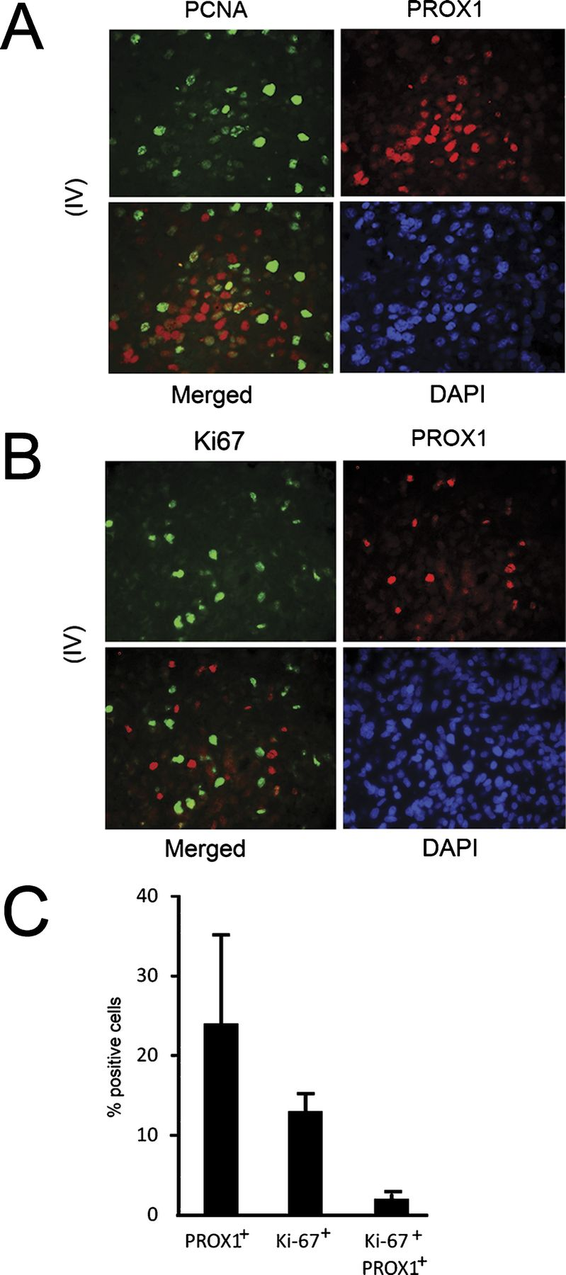
FIGURE 4. Proliferating cell nuclear antigen (PCNA) and Ki67 in relation to PROX1. Double immunofluorescence analysis ...
Notes:
FIGURE 4. Proliferating cell nuclear antigen (PCNA) and Ki67 in relation to PROX1. Double immunofluorescence analysis of PCNA and PROX1 and of Ki67 and PROX1 in paraffin-embedded tumor sections. (A) Increased PROX1 expression in a Grade IV tumor section; PROX1 is rarely coexpressed with PCNA in the cells as reflected by very little overlap (yellow) in the merged field. (B) Example of a field from a Grade IV tumor section with PROX1+ (red) and Ki67+ (green) cells with little overlap in signals reflecting the low frequency (2%) of double-positive cells. Original magnification: 40×. (C) Ki67 labeling index determined in 5 different fields in a Grade IV tumor (atleast 200 cells counted per field) and expressed as percent Ki67+ cells in the total population as well as percent Ki67/PROX1 double-positive cells. Mean and SEM are shown.
Unless provided in the caption above, the following copyright applies to the content of this slide: Copyright © 2010 by the American Association of Neuropathologists, Inc.

Slide 5
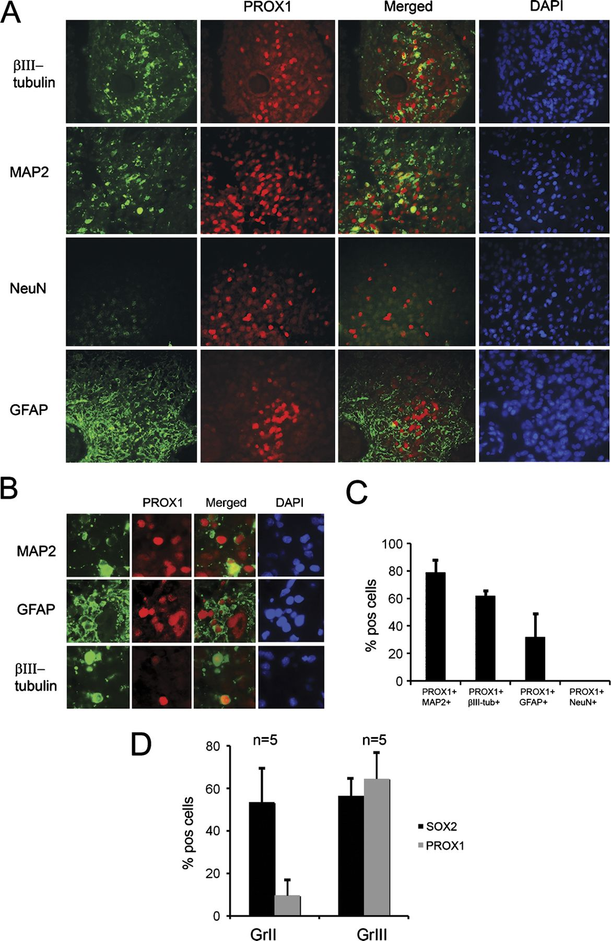
FIGURE 5. Focal coexpression of early neuronal proteins and PROX1 in Grade IV tumors. (A) PROX1+ cells (red) in a Grade ...
Notes:
FIGURE 5. Focal coexpression of early neuronal proteins and PROX1 in Grade IV tumors. (A) PROX1+ cells (red) in a Grade IV tumor displayed a similar focal distribution pattern as microtubule-associated protein 2 (MAP2)- or βIII-tubulin-positive cells (green). Glial fibrillary acidic protein (GFAP) expression is widespread but only partially overlaps with PROX1+ regions that have lower GFAP expression (GFAP green, PROX1 red, DAPI blue); there is no NeuN expression. Original magnification: 40×. (B) PROX1+ cells coexpress MAP2 (MAP2 green, PROX1 red, DAPI blue) (upper panel) and express βIII-tubulin (βIII-tubulin green, PROX1 red, DAPI blue) (lower panel). Few PROX1+ cells coexpress GFAP (GFAP green, PROX1 red, DAPI blue) (middle panel). Original magnification: 63×. (C) Quantification of results in (A) given as percent of PROX1+ cells that coexpress MAP2, βIII-tubulin, GFAP, or NeuN. (D) Average number of PROX1- and SOX2-expressing cells (%) in the same tumor area using different, but consecutive, sections comparing Grade II and Grade III tumors (n = 5 per grade).
Unless provided in the caption above, the following copyright applies to the content of this slide: Copyright © 2010 by the American Association of Neuropathologists, Inc.

